Slide 1
Linear and Non-Linear
Regression
Dr. Jianlin Cheng
Computer Science Department
University of Missouri, Columbia
Fall, 2015
Slides Adapted from Book and CMU, Stanford Machine Learning Courses

Slide 18
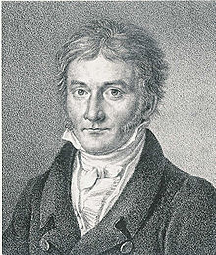
An early demonstration of the strength of Gauss's method came when it was used to predict the future location of the newly discovered asteroid Ceres. On January 1, 1801, the Italian astronomer Giuseppe Piazzi discovered Ceres and was able to track its path for 40 days before it was lost in the glare of the sun. Based on this data, astronomers desired to determine the location of Ceres after it emerged from behind the sun without solving the complicated Kepler's nonlinear equations of planetary motion. The only predictions that successfully allowed Hungarian astronomer Franz Xaver von Zach to relocate Ceres were those performed by the 24-year-old Gauss using least-squares analysis.
Source: Wikipedia

Slide 24
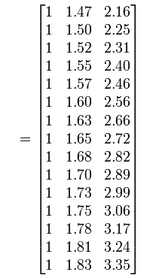
A Regression Example
Average height and weight of American women aged 30 - 39
Weight is not linear with height, so add a quadratic term into regression
52.21
53.12
54.48
55.84
57.2
58.57
59.93
61.29
63.11
64.47
66.28
68.1
69.92
72.19
74.46
?
?
?
A
Y =
Source: Wikipedia

Slide 25
Assignment 3 – Programming 1
Write programs in Matlab, R, C/C++, Java, Perl, or Python to implement the analytical (e.g. matrix-based) or iterative (e.g. gradient descent) linear regression algorithm and test it on the problem in the previous slide. Don’t directly call linear regression functions in any software
Turn in the programs and execution results

Slide 26
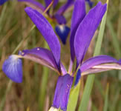
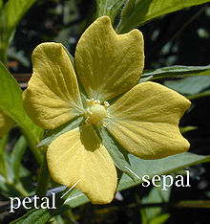
Assignment 3 – Programming 2 Due Sept. 27, 2015
Write a program to implement the iterative (e.g. gradient ascent / descent) logistic regression algorithm for binary classification and apply it to the Iris classification data set
Iris data set: http://archive.ics.uci.edu/ml/datasets/Iris
Only select data points of two highlighted classes (Iris Setosa, Iris Versicolour, Iris Virginica)
Submit programs and execution results
Iris
Wikipedia

