Slide 1
Logistic Regression &
Discriminative Classifier
Dr. Jianlin Cheng
Computer Science Department
University of Missouri, Columbia
Fall, 2015
Slides Adapted from Book and CMU, Stanford Machine Learning Courses

Slide 4
Example:
Drug dose response experiments

Slide 5
1
0

Slide 6
0
1
1
0

Slide 11
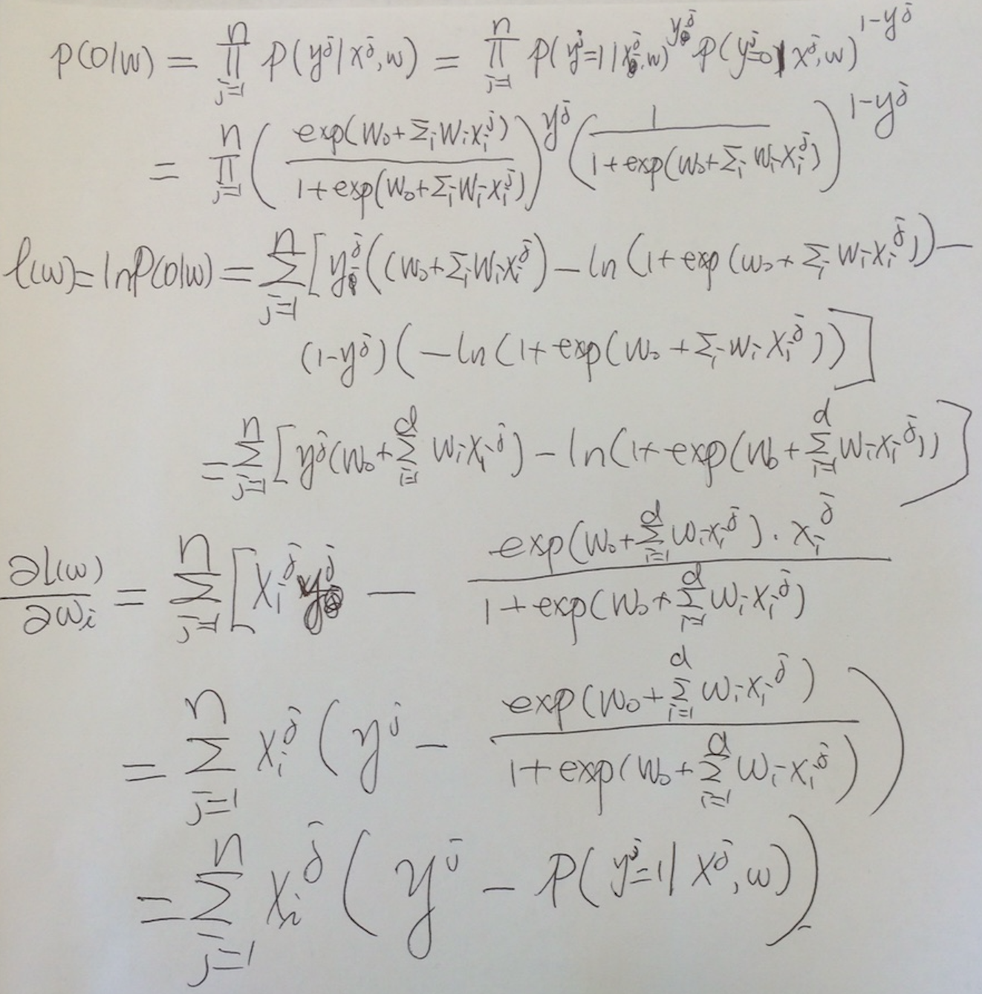
MLE Estimate

Slide 14
Calculate Partial Derivative – A Beautiful Result

Slide 20
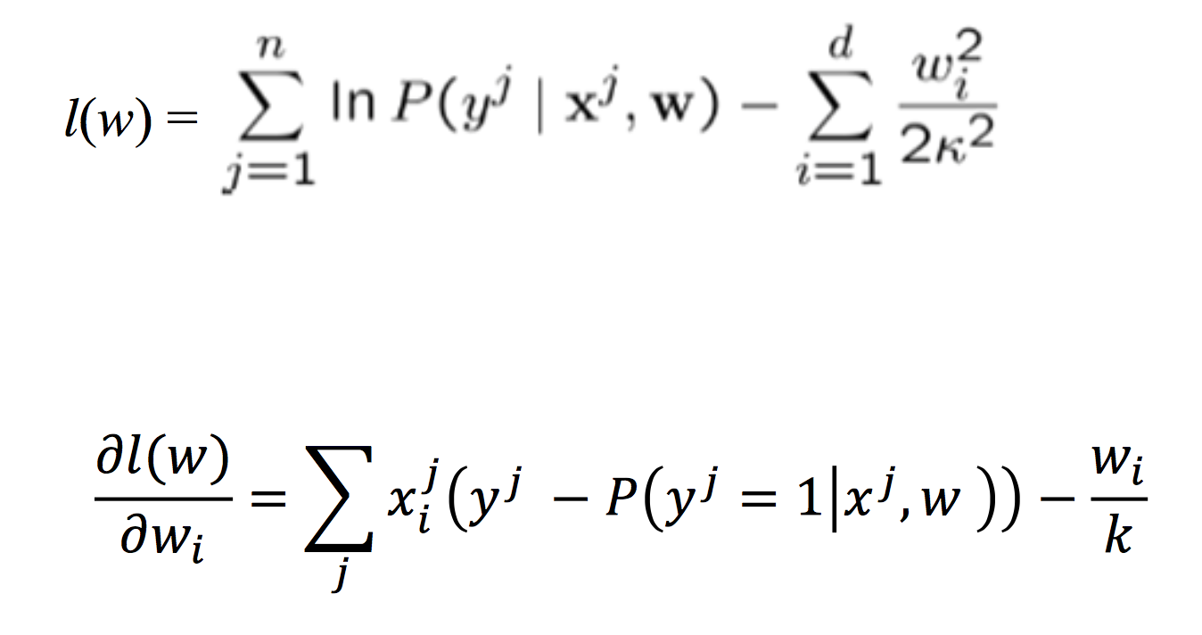
Calculate Partial Derivative – A Beautiful Result

Slide 21
