Slide 1
Support Vector Machines II
Dr. Jianlin Cheng
Department of Electrical Engineering and Computer Science
University of Missouri, Columbia
Fall, 2017
Slides Adapted from Book and CMU, Stanford Machine Learning Courses

Slide 2
The SMO Algorithm

Slide 3
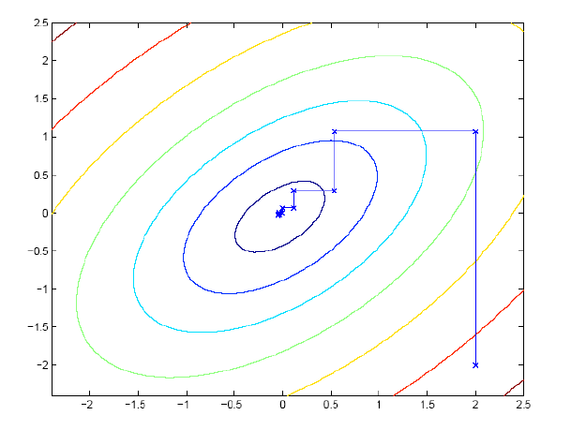
Coordinate Ascend

Slide 4
Sequential minimal optimization

Slide 5
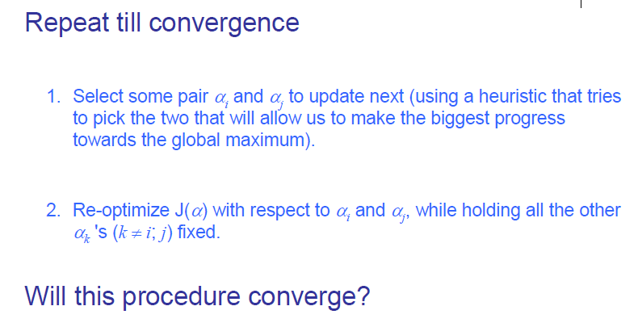
Sequential minimal optimization
How to select?

Slide 6
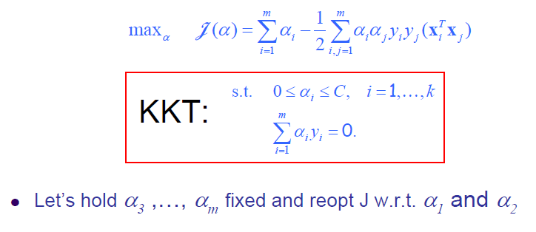
Sequential minimal optimization

Slide 7
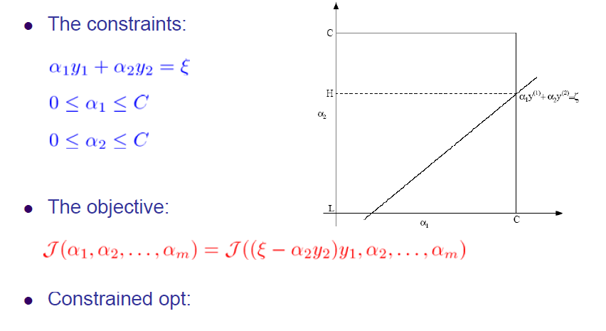
Convergence of SMO

Slide 8
Cross-Validation Error of SVM

Slide 9
Time Complexity of Testing
O(MN_{s}). M is the number of operations required to evaluate inner product. M is O(d_{L}). N_{s} is the number of support vectors.

Slide 10
Multi-Class SVM
Most widely used method: one versus all
Also direct multi-classification using SVM. (K. Crammer and Y. Singer. On the Algorithmic Implementation of Multi-class SVMs, JMLR, 2001)
Class 1 or others
No
Yes
Class 2 or others

Slide 11
Summary

Slide 12
Non-Linear Decision Boundary

Slide 13
X2
X1
XOR problem: add a dimension x1 * x2

Slide 15
Non-linear SVMs: Feature spaces
General idea: the original input space can always be mapped to some higher-dimensional feature space where the training set is separable:
Φ: x → φ(x)
M. Tan’s slides, Univ. British Columbia

Slide 16
Nonlinear Support Vector Machines
In the L_{D} function, what really matters is dot products: x_{i}.x_{j}.
Idea: map the data to some other (possibly infinite dimensional) Euclidean space H, using a mapping.
Then the training algorithm would only depend on the data
through dot products in H, i.e. Φ(x_{i}). Φ(x_{j}).

Slide 17
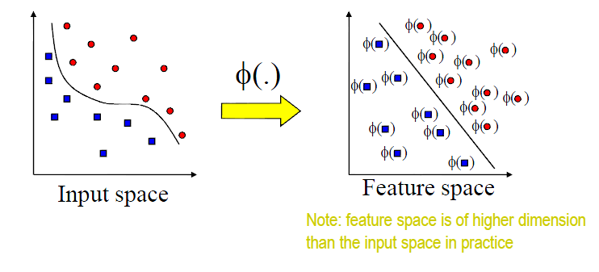
Transforming the Data

Slide 18
Kernel Trick
If there were a kernel function K such that K(x_{i},x_{j}) = Φ(x_{i}). Φ(x_{j}), we would only need to use K in the training algorithm and would never need to explicitly do the mapping Φ.
So we simply replace x_{i}.x_{j} with K(x_{i},x_{j}) in the training algorithm, the algorithm will happily produce a support vector machine which lives in a new space
Is training time on the mapped data significantly different from the un-mapped data?

Slide 19
Kernel Trick

Slide 20
How to Use the Machine?
We can’t get w if we do not do explicit mapping.
Once again we use kernel trick.
What’s the problem from a computational point of view?

Slide 21
An Example of Feature Mapping

Slide 22
Common Kernels
(1) K(x,y) = (x.y + 1)^{p}. p is degree. p = 1, linear kernel.
(2) Gaussian radial basis kernel
(3) Hyperbolic Tanh kernel
Note: RBF kernel, the weights (a_{i}) and centers (S_{i}) are automatically learned. Tanh kernel is equivalent to two-layer neural network, where number of hidden units is number of support vectors. a_{i} corresponds to the weights of the second layer.

Slide 23
Kernel Matrix
Or Gram Matrix

Slide 24
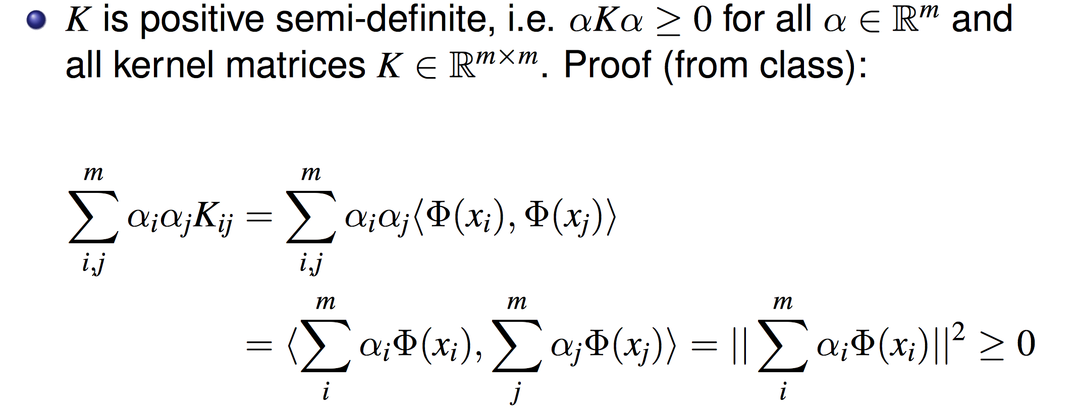
Proof

Slide 25
Mercer Kernel

Slide 26
Define Your Own Kernel Function or Combine Standard Kernel Function
We can write our own kernel function
Some non-kernel function may still work in practice
Combine standard kernels: k1 + k2 is a kernel, a*k1 is a kernel, etc. Can you prove?

Slide 27
Non-Linear SVM Demo
http://www.youtube.com/watch?v=3liCbRZPrZA
http://cs.stanford.edu/people/karpathy/svmjs/demo/

Slide 28
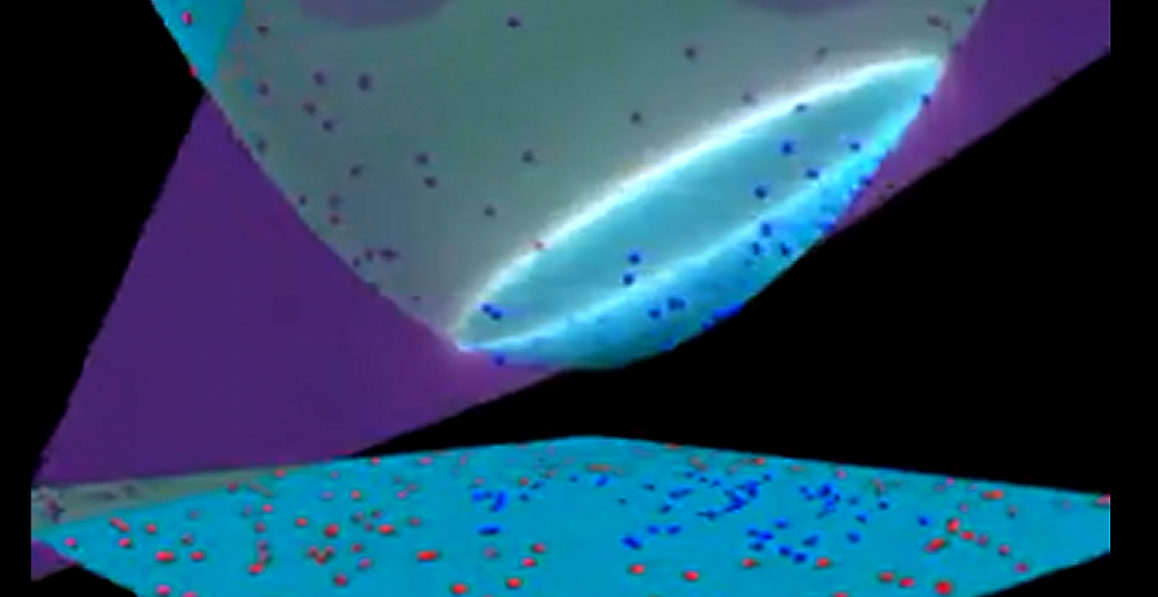

Slide 29
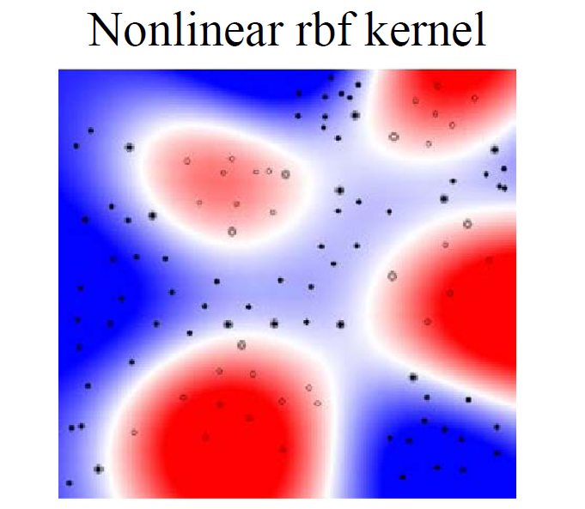
http://www.cs.ucf.edu/courses/cap6412/fall2009/papers/Berwick2003.pdf

Slide 30
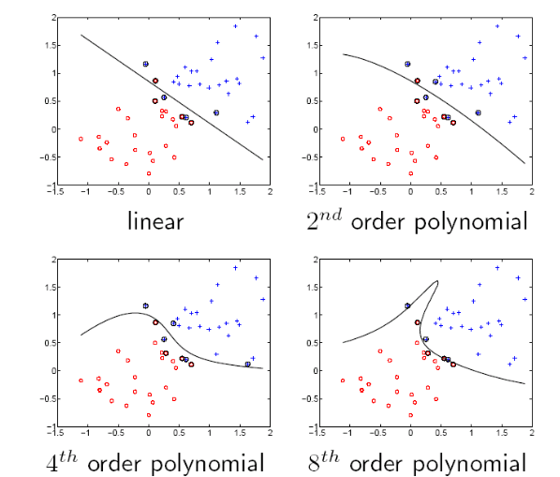
SVM Examples

Slide 31
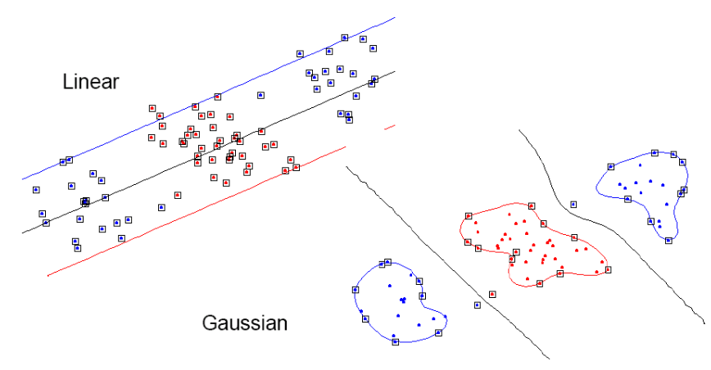
Gaussian Kernel Examples

Slide 32
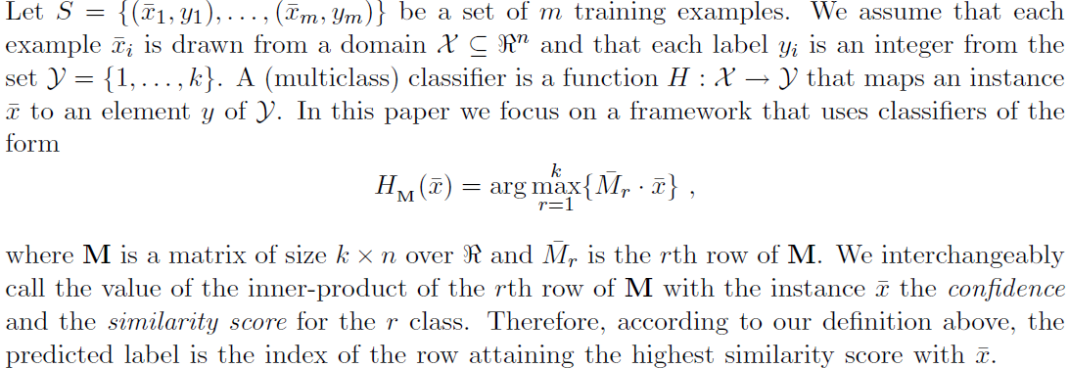
SVM Multi-Classification
One linear function (row) for each class.
Crammer, Singer, 2001

Slide 33
SVM Multi-Classification
Class 3
w3
Class 1
w2
w1
Class 2

Slide 34
SVM Multi-Classification
Note: here M is the weight matrix

Slide 35
Soft Margin Formulation
Crammer, Singer, 2001

Slide 36
Primal Optimization
Crammer, Singer, 2001

Slide 37
Dual Optimization
Crammer, Singer, 2001

Slide 38
Dual Optimization
How to extend it to non-linear multi-classification problem?
Crammer, Singer, 2001

Slide 39
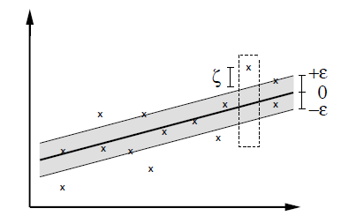
SVM Regression
Regression: f(x) = wx + b
Smola and Scholkopf, 2003

Slide 40
Hard Margin Formulation
Questions: can both constraints associated with the same data point be violated
at the same time?
Smola and Scholkopf, 2003

Slide 41
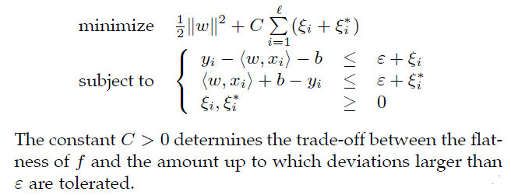
Software Margin Formulation
Smola and Scholkopf, 2003

Slide 42
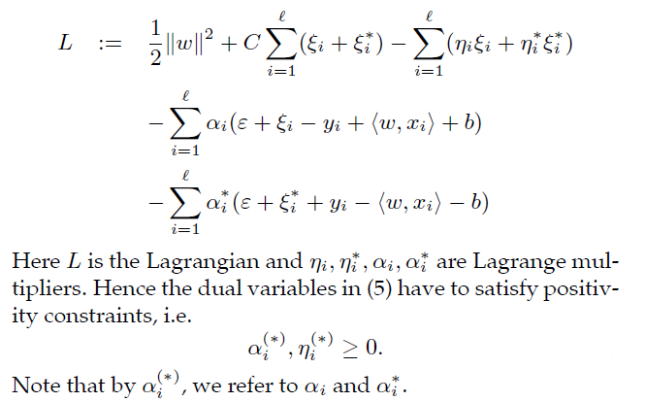
Primal Optimization
Smola and Scholkopf, 2003

Slide 43
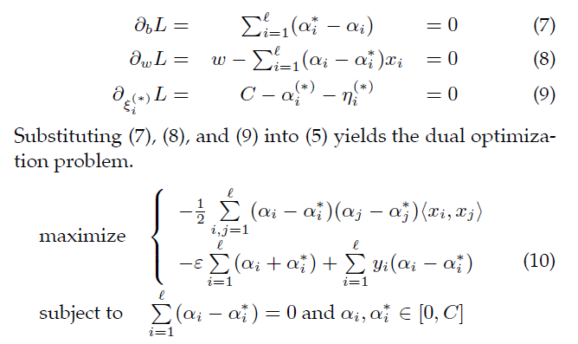
Dual Optimization
Smola and Scholkopf, 2003

Slide 44
Support Vectors and Weights
Which data points are support vectors?
What are their weights?
Smola and Scholkopf, 2003

Slide 45
Complementary Slackness
Smola and Scholkopf, 2003

Slide 46
Support Vectors
Which data points are support vectors and what are their weights?

Slide 47
Computing b
How?
Can any support vector have both a, a* non-zero?

Slide 48
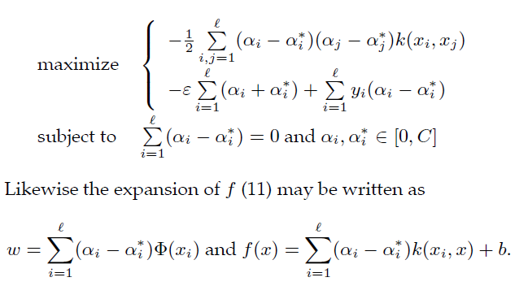
SVM for Non-Linear Regression

Slide 49
Properties of SVM
Flexibility in choosing a similarity function
Sparseness of solution when dealing with large data sets
- only support vectors are used to specify the separating hyperplane
Ability to handle large feature spaces
- complexity does not depend on the dimensionality of the feature space
Overfitting can be controlled by soft margin approach
Nice math property: a simple convex optimization problem which is guaranteed to converge to a single global solution
Feature Selection
Sensitive to noise
M. Tan’s slides, Univ. British Columbia

Slide 50
SVM Applications
SVM has been used successfully in many real-world problems
- text and hypertext categorization
- image classification
- bioinformatics (protein classification,
cancer classification)
- hand-written character recognition
M. Tan’s slides, Univ. British Columbia

Slide 51
Application 1: Cancer Classification
High Dimensional
- g>1000; n<100
Imbalanced
- less positive samples
Many irrelevant features
Noisy
Genes
Patients | g-1 | g-2 | …… | g-p
P-1
p-2
…….
p-n
FEATURE SELECTION
In the linear case,
w_{i}² gives the ranking of dim i
SVM is sensitive to noisy (mis-labeled) data ☹
M. Tan’s slides, Univ. British Columbia

Slide 52
Application 2: Text Categorization
Task: The classification of natural text (or hypertext) documents into a fixed number of predefined categories based on their content.
- email filtering, web searching, sorting documents by topic, etc..
A document can be assigned to more than one category, so this can be viewed as a series of binary classification problems, one for each category
M. Tan’s slides, Univ. British Columbia

Slide 53
Representation of Text
IR’s vector space model (aka bag-of-words representation)
A doc is represented by a vector indexed by a pre-fixed set or dictionary of terms
Values of an entry can be binary or weights
Normalization, stop words, word stems
Doc x => φ(x)
M. Tan’s slides, Univ. British Columbia

Slide 54
Text Categorization using SVM
The similarity between two documents is φ(x)·φ(z)
K(x,z) = 〈φ(x)·φ(z) is a valid kernel, SVM can be used with K(x,z) for discrimination.
Why SVM?
-High dimensional input space
-Few irrelevant features (dense concept)
-Sparse document vectors (sparse instances)
-Text categorization problems are linearly separable
M. Tan’s slides, Univ. British Columbia

Slide 55
Some Issues
Choice of kernel
- Gaussian or polynomial kernel is default
- if ineffective, more elaborate kernels are needed
- domain experts can give assistance in formulating appropriate similarity measures
Choice of kernel parameters
- e.g. σ in Gaussian kernel
- σ is the distance between closest points with different classifications
- In the absence of reliable criteria, applications rely on the use of a validation set or cross-validation to set such parameters.
Optimization criterion – Hard margin v.s. Soft margin
- a lengthy series of experiments in which various parameters are tested
M. Tan’s slides, Univ. British Columbia

Slide 56
Additional Resources
An excellent tutorial on VC-dimension and Support Vector Machines:
C.J.C. Burges. A tutorial on support vector machines for pattern recognition. Data Mining and Knowledge Discovery, 2(2):955-974, 1998.
The VC/SRM/SVM Bible:
Statistical Learning Theory by Vladimir Vapnik, Wiley-Interscience; 1998
http://www.kernel-machines.org/
M. Tan’s slides, Univ. British Columbia

Slide 57
SVM Tools
SVM-light: http://svmlight.joachims.org/
LIBSVM: http://www.csie.ntu.edu.tw/~cjlin/libsvm/
Gist: http://bioinformatics.ubc.ca/gist/
More: http://www.kernel-machines.org/software.html
M. Tan’s slides, Univ. British Columbia

