Slide 1
Inferring Cellular Networks Using Probabilistic Graphical Models
Jianlin Cheng, PhD
University of Missouri
2009

Slide 2
Bayesian Network Software
http://www.cs.ubc.ca/~murphyk/Software/BNT/bnsoft.html

Slide 3
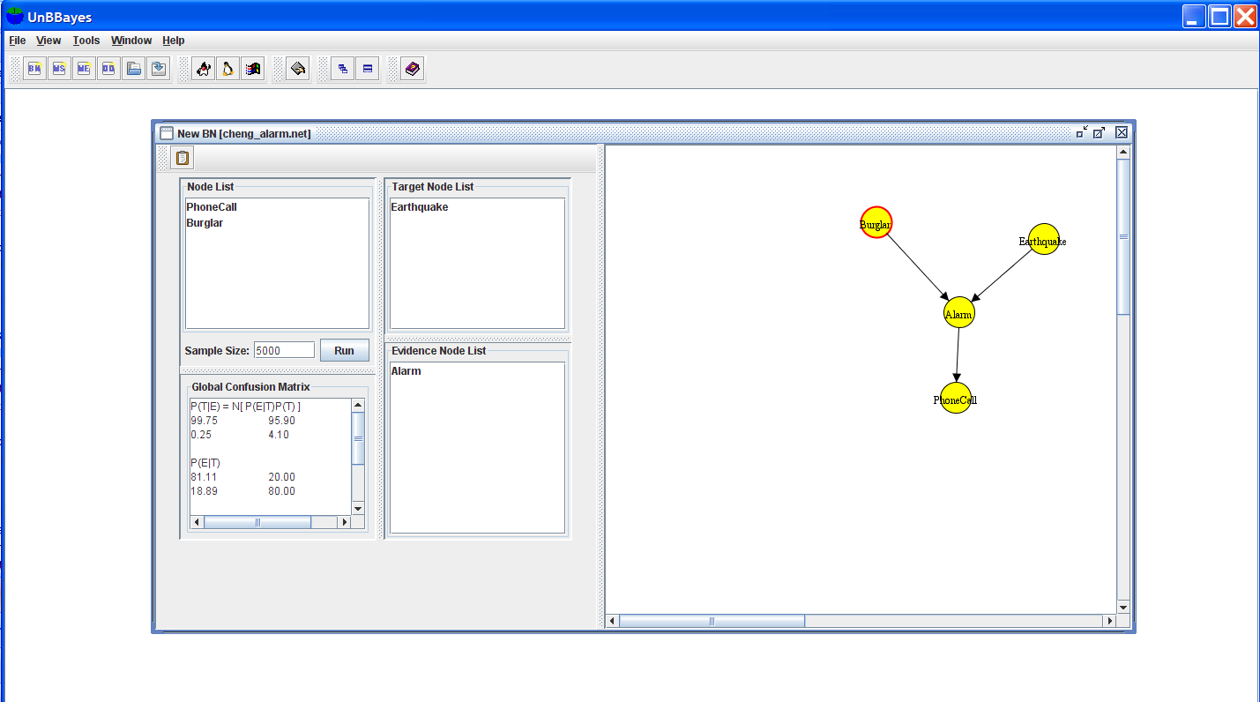
Demo

Slide 4
Research in molecular biology is undergoing a revolution
mRNA transcript quantities
protein-protein
protein-DNA interactions
chromatin structure
Protein quantities
Protein localization
Protein modification

Slide 5
Challenge
Provide methodologies for transforming high-throughput heterogeneous data sets into biological insights about the underlying mechanisms
Data is noisy
Data integration
Generate Hypothesis

Slide 6
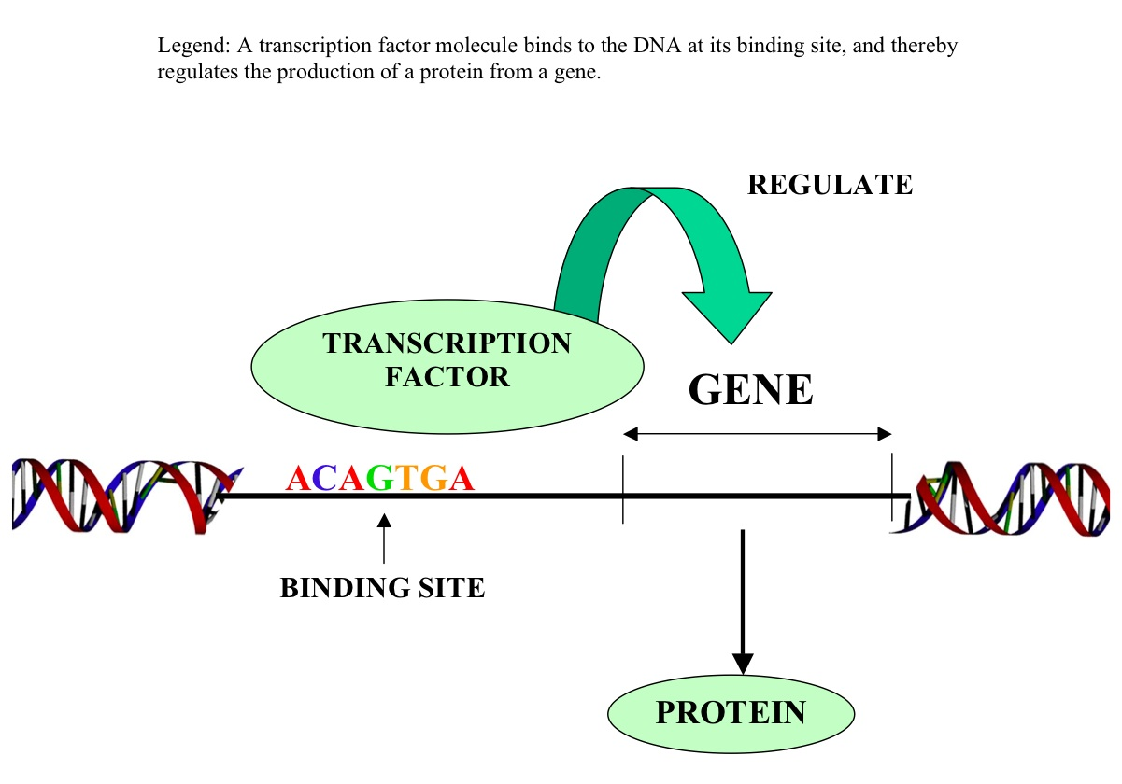
Biological Networks – Gene Regulatory Networks

Slide 7
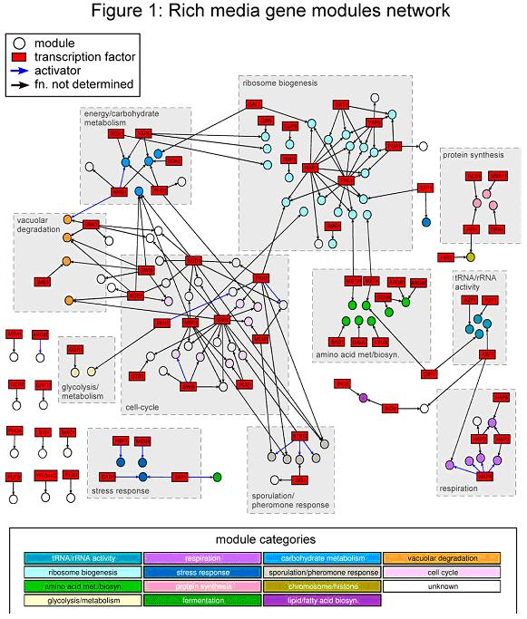

Slide 8
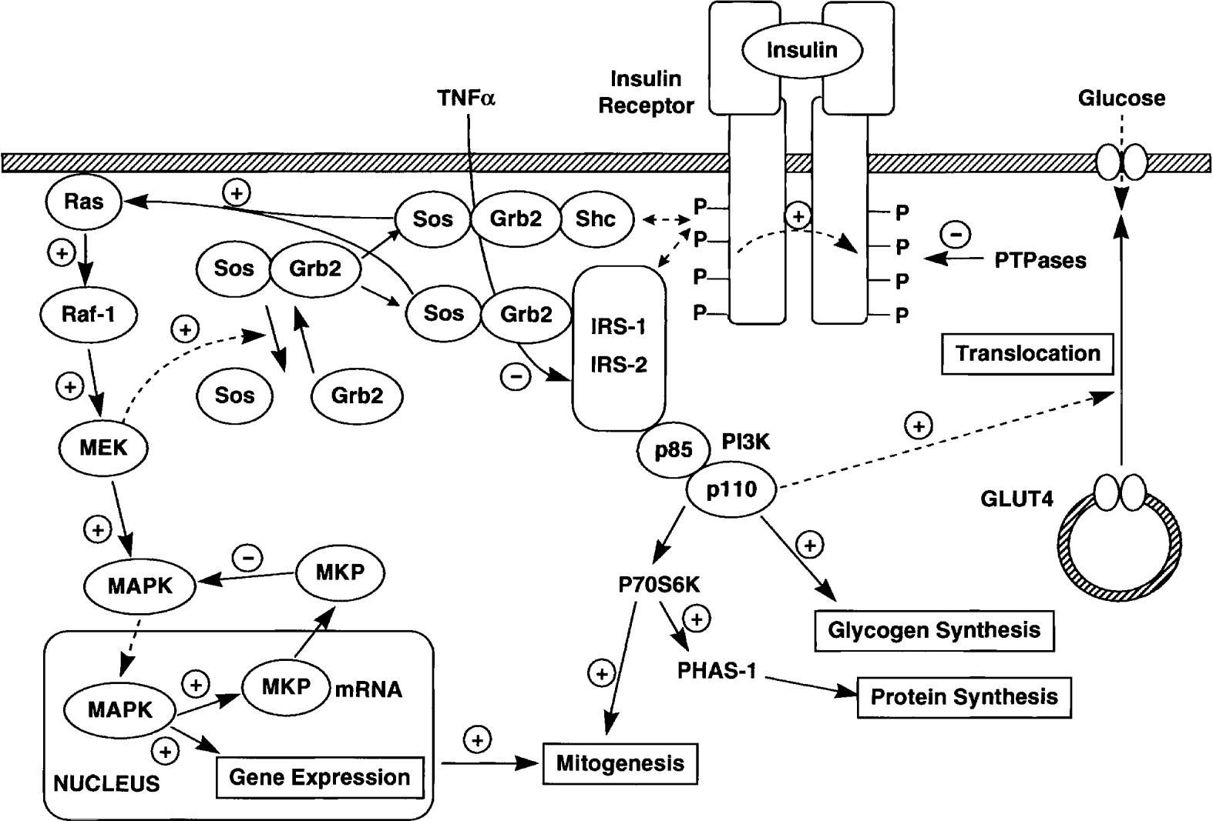
Signal Transduction Network

Slide 9
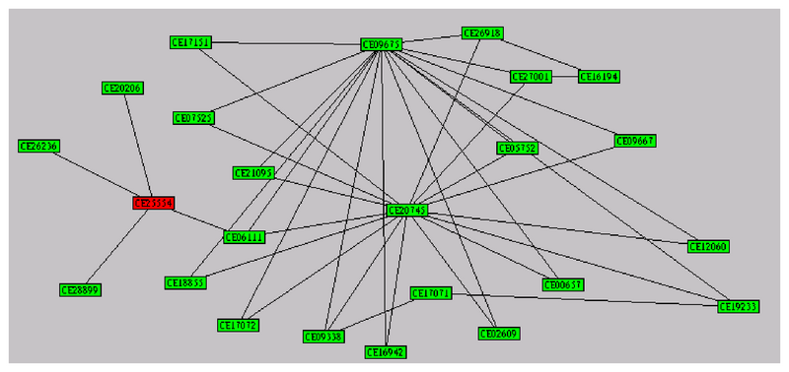
Protein Interaction Network

Slide 10
Model-Based Approaches VS Procedure Approaches
Procedure: Binding sites – Gene expression. (a) cluster co-expressed genes to find common sites (b) group genes with similar binding sites and test if they are coexpressed
Declarative: design a model that describes the relations between the two types of data. Learn parameter from data and make predictions

Slide 11
Probabilistic Models
Stochasticity for measurement noise
Learning Algorithms
Select model that fits the actual observations
Inference
Make predictions
Generate insights and hypothesis

Slide 12
Modeling Examples
Hidden Markov Model for sequence analysis
Probabilistic Graphical Model for cellular networks

Slide 13
Advantages
Concise language for describing probability distributions over the observations
Approaches to learning from data that are derived from basic well-understood principles
Use of observations to fill in model details
Provide principles for combining multiple local models into a joint global model
Declarative nature provides an advantage to extend model to account for additional aspects of the system

Slide 14
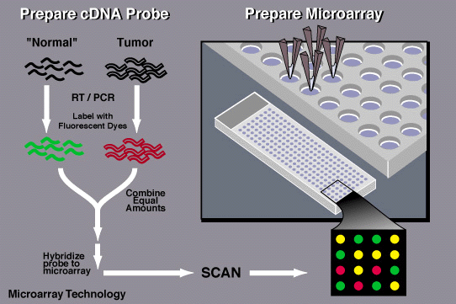
Infer Gene Regulatory Network from Gene Expression Data

Slide 15
Model for gene expression and cis-regulatory elements
Assumptions 1: genes can be partitioned into clusters of coexpressed genes, and the genes in each cluster have a typical expression level in each array.
Assumption 2: arrays are partitioned into array clusters, which capture relevant biological context, and that the expression of a gene is roughly the same in the arrays that belong to the same array cluster

Slide 16
Random Variables
X_{g,a}, where g is an index over gene and a is an index over arrays
GeneCluster_{g}: denotes the cluster assignment of gene g
ArrayCluster_{a} denotes the cluster assignment of array a.
Assumption: the expression of gene g in array a depends on the value of GeneClusterg and ArrayClustera

Slide 17
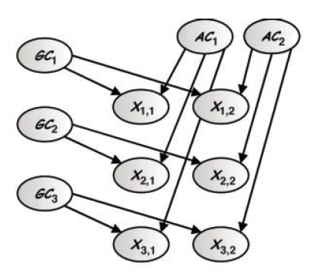
Regular Bayesian Networks

Slide 18
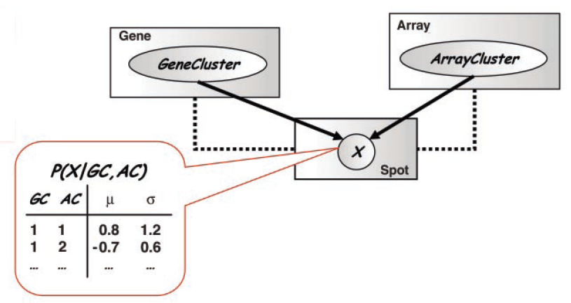
Conditional Distribution

Slide 19
Learning Models from Data
Parameter estimation – maximum likelihood problem ( P(data| model))
Model selection: select among different model structures to find one that best reflects the dependencies in the domain. P(model | data)

Slide 20
The model just described can achieve high likelihood if the cluster and gene assignment partitions the original measurements into blocks with approximately uniform expression within each block

Slide 21
Expectation Maximization procedure that iterates between an E-step, which uses current parameters to find the probabilistic cluster assignment of genes and arrays, and an M-step, which re-estimates the distribution within each gene/array cluster combination on the basis of this assignment.

Slide 22
Co-Regulation
A key regulation mechanism involves binding of transcription factors to promoter regions of genes.
we aim to identify the transcription factor binding sites in the promoter region of genes that can explain observed co-expression.

Slide 23
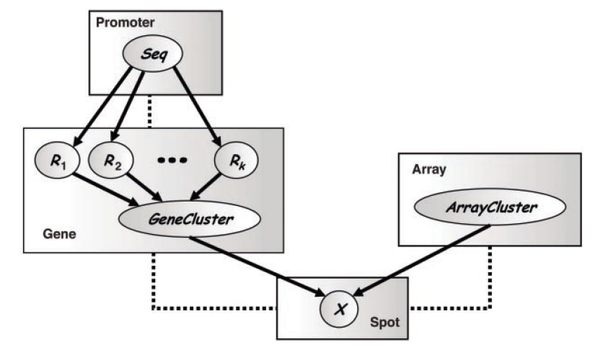
Regulatory Model
Rg,j as depending on the
promoter sequence Seqg

Slide 24
Integration of Sequence and Expression Data
The parameters of this conditional probability characterize the specific motif recognized by the transcription factor. This extension allows us to learn the characterization of the binding site while learning how its presence influences gene expression.

Slide 25
A crucial detail in building such a model
is the representation of the conditional distributions
associated with GeneClusterg. This
distribution describes how the existence of
binding sites in the promoter region determines
(or predicts) what cluster the gene
belongs to. The conditional probabilities explored
so far involve fairly generic representation
of decision trees (14) or additive votes
(15).

Slide 26
Data integration
a pair of interacting proteins are more likely to belong to the same coregulated cluster
assume that active transcription factor binding sites should correspond to observations of transcription factor location data

Slide 27
Reconstruction of Regulatory Networks
A key challenge in gene expression analysis
is the reconstruction of regulatory networks.
We then use tools for structure learning in Bayesian networks (22, 23) to determine the network architecture

Slide 28
Challenges
The second and more difficult challenge
is the biological interpretability of the results.
Can we really distinguish regulation
from coexpression? Do these methods discover
direct or indirect regulation? How do
unobserved posttranscriptional events affect
the conclusions?

Slide 29
Module Networks
The second and more difficult challenge
is the biological interpretability of the results.
Can we really distinguish regulation
from coexpression? Do these methods discover
direct or indirect regulation? How do
unobserved posttranscriptional events affect
the conclusions? (Nature Genetics)

Slide 30
A regulatory module is a set of genes that are regulated in convert by a shared regulation program.
A regulation program specifies the behavior of the genes in the module as a function of the expression level of a small set of regulators

Slide 31
Procedure
Inputs: a gene expression data set and
a large precompiled set of candidate regulatory genes for the corresponding organism (independent of data set) containing both know and putative transcription factors and signal transduction molecules
Goal: search for a partition of genes into modules and for a regulation program for each module

Slide 32
Output: a list of modules and associated regulation programs

Slide 33
Results: apply the method to Yeast gene expression data set consisting of 2355 genes and 173 arrays.
Each inferred modules contained a functionally coherent set of genes (metabolic pathways, oxidative stress, cell cycle-related processes, etc)
Many module has a match between predicted regulator and its known cis-regulatory binding motif.

Slide 34
The second and more difficult challenge
is the biological interpretability of the results.
Can we really distinguish regulation
from coexpression? Do these methods discover
direct or indirect regulation? How do
unobserved posttranscriptional events affect
the conclusions?

Slide 35
Experimental Verification
The second and more difficult challenge
is the biological interpretability of the results.
Can we really distinguish regulation
from coexpression? Do these methods discover
direct or indirect regulation? How do
unobserved posttranscriptional events affect
the conclusions? The second and more difficult challenge
is the biological interpretability of the results.
Can we really distinguish regulation
from coexpression? Do these methods discover
direct or indirect regulation? How do
unobserved posttranscriptional events affect
the conclusions?

Slide 36
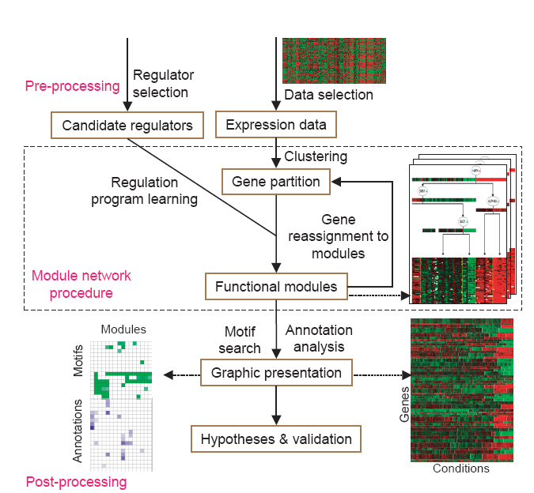

Slide 37
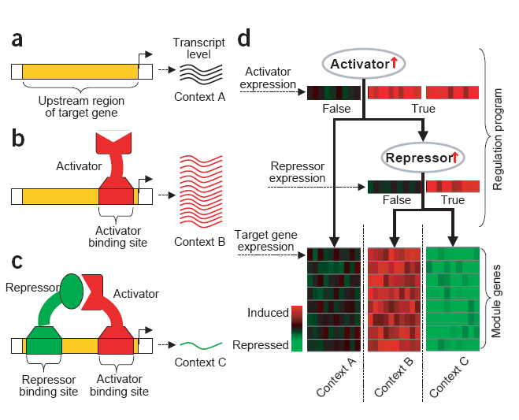
One Example

Slide 38
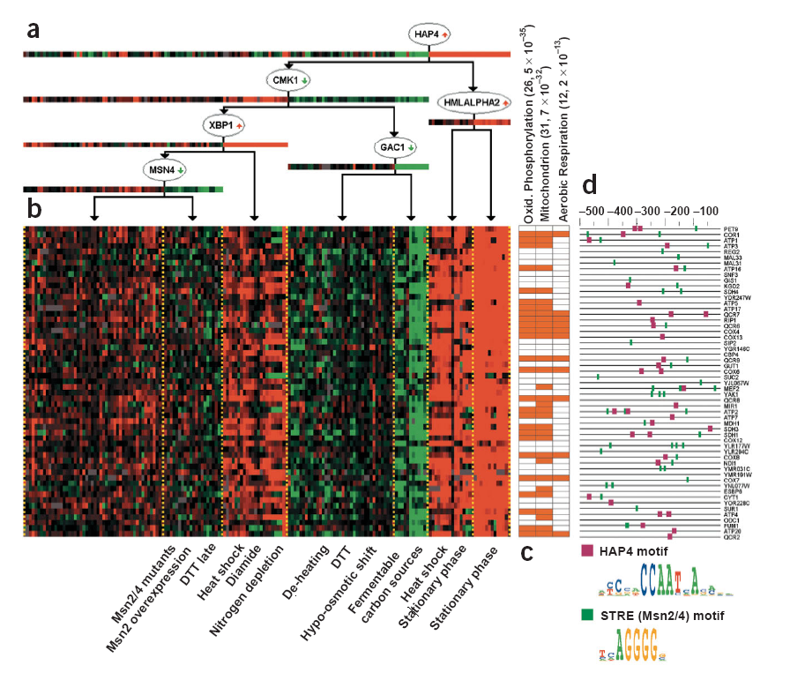
Row: genes
Column: arrays

Slide 39
Evaluation of Module Content and Regulation Program
We evaluate all 50 modules to test whether the proteins encoded by genes in the same module had related functions. We scored the functional/biological coherence of each module according to percentage of its genes covered by annotations. Most of modules had a coherence level above 50%.

Slide 40
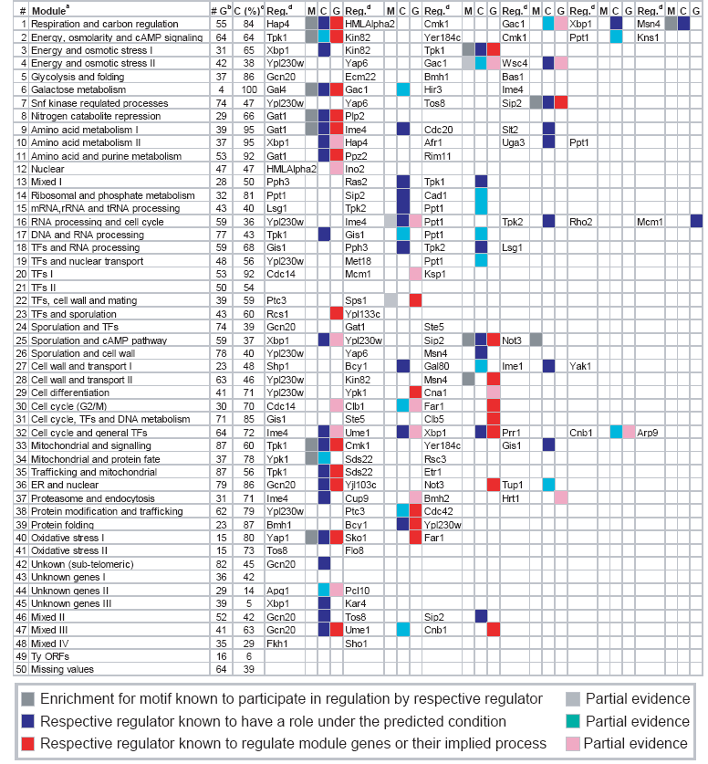

Slide 41
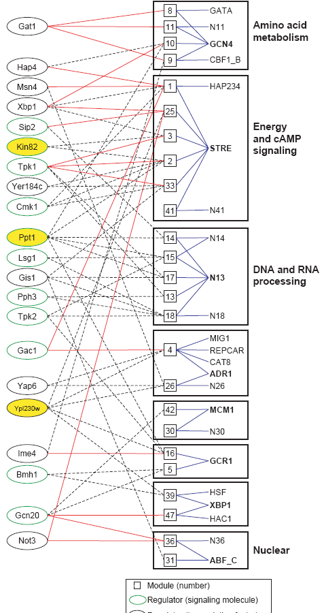
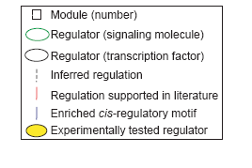

Slide 42
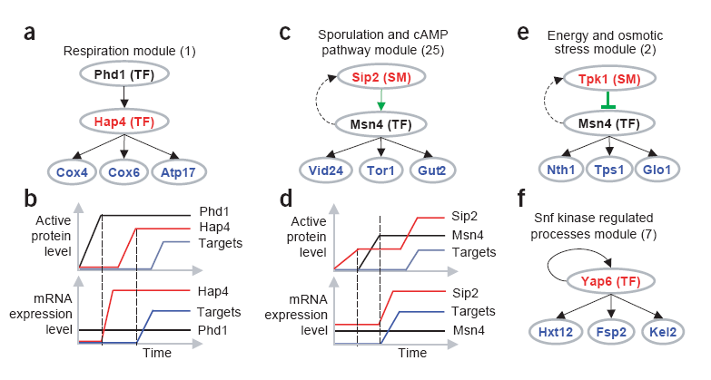

Slide 43
Candidate regulators
Compiled a set of 466 candidate regulators annotated in Yeast Genome and Proteome databases
Use Yeast gene expression data set conisting of 173 microarrays that measure responsts to various stress conditions. We downloaded these data in log (base 2) ratio to control format from Stanford Microarry Database. Chose a subset of 2355 genes that have a significant change in gene expression under the measured stress conditions

Slide 44
Protein annotations: downloaded Gene Ontology and Munich Information center for Protein Sequence (MIPS) function and KEGG.
Regulation program: context (upregulation, no change, down regulation). Regression tree (decision nodes and leaf nodes); the model semantics is that given a gene g in the module and an array a in a context, the probability of observing some expression value for a gene in array is governed by the normal distributino specified for the context.

Slide 45
Learning Module Networks
In each iteration, the procedure searches for a regulation program for each module and then reassign each gene to the module whose program best predicts its behavior. Repeated until it converges.
Search for the model with the highest score by using the EM algorithm.

Slide 46
M-Step: given a partition of genes into modules and learns the best regulation program (regression tree) fro each module. The regulation program is learned through a combinatorial search over the space of trees. The tree is grown from the root to its leaves. At any given node, the query that best partitions the gene expression into two distinct distribution is chosen.

Slide 47
E-step: given the inferred regulation programs, we determine the module whose associated regulation program best predicts each gene’s behavior. Select the module whose program gives the gene’s expresson profile the highest probability and re-assign the gene to this module.
We initialize our modules to 50 clusters using Pcluster, a hierahical agglomerative clustering. We then applied the EM algorithm to this starting point, refining both the gene partitioin and the regulatory program.

Slide 48
Evaluating statistical significance of modules
All of the statistical evaluations were done and visualized in GeneXPress. The tool can evaluate the output of any clustering program for enrichment of gene annotations and motifs

Slide 49
Annotation enrichment
We associated each gene with the processes in which it participates. Resulted in 923 GO categories, 208 MIPS categories, and 87 KEGG pathways. For each module and for each annotation, we calculated the fration of genes in the module associated with that annotaiton and used the hypergeometric distribution to calculate a P value for this fraction.

Slide 50
Promoter Analysis
We search for motifs (represented as Position-Specific Scoring Matrices) within 500 bp upstream of each gene. We downloaded TRANSFAC, containing 34 known function cis-regulatory motifs. We also use a motif finder to find 50 potentially novel motifs.

Slide 51
Motif Combination
We searched for statistically significant occurences of motif pairs. We constructed a motif pair attribute, which assigns a “true” value for each gene if and on if both motifs of the pair are found in the upstream region of that gene. For each module and for each motif pair attribute, we calculated the fraction of genes in the module associated with that attribute and used the hypergeometric distribution to calculate a P value for this fraction.

Slide 52
Regulator Annotations
We associate regulatros with annotaions and binding sites in he same way we assocte with these attributes to the modules. Because a regulator may regulate more than one module, its targets consist of the unioin of the genes in all modules predicted to be regulated by that regulator. We tested the targets of each regulator for enrichment of the same motifs and gene annotations as above using the hypergeometric P value.

