Slide 1

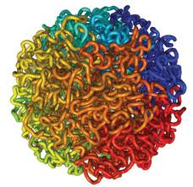

Modeling 3D Structure of Human Genome on Hi-C Data
Jianlin Cheng
Electrical Engineering and Computer Science Department
University of Missouri, Columbia, USA
Oct. 9th, 2017

Slide 2
Outline
Introduction
3D genome modeling
Application
Distance-based modeling
Contact-based modeling
Hierarchical high-resolution modeling

Slide 3
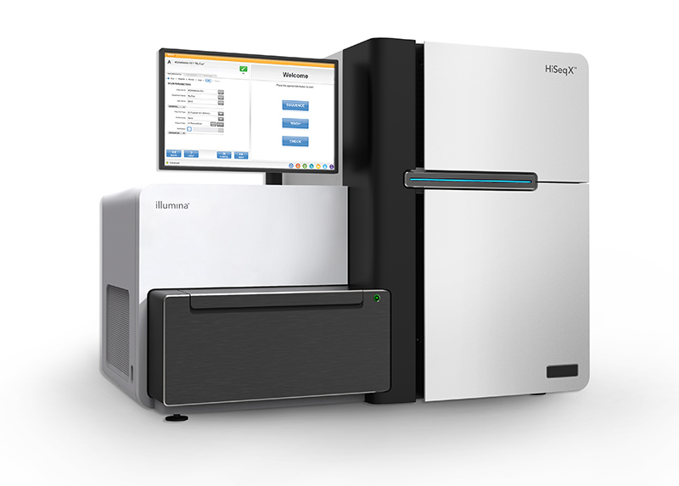
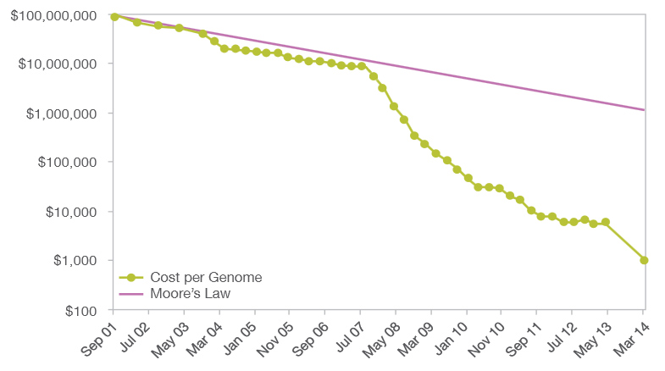
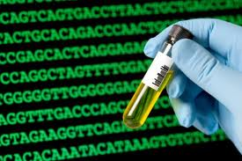
$1000 Personal Genome!
http://www.futuretimeline.net/blog/2014/01/16.htm#.U3Vg-FhdWzs

Slide 4
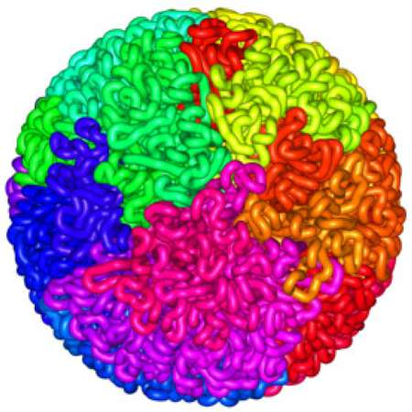
3D Shape of Genome
Liberman-Aiden et al., 2009
Fullwood et al., 2009

Slide 5
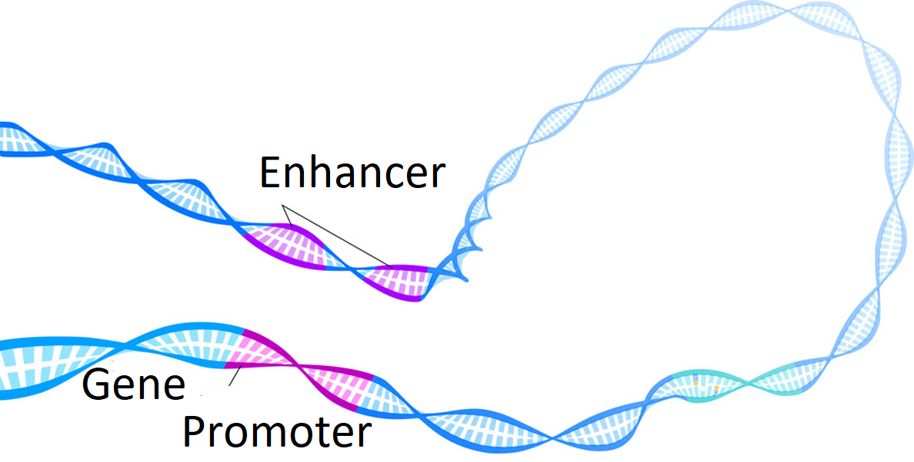
Long-range Gene Regulation in Human
Enhancer
Gene 1
Gene 2

Slide 6
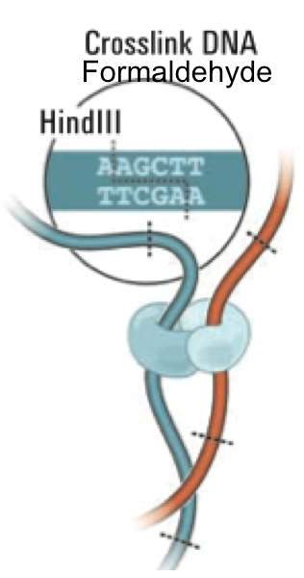
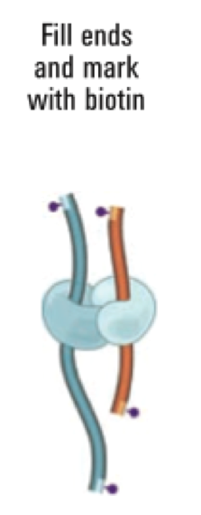
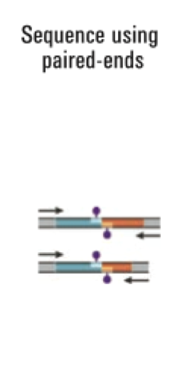
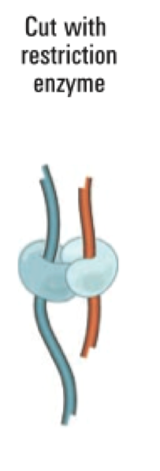
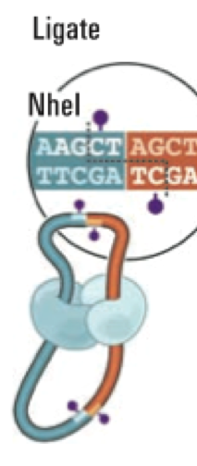
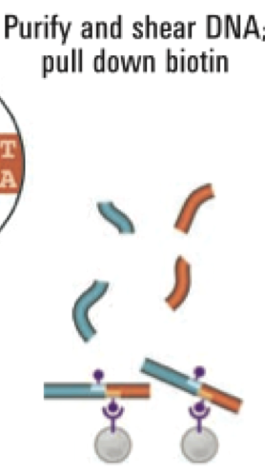
Chromosomal Conformation Capturing: Hi-C Technique
Liberman-Aiden et al., 2009

Slide 7

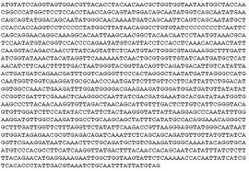
Genomic Spatial Interaction (Contact) Data
i
Map pair-end reads to the genome sequence
j
1 2 …… n
1
2
.
.
.
n
40 |  |  |  | 1
 | 7 |  | 8
 |  | 10
 | 8 |  | 15
1 |  |  |  | 6
M[i,j] = Interaction Frequency
(or contact number)
Intra- / inter-chromosome contact map
Wang et al., 2013

Slide 8
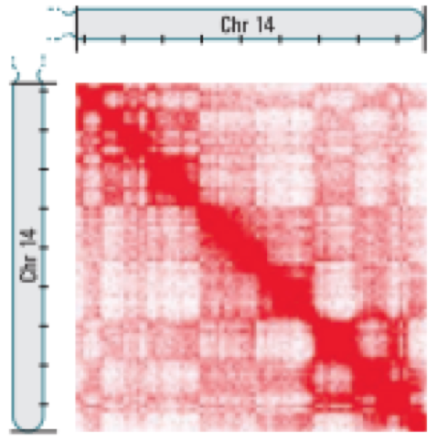
Chromosomal Contact Map
Chr. 14
Chr. 11
Intra-Chromosome
1M Resolution
B-Cell
Inter-Chromosome
1M Resolution
B-Cell
Wang et al., 2013

Slide 9
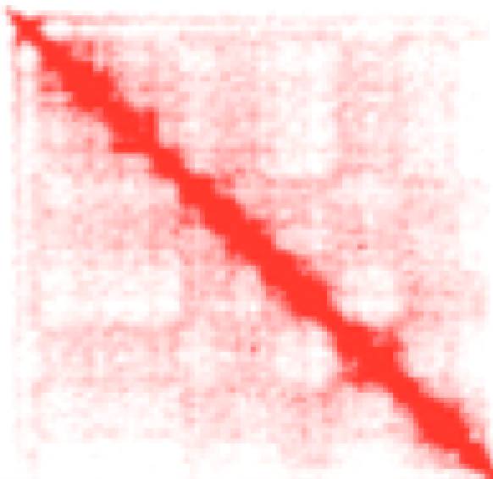
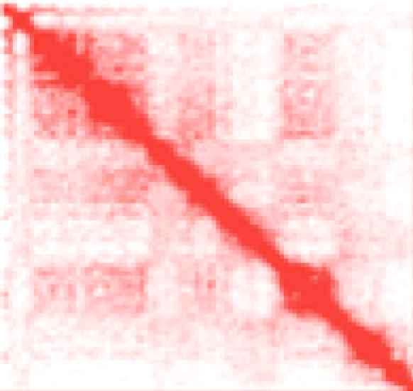
Contact Normalization
Sequential Component Normalization: M[i,j] / (|M[i]| * |M[j]|)

Slide 10
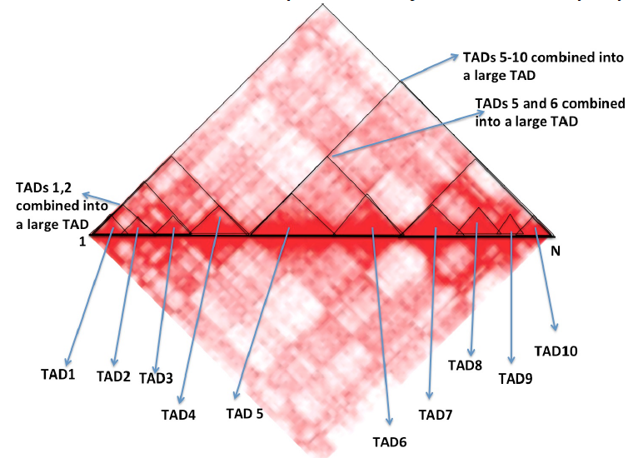
Topologically Associated Domain

Slide 11
3D Genome Modeling

Slide 12
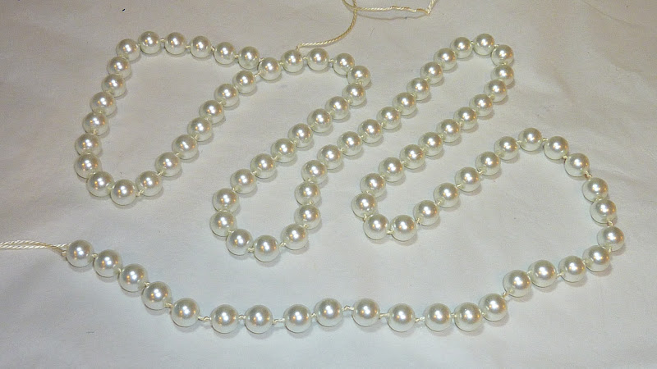

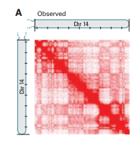
3D Genome Structure Modeling
Trieu , Cheng, 2014; Trieu, Cheng, 2017
Notes:
We consider each region of genome as a bead and the entire genome is a string of beads. Then we place those beads in 3D such that the distances between beads are consistent with the 2D contact map.

Slide 13
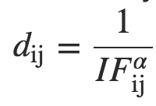


I. Distance-Based Approach
Convert observed interaction frequencies into distance map
Objective: adjust positions (x,y,z coordinates) of beads in 3D space to satisfy converted (“wish”) distances as well as possible
Challenges: approximated distances, noise, conflicts
$$i$$
Conversion
$$j$$
Hi-C contact map
Approximated spatial distance matrix
α: conversion parameter (positive number)
Notes:
Again, the same approach is to convert Hi-C data into a set of constraints. But this time IF is converted into distances with assumption that spatial distances are inversely correlated with interaction frequencies. So, a common function used by other researchers is this function.
The alpha here is unknown and we have to look for it. Then, the objective to place bead in 3D models that satisfy wish distances as much as possible. The challenge of this approach is that wish distances are just approximation and they are conflicting with each other.
This time, I have equality constraints. With similar spirit in my previous method

Slide 14
Problem of Traditional Objective Functions
Sum of Square Errors
Very sensitive to noisy / conflicting distances
Cannot build 3D models of large genomes involving noisy inter-chromosomal contacts

Slide 15
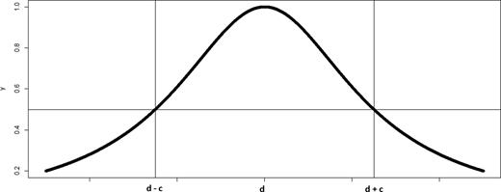
Deriving Soft Constraints by Lorentzian Function
Use Lorentzian function to measure the satisfaction of a distance restraint
[0, 1]
Tolerate noisy restraints and maximize the satisfaction of feasible restraints
Constraint is satisfied
Constraint is “less” satisfied
Trieu, Cheng, 2017

Slide 16
Objective Function
Objective function
  Sum of all distance constraints
  Adjacent beads have maximum weight to enforce their proximity
c is set to average of d_{ij}
Trieu, Cheng, 2017

Slide 17
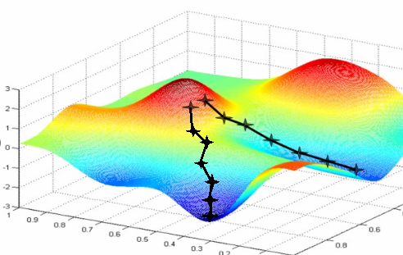
Large-Scale Gradient Ascent Optimization
Initializing model randomly in a sphere
Gradient ascent to iteratively satisfy hundreds of thousands of distances as much as possible
Adaptive step-size by backtracking line search

Slide 18
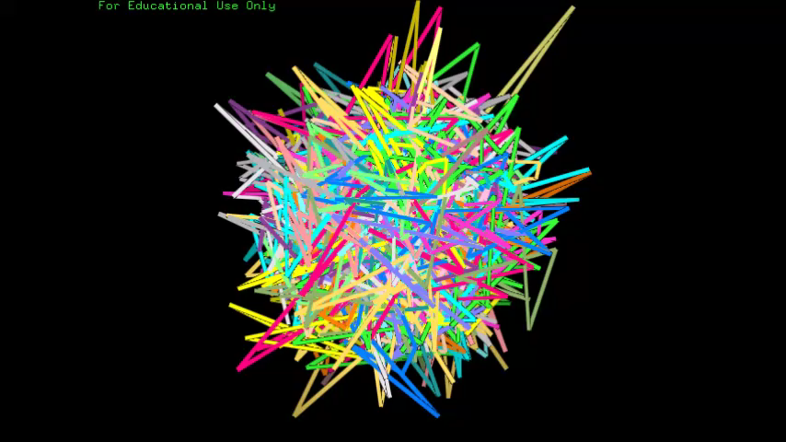

Slide 19
Correlation between Reconstructed Distances and True Distances on the Synthetic Data of Yeast
Notes:
PM2 is also named Pastis

Slide 20
Root Mean Square Error between Reconstructed Distances and True Distances

Slide 21
Real Hi-C Data
GM06990 human cell line (Lieberman-Aiden E. et al. Science 2009), ~76 million reads
GM12878 human cell line (Rao S. et al., Cell 2014), billions of reads

Slide 22
Quality of Chromosome Models

Slide 23
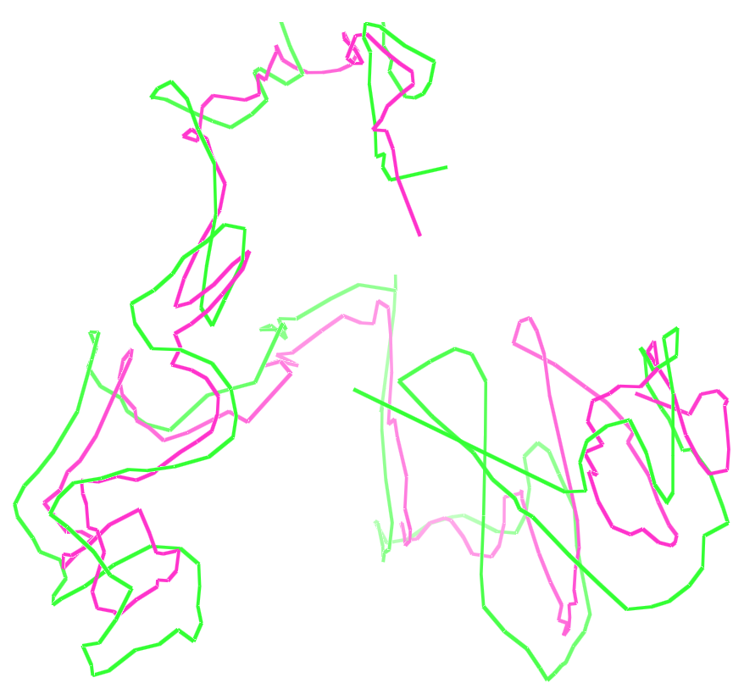
Are Models at Different Resolutions Similar ?
A model at 1MB resolution and a model of Chr. 1 at 500 KB resolution

Slide 24
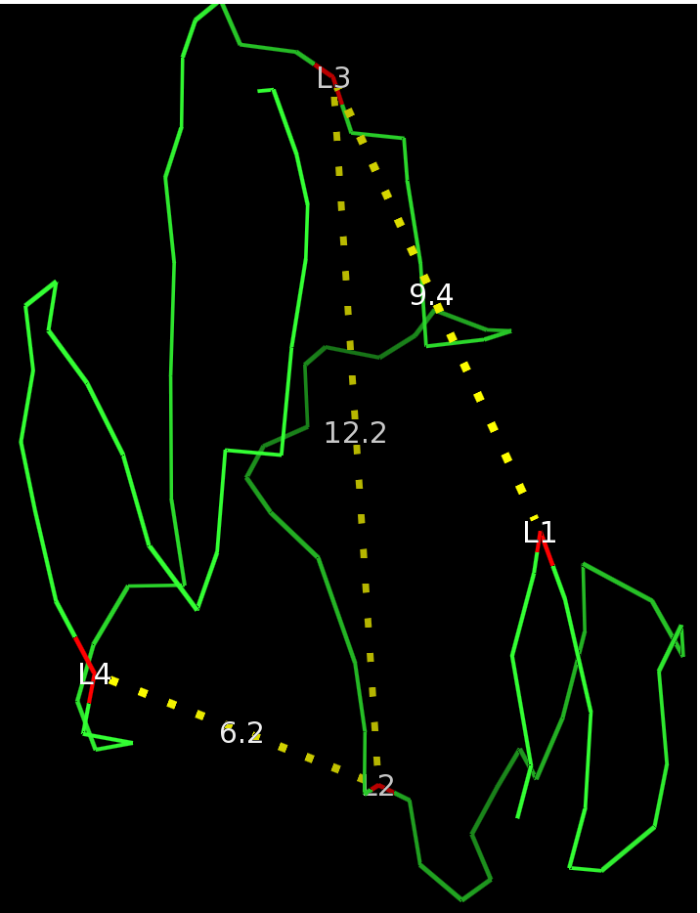
Distance Verification with FISH Data
Distances measured by Fluoresce In-Situ Hybridization (FISH) :
  L1-L3 < L2-L3 though L2 is located between L1-L3 in the 1D sequence
  L2-L4 < L2-L3 though L3 is located between L2-L4 in the 1D sequence
Chr.14 of GM06990, 1MB resolution

Slide 25
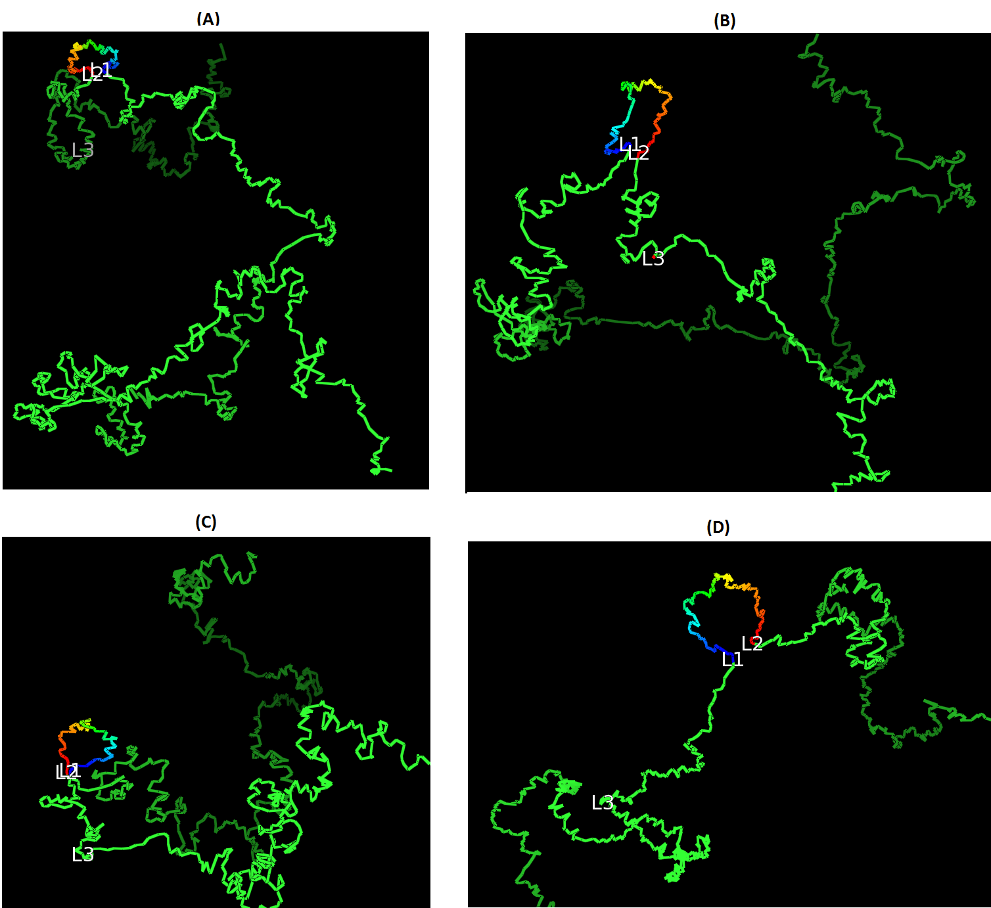
Loop Realization
4 loops were verified by 3D FISH on Chr. 11, 13, 14, 17 of GM12878
Do our reconstructed models have these 4 loops ?
Models at 10kb resolution

Slide 26
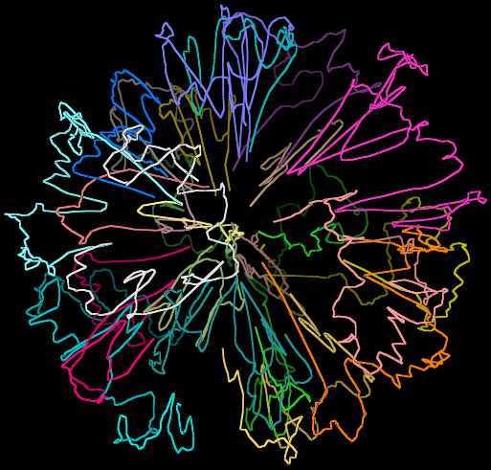
3D Genome Model
Do chromosomes have their own territories rather than intermingling together ?

Slide 27
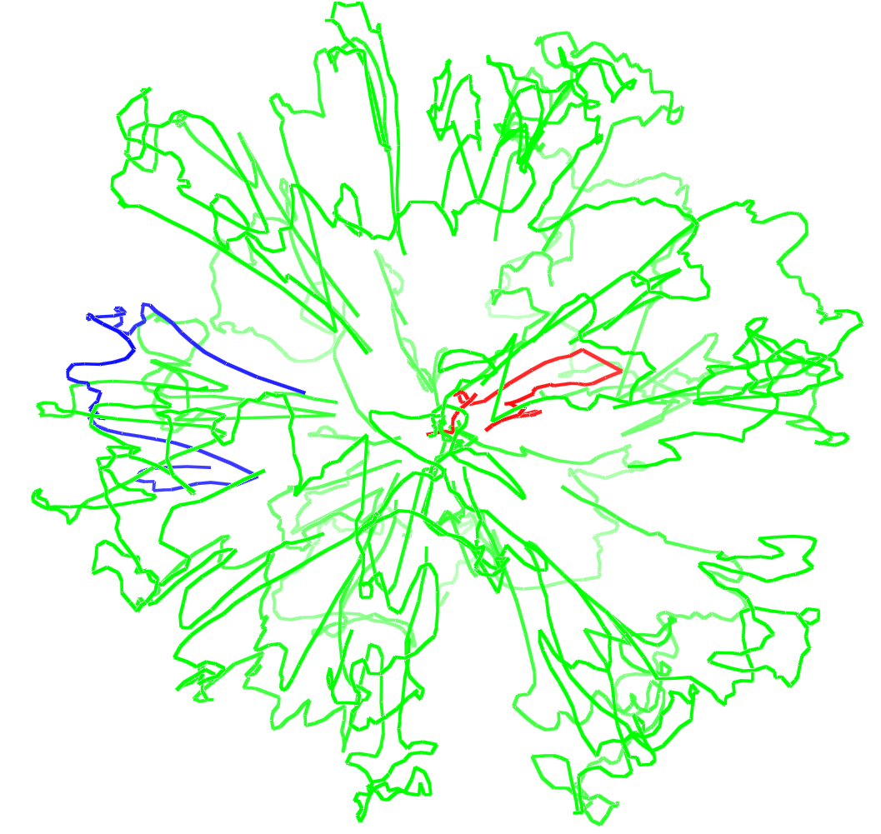
Location of Gene-Rich Small Chromosomes
Small chromosomes except Chr. 18 in the center and large chromosomes in periphery
Inter-chromosomal orientations are dynamic
Chromosome 18 in blue and Chromosome 19 in red

Slide 28
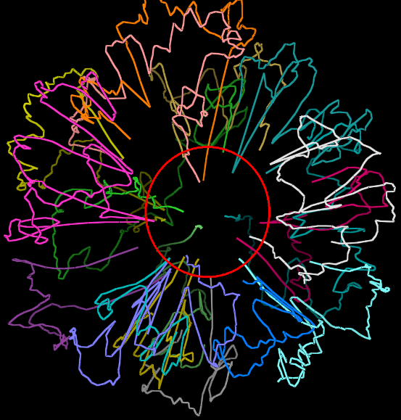
Telomere – Centromere Feature
Telomeres and centromeres of large chromosomes prefer to interact with each other in the center

Slide 29
II. Contact-Based 3D Genome Modeling
Potential problems of the distance-based approach
A strong, uniform mathematical assumption on the relation between distance and interaction frequency
Susceptible to noise or biases
Alternative solution: only require the distance
between contacted fragments is less than a threshold

Slide 30
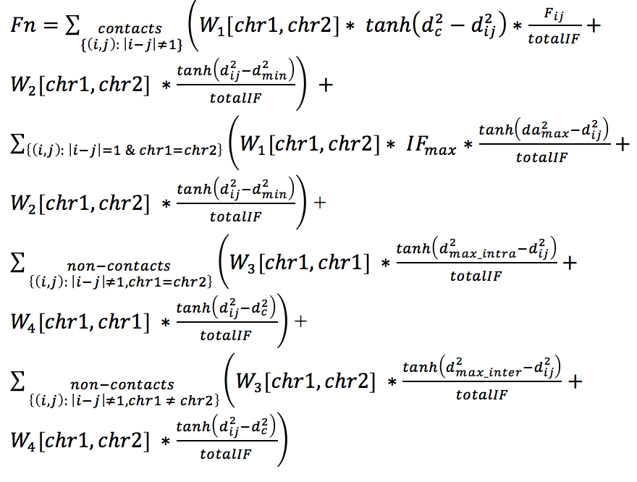
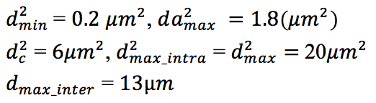
Scoring Function for Genome Optimization
Contact Pairs
Adjacent Pairs
Non-contacts on
same chromosome
Non-contacts on
different
chromosomes
Trieu, Cheng, Bioinformatics, 2016

Slide 31
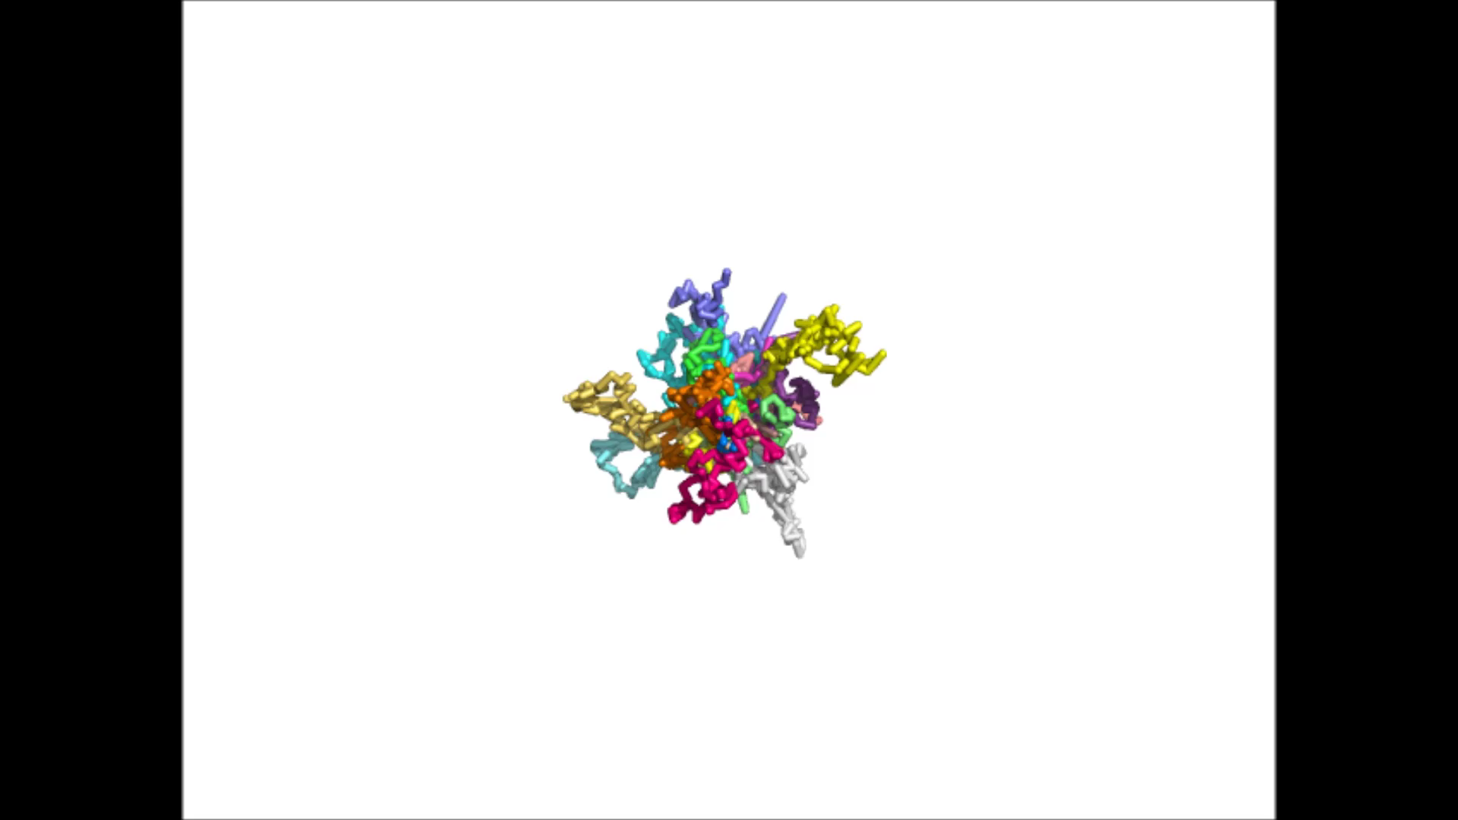
Modeling of 3D Genome

Slide 32
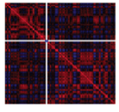
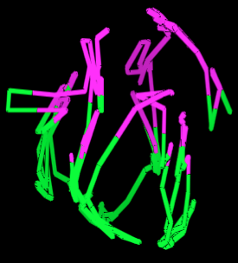

Two-Compartment (Euchromatin- Heterochromatin) Partition
Chromosome 7
Trieu, Cheng, 2014

Slide 33
Center – Periphery Architecture and Dynamic Inter-chromosomal Interactions
Small chromosomes in center
Large chromosomes in periphery
Genome structure ensemble (dynamics)
Correlation of inter-chromosomal interactions (0.48), p-value < e-16
Trieu, Cheng, Bioinformatics, 2016

Slide 34
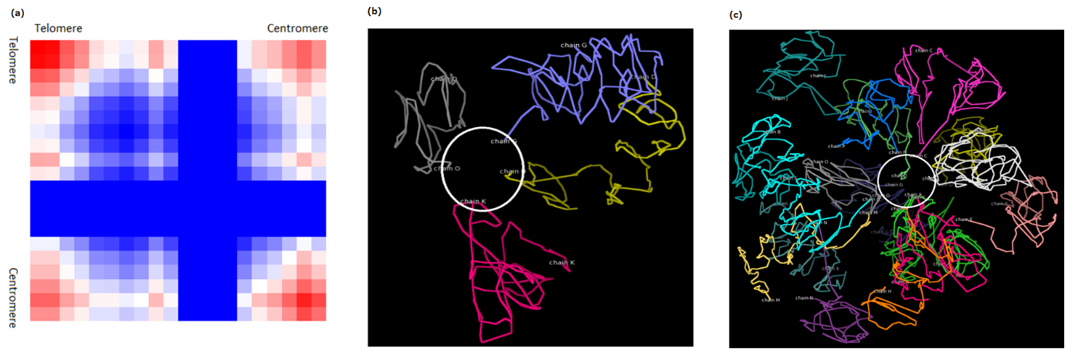
Enriched Telomere and Centromere Inter-Chromosomal Interactions
Telomere-telomere interactions > telomere/centromere interactions > other interactions
Trieu, Cheng, Bioinformatics, 2016

Slide 35
III. High-Resolution Modeling
Problems of existing methods
Deal with up to tens of thousands of points
Build low-resolution models of entire chromosome
Build high-resolution models of a chromosomal region only
How to build high resolution models
for a large chromosome or genome at
kilobase resolution?

Slide 36
A Hierarchical Modeling Algorithm

Slide 37
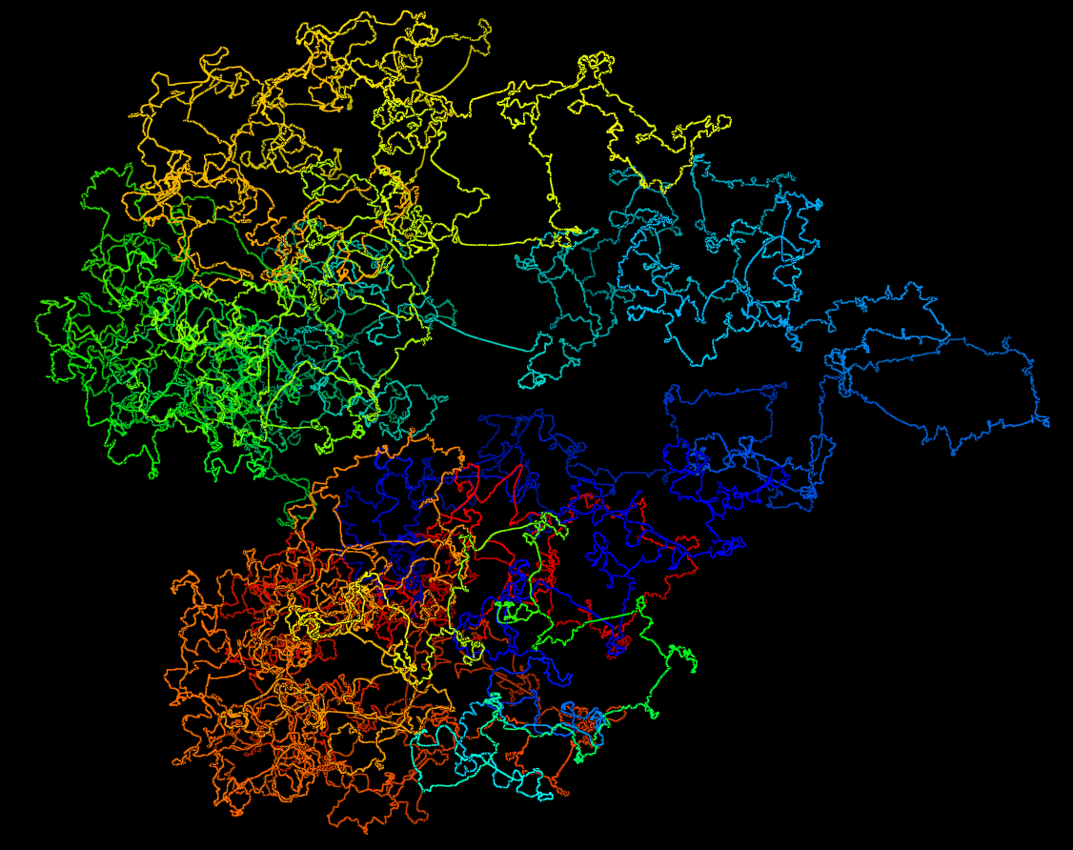
A High-Resolution Model at 5KB

Slide 38
Applications of 3D Genome Modeling

Slide 39
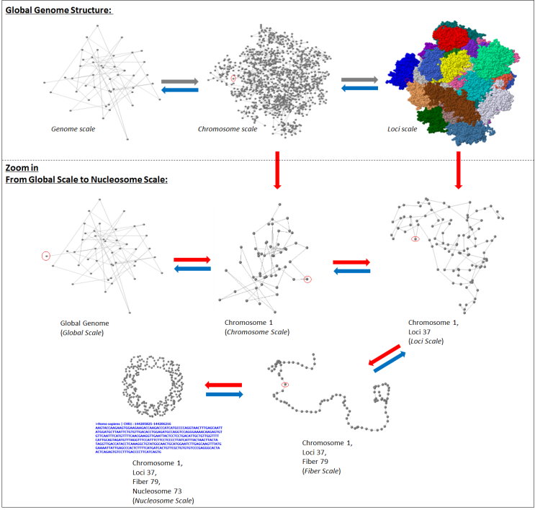
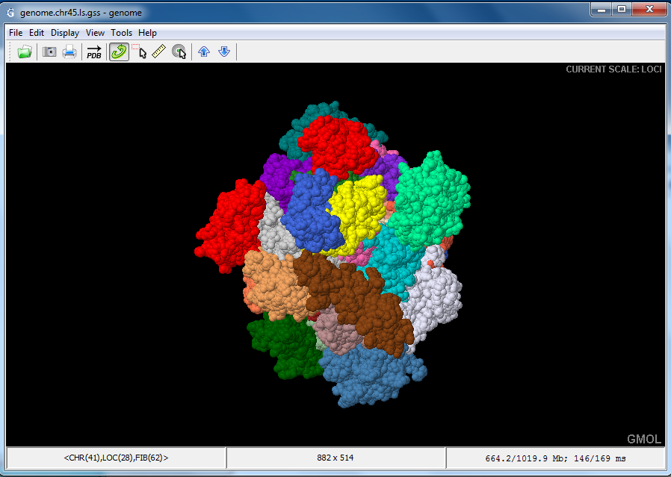
I. GMOL
Multi-scale
Genome
Visualization
&
Omics Data
Integration
Nowotny et al., 2016
http://sourceforge.net/projects/gmol/

Slide 40
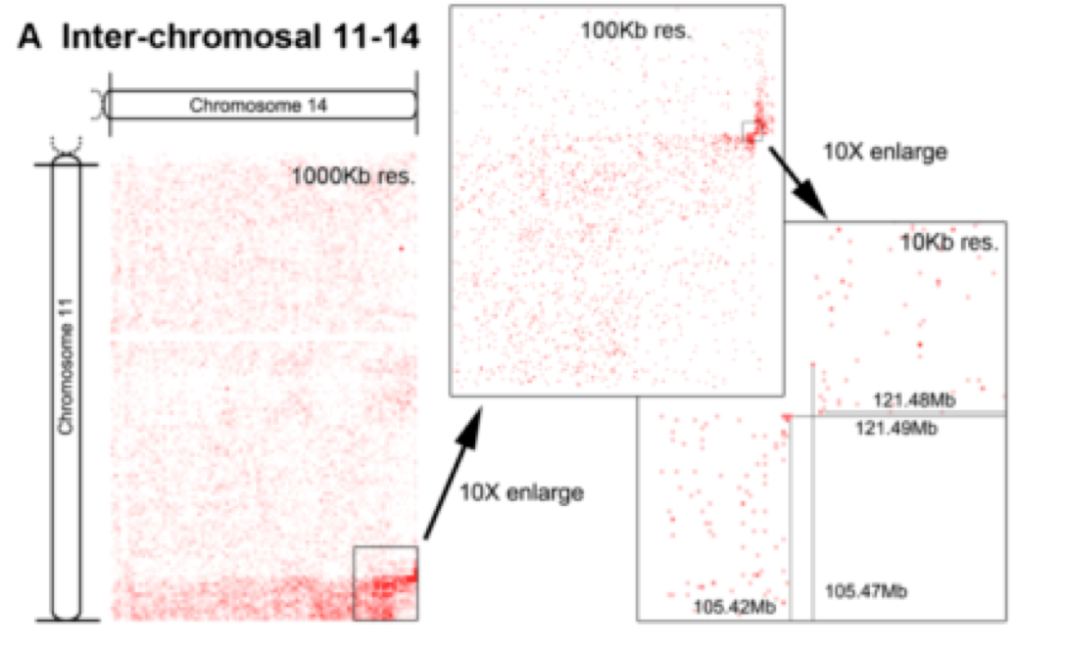
II. Chromosome Translocation (ALL B-Cell)
Taylor et al., 2013

Slide 41
Cancer Causing Chromosome Translocation
breakpoint
Confirmed by oligonucleotide tiling array and PCR
Involving IGH@ (heavy chain of antibody immunoglobulin) and miR125b1 (a tumor suppressor RNA gene)
3D model of translocated chromosomes
Kristen et al, 2013

Slide 42

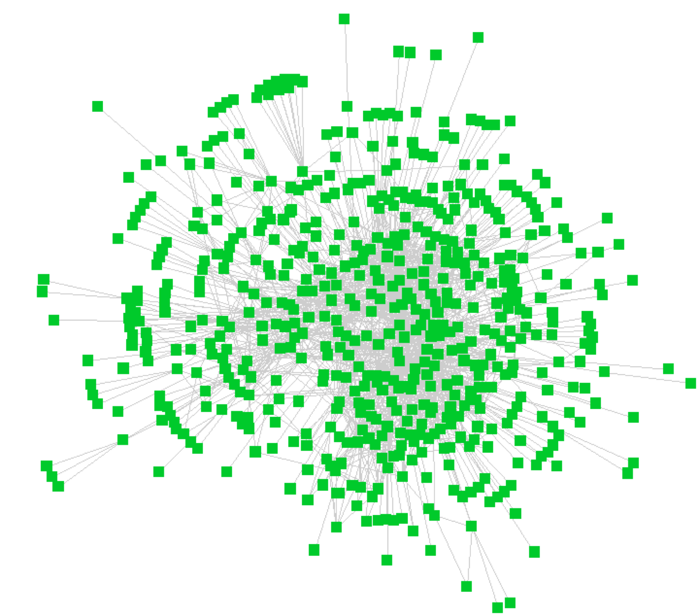
III. Gene, Transcription Factor Binding Site, & Enhancer Interaction Network
Long-range regulatory interactions among
gene promoters, enhancers, insulators

Slide 43
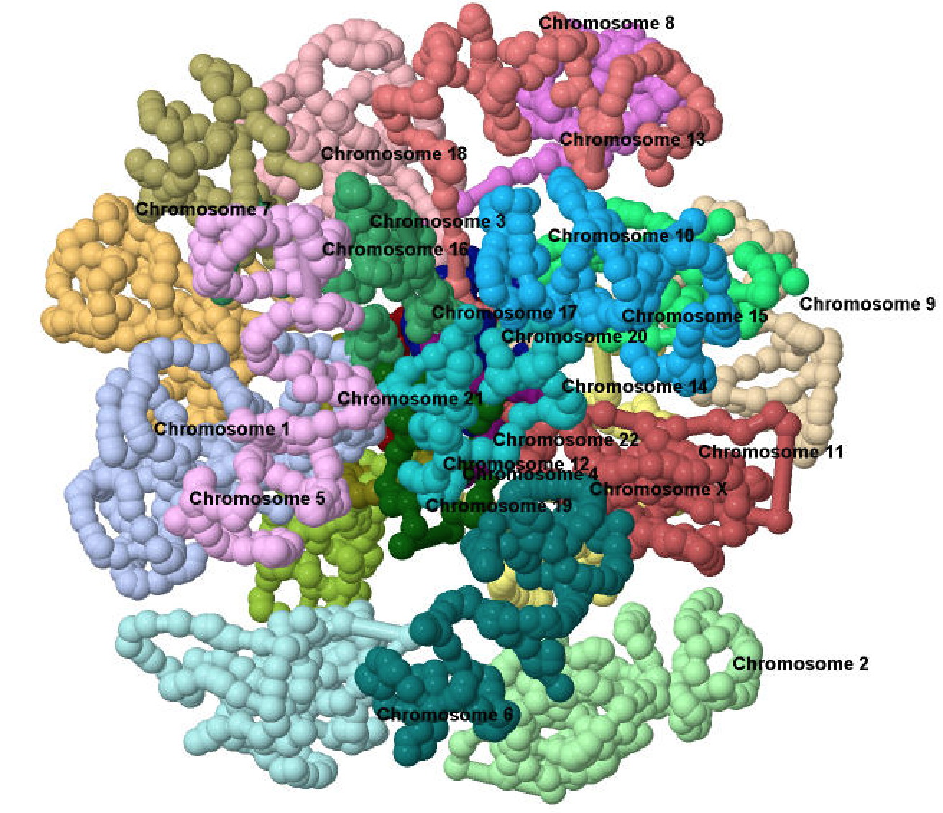
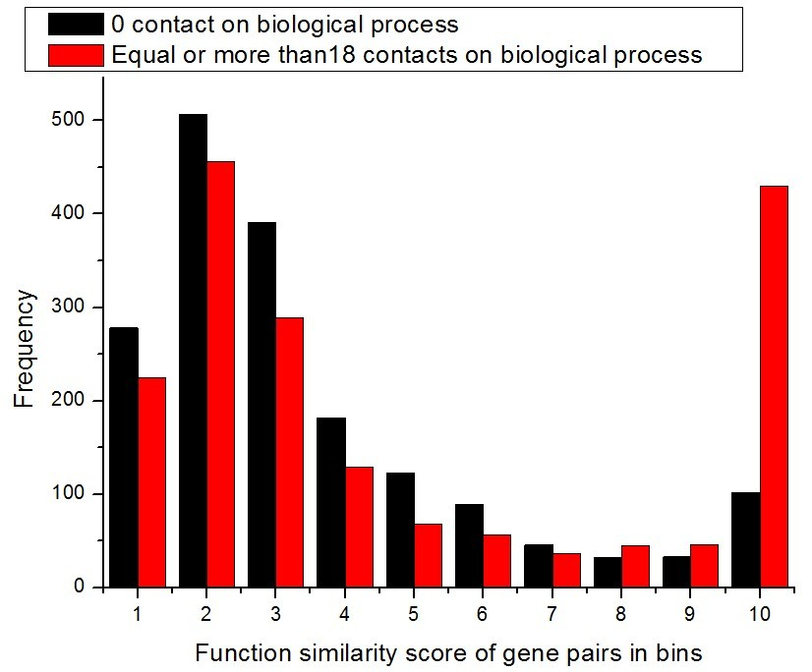
IV. Spatial Proximity Correlates with Gene Function Similarity
Gene A
Gene B
3D Genome
Cao et al., BMC Genomics, 2016

Slide 44
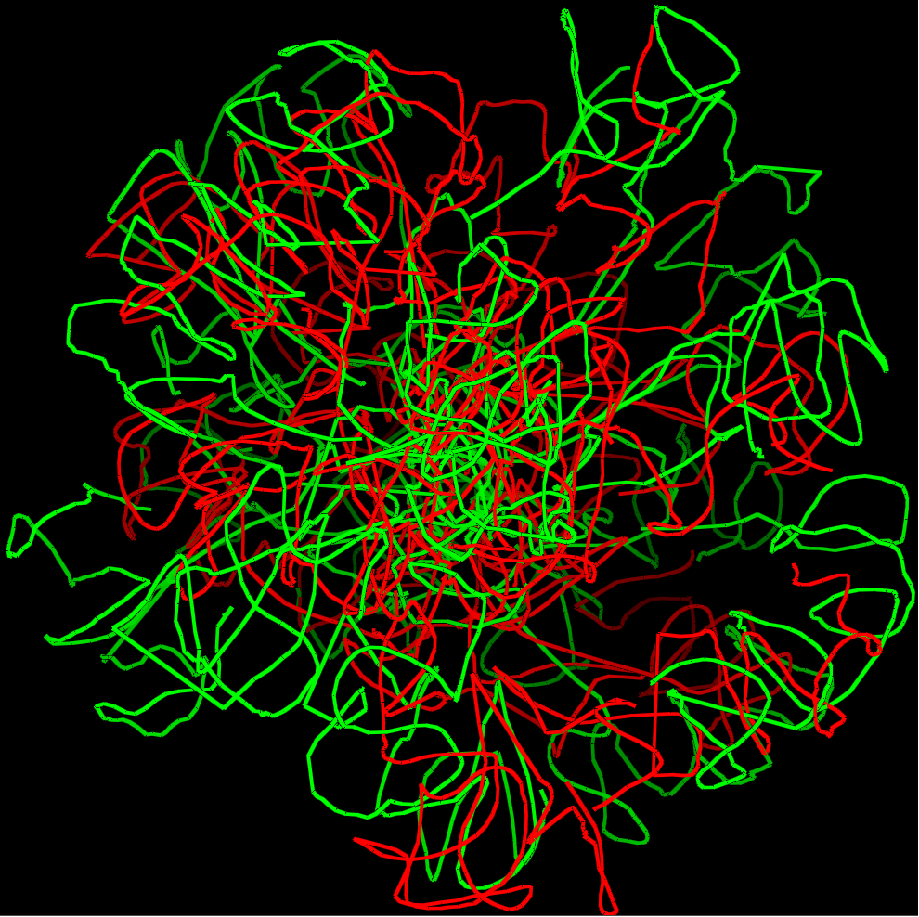
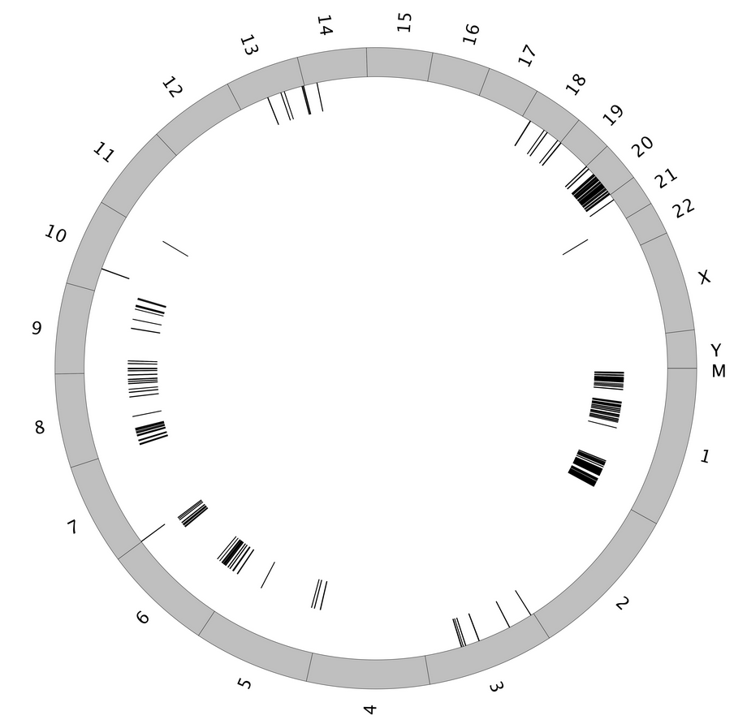
V. Genome Structural Variability and Differential Methylation in Cancers
Normal B-cell (GM06990) vs. primary tumor B-cells
Structurally dissimilar regions related to blood cancers (e.g. Chr. 20)
Correlation with H3K9me3 histone modification mark
Correlation with DNA hypersensitive sites
Collaboration with M. Dozmorov

Slide 45
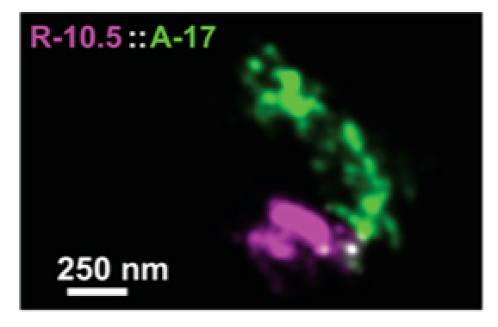
VI. 3D Volumes of TADs in Different Cell Types
Two cell types: mouse bone marrow and fetal liver hematopoetic stem cells
Billions of Hi-C reads
Build high-resolution models for TADs in two cell types (e.g. 5KB)
Compare the volumes of TADs in two cell types and link them to expression and methylation
Boettiger et al., 2016
Collaboration with Dr. Kai Tan at U. Penn.

Slide 46
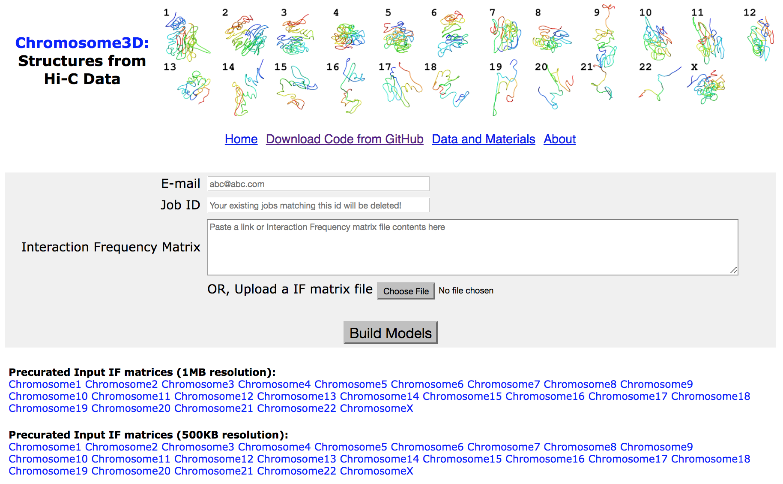
Open Source Bioinformatics Tools
LorDG: https://github.com/BDM-Lab/LorDG
MOGEN: https://github.com/BDM-Lab/MOGEN
Chromosome3D: https://github.com/multicom-toolbox/Chromosome3D
Gen3D: https://sourceforge.net/projects/gen3d/
GMOL: https://sourceforge.net/projects/gmol/

Slide 47

Acknowledgements
Students: Tuan Trieu, Renzhi Cao, Jackson Nototny, Lingfei Xu, Sharif Ahmed, Avery Wells, Zheng Wang, Oluwatosin Oluwadare
Collaborators: Kai Tan, Feng Yue, Mikhail Dozmorov, Aaron Briley, Charles Caldwell, Kristen Taylor

