Slide 1

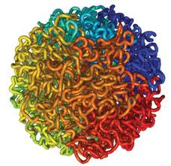

3D Genome Modeling by Lorentzian Function
Jianlin Cheng
Electrical Engineering and Computer Science Department
University of Missouri, Columbia, USA
ACM-BCB 2017, Boston

Slide 2
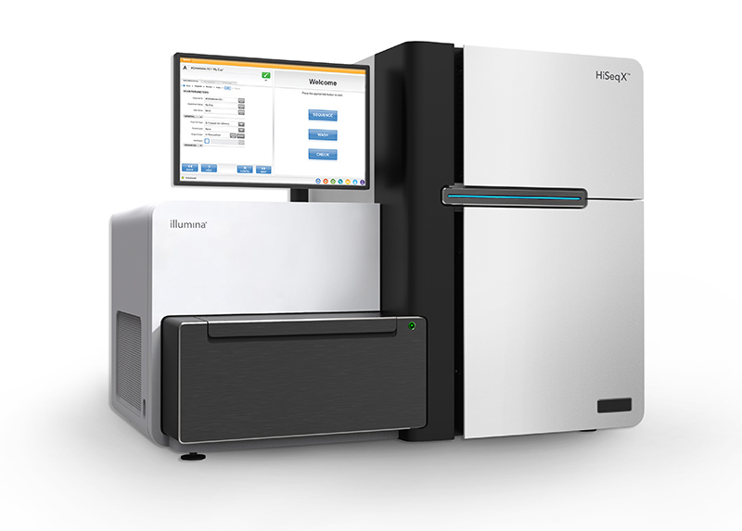
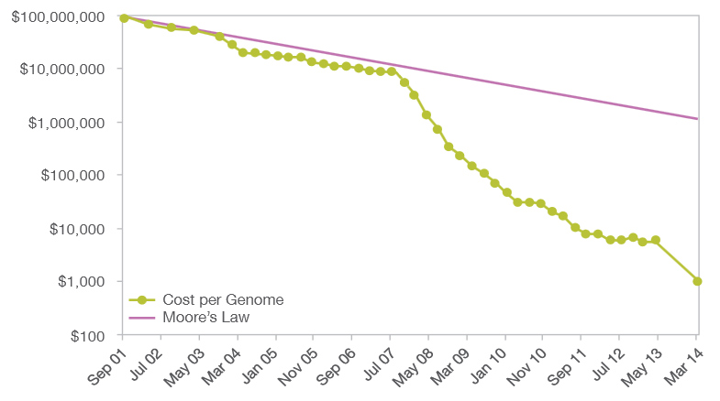
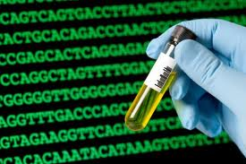
$1000 Personal Genome!
http://www.futuretimeline.net/blog/2014/01/16.htm#.U3Vg-FhdWzs

Slide 3
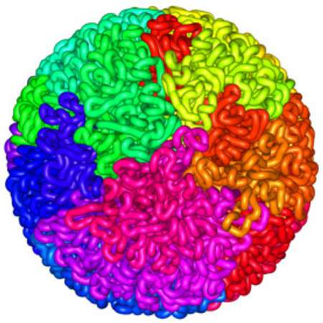
3D Shape of Genome
Liberman-Aiden et al., 2009
Fullwood et al., 2009

Slide 4
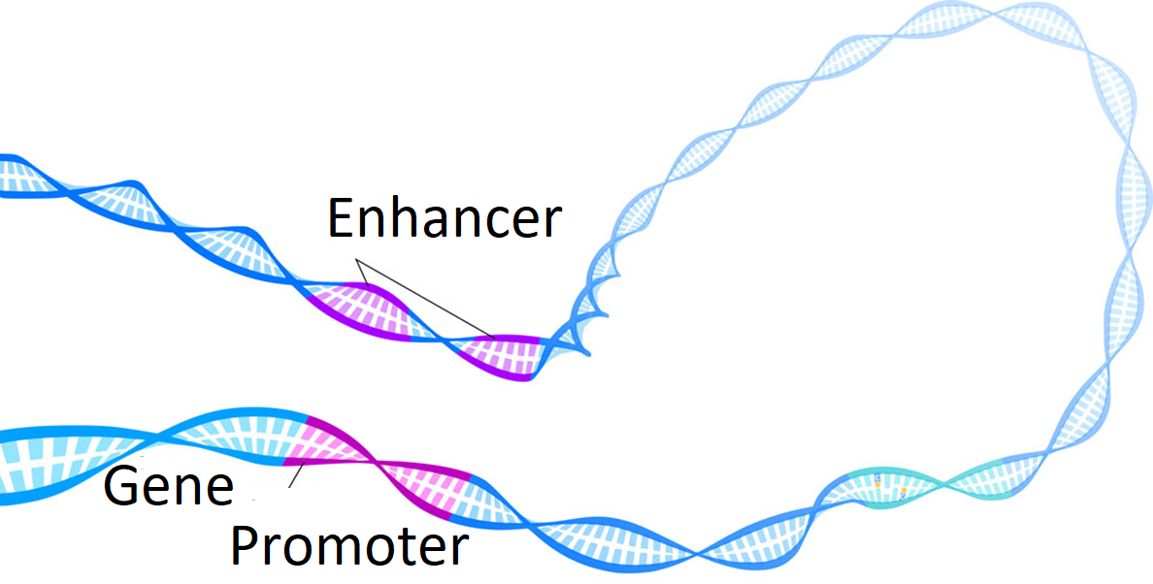
Long-range Gene Regulation
Enhancer
Gene 1
Gene 2

Slide 5
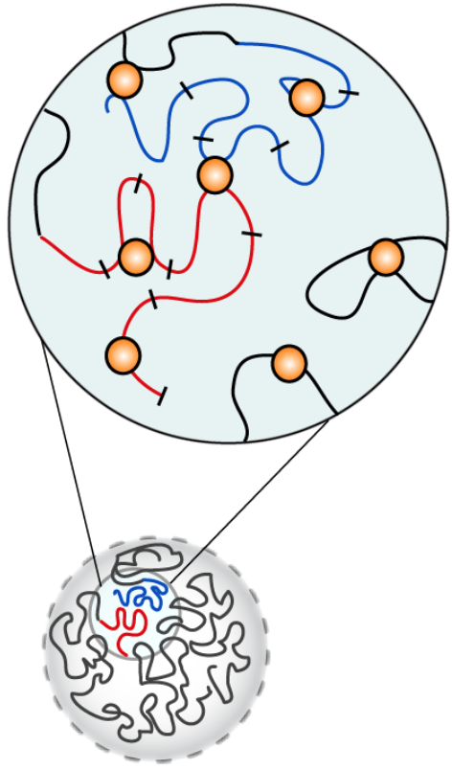
Chromosome Conformation Capturing Techniques
Liberman-Aiden et al, Science, 2009

Slide 6
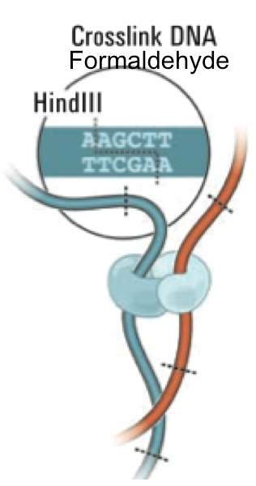
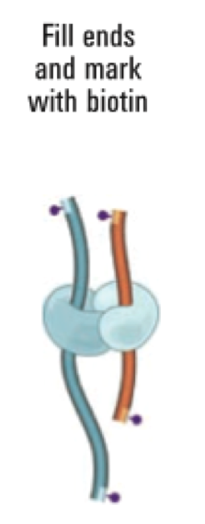
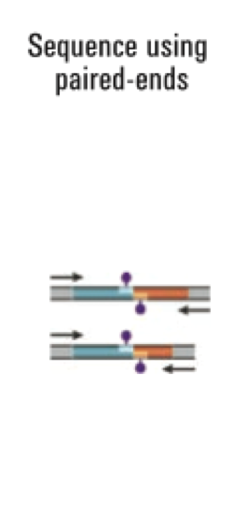
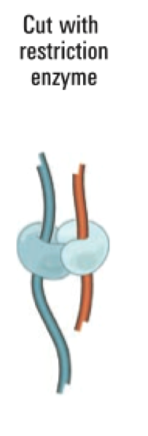
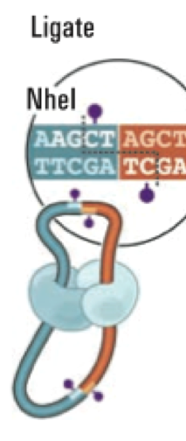
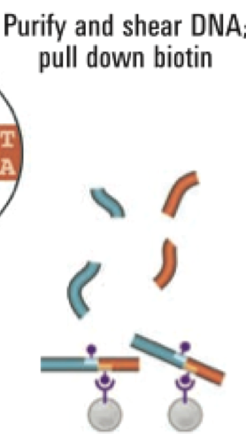
Hi-C Technique
Liberman-Aiden et al., 2009

Slide 7

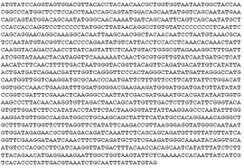
Genomic Spatial Interaction (Contact) Data
i
Map pair-end reads to the genome sequence
j
1 2 …… n
1
2
.
.
.
n
40 |  |  |  | 1
 | 7 |  | 8
 |  | 10
 | 8 |  | 15
1 |  |  |  | 6
C[i,j] = Interaction Frequency
Intra- / inter-chromosome contact map
Wang et al., 2013

Slide 8
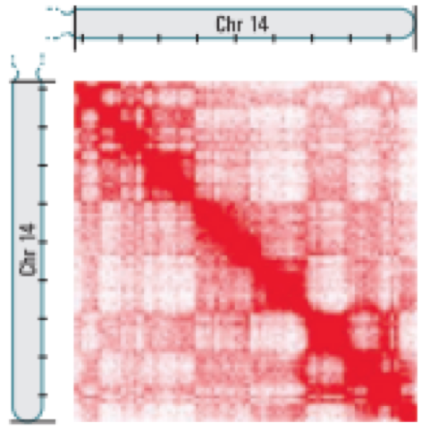
Chromosomal Contact Map
Chr. 14
Chr. 11
Intra-Chromosome
1M Resolution
B-Cell
Inter-Chromosome
1M Resolution
B-Cell
Wang et al., 2013

Slide 9
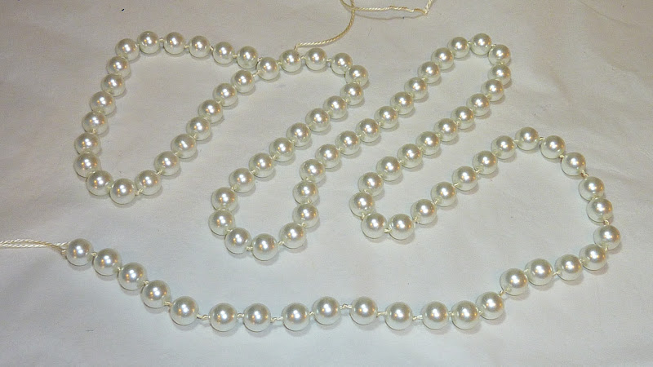

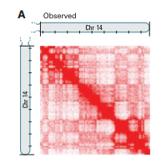
3D Genome Structure Modeling
Trieu , Cheng, 2014; Trieu, Cheng, 2017
Notes:
We consider each region of genome as a bead and the entire genome is a string of beads. Then we place those beads in 3D such that the distances between beads are consistent with the 2D contact map.

Slide 10
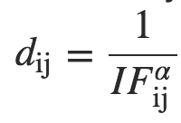


The Data Driven Optimization Approach
A chromosome is represented as a string of beads, each of which denotes a DNA fragment (resolution: e.g. 10KB, 1MB)
Convert observed interaction frequencies into distance map
Objective: Adjust positions (x,y,z coordinates) of beads in 3D space to satisfy converted (“wish”) distances as well as possible
Challenges: approximated distances, noise, conflicts
$$i$$
Conversion
$$j$$
Hi-C contact map
Approximated spatial distance matrix
α: conversion parameter (positive number)
Notes:
Again, the same approach is to convert Hi-C data into a set of constraints. But this time IF is converted into distances with assumption that spatial distances are inversely correlated with interaction frequencies. So, a common function used by other researchers is this function.
The alpha here is unknown and we have to look for it. Then, the objective to place bead in 3D models that satisfy wish distances as much as possible. The challenge of this approach is that wish distances are just approximation and they are conflicting with each other.
This time, I have equality constraints. With similar spirit in my previous method

Slide 11
Some Existing Methods
MCMC5
  Using MCMC to minimize square errors on distances
ChromSDE
  Using semi-definite programming to solve the optimization problem
ShRec3D
  Using multi-dimensional scaling to reconstruct models
PASTIS
  Finding models that maximize the likelihood of the observed IFs according to Poisson distribution

Slide 12
Problem of Traditional Objective Functions
Square Error
Very sensitive to noisy / conflicting distances
Cannot build 3D models of large genomes involving noisy inter-chromosomal contacts

Slide 13
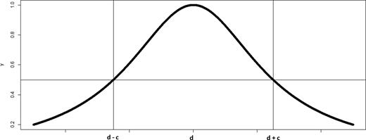
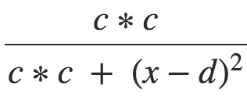
Deriving Soft Constraints by Lorentzian Function
Use Lorentzian function to measure the satisfaction of a distance restraint
[0, 1]
Tolerate noisy restraints and maximize the satisfaction of feasible restraints
Constraint is satisfied
Constraint is “less” satisfied

Slide 14
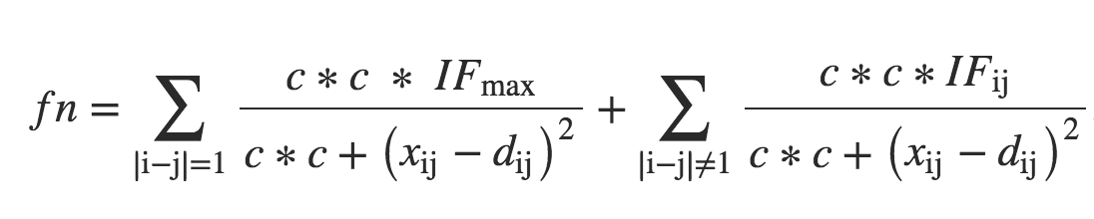
Objective Function
Objective function
  Sum of all distance constraints
  Adjacent beads have maximum weight to enforce their proximity
c is set to average of d_{ij} to control gradient vanishing during optimization

Slide 15
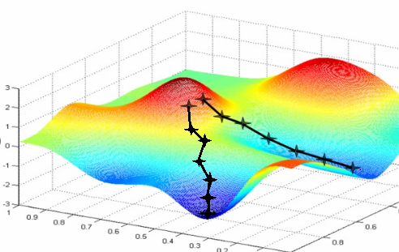
Large-Scale Optimization
Initializing model randomly in a sphere
Gradient ascent to iteratively satisfy hundreds of thousands of distances as much as possible
Adaptive step-size by backtracking line search
α is searched in a reasonable range to maximize correlation between reconstructed distances and converted distances

Slide 16
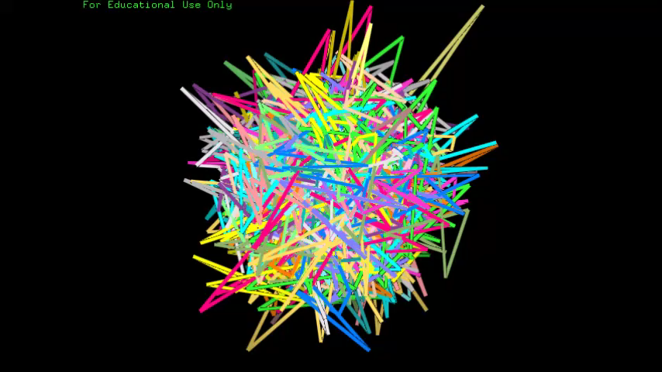

Slide 17
Synthetic Data to Evaluate the Method
An existing 3D chromosome model of yeast (Duan et al. Nature 2010)
Interaction frequencies were simulated using Poisson distribution
Build models from simulated data
α = 1

Slide 18

Searching for $α$

Slide 19
Correlation Between Reconstructed Distances and True Distances
Notes:
PM2 is also named Pastis

Slide 20
Root Mean Square Error Between Reconstructed Distances And True Distances

Slide 21
Real Hi-C Data
GM06990 human cell line (Lieberman-Aiden E. et al. Science 2009)
GM12878 human cell line (Rao S. et al., Cell 2014)

Slide 22
Quality of Chromosome Models

Slide 23
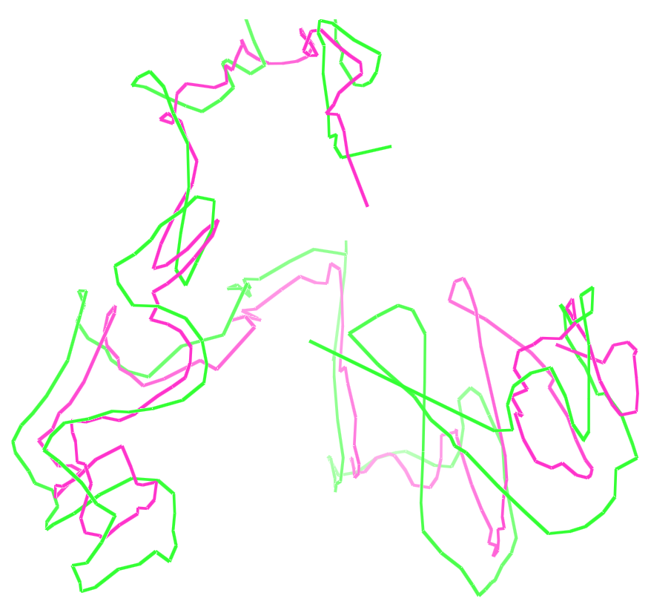
Are Models at Different Resolutions Similar ?
A model at 1MB resolution and a model of Chr. 1 at 500 KB resolution

Slide 24
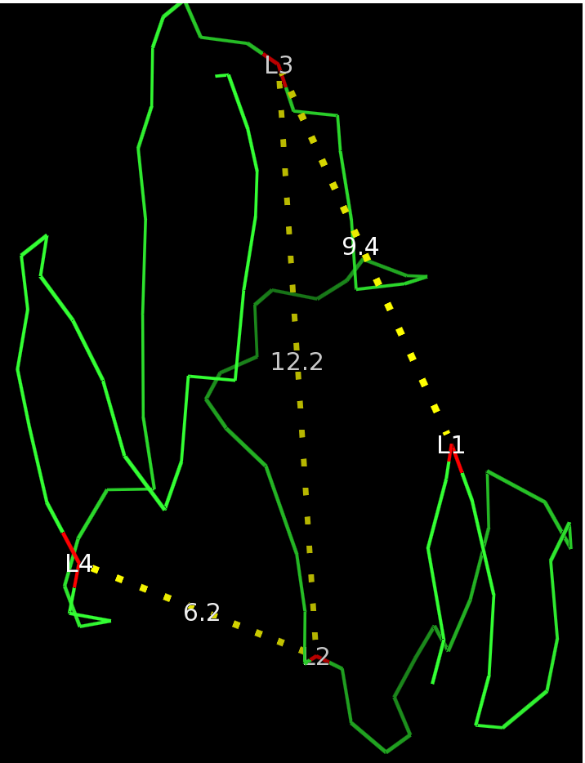
Distance Verification with FISH Data
Distances measured by Fluoresce In-Situ Hybridization (FISH) :
  L1-L3 < L2-L3 though L2 is located between L1-L3 in the 1D sequence
  L2-L4 < L2-L3 though L3 is located between L2-L4 in the 1D sequence
Chr.14 of GM06990, 1MB resolution

Slide 25
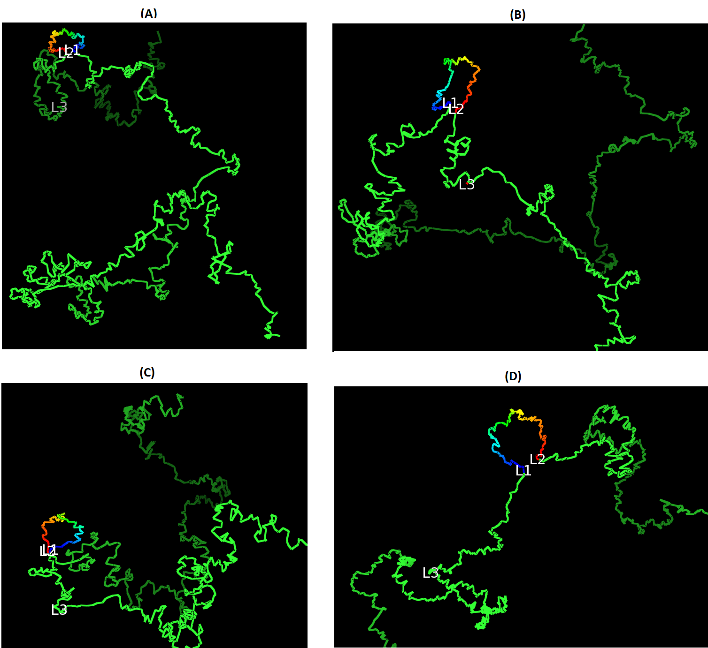
Loop Realization
4 loops were verified by 3D FISH on Chr. 11, 13, 14, 17 of GM12878
Do our reconstructed models have these 4 loops ?
Models at 10kb resolution

Slide 26
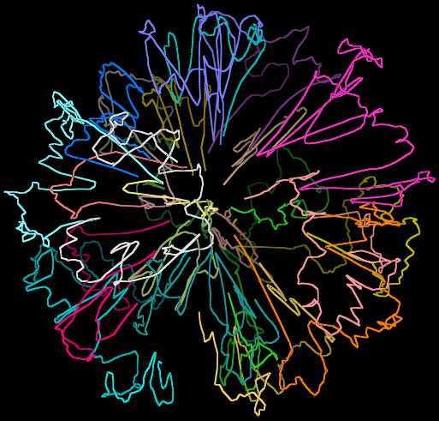
3D Genome Model
Do chromosomes have their own territories rather than intermingling together ?

Slide 27
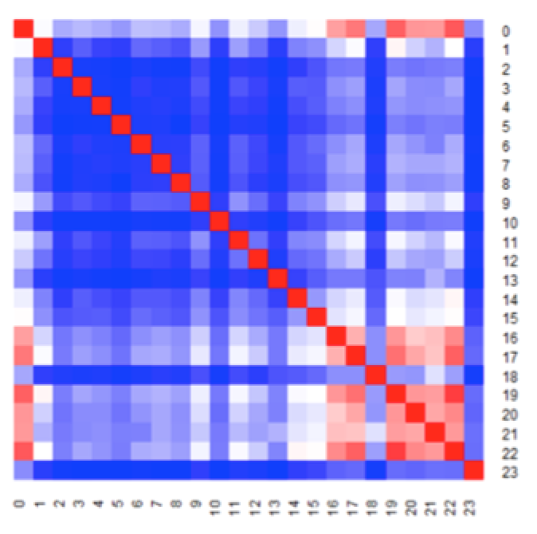
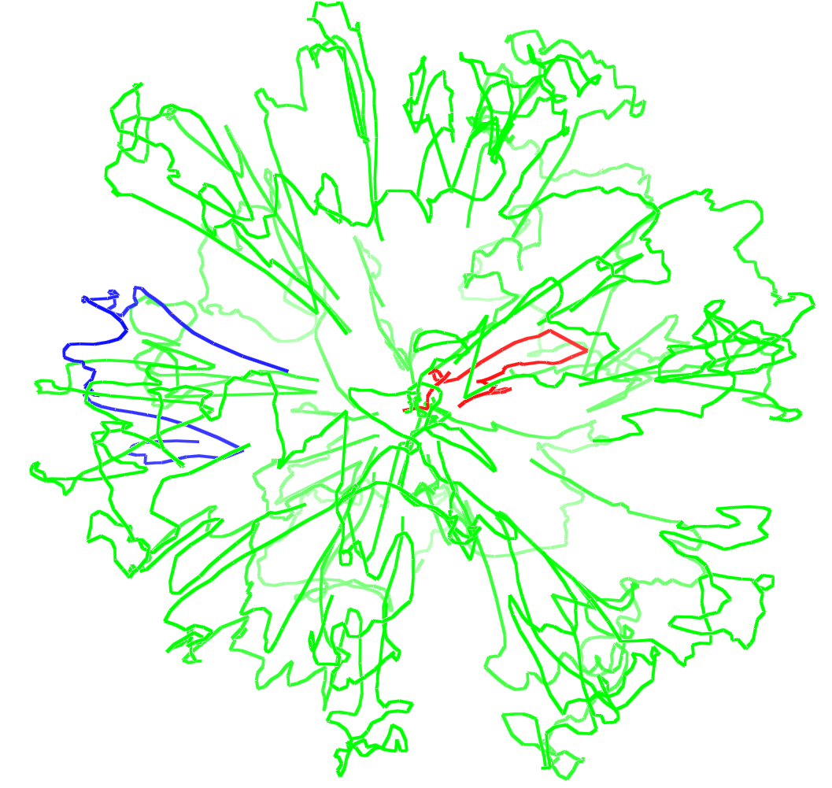
Location of Gene-Rich Small Chromosomes
Does Chr. 18 stay near the periphery ?
Does Chr. 19 lie in the center ?
Does other small chromosomes cluster in the center ?
Distance heat map between centers of mass of chromosomes (0: center of the genome)
Chromosome 18 in blue and Chromosome 19 in red

Slide 28
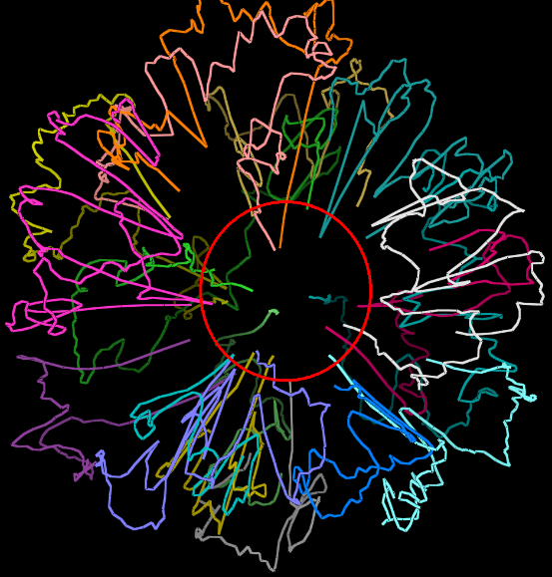
Telomere – Centromere Feature
Telomeres and centromeres of large chromosomes prefer to interact with each other in the center

Slide 29
Summary
A robust 3D genome modeling method that outperforms existing methods
Reconstructing 3D models of chromosomes with known features
Building realistic 3D models of large genomes (e.g. the human genome)
Github: https://github.com/BDM-Lab/LorDG

Slide 30

Acknowledgements
Students: Tuan Trieu, Renzhi Cao, Jackson Nototny, Lingfei Xu, Sharif Ahmed, Avery Wells, Zheng Wang, Oluwatosin Oluwadare
Collaborators: Mikhail Dozmorov, Aaron Briley, Charles Caldwell, Kristen Taylor

