Slide 1
Support Vector Machines
Dr. Jianlin Cheng
Department of Electrical Engineering and Computer Science
University of Missouri, Columbia
Fall, 2019
Slides Adapted from Book and CMU, Stanford Machine Learning Courses

Slide 2
Deterministic Learning Machine
Learning a mapping: x_{i} |→ y_{i}.
The machine is defined by a set of mappings (functions): f(x, a)
f(x,a) are defined by the adjustable parameters a. The machine is assumed to be deterministic.
A particular choice of a generates a “trained” machine (examples?)

Slide 3
Linear Classification Hyperplane
A set of labeled training data {x_{i}, y_{i}}, i = 1, …, l, x_{i} in R^{d}, y_{i} in {-1, 1}.
A linear machine trained on the separable data.
A linear hyperplane f(x) = w.x+b, separates the positive from negative examples, w is normal to the hyperplane.
The points which lie on the hyperplane satisfy w.x + b = 0, positives w.x+b > 0, and negatives w.x+b < 0.

Slide 4
+
w
-
wx + b = 1
wx + b = 0
Origin
wx + b = -1
x_{i} . w + b >= +1 for y_{i} = +1
x_{i} . w + b <= -1, for y_{i} = -1
combined into:
y_{i}(x_{i}.w+b) >= 1
Comments: equivalent to general form y_{i}(x_{i}.w+b) >= c

Slide 5
+
x₁
w
x₂
-
wx + b = 1
wx + b = 0
wx + b = -1
Prove w is normal (perpendicular) to the hyperplane
(x₂ – x₁) . w = x₂.w – x₁.w = -b – (-b) = 0

Slide 6
+
w
|b|
|w|
-
wx + b = 1
wx + b = 0
Origin
wx + b = -1

Slide 7
Distance from origin to wx + b=0 is |b| / |w|
+
x
w
|b|
|w|
-
wx + b = 1
wx + b = 0
Origin
wx + b = -1
Choose a point x on wx+b=0 such that vector (0, x) is perpendicular to wx+b = 0. So x is λw because w is norm of wx+b=0.
So λw.w+b = 0 ➔ λ = -b/ w.w = -b / |w|²
So x = -b / |w|² *w ➔ |x| = |b| / |w|.

Slide 8
Q1: How logistic regression
finds a linear hyperplane?
Is the function found by
logistic regression unique?
1
2
3
Q2: From your intuition,
which one is better?

Slide 9
Margin
M
wx + b = 1
wx + b = 0
wx + b = -1

Slide 10
How to Compute Margin?
A. Moore, 2003

Slide 11
A. Moore, 2003

Slide 12
A. Moore, 2003

Slide 13
x⁺
λw
x⁻
wx+b = +1
wx+b = 0
wx+b = -1
x⁺ = x⁻ + λw
origin

Slide 14
A. Moore, 2003

Slide 15
λ
A. Moore, 2003

Slide 16
λ
λ
λ
A. Moore, 2003

Slide 17
A. Moore, 2003

Slide 18
Constrained Optimization Problem
A. Moore, 2003

Slide 19
A. Moore, 2003

Slide 20
Margin and Support Vectors
H1
H
Support vectors,
lying on the
hyperplane
H2
M = 2 / |w|
wx + b = 1
wx + b = 0
wx + b = -1

Slide 21
Relationship with Vapnik Chevonenkis (VC) Dimension Learning Theory

Slide 22
Expectation of Test Error
R(a) is called expected risk / loss, the same as before except
the ½ ratio.
Empirical Risk R_{emp}(a) is defined to be the measured
mean error rate on l training examples.

Slide 23
Vapnik Risk Bound
½|y_{i} – f(X_{i}, a)| is also called the loss. It can only take the values 0 and 1.
Choose η such that 0 <= η <= 1. With probability 1 – η, the following bound holds (Vapnik, 1995)
Where h is a non-negative integer called the Vapnik Chevonenkis
(VC) dimension, and is a measure of the notion of capacity.
The second part of the right is called VC confidence.

Slide 24
Insights about Risk Bound
Independent of p(X,y).
Often not possible to compute the left hand side.
Easily compute right hand side if h is known.
Structural Risk Minimization: Given sufficiently small η, taking the machine which minimizes the right hand side and gives the lowest upper bound on the actual risk.
Question: how does the bound change according to η?

Slide 25
VC Dimension
VC dimension is a property of a set of functions { f(a) }. Here we consider functions that correspond to two-class pattern recognition case, so that f(X,a) {-1, +1}.
If a given set of l points can be labeled in all possible 2^{l} ways, and for each labeling, a member of set {f(a)} can be found to correctly assign those labels, we say that set of points is shattered by that set of functions.

Slide 26
VC Dimension
VC dimension for a set of functions {f(a)} is defined as the maximum number of training points that can be shattered by {f(a)}.
If the VC dimension is h, then there exists at least one set of h points that can be shattered. But not necessary for every set of h points.

Slide 27
A linear function has VC dimension 3
8 possible labeling of 3 points can be separated by lines.

Slide 28
Simply can not separate the labeling of these four points
using a line. So the VC dimension of a line is 3.

Slide 29
VC Dimension and the Number of Parameters
Intuitively, more parameters ➔ higher VC dimension?
However, 1 parameter function can have infinite VC dimension. (see Burge’s tutorial)
If sin(ax) > 0, f(x,a) = 1, -1 otherwise

Slide 30
VC Confidence and VC Dimension h
VC confidence is monotonic in h. (here l = 10,000, η = 0.05 (95%))

Slide 31
Structural Risk Minimization
Given some selection of learning machines whose empirical
risk is zero, one wants to choose that learning machine
whose associated set of functions has minimal VC dimension.
This is called Occam’s Razor: "All things being equal, the simplest solution tends to be the best one."

Slide 32
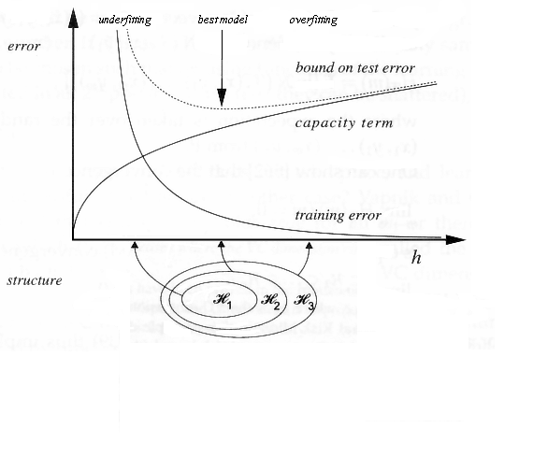
http://www.svms.org/srm/

Slide 33
Comments
The risk bound equation gives a probabilistic upper bound on the actual risk. This does not prevent a particular machine with the same value for empirical risk, and whose function set has higher VC dimension from having better performance.
For higher h value, the bound is guaranteed not tight.
h/l > 0.37, VC confidence exceeds unity.

Slide 34
Example
What is the VC dimension of one-nearest neighbor method?
Nearest neighbor classifier can still perform well.
For any classifier with an infinite VC dimension, the bound is not even valid.

Slide 35
Structure Risk Minimization for SVM
Margin (M) is a measure of capacity / complexity of a linear support vector machine
The objective is to find a linear hyperplane with maximum margin
Maximum margin classifier

Slide 36
Maximum Margin Classifier

Slide 37
Support Vector Machines Optimization

Slide 38
Lagrange Optimization
An mathematical optimization technique named after Joseph Louis Lagrange
A method for finding local minima of a function of several variables subject to one or more constraints
The method reduces a problem in n variables with k constraints to a solvable problem in n+k variables with no constraints.
The method introduces a new unknown scalar variable, the Lagrange multiplier, for each constraint and forms a linear combination involving the multipliers as coefficients.
http://en.wikipedia.org/wiki/Lagrange_multipliers

Slide 39
Langrangian Duality

Slide 40
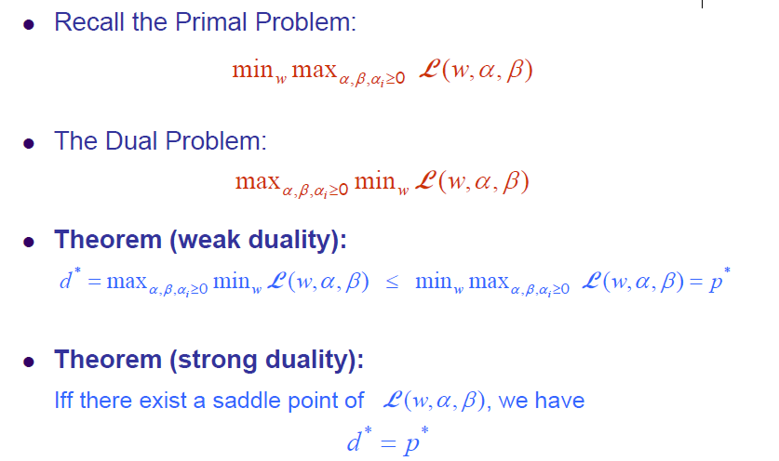
Lagrangian Duality

Slide 41
Primal and Dual Problems
Primal
f(w*)
Dual

Slide 42
KKT Condition

Slide 43
Solve Maximum Margin Classifier

Slide 44
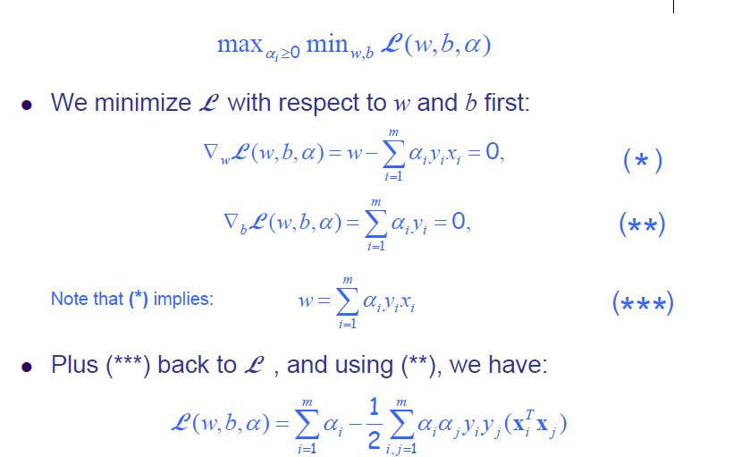
The Dual Problem

Slide 45
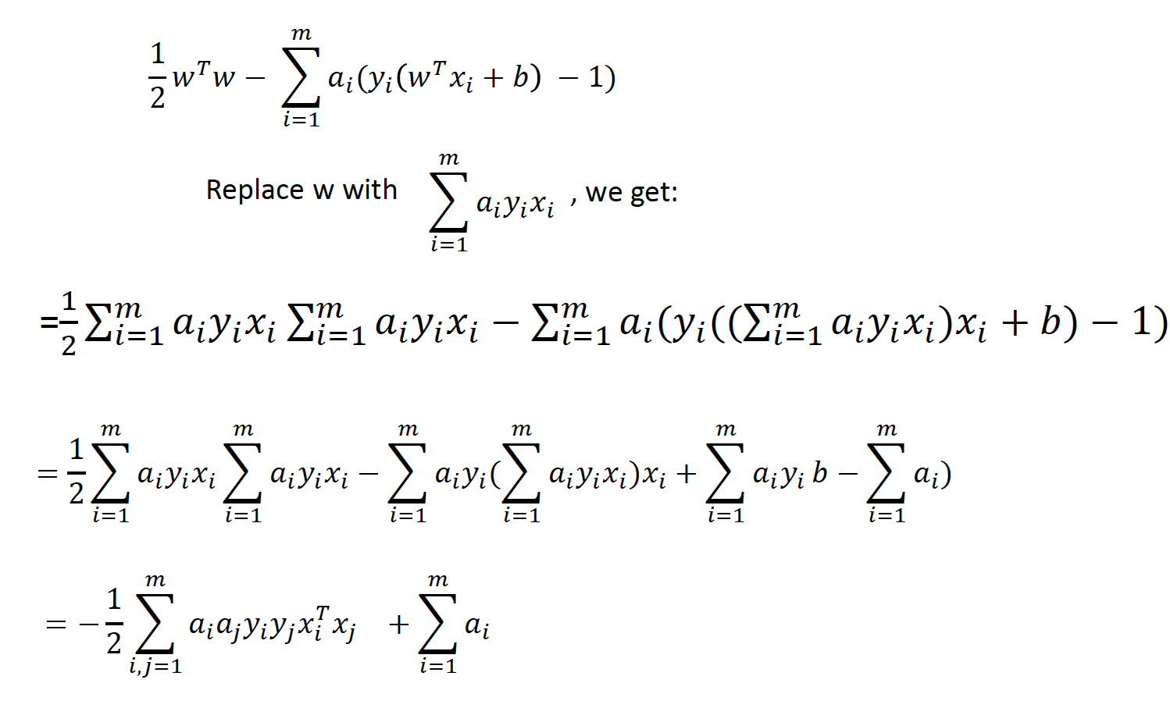
Proof
(

Slide 46
The Dual Problem

Slide 47
Support Vectors

Slide 48
Support Vector Machines
Question: how to get b?

Slide 49
How to Determine w and b
Use quadratic programming to solve a_{i} and compute w is trivial. (use KKT condition (1))
How to compute b?
Use KKT condition (5), for any support vector (point a_{i} > 0), y_{i}(w.x_{i}+b)-1 = 0.
We compute b in terms of a support vector. Better: we computer b in terms of all support vectors and take the average.

Slide 50
Interpretation of Support Vector Machines

Slide 51
Non-Separable Case
+
-
Can’t satisfy the constraints y_{i}(wx_{i}+b) >=1 for
some data points? What can we do?

Slide 52
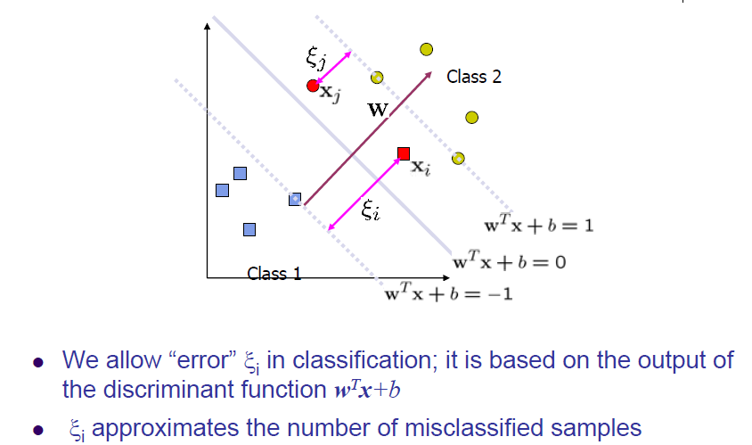
Non-Linearly Separable Problem

Slide 53
Relax Constraints – Soft Margin
Introduce positive slack variables ξ_{i}, i = 1, …, l to relax constraints. (ξ_{i} >= 0)
New constraints:
x_{i}.w + b >= +1 - ξ_{i} for y_{i} = +1
x_{i}.w + b <= -1 + ξ_{i} for y_{i} = -1
Or y_{i}(wx_{i} +b) >= 1- ξ_{i}
ξ_{i} >= 0
For an classification error to happen, the corresponding ξ_{i} must exceed unity, so Σ ξ_{i} is an upper bound on the number of training errors.

Slide 54
Soft Margin Hyperplane

Slide 55
Primal Optimization
u_{i} is the Lagrange multipliers introduced to enforce
Non-negativity of ξ_{i}

Slide 56
KKT Conditions
Max Welling, 2005

Slide 57
Proof of Soft Margin Optimization

Slide 58
The Optimization Problem

Slide 59
Values of Multipliers
+
a_{i} = C, ξ_{i} > 0, u_{i} = 0
a_{i} < C, ξ_{i} = 0, u_{i} > 0
a_{i} = 0, ξ_{i} = 0, u_{i} > 0
-

Slide 60
Solution of w and b
Use complementary slackness to compute b. Choose
a support vector (0 < a_{i} < C ) to compute b, where
ξ_{i} = 0. ξ_{i} = 0 is derived by combining equations 3 and 9.

Slide 61
New Objective Function
Minimize |w|²/2 + C(Σξ_{i})^{k}.
C is parameter to be chosen by the user, a larger C corresponding to assigning a higher penalty to errors.
This is a convex programming problem for any positive integer k.

Slide 62
SVM Demo
https://www.youtube.com/watch?v=bqwAlpumoPM
http://cs.stanford.edu/people/karpathy/svmjs/demo/

