Slide 1
Boosting
Dr. Jianlin Cheng
Department of Electrical Engineering and Computer Science
University of Missouri, Columbia
Fall, 2019
Slides Adapted from Book and CMU, Stanford Machine Learning Courses

Slide 11
Decision Stump
Source: Wikipedia

Slide 12
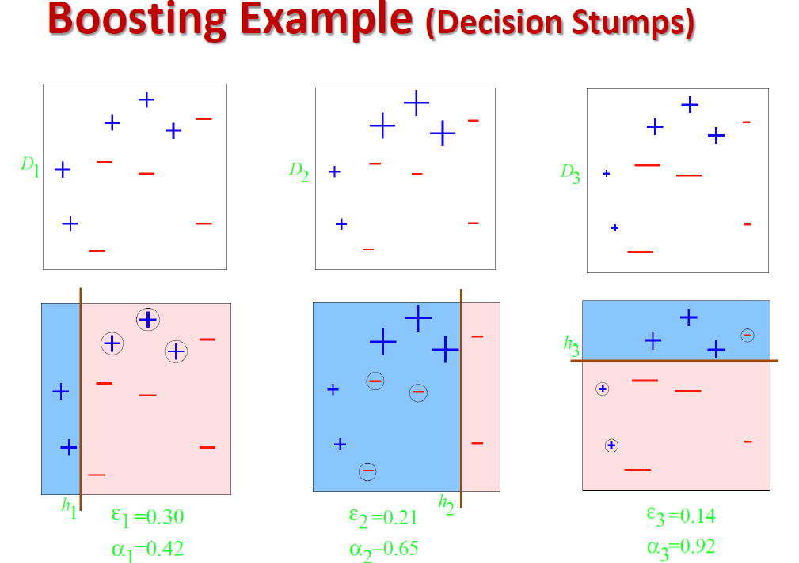

Slide 23
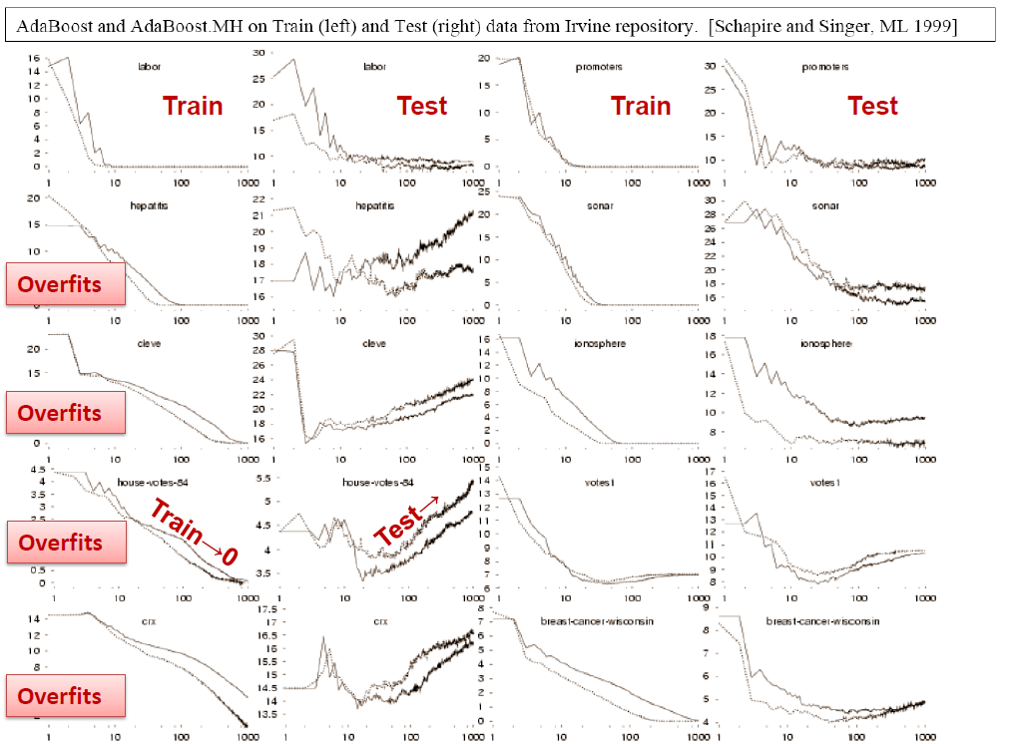

Slide 24
-
Y_{i} = 1 or -1

Slide 27
-

