Slide 1
2D and 3D Genome Structure Modeling
Jianlin Cheng, PhD
Associate Professor
Computer Science Department
Informatics Institute
University of Missouri, Columbia
2013

Slide 2
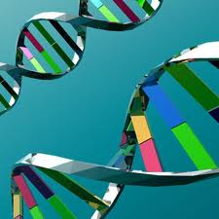
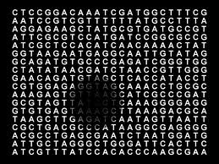
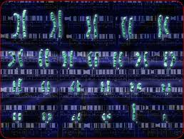
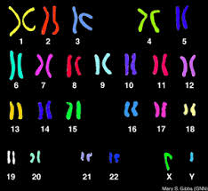
Genome – Code of Life

Slide 3
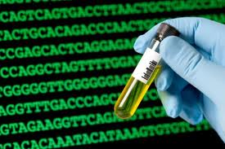
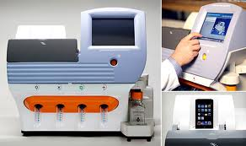
Genome Sequencing (1D)

Slide 4

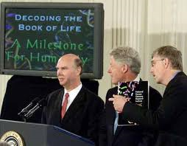
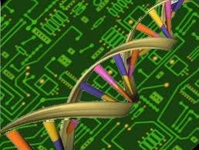

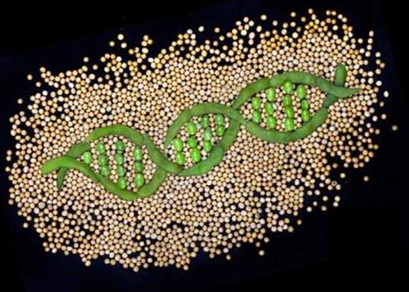
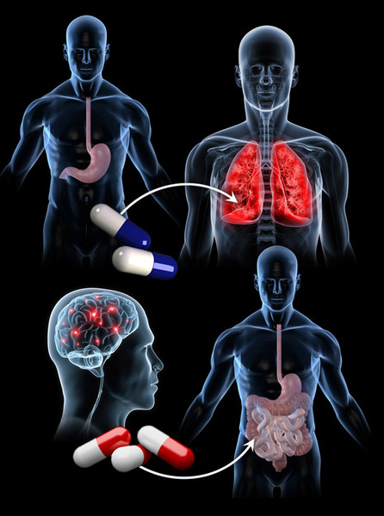
The Genomic Era
Collins, Venter, Human Genome, 2000
Personal Genome

Slide 5
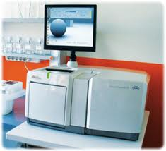
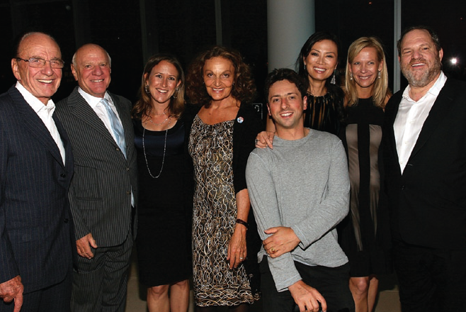

Sequencing Revolution

Slide 6
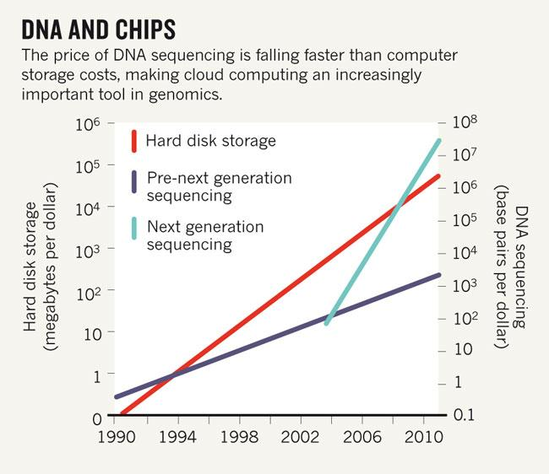
$1000 Personal Genome in 2010s

Slide 7
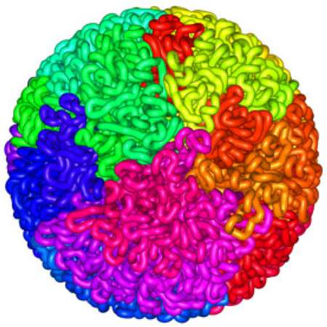
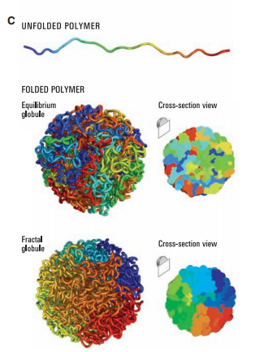
3D
Shape
http://images.google.edu

Slide 8
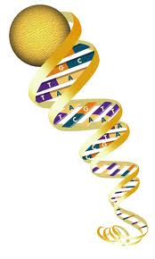
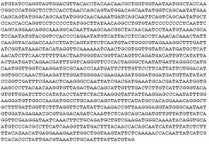

Genome
>95% non-coding
regions of a genome
are not junk!!

Slide 9
Genome Conformation
Liberman-Aiden et al., 2009

Slide 10
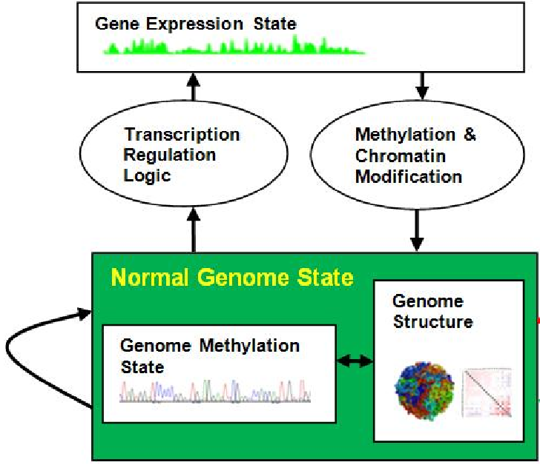
3D Genome Structure is Important
Spatial gene regulation
Transcription efficiency
Genome interpretation
Function implication (ENCODE)
Disease diagnosis & treatments
Drug design

Slide 11
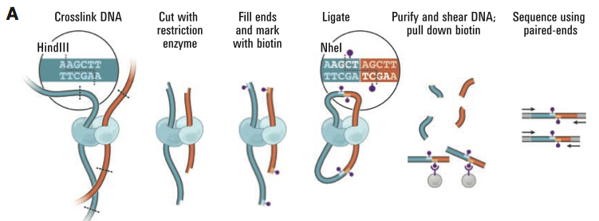
Chromosome Conformation Capturing (Hi-C)
Liberman-Aiden et al., 2009

Slide 12
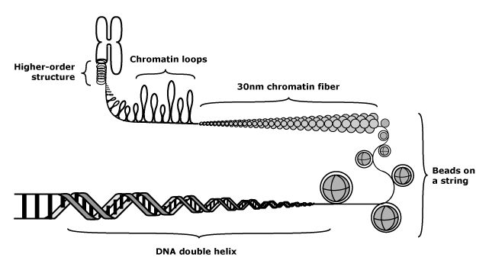
Multi-Level Chromosome Structure
http://missinglink.ucsf.edu/lm/genes_and_genomes/chromatin.html
DNA is further packaged. Nucleosomes are arranged together into a fiber approximately 30 nanometers in diameter. The precise structure of the chromatin fiber is not known. Chromatin fiber is further organized into chromatin loops, and chromatin loops are further organized into higher-order structures. It has been suggested that packaging plays a role in gene expression (gene expression may require associated DNA to open up and acquire an unpackaged conformation). The fully condensed chromosome structure is only seen during mitosis.

Slide 13
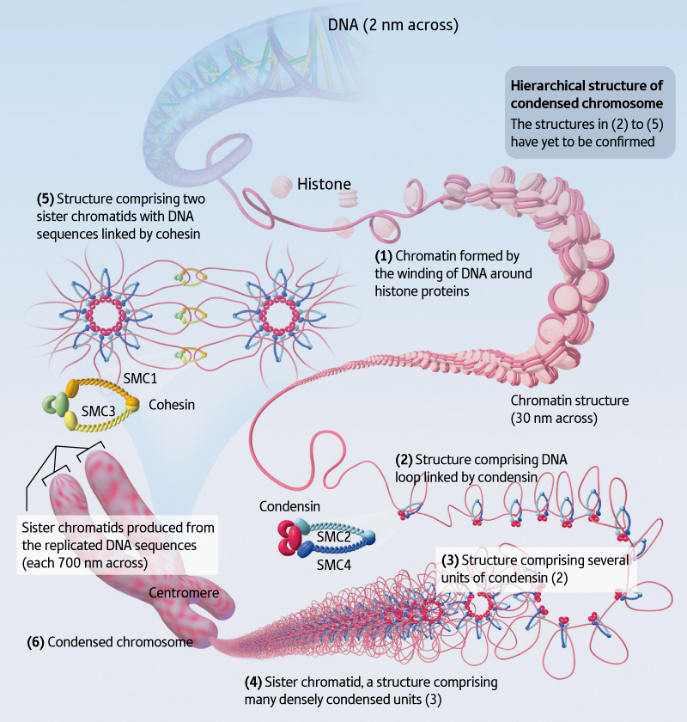
Model 1 (Riken)
The DNA is a remarkable molecule in many ways. It encodes our entire genome, and if stretched out in a thin thread would measure 1.8 m in length.
Globular
Structure
http://www.rikenresearch.riken.jp/eng/frontline/6485

Slide 14
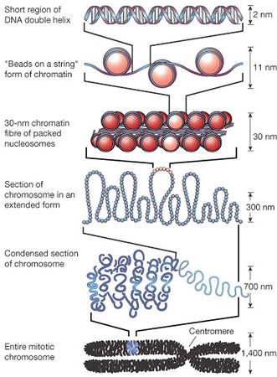
Size of Elements
NM: 10⁻⁹ meter
A complex of DNA and basic proteins (such as histone) in eukaryotic cells that is condensed into chromosomes in mitosis and meiosis. There are two types. Heterochromatic is densely-coiled chromatin that appears as nodules in or along chromosomes and contains relatively few genes. Euchromatic is the less-coiled and genetically active portion of chromatin that is largely composed of genes.
http://www.daviddarling.info/encyclopedia/C/chromatin.html

Slide 15
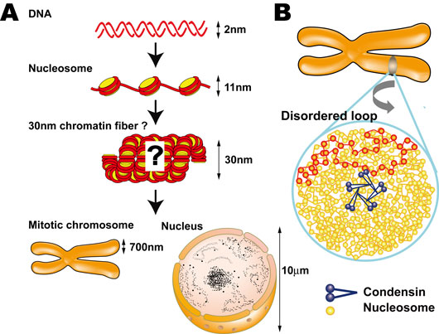
Size of Elements
http://www.nig.ac.jp/section/maeshima/maeshima-e.html

Slide 16
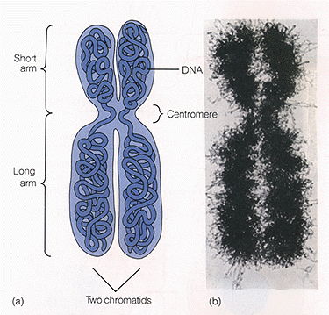
Chromosomes
http://www.copernicusproject.ucr.edu/ssi/HSBiologyResources.htm

Slide 17
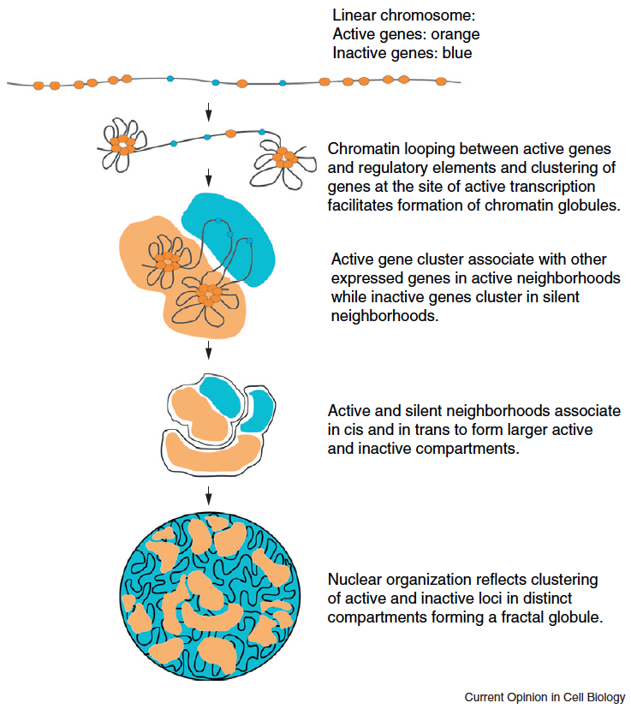
Two Compartments
A. Sanyal et al., Current Opinion in Cell Biology, 2011

Slide 18
Chromosome Conformation Capturing Techniques

Slide 19
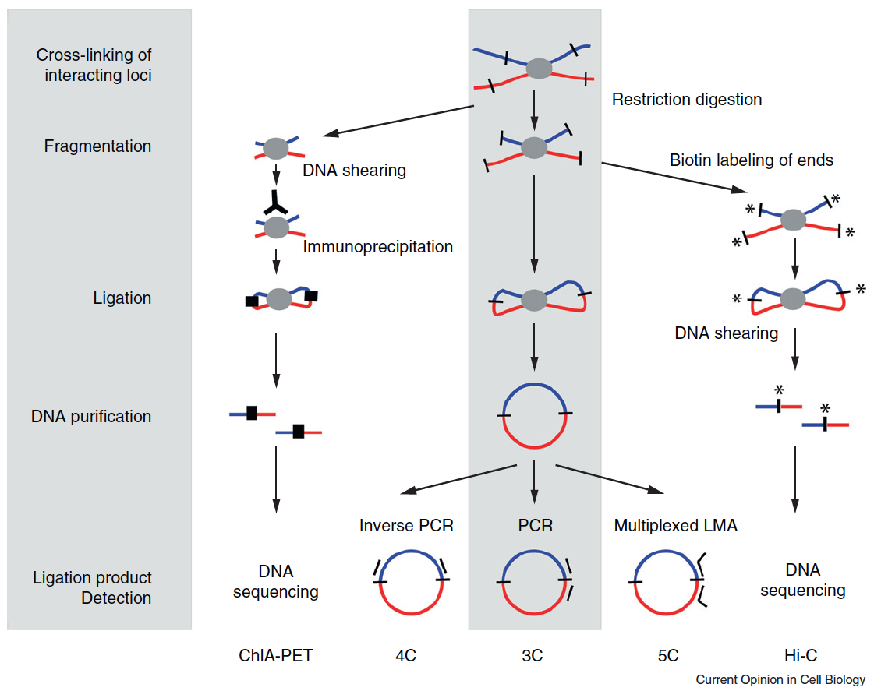
A. Sanyal et al., Current Opinion in Cell Biology, 2011

Slide 20
3C, 4C, 5C, Hi-C Methods
All 3C-based methods use the same principle of chromatin interaction detection (indicated in grey): cross-linking of interacting loci with formaldehyde, followed by DNA fragmentation, DNA ligation, DNA purification and finally ligation product detection.
3C employs restriction enzymes to fragment DNA, and regular PCR to detect ligation products, while 4C employs inverse PCR to detect all fragments ligated to a locus of choice.
5C uses multiplexed ligation mediated amplification (LMA) to detect large numbers of interactions simultaneously using pools of primers for
thousands of loci of interest.
ChIA-PET employs sonication to fragment cross-linked chromatin followed by an immunoprecipitation step before DNA ligation to enrich for loci bound by a protein of interest. Linkers are then ligated (black thick lines) and DNA is analyzed by direct deep sequencing.
Hi-C employs restriction enzymes to fragment chromatin followed by filling in of the staggered ends using biotinylated nucleotides before DNA ligation. DNA is sheared and DNA fragments containing ligation junctions are purified using streptavidin-coated beads. DNA is then directly deep sequenced.

Slide 21
Chromosome Conformation Capturing (Hi-C)

Slide 22
Hi-C Protocol
Cells are crosslinked with formaldehyde
DNA is digested with a restriction enzyme and ligated, resulting enriched with cross-linked elements with a biotin marked at the junction
Shearing DNA and selecting biotin-containing fragments to create a Hi-C library
Sequence the library to create a catalog of interacting fragments

Slide 23
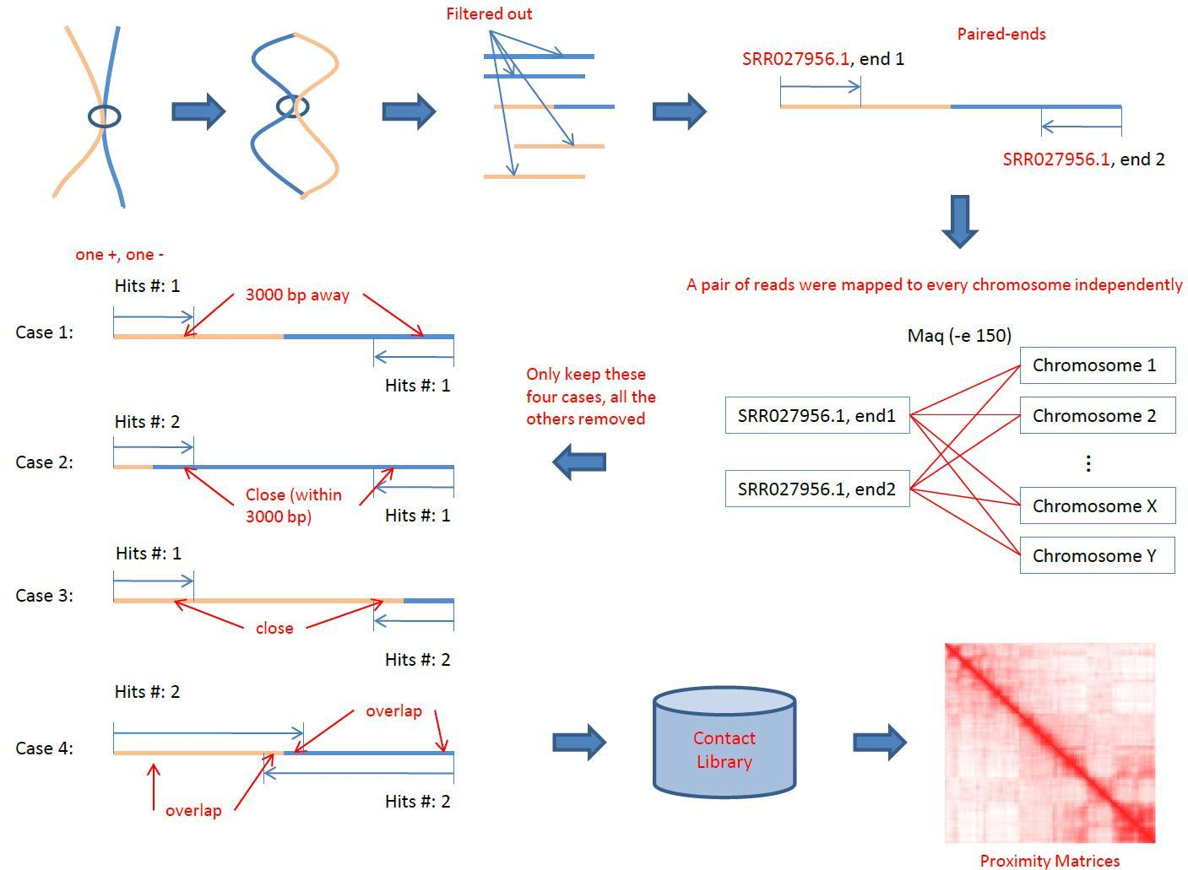
Hi-C Data Analysis Pipeline

Slide 24
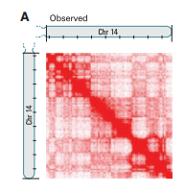
2D Chromosome Contact Map
Chromosome
Conformation
Capturing

Slide 25
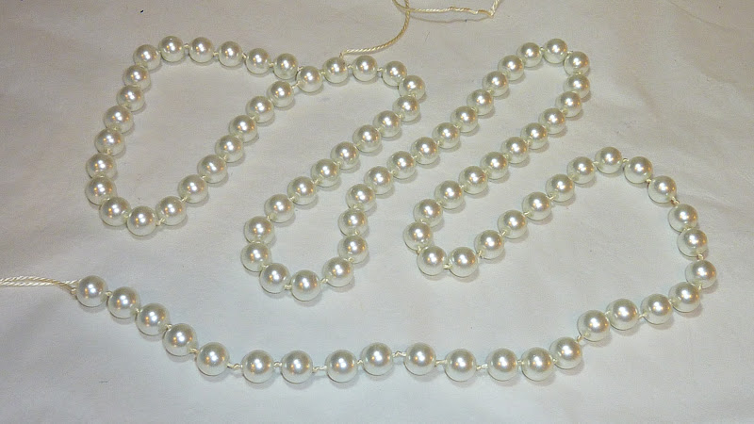
Construct 3D Shape of Genome
Images.google.com

Slide 26
Data Set I
A normal human lymphoblastoid cell line (B-cell)
8.4 million read pairs uniquely mapped to the human genome reference sequence
6.7 million corresponded to long-range contacts between segments > 20 kb apart
Liberman-Aiden et al., 2009

Slide 27
Genome Wide Contact Map
Divide genome into 1-Mb regions (loci)
M_{ij}: number of contacts between loci i and j
The matrix reflects an ensemble average of the interactions in the original sample of cells
Represented as a heat map

Slide 28
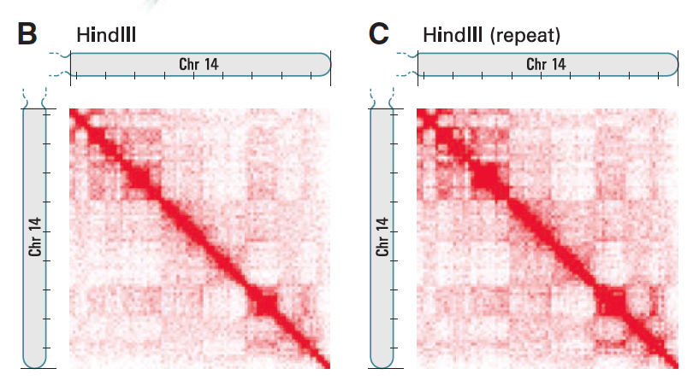
(B) Hi-C produces a genome-wide contact matrix. The submatrix shown here corresponds to intrachromosomal interactions on chromosome 14. (Chromosome 14 is acrocentric; the short arm is not shown.) Each pixel represents all interactions between a 1-Mb locus and another 1-Mb locus; intensity corresponds to the total number of reads (0 to 50). Tick marks appear every 10 Mb. (C ) We compared the original experiment with results from a biological repeat using the same restriction enzyme [(C), range from 0 to 50 reads]. Correlation is 0.99.

Slide 29
Relation between Euclidean Distance and Genomic Distance
Average intrachromosomal contact probability I_{n}(s) for pairs of loci separated by a genomic distance s on chromosome n.
I_{n}(s) decreases monotonically on every chromosome
Even at distances > 200 Mb, I_{n}(s) is always much greater than the average contact probability between different chromosomes

Slide 30
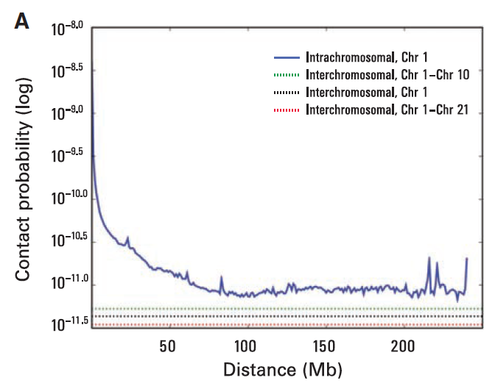
Implication:
Chromosome
territory
Probability of contact decreases as a function of genomic distance on chromosome 1,
eventually reaching a plateau at ~90 Mb (blue). The level of interchromosomal contact (black dashes) differs for different pairs of chromosomes; loci on chromosome 1 are most likely to interact with loci on chromosome 10 (green dashes) and least likely to interact with loci on chromosome 21 (red dashes). Interchromosomal interactions are depleted relative to intrachromosomal interactions.

Slide 31
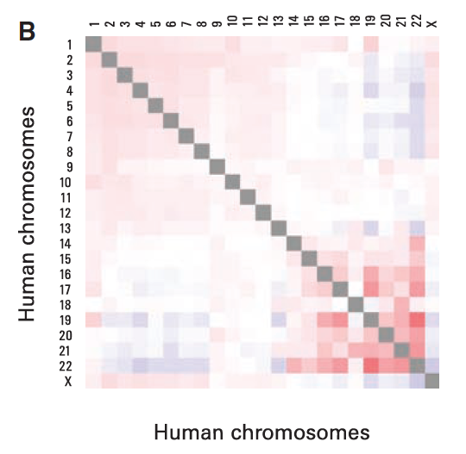
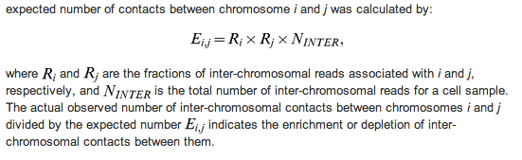
Observed/expected number of interchromosomal contacts
between all pairs of chromosomes. Red indicates enrichment, and blue indicates depletion (range from 0.5 to 2). Small, gene-rich chromosomes tend to interact
more with one another, suggesting that they cluster together in the nucleus.

Slide 32
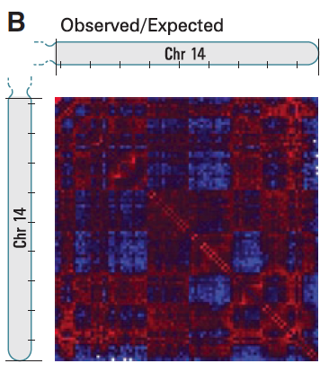
Normalizing Contact Map by Expected Number of Contacts at Genomic Distance
M* by dividing each entry in the contact matrix by the genome-wide average contact probability for loci at that genomic distance. The normalized matrix shows many large blocks of enriched and depleted interactions, generating a plaid pattern

Slide 33
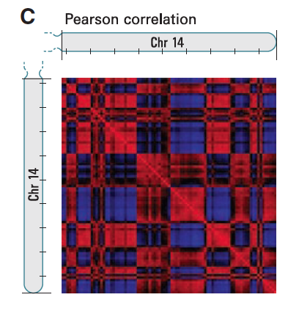
Pearson Correlation Map
If two loci (here 1-Mb regions) are nearby in space, we reasoned that they will share neighbors and have correlated interaction profiles.
This process dramatically sharpened
the plaid pattern (Fig. 3C); 71% of the resulting
matrix entries represent statistically significant
correlations (P ≤ 0.05).
The plaid pattern suggests that each chromosome can be decomposed into two sets of loci (arbitrarily labeled A and B) such that contacts within each set are enriched and contacts between sets are depleted.

Slide 34
Principle Component Analysis
For all but two chromosomes, the first principal component (PC) clearly corresponded to the plaid pattern (positive values defining one set, negative values the other) (fig. S1). The entries of the PC vector reflected the sharp transitions from compartment to compartment observed within the plaid heatmaps.
Moreover, the plaid patterns within each chromosome were consistent across chromosomes: the labels (A and B) could be assigned on each chromosome so that sets on different chromosomes carrying the same label had correlated contact profiles, and those carrying different labels had anticorrelated contact profiles (Fig. 3D). These results imply that the entire genome can be partitioned into two spatial compartments such that greater interaction occurs within each compartment rather than across compartments. The Hi-C data imply that regions tend be closer in space if they belong to the same compartment
(A versus B) than if they do not.

Slide 35
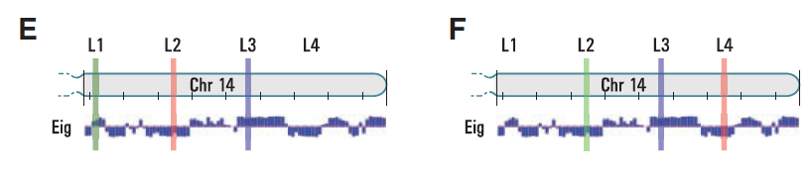
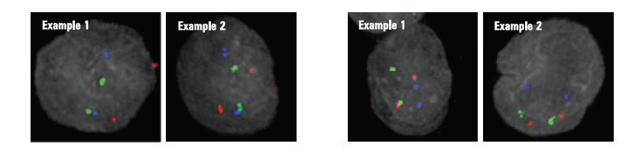
FISH Validation of Two Compartments
L1 – L3: Compartment A
L2 – L 4: Compartment B

Slide 36
# Contacts and Physical Distance Measured by FISH
More generally, a strong correlation was observed between the number of Hi-C reads m_{ij} and the 3D distance between locus i and locus j as measured by FISH [Spearman’s r = –0.916, P = 0.00003 (fig. S3)], suggesting that Hi-C read count may serve as a proxy for distance.
Upon close examination of the Hi-C data, we noted that pairs of loci in compartment B showed a consistently higher interaction frequency at a given genomic distance than pairs of loci in compartment A (fig. S4). This suggests that compartment B is more densely packed (15).
The FISH data are consistent with this observation; loci in compartment B exhibited a stronger tendency for close spatial localization.

Slide 37
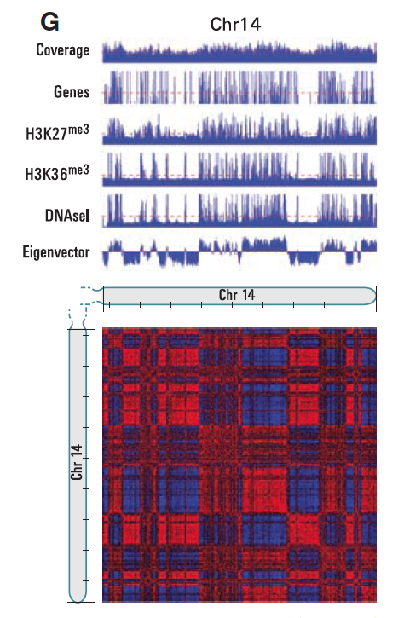
Open More Accessible, Gene Rich Compartment VS less Accessible
H3K27/H3K36: activating/repressive chromatin
Marks
DNAsel: deoxyribonuclease I
(DNAseI) sensitivity, measure chromatin
accessibility

Slide 38
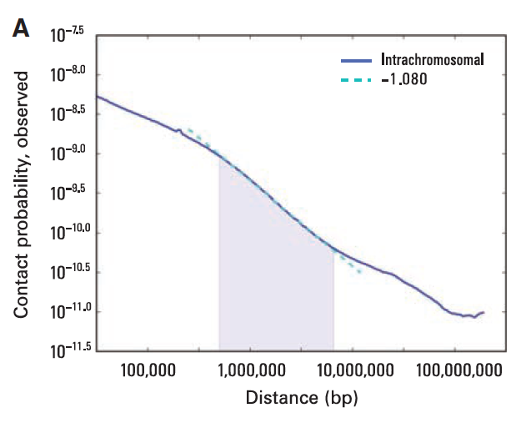
Contact Probability VS Genomic Distance
Contact probability as a function
of genomic distance averaged
across the genome (blue) shows
a power law scaling between
500 kb and 7 Mb (shaded region)
with a slope of –1.08 (fit
shown in cyan).
When plotted on log-log axes, I(s) exhibits a prominent power law scaling between ~500 kb and ~7 Mb, where contact probability scales as s^{–1} (Fig. 4A). This range corresponds to the known size of open and closed chromatin domains.

Slide 39
Genome 3D Model
Power-law dependencies can arise from polymer like behavior.
Equilibrium globule: a compact, densely knotted configuration originally used to describe a polymer in a poor solvent at equilibrium
Fractal Model: This highly compact state is formed by an unentangled polymer when it crumples into a series of small globules in a “beads-on-a-string” configuration. These beads serve as monomers in subsequent rounds of spontaneous crumpling until only a single globule of globules-of-globules remains.

Slide 40
Fractal Model
Fractal globules are an attractive structure for chromatin segments because they lack knots (31) and would facilitate unfolding and refolding, for example, during gene activation, gene repression, or the cell cycle.
In a fractal globule, contiguous regions of the genome tend to form spatial sectors whose size corresponds to the length of the original region (Fig. 4C). In contrast, an equilibrium globule is highly knotted and lacks such sectors; instead, linear and spatial positions are largely decorrelated after, at most, a few megabases (Fig. 4C).

Slide 41
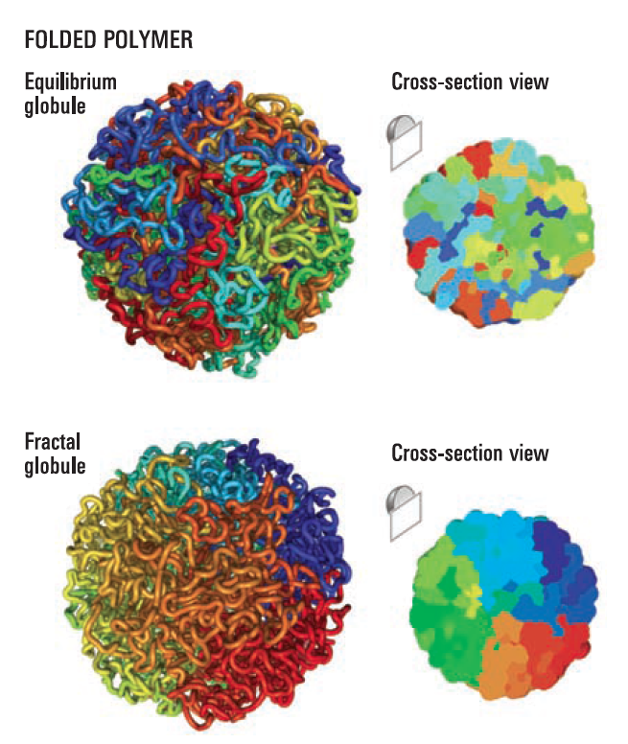
Comparison of Two Models

Slide 42
Consistency Checking
The equilibrium globule and fractal globule models make very different predictions concerning the scaling of contact probability with genomic distance s. The equilibrium globule model predicts that contact probability will scale as s^{–3/2}, which we do not observe in our data. We analytically derived the contact probability for a fractal globule and found that it decays as s^{–1} (10); this corresponds closely with the prominent scaling we observed (s^{–1.08}).
The equilibrium and fractal globule models also make differing predictions about the 3D distance between pairs of loci (s^{1/2} for an equilibrium globule, s1/3 for a fractal globule). Although 3D distance is not directly measured by Hi-C, we note that a recent paper using 3D-FISH reported an s^{1/3} scaling for genomic distances between 500 kb and 2 Mb

Slide 43
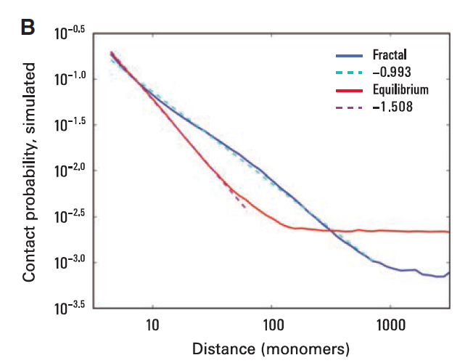
MCMC Simulation Validation
We used Monte Carlo simulations to construct ensembles of fractal globules and equilibrium globules (500 each). The properties of the ensembles matched the theoretically derived scalings for contact probability (for fractal globules, s^{–1}, and for equilibrium globules, s^{–3/2}) and 3D distance (for fractal globules s^{1/3}, for equilibrium globules s^{1/2}). These simulations also illustrated the lack of entanglements [measured by using the knot-theoretic Alexander polynomial (10, 32)] and the formation of spatial sectors within a fractal globule (Fig. 4B).

Slide 44
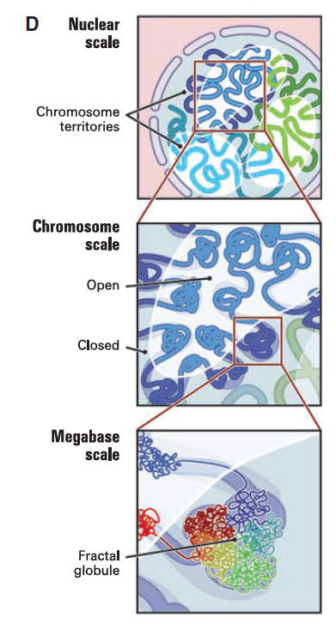
Multi-Scale
Fractal Model

Slide 45
Hi-C Data Analysis II
Z. Wang, R. Cao, K. Taylor, A. Briley, C. Caldwell, J. Cheng. The Properties of Genome Conformation and Spatial Gene Interaction and Regulation Networks of Normal and Malignant Human Cell Types. PLoS ONE. 2013

Slide 46
Data Sets
Primary human acute lymphoblastic leukemia (B-ALL) B-cell
The MHH-CALL-4 B-ALL cell line (CALL4)
The follicular lymphoma cell-line (RL)
Sequenced by Illumina HiSeq 2000

Slide 47
Number of Reads of
the samples
Read coverage

Slide 48
Read Quality

Slide 49
Mapping Reads to Human Genome

Slide 50
Plots of Contact Numbers against Regions of Chromosomes 7, 11, 14
(CALL4, RL, normal B-Cell, Primary B-ALL)

Slide 51
Un-normalized intra-chromosomal heat maps for primary ALL B-Cell

Slide 52
Normalized intra-chromosomal heat maps for primary ALL B-Cell
Sequential Component Normalization:
M[i,j] / |M[i]|
M[i,j] / |M[j]|
Repeat until symmetric

Slide 53
Intra-Chromosomal Contacts
Correlation
Map
C[i,j] = Person’s
Correlation
Between row i,
column j
Plaid
Pattern

Slide 54
Contact Correlation Between Cell Types
Correlate intra-contact numbers of 23 pairs of chromosomes

Slide 55
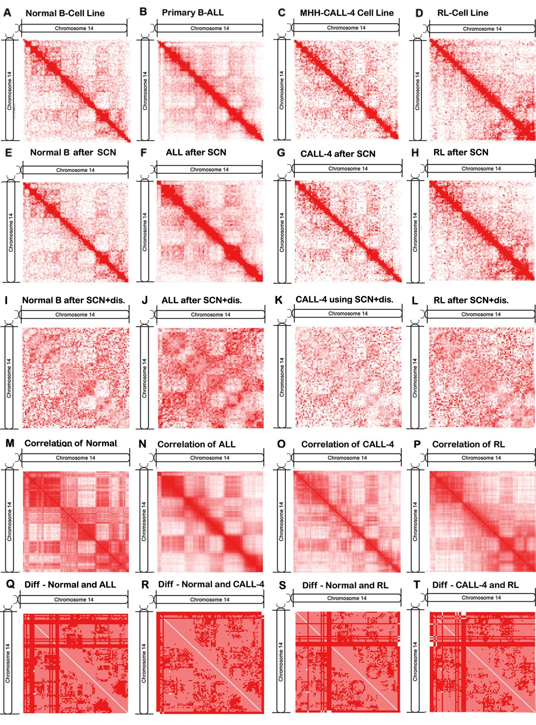
Comparison of Maps Using Genomic Distance and SCN Normalizations

Slide 56
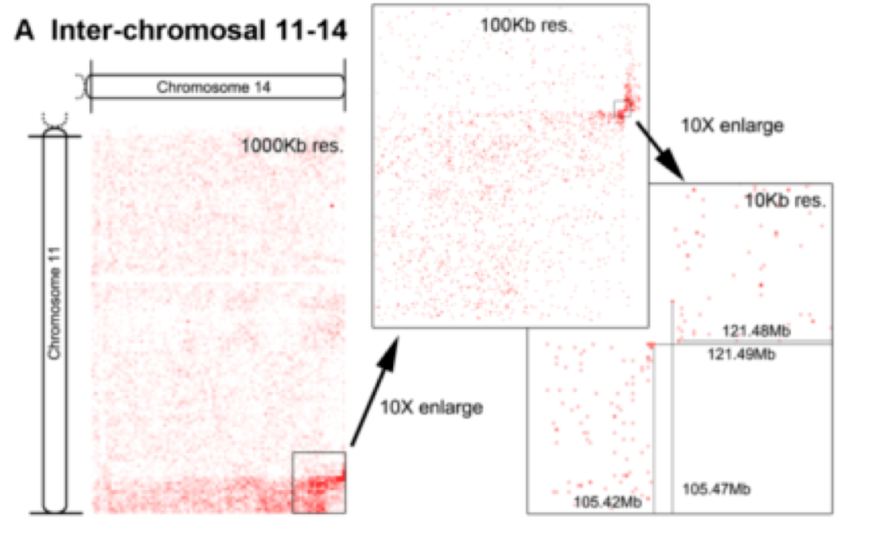
Inter-Chromosome Contacts and Chromosome Translocation

Slide 57
Cancer Causing Chromosome Translocation
Reconstruction of translocated
chromosomes
Two cancer related genes

Slide 58
Comparison of Inter-Chromosome Contact Profiles of Different Cells

Slide 59
Gene-Gene Contact Map of HoxA Gene Cluster:
HoxA gene region (27,104,502 – 27,212,501) on chromosome 7,
Transcription factor controlling embrynoic development

Slide 60
Intra-Chromosome Gene-Gene Interaction Network of Chr. 14 of Call4 Cell Line
Applications?
Spatial gene interaction
Gene function
Transcription efficiency
Scale free network: power law, short path, hub genes
Gene locations were determined by UCSC genome

Slide 61
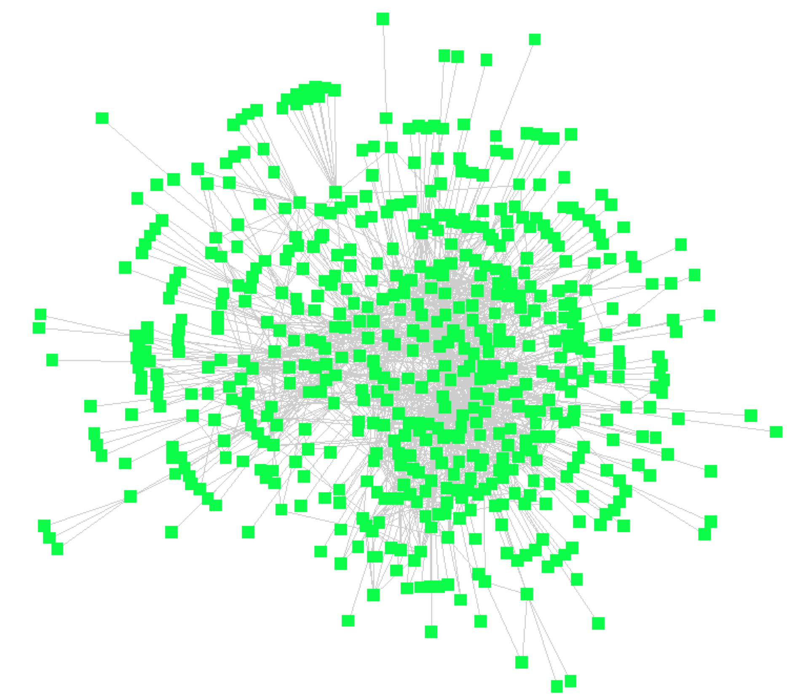
Genome Wide TBS-TBS Interaction Network (Call4)
Question: why do TBSs
form contact clusters
and how?
Do they form control
Module?
The definitions and coordinates of transcription factor binding sites were downloaded from Yale TFBS [31], which were identified by ChiP-seq experiments
Wang et al., submitted

Slide 62
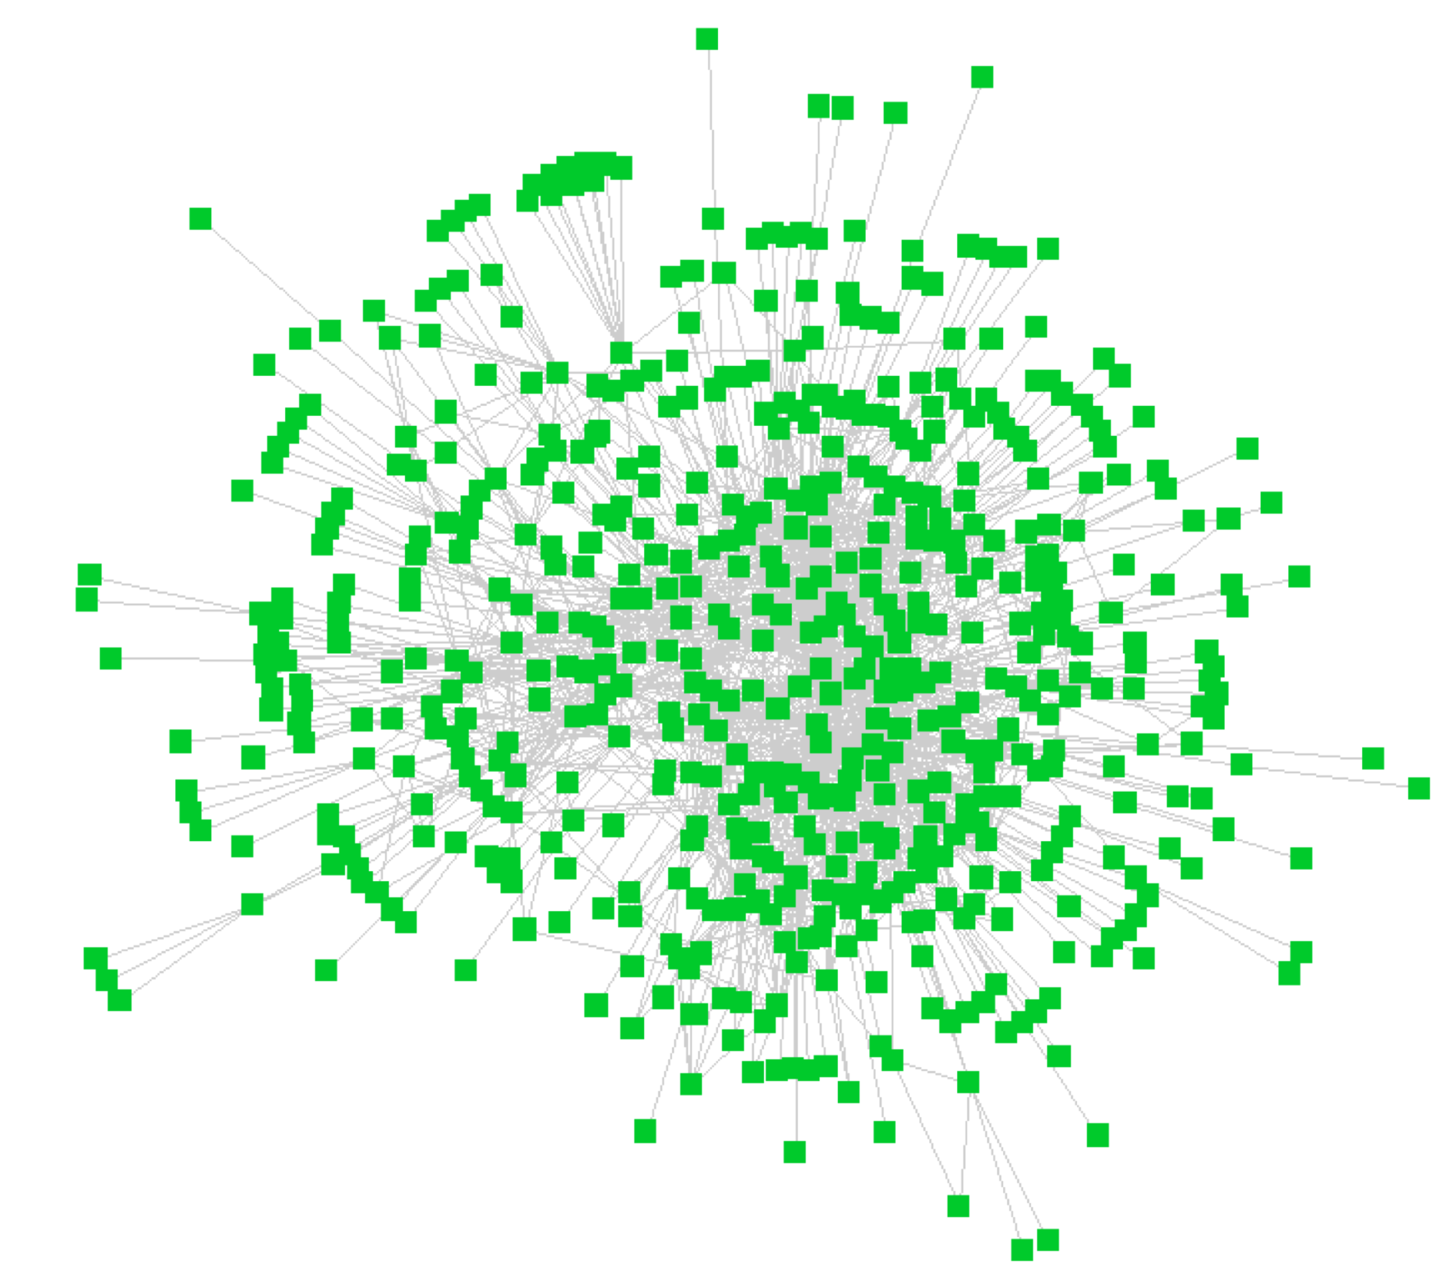
Gene – TBS Interaction Network
Question: can this explain
long-range regulatory
Relationships?
(promoter, enhancer, insulator)
ENCODE: Coding/Non-Coding
Interactions are not random.
Why are the non-coding
DNA elements not junk?
Do they play a structural
Role mediated by interaction (insulator)
influencing gene
Expression at least?
Wang et al., 2013

Slide 63
3D Genome Structure Modeling
(Key Hypothesis)
Images.google.com

Slide 64
Opportunities
Chromosome contact data can be generated easily and cheaply
Chromosome contact data is rather reliable
A 3D model of a genome is very valuable in studying spatial regulation of gene expression and methylation

Slide 65
Challenges
Genome and chromosome is very large (3 billion nucleotide of human genome)
Genome structure is very dynamic
No known experimental genome structure other than some point distance data generated by FISH
Relationship between contact and distance is not deterministic
Unknown quantities

Slide 66
Limitation of Existing Work
Small scale: a gene locus or a small chromosome (10 – 50 M)
One Scale
Rough approximation: convert contacts to distance
Low accuracy

Slide 67
A MCMC Approach
M. Rousseau, J. Fraser, M.A. Ferraiuolo, J. Dostie, M. Blanchette. Three-dimensional modeling of chromatin structure from interaction frequency data using Markov chain Monte Carlo sampling. BMC Bioinformatics, 2011.
Long-range interactions between regulatory DNA elements such as enhancers, insulators and promoters play an important role in regulating transcription. As chromatin contacts have been found throughout the human genome and in different cell types, spatial transcriptional control is now viewed as a general
mechanism of gene expression regulation.

Slide 68
MCMC5C
We formulate a probabilistic model linking 5C/Hi-C data to physical distances and describe a Markov chain Monte Carlo (MCMC) approach called MCMC5C to generate a representative sample from the posterior distribution over structures from IF data.
Structures produced from parallel MCMC runs on the same dataset demonstrate that our MCMC method mixes quickly and is able to sample from the posterior distribution of structures and find subclasses of structures.

Slide 69
MCMC5C
Structural properties (base looping, condensation, and local density) were defined and their distribution measured across the ensembles of structures generated. We applied these methods to a biological model of human myelomonocyte cellular differentiation and identified distinct chromatin conformation signatures (CCSs) corresponding to each of the cellular states.

Slide 70
MCMC5C
We also demonstrate the ability of our method to run on Hi-C data and produce a model of human chromosome 14 at 1Mb resolution that is consistent with previously observed structural properties as measured by 3D-FISH.

Slide 71
Existing Methods (Non MCMC)
5C3D (Fraser et al.): translates IF values into physical distance estimates and then uses a gradient descent approach to find the 3D conformations.

Slide 72
Existing Methods (Non MCMC)
Bau et al. Interactions are modeled with springs whose equilibrium length depends on the observed IF values, subject to certain constraints based on the structure of the 30-nm fiber, optimized by Integrative Modeling Platform.

Slide 73
Existing Methods (Non MCMC)
Duan et al., convert interaction frequencies to Euclidean distances and then seek conformation minimizing the misfit, with addition of a set of clash avoidance constraints and a few prior known knowledge about the yeast genome organization. The constrained optimization problem is solved to find the best structure.
Tanizawa et al. Similar to Duan et al.

Slide 74
Existing Methods (Non MCMC)
Common: convert IF to distances, convert n*n constraints into n coordinates
Different: conversion method, additional constraints, and optimization techniques.

Slide 75
Possible Drawbacks of Existing Methods
Objective function (sum of square difference between predicted and derived distance) is debatable.
Assume each IF is equally reliable.
The absence of an underlying probabilistic model, preventing the calculation of confidence intervals on specific structural properties (e.g. distance between two genomic sites)

Slide 76

Probabilistic Model of Chromatin Conformation
A chromosome is modeled as a continuous piece-wise linear curve in 3D.
Theoretical interaction frequency between fragment i an d j, denoted IF(I, j), is inversely correlated with the distance between two fragments in 3D conformation: IF(i,j) = f(D_{s}(i,j)), where D_{s}(i,j) is the Euclidean distance between sites i and j and f is an appropriately chosen function.

Slide 77
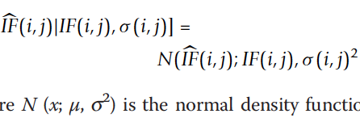
Observed IF and Theoretical IF
For 5C data, where σ can be estimated by IF-Calculator.

Slide 78
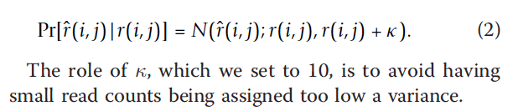
Observed IF and Theoretical IF (Hi-C)

Slide 79
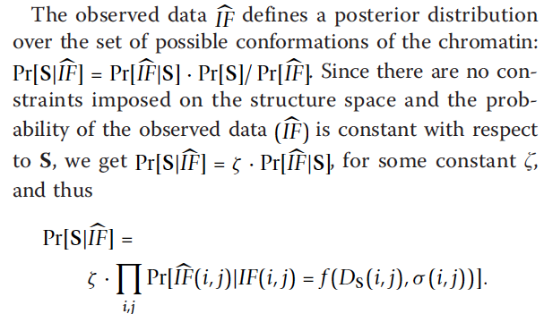
Prob(Structure | IF data)

Slide 80
Sampling Conformations from Posterior Distribution
A random structure R₀ is initially chosen to seed the process (t=0), where each point is placed randomly in a cube of side length 10*avg(f(IF)).
Repeat: The current structure R_{t} is randomly perturbed to obtain a new structure R_{t’}. If Pr[R_{t’}|IF] > Pr[R_{t}|IF], the perturbation is obtained and we set R_{t+1} = R_{t’}. Otherwise, we set R_{t+1} = Rt.
For values of t sufficiently large, Pr[R_{t}=S] = Pr[S|IF].

Slide 81
Random Structure Perturbation
Randomly choose one point S(i) along the structure and moving it by a vector v randomly choosing within a sphere of radius r (e.g. r = 0.25 nm) while keeping positions of other points unchanged – within a gene cluster
The likelihood of the resulting structure is then quickly obtained from that of the old by updating the terms corresponding to the pairs of points involving i.

Slide 82
Assessing Mixing
R₁, …, R_{k} of early iterations are highly dependent on R₀.
Determine at what point m, the Markov process has mixed, i.e., R_{m} is independent of R₀
After mixing, i.e. for k>= m, any sample R_{k} is representative of the target distribution. For d sufficiently large, R_{k} and R_{k+d} are independent.

Slide 83
Convergence Determination
Run two independent chains R and R’ in parallel, from independently chosen initial conformations R₀ and R_{0’}.
Mixing is achieved if the samples {R_{k/2}, … R_{k}} and {R’_{k/2}, …, R’_{k}} cannot be distinguished from each other. Specifically, the average pairwise structural distances among R_{k} is compared to that between R_{k} and R_{k’}.
After mixing is achieved, collect samples every d=k/20 iterations.

Slide 84

Clustering of Structure Ensembles
Distance metric: N*N intra-structure distance matrix Ds.
The distance (S,T) between two structures S and T is:

Slide 85
Structure Clustering
Hierarchical clustering
Visualization: tree dendrogram and a heatmap representation.
Visual inspection is performed to determine the tree height cutoff and number of subfamilies
Choose maximum likelihood structure from each cluster as representative and assigning it a weight proportional to the number of structures in its cluster.

Slide 86
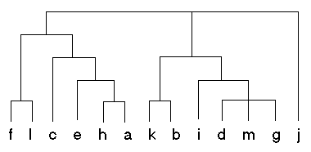
Hierarchical Clustering

Slide 87

Measuring Structural Properties
Local density at position i along the sequence is the number of DNA bases located within a sphere of radius r centered at position i.
Compaction: the number of DNA bases located within the sphere and consecutive to position i.
Looping counts the number of bases inside the sphere but outside the portion the sequence portion containing i.

Slide 88
5C Data Sets
HoxA Gene Cluster
In both datasets, the genomic, region analyzed spans 142 kb and contains 11 protein coding genes. The region contains 42 restriction sites, for the BglII restriction enzyme, which was used for the, experiment.
MLL-ENL fusion cell line (HB-1119)

Slide 89
Convert IF to distance
Duan et al., the resulting conversion approximately follows d ∝ 1/IF . Mateos-Langerak et al . [50] also suggest a relationship of the form d ∝ 1 / IFª . Bau et al . [28] convert their IF via a linear transformation of the IF’ s z-score. Tanizawa et al . [29] relate IF to physical distance by using a loess regression on a set of physical distances measured by 3D-FISH, but do not report the parameters of this regression.

Slide 90

Convert IF to distance
The most accurate model (d ∝ C / IFª) is the one that is best able to predict unseen pairwise interaction frequencies. For each of a set of possible a leave-one-out cross-validation was performed. Find a to minimize

Slide 91


Slide 92
C (Distance Scaling Factor) Calibration
Without physical measurement of the distance between pairs of points along the sequence, it is difficult to accurately estimate the value of C . However, based on the average IF value of pairs of fragments located less than 5kb apart along the sequence and following Bystricky et al . [51] that packed chromatin has a physical length of 1 nm for every 110-150bp, C was estimated as approximately 50 nm.

Slide 93
Experiment
Figure 4 shows that mixing is achieved after approximately 350 * 10⁵ iterations, which requires less than 250 seconds of running time. Passed this point, structures sampled every 10⁶ steps from the two parallel runs are undistinguishable from each other and sample structures from the same distribution.
250 structures were sampled after burn-in from each of the two runs. The two ensembles of structures were then combined and the 500 structures were clustered based on their structural similarity
Analysis of the two THP-1 5C datasets produced similar results, and runs of a larger number of parallel MCMC chains confirm that they all sample similar structures.

Slide 94


Slide 95
Simulation Verification
Gold structure: a computationally constructed 3D structure used to generated IF data.
Simulated structure: models constructed from the IF data of the gold structure.

Slide 96

Verification by Sampling from Simulated True Structures

Slide 97

Structure Clustering and Sub-Structure Families.
Sub-structure families may correspond to chromatin structures of cells in different stages

Slide 98

Conformations of HoxA in Undifferentiated and Differentiated Conditions

Slide 99


Slide 100
Structural Variation and Conservation
The subset of fragments that are the most conserved across the ensemble of structures are found to lie within the central core region of the structures. These fragments are spatially close to each other and may be involved in looping contacts that are important for the maintenance of the chromatin structure and are therefore highly conserved.

Slide 101

Analysis of Structural Properties

Slide 102
On Hi-C Data (Data Set II)
Model the long arm of human chromosome 14 (88.4 Mb region) from Hi-C data published by Lieberman-Aiden et al . [18] at a 1Mb resolution (89 fragments in total). Lieberman- Aiden et al . [18] proposed the existence of two physically disjoint compartments, whereby compartment A was found to correlate with open and actively transcribed chromatin, while compartment B was found to be more densely packed and repressed.

Slide 103
On Hi-C Data (Data Set II)
The authors designed four 3D-FISH probes (termed L1, L2, L3, and L4) that lie consecutively along chromosome 14 but alternate between compartments (A: L1 and L3; B: L2 and L4) and showed that the non-consecutive regions of the chromosome that belong to the same compartment appear to be physically closer than those that do not [18].

Slide 104
On Hi-C Data (Data Set II)
Our results using MCMC5C weakly supports this hypothesis, with the 3D-FISH probes L2 and L4 indeed being in close proximity. Importantly, we used an ensemble of 250 structures to estimate the distribution of predicted Euclidean distances between each pair of probes and found an excellent linear correlation with the physical distances measured by Lieberman-Aiden et al .

Slide 105


Slide 106
MCMC5C Availability
MCMC5C is available at http://Dostielab.biochem.mcgill.ca.

Slide 107


A Multi-Scale Modeling and Visualization Strategy
Nucleosome (100b)
Chromatin Fiber (Kb)
Gene Loci (Mb)
Chromosome (100Mb)
Genome (Gb)
J. Cheng, NSF CAREER Project Plan, 2011, 2012, 2013

Slide 108
Spatial Representation of A Genome Region at a Scale
……
A genome region (e.g. a chromosome) is divided into N equal / variable size units sequentially
The spatial position of the center of a unit is denoted by a point and its coordinate (x, y, z) and constraints on the size of unit (radius of sphere)
The consecutive points are joined into fragments forming the folding trace of the region.
J. Cheng, NSF CAREER Project Plan, 2011, 2012, 2013

Slide 109



Structure Construction at One Scale
Initial Structure Representation of Units
Contact Map Between Units
Sampling & Optimization
J. Cheng, NSF CAREER Project Plan, 2011, 2012, 2013

Slide 110
Contact-Driven Modeling at Chromosome Scale
Input: initial representation of chromosome, contact map, and physical distance restraints
Objective: find 3D chromosome structures that satisfy the contact map and physical distance restraints as much as possible.
Scoring Function
Optimization
Output: an ensemble of 3D shapes
J. Cheng, NSF CAREER Project Plan, 2011, 2012, 2013

Slide 111
Structure Modeling Movie
At YouTube without music: http://www.youtube.com/watch?v=C03R7A9kYc8
At NSF CAREER project web site with music:
http://people.cs.missouri.edu/~chengji/genome_modeling_movie.mp4
J. Cheng, NSF CAREER Project Plan, 2011, 2012, 2013. T. Tuan made the movie.

Slide 112



Two Compartment Validation on Normal B-Cell
Chromosome 7
Purple and green denote regions in two different components
using principle component analysis on contact correlation map
J. Cheng, NSF CAREER Project Plan, 2011, 2012, 2013

Slide 113

3D Models for 22 Chromosomes of Normal B-Cell
J. Cheng, NSF CAREER Project Plan, 2011, 2012, 2013

Slide 114


Models of Chr. 2 for Normal and Malignant Cells
Primary Leukemia B-Cell
Normal B-Cell
J. Cheng, NSF CAREER Project Plan, 2011, 2012, 2013

Slide 115
Demo: GMol - Multi-Scale Visualization of 3D Genome Structure

Slide 116



Acknowledgements
Zheng Wang, Renzhi Cao
Tuan Trieu, Chenfeng He, Sharif Ahmed
Avery Wells
Charles Caldwell, Kristen Taylor, Aaron Briley

