Slide 1
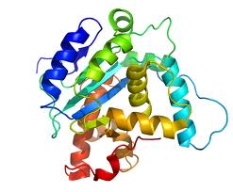
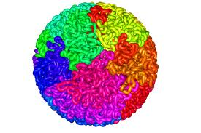
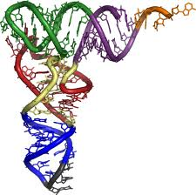
Computational Modeling of Molecular Structure
Jianlin Cheng, PhD
Department of EECS
University of Missouri, Columbia
Spring, 2019

Slide 2
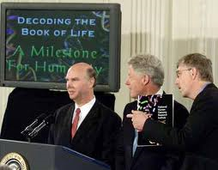
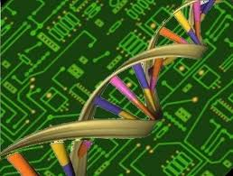
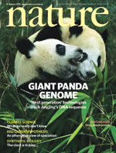
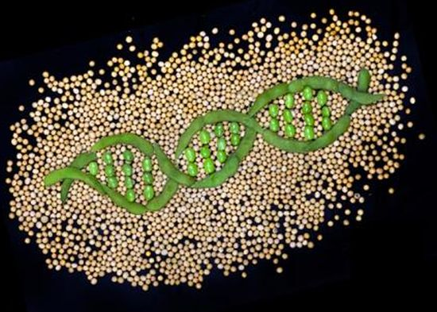
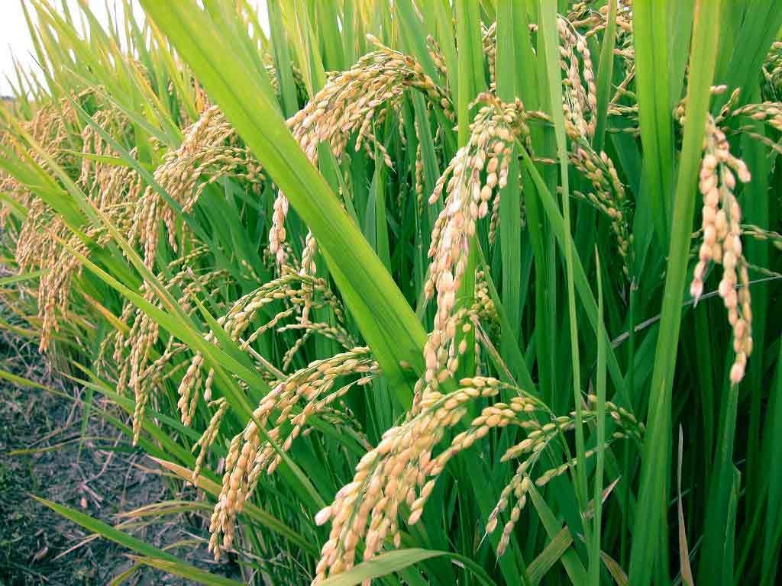
The Genomic Era
Collins, Venter, Human Genome, 2000

Slide 3
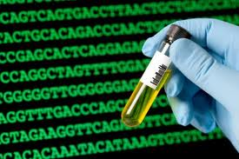
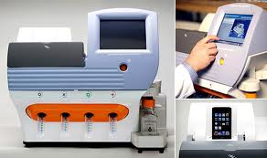
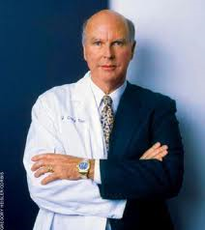
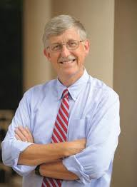
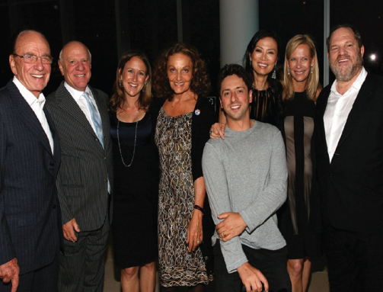
DNA Sequencing Revolution
$1000 Personal Genome
Scientists
Government
Company

Slide 4
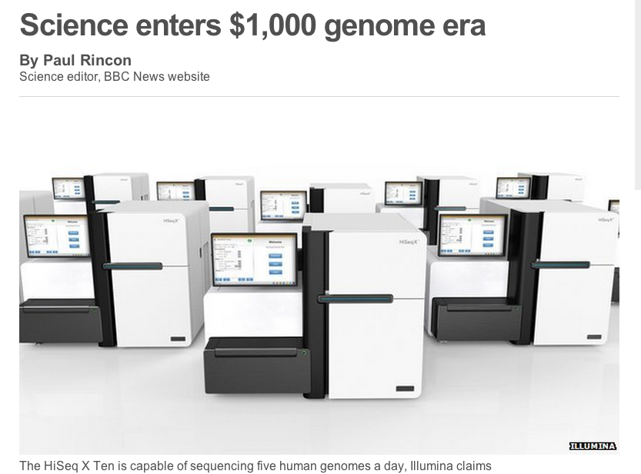
A Topic of Big Bio Data Analysis

Slide 5
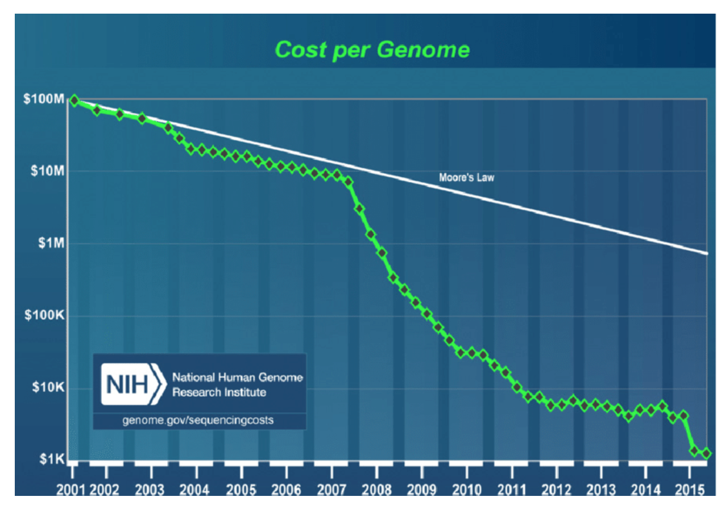

Slide 6
AI, Deep Learning, Google’s DeepMind

Slide 7
DeepMind’s AlphaFold Buzz

Slide 8
AlphaFold is built on the original ideas and stratigies developed by the protein folding community over many years! Deeper networks, better engineering, and innovative integration.

Slide 9
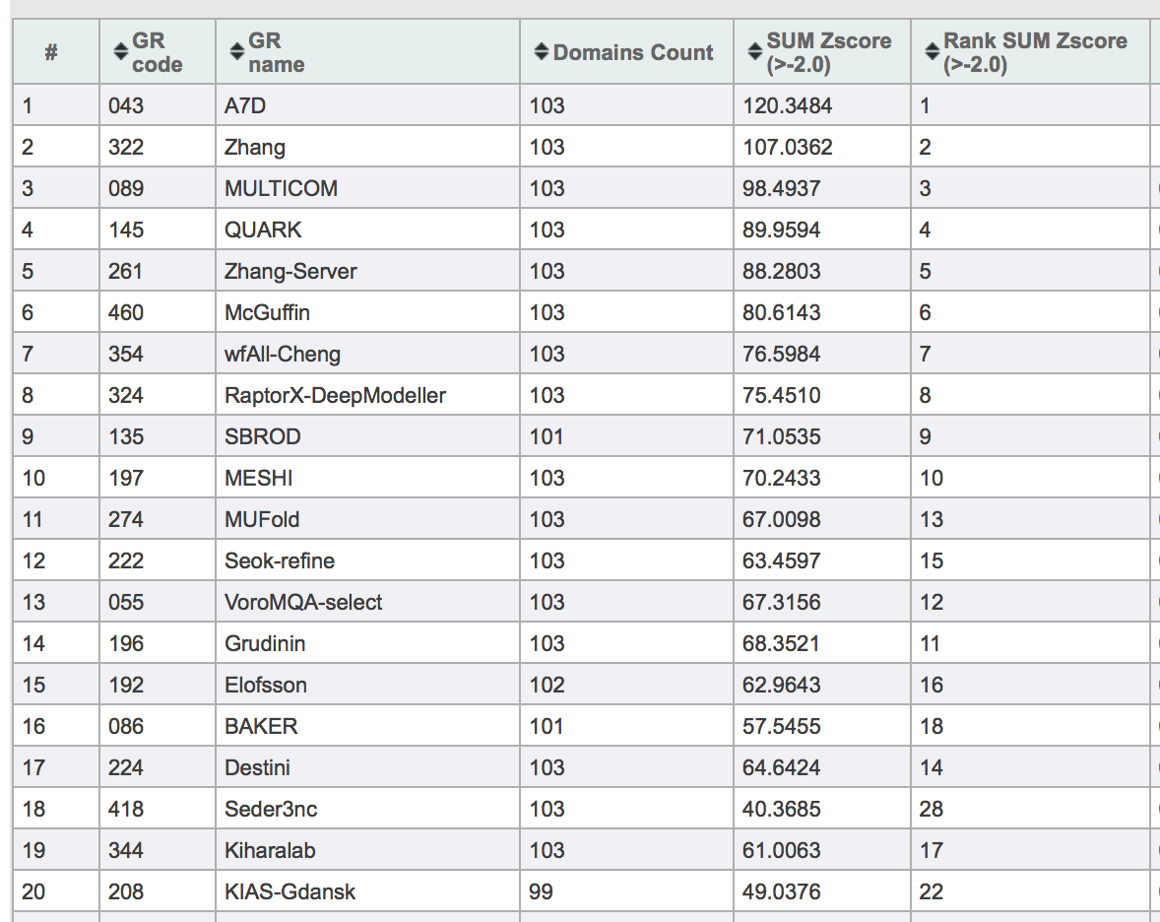
Top 20 out of 98 predictors in CASP13

Slide 10
100 Top Scientific Problems by Science Magazine
http://science.sciencemag.org/content/309/5731/78.2.full
Can we predict how proteins will fold?
Out of a near infinitude of possible ways to fold, a protein picks one in just tens of microseconds. The same task takes 30 years of computer time.
How many proteins are there in humans?
It has been hard enough counting genes. Proteins can be spliced in different ways and decorated with numerous functional groups, all of which makes counting their numbers impossible for now.
How do proteins find their partners?
Protein-protein interactions are at the heart of life. To understand how partners come together in precise orientations in seconds, researchers need to know more about the cell's biochemistry and structural organization.
What role do telomeres and centromeres play in genome function?
These chromosome features will remain mysteries until new technologies can sequence them.
Why are some genomes really big and others quite compact?
The puffer fish genome is 400 million bases; one lungfish's is 133 billion bases long. Repetitive and duplicated DNA don't explain why this and other size differences exist.
What is all that “junk” doing in our genomes?
DNA between genes is proving important for genome function and the evolution of new species. Comparative sequencing, microarray studies, and lab work are helping genomicists find a multitude of genetic gems amid the junk.
How can genome changes other than mutations be inherited?
Researchers are finding ever more examples of this process, called epigenetics, but they can't explain what causes and preserves the changes.
What are the limits of learning by machines?
Computers can already beat the world's best chess players, and they have a wealth of information on the Web to draw on. But abstract reasoning isstill beyond any machine.

Slide 11
Objectives
Properties of molecular structures (proteins, RNA, genome / DNA)
Computational representation of molecular structures
Data-driven computational modeling of molecular structures
Application of modeling of molecular structures such as drug design

Slide 12
Significance of Studying Molecular Structures
One foundation of life sciences
Personal healthcare and medicine
One major topic of bioinformatics and computational biology – an important field of computer science
A great application area of computer algorithms, data science and artificial intelligence (AI)
A very interdisciplinary field (CS, machine learning, data science, stats, math, biology, chemistry, physics)

Slide 13
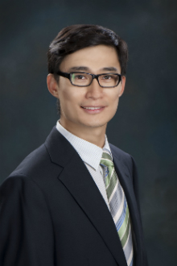
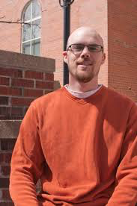
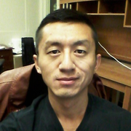
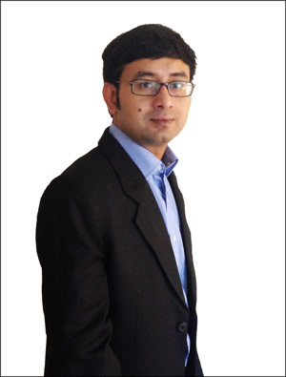
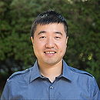
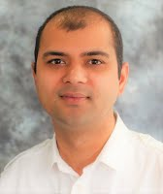
A Good Career for CS Graduates
Five PhD graduates are assistant / associate professors of bioinformatics in CS departments
One PhD student secured a scientist position in a bioinformatics company
One PhD student works for Microsoft
One PhD student as postdoc at Cornell
Numerous other graduate students received
good training and worked in data-intensive fields
(IBM, Didi, etc).

Slide 14
Three Kinds of Structures
Protein Structure
Genome Structure
RNA Structure

Slide 15
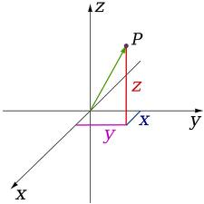
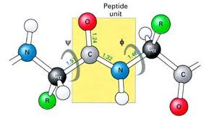
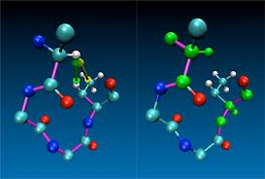
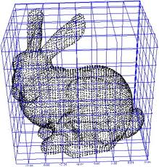
Representation of Molecular Structures
X, Y, Z coordinates
Euclidean grid
Vector and angles
Computer graphics

Slide 16
Algorithms
Grid-based simulation (random walk)
Vector-based simulation
Angular-based simulation
Gradient descent simulation and variants
Simulated annealing
Markov Chain Monte Carlo
Probabilistic modeling
Constraint-based optimization
Machine learning (e.g., deep learning)

Slide 17
Software Packages
RasMol, Jmol, PyMol, Chimera
Modeller, Rosetta, I-TASSER, MULTICOM, MTMG, IMP, CNS, CONFOLD, Zdock, MOGEN, LorDG, GenomeFlow, AutoDock, DeepCov, DNCON
Keras, Tensoflow
Your own algorithm, implementation, and practice

Slide 18
Course Format
Course web site: http://calla.rnet.missouri.edu/cheng_courses/cscmms2019/
Problem solving
Active learning by practicing
Syllabus (see details)

Slide 19
Teaching Format of Each Topic
Course Introduction
Group project:
~4 students per group
Rotate as topic coordinator
Each member participates
in every topic
All members present
the whole project
Topic Lecture (reading)
Problem Definition (discussion, planning)
Plan Presentation
Project Implementation (programming)
Results and Analysis (report and update)
Final presentation and report

Slide 20
Grading
Class discussions (15%)
Literature reviews (10%)
Topic plan presentation (20%, group)
Topic implementation and report (45%, group)
Final presentation (10%, group)
Grade scale: A+, A, A-, B+, B, B-, C+, C, C-, and F.

Slide 21
Introduction to Molecular Biology for Computer Science and Engineering Students

Slide 22
Introduction to Molecular Biology
Cell is the unit of structure and function of all living things.
Two types of cells: eukaryote (higher organisms) and prokaryote
(lower organisms)

Slide 23
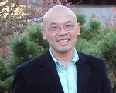
Central Dogma of Molecular Biology
Phenotype
Replication
Transcription
Translation
DNA
RNA
Protein
Genotype

Slide 24
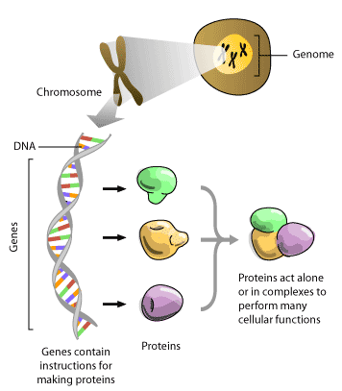

Slide 25
Central Dogma of Molecular Biology
Replication
Transcription
Translation
DNA
RNA
Protein
Reverse
Transcription (HIV virus)
Information flow

Slide 27
DNA (Deoxyribose Nucleotide Acids)
DNA is a polymer. The monomer
units of DNA are nucleotides,
and the polymer is known as a
"polynucleotide." Each nucleotide
consists of a 5-carbon sugar
(deoxyribose), a nitrogen containing
base attached to the sugar, and
a phosphate group.
A is for adenine
G is for guanine
C is for cytosine
T is for thymine
CGAATGGGAAA……
Introduction to DNA structure, Richard B. Hallick, 1995

Slide 29
Base Pairs:
A-T (2 H-bonds)
C-G (3 H-bonds)
Hydrogen bonds: non-covalent bonds mediated by hydrogen atoms

Slide 30
Uncoiled DNA Molecule
Source: Dr. Gary Stormo, 2002

Slide 32
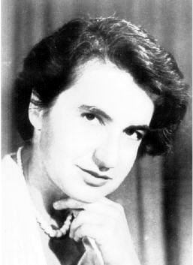
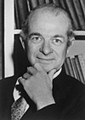
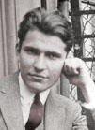
Maurice
Wilkins
Rosalind
Franklin
Linus
Pauling
Erwin
Chargaff
James Watson & Francis Crick
Fundamental Problems: How genetic information pass from one
cell to another and from one generation to next generation

Slide 33
DNA Replication
DNA
Polymerase

Slide 34
RNA (Ribose Nucleotide Acids)
ACGAAUAACAGGUAAUAAAAAUAGAUAUACCUAUAGAUUCGU

Slide 35
Different Kinds of RNA
mRNA: messager RNA
carry genetic information out of nucleus for protein synthesis (transcription process: RNA polymerase)
rRNA: ribosomal RNA
constitute 50% of ribosome, which is a molecular assembly for protein synthesis
tRNA: transfer RNA
decode information (map 3 nucleotides to amino acid); transfer amino acid
snRNA: small RNA molecules found in nucleus
involve RNA splicing
Non-coding RNA

Slide 36
Transcription of Gene into RNA

Slide 37
Genetic Code and Translation
Three Nucleotides
is called a codon.

Slide 38
Protein Sequence
A directional sequence of amino acids/residues
N
C
…
Amino Acid 1
Amino Acid 2
Peptide bond

Slide 39
Amino Acid Structure

Slide 40
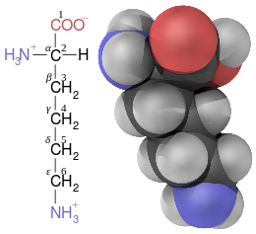
Lysine

Slide 41
Amino Acids
Hydrophilic

Slide 42
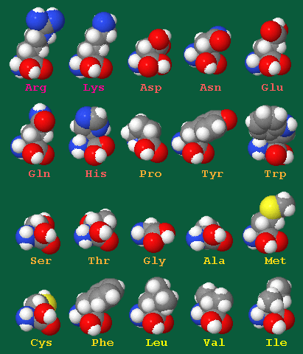

Slide 43
Central Dogma of Proteomics
AGCWY……
Cell
Sequence Structure Function

Slide 44
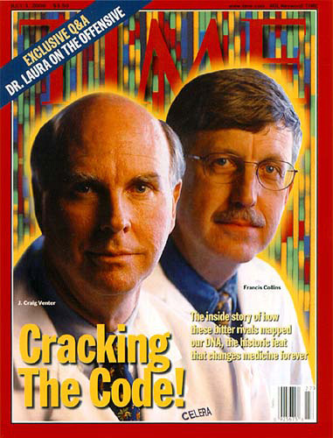
The Genomic Era
Collins, Venter, Human Genome, 2000

Slide 45
Personal Genome’s Implications
Personalized Disease Prevention
Personalized Disease Diagnosis
Personalized Medicine
Personalized Health Care
Precision Medicine

Slide 46
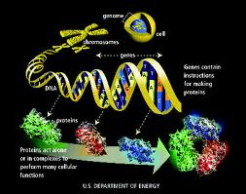
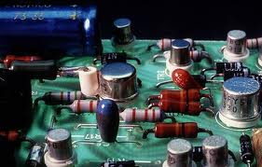
Genome Implications to Information Sciences and Life Sciences
Elements and Systems

Slide 47
Assignment One
Read one of the two articles and write a half page summary:
A. Sali. T. Blundell. Comparative Protein Modeling by Satisfaction of Spatial Restraints. JMB, 1993.
J. Li, J. Cheng. A Stochastic Point Cloud Sampling Method for Multi-Template Protein Comparative Modeling. Scientific Reports, 2016.
Submit your review summary (half page)
to mumachinelearning@gmail.com .
Due by Feb. 10 (Sunday).
Form your group (~4 students per group)

Slide 48
Acknowledgements
images.google.com and all the authors providing valuable images

