Slide 1
2D and 3D Genome Structure Modeling
Jianlin Cheng, PhD
Department of EECS
Informatics Institute
University of Missouri, Columbia
2018

Slide 2
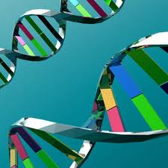
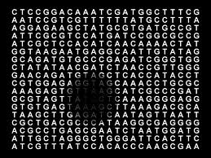
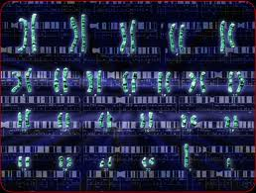
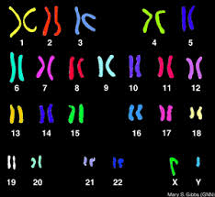
Genome – Code of Life

Slide 3
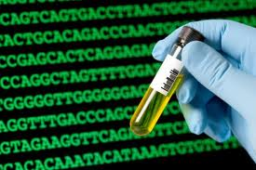
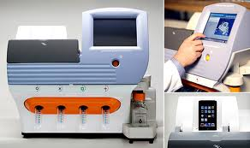
Genome Sequencing (1D)

Slide 4

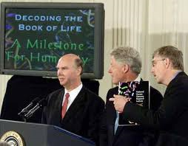
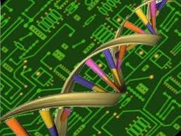

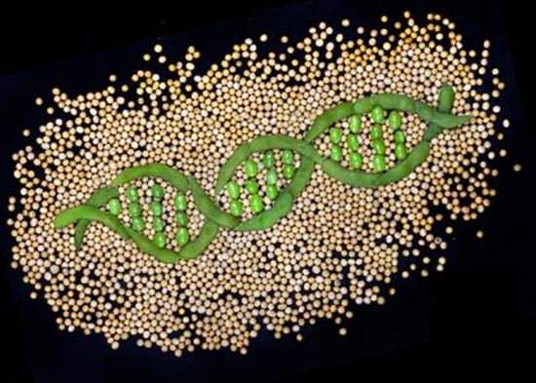
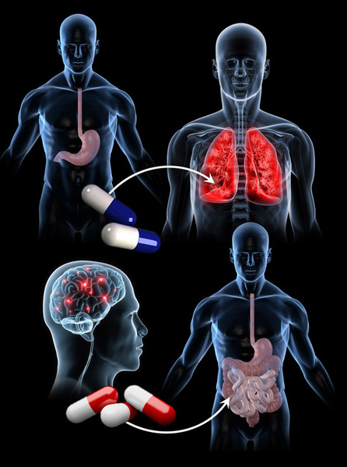
The Genomic Era
Collins, Venter, Human Genome, 2000
Personal Genome

Slide 5
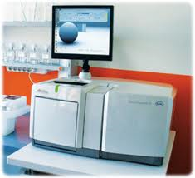
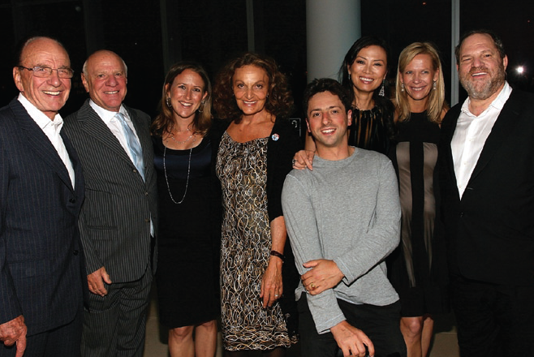

Sequencing Revolution

Slide 6
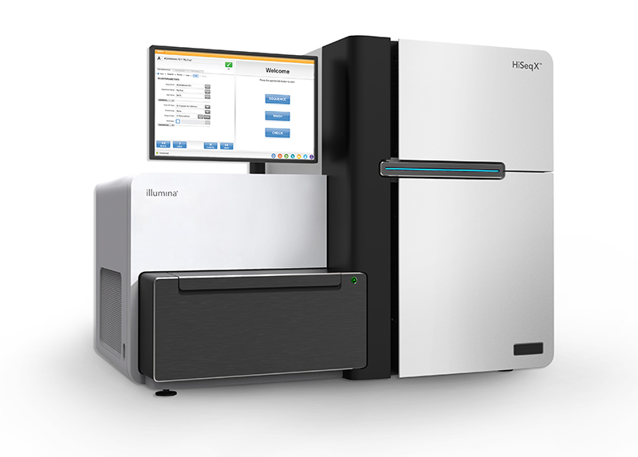
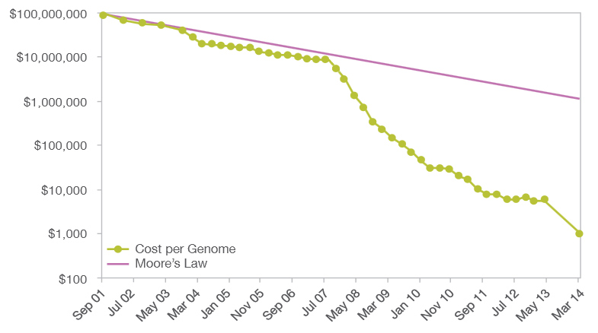
$1000 Personal Genome!
http://www.futuretimeline.net/blog/2014/01/16.htm#.U3Vg-FhdWzs

Slide 7
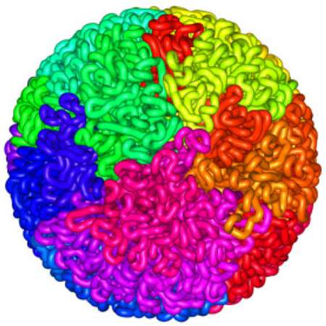
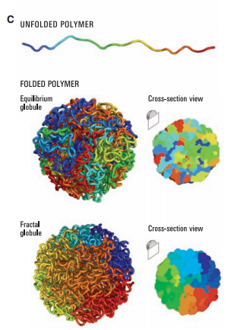
3D
Shape
http://images.google.edu

Slide 8
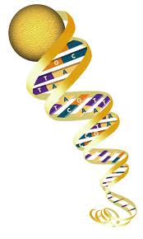
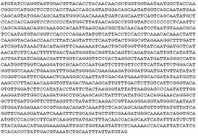

Genome
>95% non-coding
regions of a genome
are not junk!!

Slide 9
Genome Conformation
Liberman-Aiden et al., 2009

Slide 10
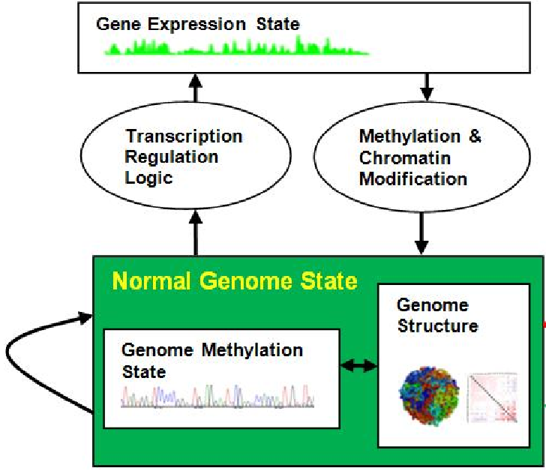
3D Genome Structure is Important
Spatial gene regulation
Transcription efficiency
Genome interpretation
Function implication (ENCODE)
Disease diagnosis & treatments
Drug design

Slide 11
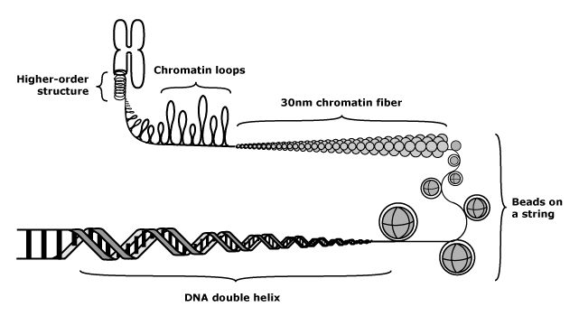
Multi-Level Chromosome Structure
http://missinglink.ucsf.edu/lm/genes_and_genomes/chromatin.html
DNA is further packaged. Nucleosomes are arranged together into a fiber approximately 30 nanometers in diameter. The precise structure of the chromatin fiber is not known. Chromatin fiber is further organized into chromatin loops, and chromatin loops are further organized into higher-order structures. It has been suggested that packaging plays a role in gene expression (gene expression may require associated DNA to open up and acquire an unpackaged conformation). The fully condensed chromosome structure is only seen during mitosis.

Slide 12
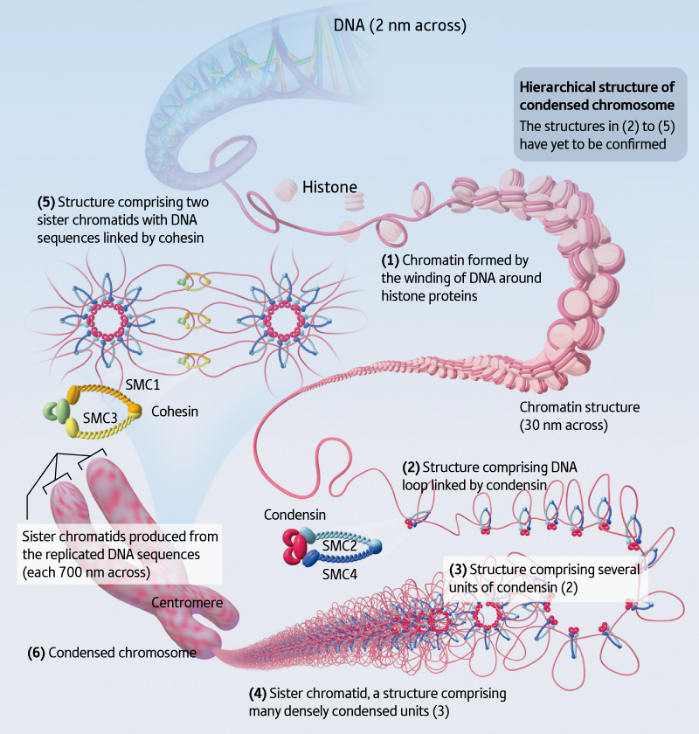
Model 1 (Riken)
The DNA is a remarkable molecule in many ways. It encodes our entire genome, and if stretched out in a thin thread would measure 1.8 m in length.
Globular
Structure
http://www.rikenresearch.riken.jp/eng/frontline/6485

Slide 13
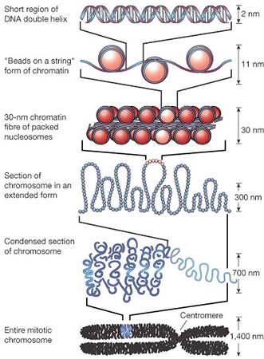
Size of Elements
NM: 10⁻⁹ meter
A complex of DNA and basic proteins (such as histone) in eukaryotic cells that is condensed into chromosomes in mitosis and meiosis.
There are two types. Heterochromatic is densely-coiled chromatin that appears as nodules in or along chromosomes and contains relatively few genes. Euchromatic is the less-coiled and genetically active portion of chromatin that is largely composed of genes.
http://www.daviddarling.info/encyclopedia/C/chromatin.html

Slide 14
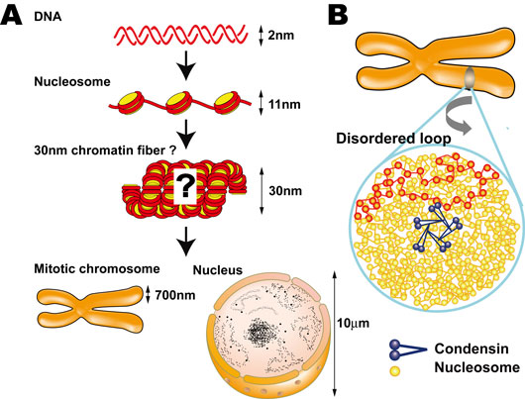
Size of Elements
http://www.nig.ac.jp/section/maeshima/maeshima-e.html

Slide 15
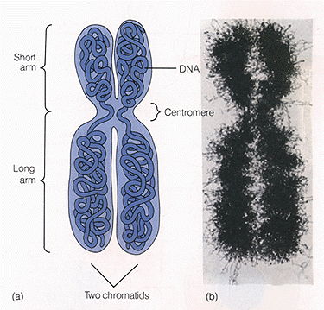
Chromosomes
http://www.copernicusproject.ucr.edu/ssi/HSBiologyResources.htm

Slide 16
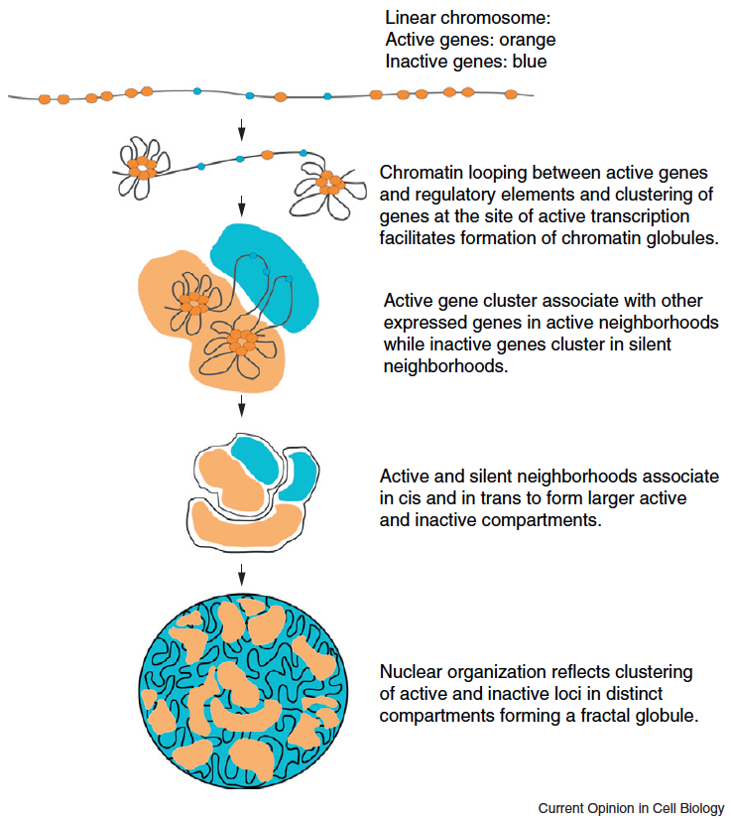
Two Compartments
A. Sanyal et al., Current Opinion in Cell Biology, 2011

Slide 17
Chromosome Conformation Capturing Techniques

Slide 18
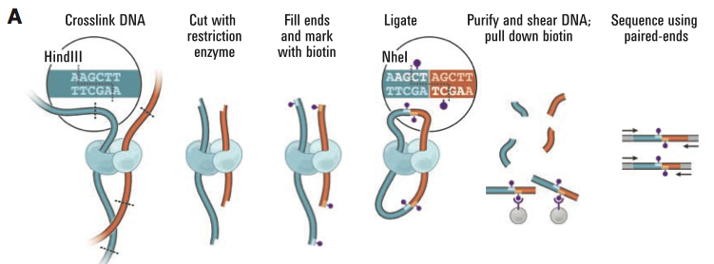
Chromosome Conformation Capturing (Hi-C)

Slide 19
Hi-C Protocol
Cells are cross-linked with formaldehyde
DNA is digested with a restriction enzyme and ligated, resulting enriched with cross-linked elements with a biotin marked at the junction
Shearing DNA and selecting biotin-containing fragments to create a Hi-C library
Sequence the library to create a catalog of interacting fragments

Slide 20

Genomic Spatial Interaction (Contact) Data
i
Map reads to the human
genome sequence
j
1 2 …… n
1
2
.
.
.
n
40 |  |  |  | 1
 | 3 |  | 8
 |  | 10
 | 8 |  | 15
1
C[i,j] = # contacts
Intra- / inter-chromosome contact map
Wang et al., 2013

Slide 21
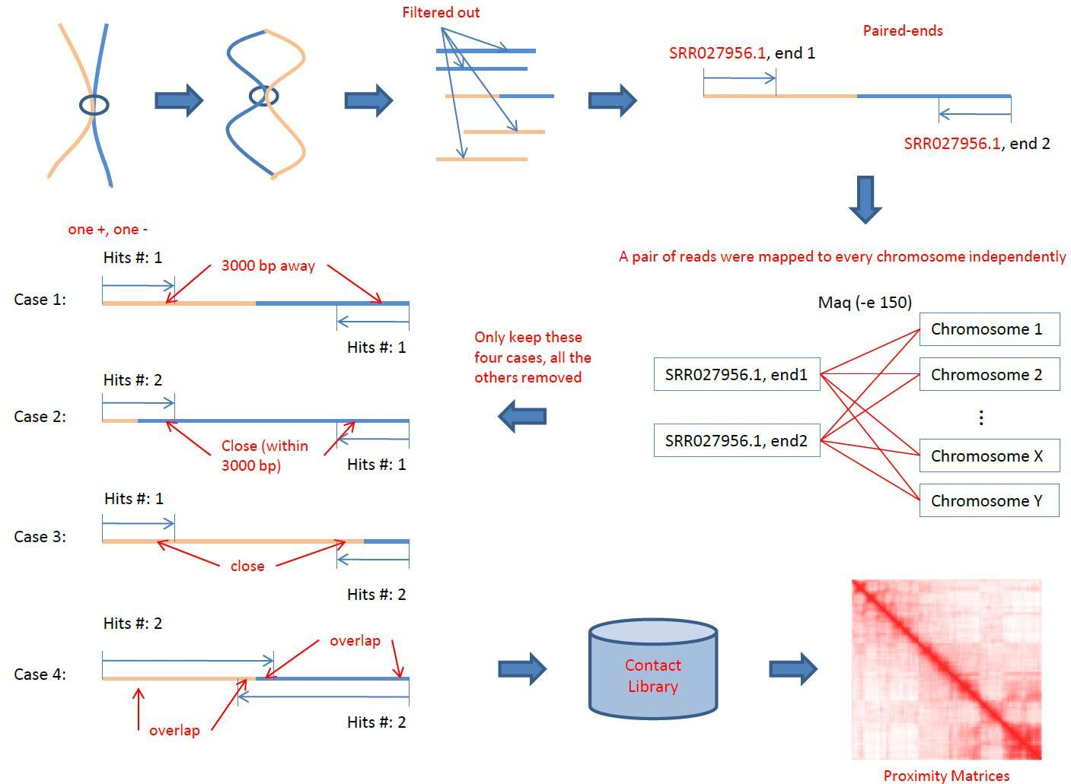
Hi-C Data Analysis Pipeline

Slide 22
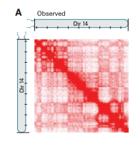
2D Chromosome Contact Map
Chromosome
Conformation
Capturing

Slide 23
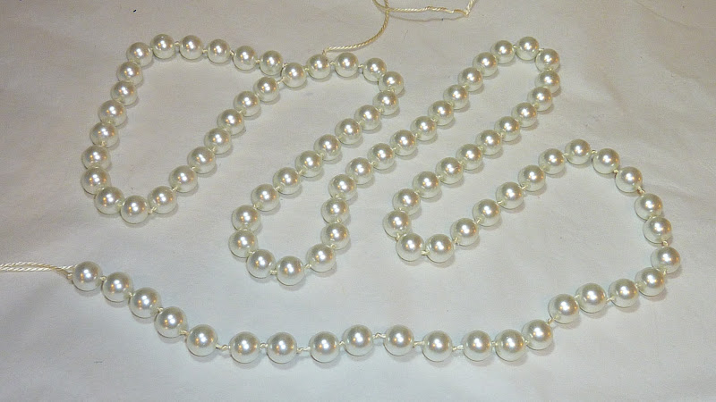
Construct 3D Shape of Genome
Images.google.com

Slide 24
Data Set I
A normal human lymphoblastoid cell line (B-cell)
8.4 million read pairs uniquely mapped to the human genome reference sequence
6.7 million corresponded to long-range contacts between segments > 20 kb apart
Liberman-Aiden et al., 2009

Slide 25
Genome Wide Contact Map
Divide genome into 1-Mb regions (loci)
M_{ij}: number of contacts between loci i and j
The matrix reflects an ensemble average of the interactions in the original sample of cells
Represented as a heat map

Slide 26
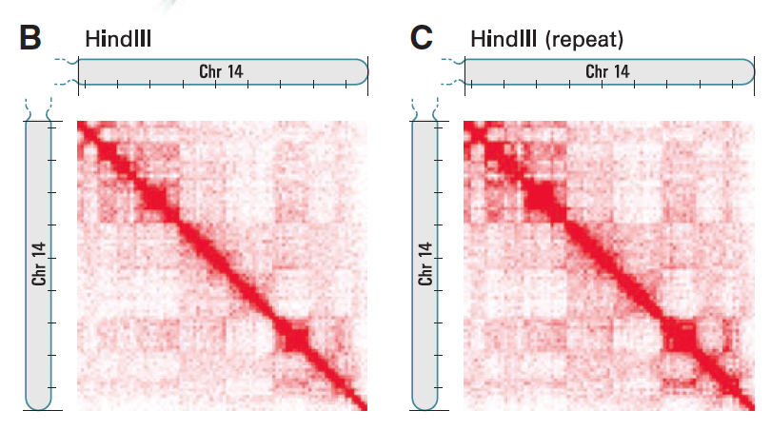
(B) Hi-C produces a genome-wide contact matrix. The submatrix shown here corresponds to intrachromosomal interactions on chromosome 14. (Chromosome 14 is acrocentric; the short arm is not shown.) Each pixel represents all interactions between a 1-Mb locus and another 1-Mb locus; intensity corresponds to the total number of reads (0 to 50). Tick marks appear every 10 Mb. (C ) We compared the original experiment with results from a biological repeat using the same restriction enzyme [(C), range from 0 to 50 reads]. Correlation is 0.99.

Slide 27
Relation between Euclidean Distance and Genomic Distance
Average intrachromosomal contact probability I_{n}(s) for pairs of loci separated by a genomic distance s on chromosome n.
I_{n}(s) decreases monotonically on every chromosome
Even at distances > 200 Mb, I_{n}(s) is always much greater than the average contact probability between different chromosomes

Slide 28
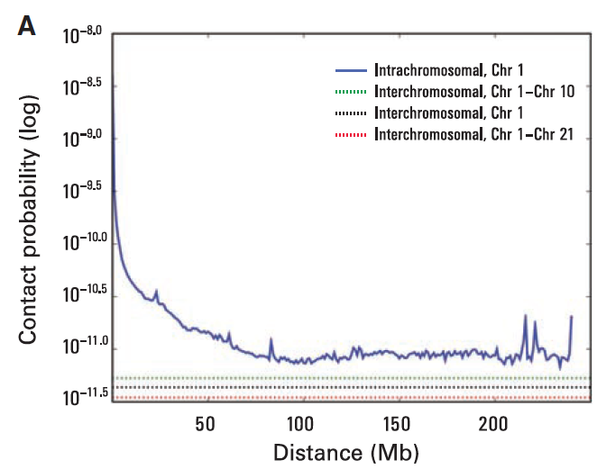
Implication:
Chromosome
territory
Probability of contact decreases as a function of genomic distance on chromosome 1,
eventually reaching a plateau at ~90 Mb (blue). The level of interchromosomal contact (black dashes) differs for different pairs of chromosomes; loci on chromosome 1 are most likely to interact with loci on chromosome 10 (green dashes) and least likely to interact with loci on chromosome 21 (red dashes). Interchromosomal interactions are depleted relative to intrachromosomal interactions.

Slide 29
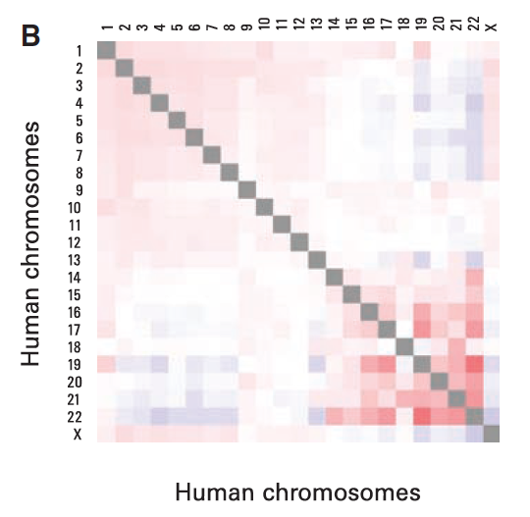
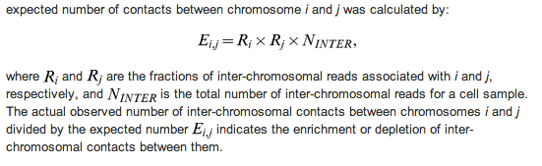
Observed/expected number of interchromosomal contacts
between all pairs of chromosomes. Red indicates enrichment, and blue indicates depletion (range from 0.5 to 2). Small, gene-rich chromosomes tend to interact
more with one another, suggesting that they cluster together in the nucleus.

Slide 30
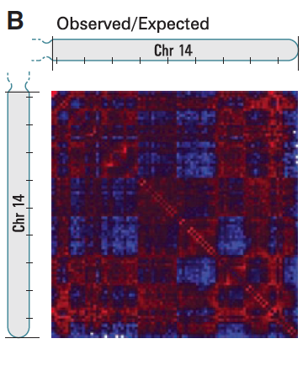
Normalizing Contact Map by Expected Number of Contacts at Genomic Distance
Dividing each entry in the contact matrix (M) by the genome-wide average contact probability for loci at that genomic distance. The normalized matrix shows many large blocks of enriched and depleted interactions, generating a plaid pattern

Slide 31
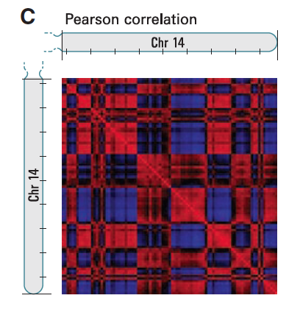
Pearson Correlation Map
If two loci (here 1-Mb regions) are nearby in space, we reasoned that they will share neighbors and have correlated interaction profiles.
This process dramatically sharpened
the plaid pattern; 71% of the resulting
matrix entries represent statistically significant
correlations (P ≤ 0.05).
The plaid pattern suggests that each chromosome can be decomposed into two sets of loci (arbitrarily labeled A and B) such that contacts within each set are enriched and contacts between sets are depleted.

Slide 32
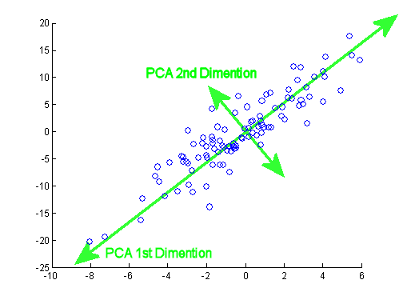
Principle Component Analysis
The first two principal components (PC) clearly corresponded to the plaid pattern (positive values defining one set, negative values the other).
The entire genome can be partitioned into two spatial compartments such that greater interaction occurs within each compartment rather than across compartments.

Slide 33
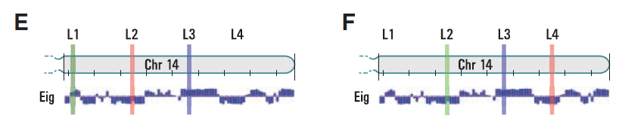
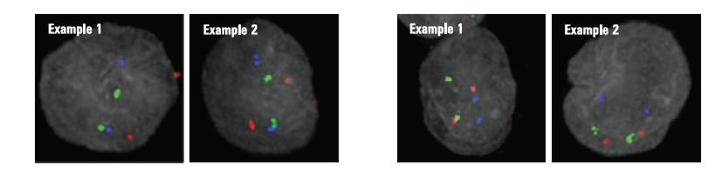
FISH Validation of Two Compartments
L1 – L3: Compartment A
L2 – L 4: Compartment B

Slide 34
# Contacts and Physical Distance Measured by FISH
A strong correlation was observed between the number of Hi-C reads m_{ij} and the 3D distance between locus i and locus j as measured by FISH [Spearman’s r = –0.916, P = 0.00003], suggesting that Hi-C read count may serve as a proxy for distance.
Pairs of loci in compartment B showed a consistently higher interaction frequency at a given genomic distance than pairs of loci in compartment A. This suggests that compartment B is more densely packed.

Slide 35
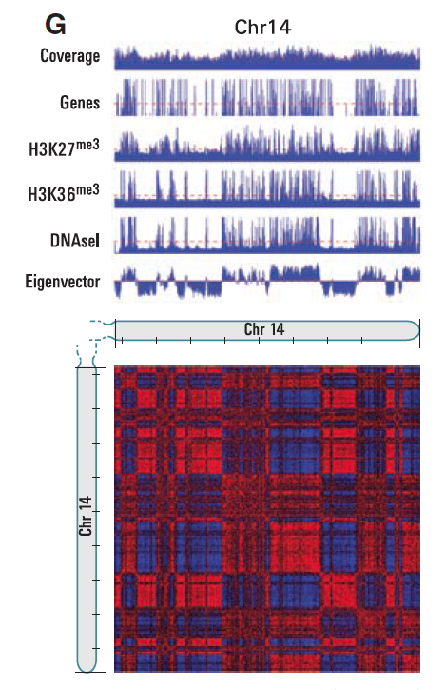
Open More Accessible, Gene Rich Compartment VS less Accessible
H3K27/H3K36: activating/repressive chromatin
Marks
DNAsel: deoxyribonuclease I, sensitivity, measure chromatin accessibility

Slide 36
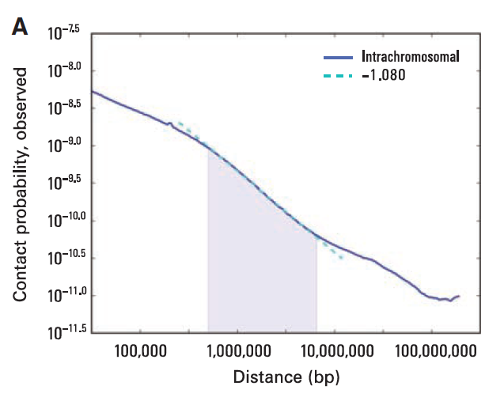
Contact Probability VS Genomic Distance (Power Law Distribution)
Contact probability as a function
of genomic distance averaged
across the genome (blue) shows
a power law scaling between
500 kb and 7 Mb (shaded region)
with a slope of –1.08 (fit
shown in cyan).
When plotted on log-log axes, I(s) exhibits a prominent power law scaling between ~500 kb and ~7 Mb, where contact probability scales as s^{–1}. This range corresponds to the known size of open and closed chromatin domains.

Slide 37
Genome 3D Model
Power-law dependencies can arise from polymer like behavior.
Equilibrium globule: a compact, densely knotted configuration originally used to describe a polymer in a poor solvent at equilibrium
Fractal Model: This highly compact state is formed by an unentangled polymer when it crumples into a series of small globules in a “beads-on-a-string” configuration. These beads serve as monomers in subsequent rounds of spontaneous crumpling until only a single globule of globules-of-globules remains.

Slide 38
Fractal Model
Lack knots and would facilitate unfolding and refolding, for example, during gene activation, gene repression, or the cell cycle.
In a fractal globule, contiguous regions of the genome tend to form spatial sectors whose size corresponds to the length of the original region.
In contrast, an equilibrium globule is highly knotted and lacks such sectors; instead, linear and spatial positions are largely decorrelated

Slide 39
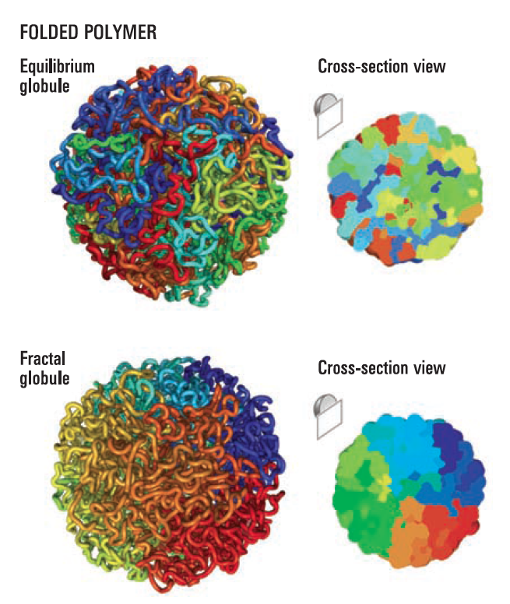
Comparison of Two Models

Slide 40
Consistency Checking
The equilibrium globule model predicts that contact probability will scale as s^{–3/2}, which we do not observe in our data.
We analytically derived the contact probability for a fractal globule and found that it decays as s^{–1}; this corresponds closely with the prominent scaling we observed (s^{–1.08}).
3D distance between pairs of loci: s^{1/2} for an equilibrium globule, s^{1/3} for a fractal globule. Although 3D distance is not directly measured by Hi-C, we note that a recent paper using 3D-FISH reported an s^{1/3} scaling for genomic distances between 500 kb and 2 Mb

Slide 41
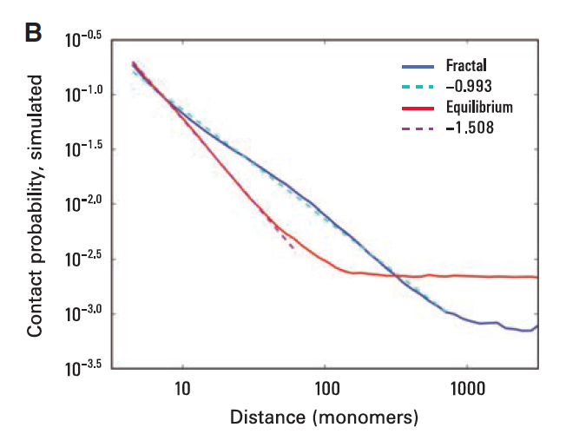
MCMC Simulation Validation
Monte Carlo simulations to construct ensembles of fractal globules and equilibrium globules (500 each).
Contact probability (for fractal globules, s^{–1}, and for equilibrium globules, s^{–3/2})
3D distance (for fractal globules s^{1/3}, for equilibrium globules s^{1/2})
Lack of entanglements and the formation of spatial sectors within a fractal globule.

Slide 42
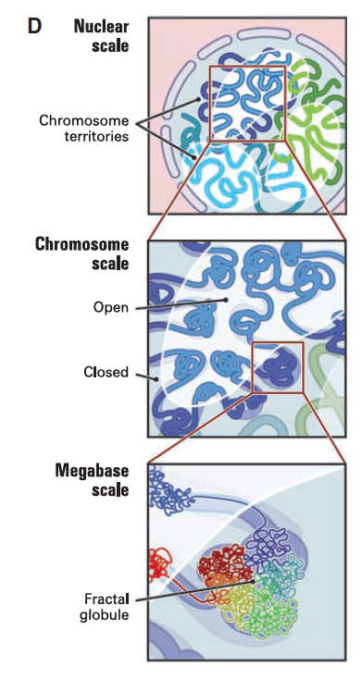
Multi-Scale Fractal Model

Slide 43
Hi-C Data Analysis II
Z. Wang, R. Cao, K. Taylor, A. Briley, C. Caldwell, J. Cheng. The Properties of Genome Conformation and Spatial Gene Interaction and Regulation Networks of Normal and Malignant Human Cell Types. PLoS ONE. 2013

Slide 44
Data Sets
Primary human acute lymphoblastic leukemia (B-ALL) B-cell
The MHH-CALL-4 B-ALL cell line (CALL4)
The follicular lymphoma cell-line (RL)
Sequenced by Illumina HiSeq 2000

Slide 45
Number of Reads of
the samples
Read coverage

Slide 46
Read Quality

Slide 47
Mapping Reads to Human Genome

Slide 48
Un-normalized intra-chromosomal heat maps for primary ALL B-Cell

Slide 49
Normalized intra-chromosomal heat maps for primary ALL B-Cell Sequential Component Normalization: M[i,j] / |M[i]| M[i,j] / |M[j]| Repeat until symmetric

Slide 50
Contact Correlation Between Cell Types
Correlate intra-contact numbers of 23 pairs of chromosomes

Slide 51
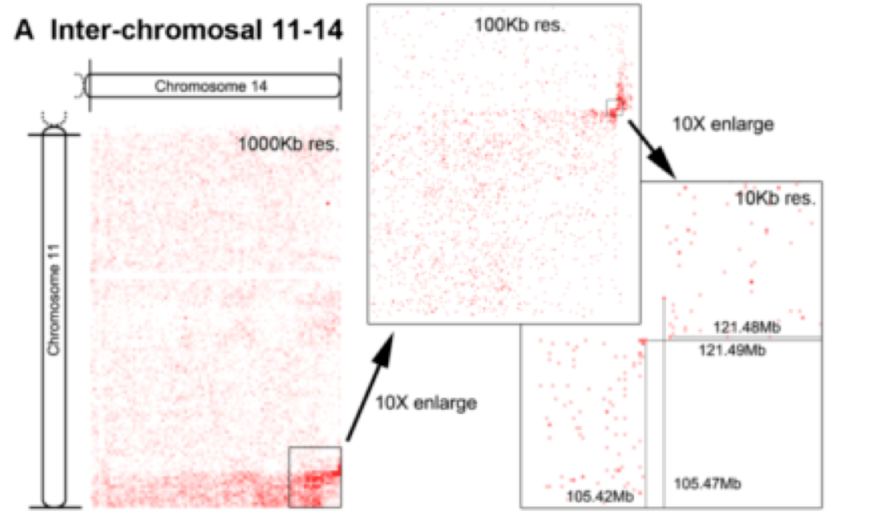
Inter-Chromosome Contacts and Chromosome Translocation

Slide 52
Cancer Causing Chromosome Translocation
Reconstruction of translocated
chromosomes
Two cancer related genes

Slide 53
Comparison of Inter-Chromosome Contact Profiles of Different Cells

Slide 54
Gene-Gene Contact Map of HoxA Gene Cluster: HoxA gene region (27,104,502 – 27,212,501) on chromosome 7, Transcription factor controlling embrynoic development

Slide 55
Hi-C Databases
4DN data portal: https://data.4dnucleome.org
ENCODE database: https://www.encodeproject.org

Slide 56
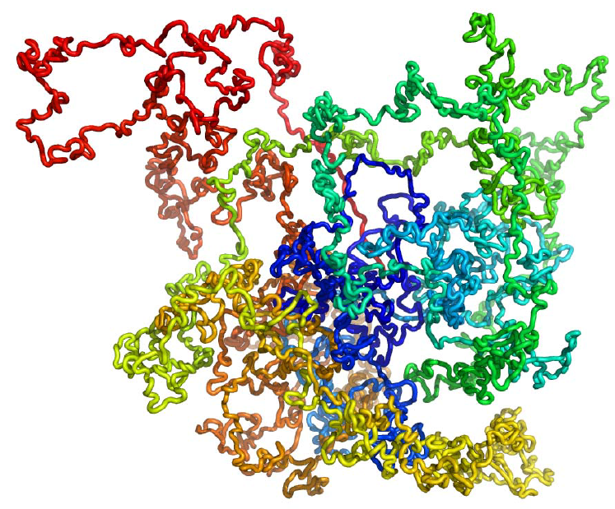
3D Genome Structure Modeling
Trieu, Cheng, 2014
Notes:
We consider each region of genome as a bead and the entire genome is a string of beads. Then we place those beads in 3D such that the distances between beads are consistent with the 2D contact map.

Slide 57
Spatial Representation of Chromsome or Genome
……
Divided into N equal-size (e.g. 1MB) consecutive units sequentially
The center of a unit is denoted by a point and its coordinate (x, y, z)
Trieu, Cheng, 2014

Slide 58
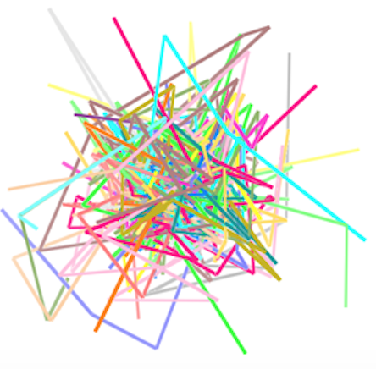
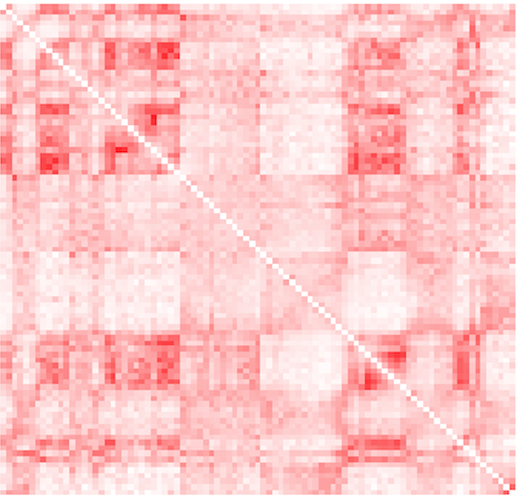
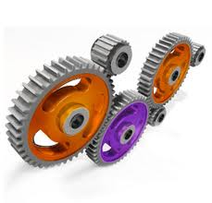
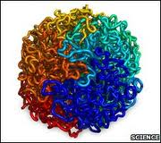
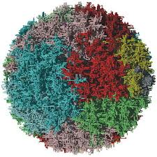

Contact Driven Structure Modeling
Random
Structure
Normalized
Contact Map
Permutation & Optimization
Trieu, Cheng, 2014

Slide 59
Opportunities
Chromosome contact data can be generated easily and cheaply
Chromosome contact data is rather reliable
A 3D model of a genome is very valuable in studying spatial regulation of gene expression and methylation

Slide 60
Challenges
Genome and chromosome is very large (3 billion nucleotide of human genome)
Genome structure is very dynamic
No known experimental genome structure other than some point distance data generated by FISH
Relationship between contact and distance is not deterministic
Hi-C data is noisy

Slide 61
Maximum Likelihood or Distance-Based Approaches
Convert interaction frequency (contact number) into distance
or
Translate distance into (x, y, z) coordinates
d ∝ 1 / IFª
IF ∝ 1 / dª

Slide 62
A MCMC Approach
M. Rousseau, J. Fraser, M.A. Ferraiuolo, J. Dostie, M. Blanchette. Three-dimensional modeling of chromatin structure from interaction frequency data using Markov chain Monte Carlo sampling. BMC Bioinformatics, 2011.

Slide 63
MCMC5C
Formulate a probabilistic model linking 5C/Hi-C data to physical distances
Markov chain Monte Carlo (MCMC) approach called MCMC5C to generate a representative sample from the posterior distribution over structures from IF data.

Slide 64
MCMC5C
Structural properties (base looping, condensation, and local density) were defined in the models
Applied these methods to a biological model of human myelomonocyte cellular differentiation and identified distinct chromatin conformation signatures corresponding to each of the cellular states.
run on Hi-C data and produce a model of human chromosome 14 at 1Mb resolution that is consistent with previously observed structural properties as measured by 3D-FISH.

Slide 65
Other Existing Methods
5C3D (Fraser et al.): translates IF values into physical distance estimates and then uses a gradient descent approach to find the 3D conformations.

Slide 66
Other Existing Methods
Bau et al. Interactions are modeled with springs whose equilibrium length depends on the observed IF values, subject to certain constraints based on the structure of the 30-nm fiber, optimized by Integrative Modeling Platform.

Slide 67
Other Existing Methods
Duan et al., convert interaction frequencies to Euclidean distances and then seek conformation minimizing the misfit, with addition of a set of clash avoidance constraints and a few prior known knowledge about the yeast genome organization. The constrained optimization problem is solved to find the best structure.

Slide 68
Possible Drawbacks of Existing Methods
Objective function (sum of square difference between predicted and derived distance) is debatable.
Assume each IF is equally reliable.
The absence of an underlying probabilistic model, preventing the calculation of confidence intervals on specific structural properties (e.g. distance between two genomic sites)

Slide 69

Probabilistic Model of Chromatin Conformation
A chromosome is modeled as a continuous piece-wise linear curve in 3D.
Theoretical interaction frequency between fragment i an j, denoted IF(i, j), is inversely correlated with the distance between two fragments in 3D conformation: IF(i,j) = f(D_{s}(i,j)), where D_{s}(i,j) is the Euclidean distance between sites i and j and f is an appropriately chosen function.

Slide 70

Probabilistic Model of Observed IF and Theoretical IF

Slide 71

Observed IF and Theoretical IF (Hi-C)

Slide 72

Posterior Probability (Structure | IF data)

Slide 73
Sampling Conformations from Posterior Distribution to maximize probability
A random structure R₀ is initially chosen to seed the process (t=0), where each point is placed randomly in a cube of side length 10*avg(f(IF)).
Repeat: The current structure R_{t} is randomly perturbed to obtain a new structure R_{t’}. If Pr[R_{t’}|IF] > Pr[R_{t}|IF], the perturbation is obtained and we set R_{t+1} = R_{t’}. Otherwise, we set R_{t+1} = R_{t}.
For values of t sufficiently large, find a structure with high probability: Pr[S|IF], let R_{t}=S.

Slide 74
Random Structure Perturbation
Randomly choose one point S(i) along the structure and moving it by a vector v randomly choosing within a sphere of radius r (e.g. r = 0.25 nm)
The likelihood of the resulting structure is then quickly obtained from that of the old by updating the terms corresponding to the pairs of points involving i.

Slide 75
Assessing Mixing
R₁, …, R_{k} of early iterations are highly dependent on R₀.
Determine at what point m, the Markov process has mixed, i.e., R_{m} is independent of R₀
After mixing, i.e. for k>= m, any sample R_{k} is representative of the target distribution. For d sufficiently large, R_{k} and R_{k+d} are independent.

Slide 76
Convergence Determination
Run two independent chains R and R’ in parallel, from independently chosen initial conformations R₀ and R_{0’}.
Mixing is achieved if the samples {R_{k/2}, … R_{k}} and {R’_{k/2}, …, R’_{k}} cannot be distinguished from each other. Specifically, the average pairwise structural distances among R_{k} is compared to that between R_{k} and R_{k’}.
After mixing is achieved, collect samples every d=k/20 iterations.

Slide 77

Clustering of Structure Ensembles
Distance metric: N*N intra-structure distance matrix Ds.
The distance (S,T) between two structures S and T is:

Slide 78
Structure Clustering
Hierarchical clustering
Visualization: tree dendrogram
Visual inspection is performed to determine the tree height cutoff and number of subfamilies
Choose maximum likelihood structure from each cluster as representative and assigning it a weight proportional to the number of structures in its cluster.

Slide 79

Hierarchical Clustering

Slide 80

Convert IF to distance
The most accurate model is the one that is best able to predict unseen pairwise interaction frequencies. For each of a set of possible a leave-one-out cross-validation was performed. Find a to minimize

Slide 81


Slide 82
C (Distance Scaling Factor) Calibration
Without physical measurement of the distance between pairs of points along the sequence, it is difficult to accurately estimate the value of C . However, based on the average IF value of pairs of fragments located less than 5kb apart along the sequence and following Bystricky et al . [51] that packed chromatin has a physical length of 1 nm for every 110-150bp, C was estimated as approximately 50 nm.

Slide 83

Assessment of
Mixing

Slide 84
Experiment
Figure 4 shows that mixing is achieved after approximately 350 * 10⁵ iterations, which requires less than 250 seconds of running time. Passed this point, structures sampled every 10⁶ steps from the two parallel runs are undistinguishable from each other and sample structures from the same distribution.
250 structures were sampled after burn-in from each of the two runs. The two ensembles of structures were then combined and the 500 structures were clustered based on their structural similarity
Analysis of the two THP-1 5C datasets produced similar results, and runs of a larger number of parallel MCMC chains confirm that they all sample similar structures.

Slide 85
Simulation Verification
Gold structure: a computationally constructed 3D structure used to generated IF data.
Simulated structure: models constructed from the IF data of the gold structure.

Slide 86

Verification by Sampling from Simulated True Structures

Slide 87

Structure Clustering and Sub-Structure Families. Sub-structure families may correspond to chromatin structures of cells in different stages

Slide 88

Conformations of HoxA in Undifferentiated and Differentiated Conditions

Slide 89


Slide 90
Structural Variation and Conservation
The subset of fragments that are the most conserved across the ensemble of structures are found to lie within the central core region of the structures. These fragments are spatially close to each other and may be involved in looping contacts that are important for the maintenance of the chromatin structure and are therefore highly conserved.

Slide 91
On Hi-C Data (Data Set II)
Model the long arm of human chromosome 14 (88.4 Mb region) from Hi-C data published by Lieberman-Aiden et al . [18] at a 1Mb resolution (89 fragments in total). Lieberman- Aiden et al . [18] proposed the existence of two physically disjoint compartments, whereby compartment A was found to correlate with open and actively transcribed chromatin, while compartment B was found to be more densely packed and repressed.

Slide 92
MCMC5C Availability
MCMC5C modeling movie: https://www.youtube.com/watch?v=2aIQvUDlGNc

Slide 93
Distance-based approach: convert IF to distance
Duan et al., the resulting conversion approximately follows d ∝ 1/IF .
Mateos-Langerak et al . [50] also suggest a relationship of the form d ∝ 1 / IFª .
Bau et al . [28] convert their IF via a linear transformation of the IF’ s z-score.

Slide 94
Spatial Representation of A Genome Region at a Scale
……
A genome region (e.g. a chromosome) is divided into N equal / variable size units sequentially
The spatial position of the center of a unit is denoted by a point and its coordinate (x, y, z) and constraints on the size of unit (radius of sphere)
The consecutive points are joined into fragments forming the folding trace of the region.
J. Cheng, NSF CAREER Project Plan, 2011, 2012, 2013

Slide 95
Structure Construction at One Scale
Initial Structure Representation of Units
Contact Map Between Units
Sampling & Optimization
J. Cheng, NSF CAREER Project Plan, 2011, 2012, 2013

Slide 96



A Data Driven Optimization Approach
Convert observed interaction frequencies into distance map
Objective: Adjust positions (x,y,z coordinates) of beads in 3D space to satisfy converted expected distances as well as possible
Challenges: approximated distances, noise, conflicts
$$i$$
Conversion
$$j$$
Hi-C contact map
Approximated spatial distance matrix
α: conversion parameter (positive number)
Tuan and Cheng, NAR, 2017
Notes:
Again, the same approach is to convert Hi-C data into a set of constraints. But this time IF is converted into distances with assumption that spatial distances are inversely correlated with interaction frequencies. So, a common function used by other researchers is this function.
The alpha here is unknown and we have to look for it. Then, the objective to place bead in 3D models that satisfy wish distances as much as possible. The challenge of this approach is that wish distances are just approximation and they are conflicting with each other.
This time, I have equality constraints. With similar spirit in my previous method

Slide 97
Problem of Traditional Objective Functions
Square Error
Very sensitive to noisy / conflicting distances
Cannot build 3D models of large genomes involving noisy inter-chromosomal contacts

Slide 98


Deriving Soft Constraints by Lorentzian Function
Use Lorentzian function to measure the satisfaction of a distance restraint
[0, 1]
Tolerate noisy restraints and maximize the satisfaction of feasible restraints
Constraint is satisfied
Constraint is “less” satisfied
Tuan and Cheng, NAR, 2017

Slide 99

Objective Function
Objective function
Sum of all distance constraints
Adjacent beads have maximum weight to enforce their proximity
c is set to average of d_{ij} to control gradient vanishing during optimization
Tuan and Cheng, NAR, 2017

Slide 100

Large-Scale Adaptive Step-Size Gradient Ascent

Slide 101

Tuan and Cheng, NAR, 2017

Slide 102
Correlation Between Reconstructed Distances and True Distances
Yeast datasets (Duan et al. Nature 2010)
Notes:
PM2 is also named Pastis

Slide 103

3D Genome Model for Human

Slide 104

A Open Source Tool - LorDG
Github: https://github.com/BDM-Lab/LorDG

Slide 105
Contact-Driven Modeling at Chromosome Scale
Input: initial representation of chromosome, contact map, and physical distance restraints
Objective: find 3D chromosome structures that satisfy the contact map and physical contact restraints as much as possible.
Scoring Function
Optimization
Output: an ensemble of 3D shapes
J. Cheng, NSF CAREER Project Plan, 2011, 2012, 2013

Slide 106
Data Preparation
Data Sets: Normal B-Cell, ALL B-Cell
Unit Size: 1Mb
Unit Number: Chr. 1, 248 – Chr. 22, 50
Contact map normalization: C_{ij}’ = C_{ij} / expected IF
Remove noisy contacts with low interaction frequency
Normalized Interaction Frequencies (IF) on the normal B-Cell

Slide 107


Scoring Function for Optimization
tanh: hyperbolic tangent function
IF_{ij}: interaction frequency between units i and j
T: total interaction frequencies
d_{c}: contact distance threshold
d_{min}: minimum distance between two units
d_{max}: maximum distance between two units
da_{max}: maximum distance between two adjacent units
W1, W2, W3, W4: weight parameters in order to maximize % satisfied contacts + % satisfied non-contacts

Slide 109
Estimating Parameters
FISH data (Mateos-Langerak et al., 2009) for physical distances of Chr. 1 and 11 at various genomic distances
d_{min}, da_{max}: min and max distance between pairs at 1Mb away. (0.2 um , 1.8 um)
d_{max}: max distance between all pairs
d_{c}: a threshold resulting in the same percent of contacts in our data
d_{c} and d_{max} are chromosome length dependent (1.73 – 2.24 um, 2.45 – 3.32 um)

Slide 110
Steepest Gradient Ascent with Backtracking Line Search
Random Initialization: (x₁⁰ y₁⁰, z₁⁰), (x₂⁰ y₂⁰, z₂⁰),…, (x_{N}⁰ y_{N}⁰, z_{N}⁰) in [-0.5, 0.5]
Update:
X₁^{t+1} = X₁^{t} + η*ΔX
Y₁^{t+1} = Y₁^{t} + η*ΔY
Z₁^{t+1} = Z₁^{t} + η*ΔZ
X₂^{t+1} = X₂^{t} + η*ΔX
Y₂^{t+1} = Y₂^{t} + η*ΔY
Z₂^{t+1} = Z₂^{t} + η*ΔZ
.
.
.
X_{N}^{t+1} = X₁^{t} + η*ΔX
Y_{N}^{t+1} = Y₁^{t} + η*ΔY
Z_{N}^{t+1} = Z₁^{t} + η*ΔZ
Step size (η) is adjusted dynamically during iterations to avoid too big moves.

Slide 111

Structure Modeling Movie

Slide 112
Structure Modeling Movie
At YouTube without music: http://www.youtube.com/watch?v=C03R7A9kYc8
At NSF CAREER project web site with music:
http://people.cs.missouri.edu/~chengji/genome_modeling_movie.mp4
J. Cheng, NSF CAREER Project Plan, 2011, 2012, 2013. T. Tuan made the movie.

Slide 113



Two Compartment Validation on Normal B-Cell
Chromosome 7
Purple and green denote regions in two different components
using principle component analysis on contact correlation map
J. Cheng, NSF CAREER Project Plan, 2011, 2012, 2013

Slide 114
Model Selection
Use TM-Score (Zhang & Skolnick, 2004) to superpose every pair of models in an ensemble of models
Calculate GDT-HA score: percent of unit pairs within specific distance thresholds
Choose centroid model as representative

Slide 115
Satisfaction of Contacts in Representative Models of Normal B-Cell

Slide 116

Violations of Contacts on Normal B-Cell

Slide 117

3D Models for 22 Chromosomes of Normal B-Cell
J. Cheng, NSF CAREER Project Plan, 2011, 2012, 2013

Slide 118

Models: 200KB resolution

Slide 119


Models of Chr. 2 for Normal and Malignant Cells
Primary Leukemia B-Cell
Normal B-Cell
J. Cheng, NSF CAREER Project Plan, 2011, 2012, 2013

Slide 120

Model Consistency
The similarity scores measured as average GDT-HA scores. Y-axis denotes the similarity scores and X-axis the indices of chromosomes. ‘Blue bars’ represent the average GDT-HA scores of models within the same model ensemble constructed from the whole normalized data sets of the normal B-cell for each chromosome, ‘red bars’ the average GDT-HA scores between models constructed from sampled data sets with those constructed from the whole data sets and ‘green bars’ the average GDT-HA scores between models of the leukemia B-cell and those of the normal B-cell.
Trieu T , and Cheng J Nucl. Acids Res. 2014;nar.gkt1411
© The Author(s) 2014. Published by Oxford University Press.
Notes:
The similarity scores measured as average GDT-HA scores. Y-axis denotes the similarity scores and X-axis the indices of chromosomes. ‘Blue bars’ represent the average GDT-HA scores of models within the same model ensemble constructed from the whole normalized data sets of the normal B-cell for each chromosome, ‘red bars’ the average GDT-HA scores between models constructed from sampled data sets with those constructed from the whole data sets and ‘green bars’ the average GDT-HA scores between models of the leukemia B-cell and those of the normal B-cell.

Slide 121


The percentage of recovered contacts in all chromosomes in validation
Trieu T , and Cheng J Nucl. Acids Res. 2014;nar.gkt1411
© The Author(s) 2014. Published by Oxford University Press.
Notes:
The percentage of recovered contacts in all chromosomes.

Slide 122

The superimposition of the plots of IFs of all missing contacts and the plots of IFs of recovered contacts for chromosome 1 (left) and chromosome 11 (right).
The superimposition of the plots of IFs of all missing contacts and the plots of IFs of recovered contacts for chromosome 1 (left) and chromosome 11 (right). Y-axis denotes interaction frequencies and X-axis the indices of contacts. The green tails visualized the contacts that were not recovered and had lower IFs.
© The Author(s) 2014. Published by Oxford University Press.
Notes:
The superimposition of the plots of IFs of all missing contacts and the plots of IFs of recovered contacts for chromosome 1 (left) and chromosome 11 (right). Y-axis denotes interaction frequencies and X-axis the indices of contacts. The green tails visualized the contacts that were not recovered and had lower IFs.

Slide 123

Average of spatial distances and IFs of region pairs within and across (between) compartments in chromosomes 1 and 11.
Trieu T , and Cheng J Nucl. Acids Res. 2014;nar.gkt1411
© The Author(s) 2014. Published by Oxford University Press.
Notes:
Average of spatial distances and IFs of region pairs within and across (between) compartments in chromosomes 1 and 11. Red: region pairs in heterochromatin compartment; green: region pairs in euchromatin compartment; and blue: region pairs across/between two compartments.

Slide 124

The contact scores and non-contact scores of the chromosomal models of the leukemia B-cell.
Trieu T , and Cheng J Nucl. Acids Res. 2014;nar.gkt1411
© The Author(s) 2014. Published by Oxford University Press.
Notes:
The contact scores and non-contact scores of the chromosomal models of the leukemia B-cell.

Slide 125

The models of chromosome 1 at resolution of 200 K (A) and at resolution of 1 MB (B).
Trieu T , and Cheng J Nucl. Acids Res. 2014;nar.gkt1411
© The Author(s) 2014. Published by Oxford University Press.
Notes:
The models of chromosome 1 at resolution of 200 K (A) and at resolution of 1 MB (B).

Slide 126

Pairwise comparison:
1Mb versus 200Kb

Slide 127


Scoring Function for Genome Optimization
Contact Pairs
Adjacent Pairs
Non-contacts on
same chromosome
Non-contacts on
different
chromosomes
Trieu, Cheng, Bioinformatics, 2016

Slide 128

Modeling of 3D Genome

Slide 129

Test on Simulated Data of the Yeast Genome Structure
Known Structure (Duan et al., 2010)
Reconstructed Model
Trieu, Cheng, Bioinformatics, 2016

Slide 130

A 3D Model of Genome of Human B-Cell in an Ensemble
Trieu, Cheng, Bioinformatics, 2016

Slide 131

Largely Conserved Chromosomal Structure, Dynamic Genome Structure
Chromosome 11
Pairwise structural similarity between chromosomal models: 0.71
Pairwise structural similarity between genome models: 0.16
Trieu, Cheng, Bioinformatics, 2016

Slide 132
Center – Periphery Architecture and Dynamic Inter-chromosomal Interactions
Small chromosomes in center
Large chromosomes in periphery
Genome structure ensemble (dynamics)
Correlation of inter-chromosomal interactions (0.48), p-value < e-16
Trieu, Cheng, Bioinformatics, 2016

Slide 133

Enriched Telomere and Centromere Inter-Chromosomal Interactions
Telomere-telomere interactions > telomere/centromere interactions > other interactions
Trieu, Cheng, Bioinformatics, 2016

Slide 134

MOGEN: Model of Genome (Tool)
http://calla.rnet.missouri.edu/mogen/

Slide 135

MOGEN at GitHub
https://github.com/BDM-Lab/MOGEN
Trieu, Tuan, and Jianlin Cheng. "MOGEN: a tool for reconstructing 3D models of genomes from chromosomal conformation capturing data." Bioinformatics 32.9 (2015): 1286-1292.

Slide 136

3D Structure of the Entire Genome

Slide 137

Smaller Chromosomes are Closer to the Center

Slide 138


Slide 139

GMOL - Multi-Scale Visualization of 3D Genome Structure

Slide 140
Project 4
Apply a gradient descent method LorDG / MOGEN to build 3D models for human chromosome 7.
References: (1) T. Trieu, J. Cheng. 3D Genome Structure Modeling by Lorentzian Objective Function. Nucleic Acids Research, accepted, 2016; (2) Trieu, Cheng. Large-scale reconstruction of 3D structures of human chromosomes from chromosomal contact data. Nucleic Acids Research, 2014; (3) T. Tuan, J. Cheng. MOGEN: a tool for reconstructing 3D models of genomes from chromosomal conformation capturing data. Bioinformatics, accepted, doi: 10.1093/bioinformatics/btv754.
How to assess the models (check the paper)?
Visualization of models
Reference models (constructed from somewhat different contact data of Chr. 7: http://calla.rnet.missouri.edu/mogen/
LorDG at GitHub: https://github.com/BDM-Lab/LorDG
MOGEN at GitHub: https://github.com/BDM-Lab/MOGEN

Slide 141
Data II: Hi-C data of Chromosome 7
HWI-EAS313_0025:7:78:7863:19096|7 40786044 7 45502707|case 0
HWI-EAS313_0025:7:63:14188:6924|7 128562332 7 128562745|case 0
HWI-EAS313_0025:7:94:3739:17610|7 154672365 7 154672125|case 0
HWI-EAS313_0025:7:78:17921:8167|7 90166635 7 90166267|case 0
HWI-EAS313_0025:7:98:5753:2860|7 146851262 7 82792917|case 0
WI-EAS313_0025:7:104:3993:13804|7 101472788 7 101472557|case 0
HWI-EAS313_0025:7:4:13123:19420|7 63615352 7 62522230|case 0
HWI-EAS313_0025:7:54:7610:3364|7 24688078 7 24687498|case 0
HWI-EAS313_0025:7:6:8245:1169|7 47788402 7 47788122|case 0
http://sysbio.rnet.missouri.edu/3dgenome/contact_ALL_chrom7
The LorDG /MOGEN software package includes some sample data and examples of how to run the program.

Slide 142
Timeline
April 30: discussion of plan
May2: presentation of the plan
May 9: Presentation of your results

Slide 143



Acknowledgements
Tuan Trieu, Oluwatosin Oluwadare, Chenfeng He, Sharif Ahmed, Lingfei Xu
Zheng Wang, Renzhi Cao, Avery Wells
Charles Caldwell, Kristen Taylor, Aaron Briley

