Slide 1
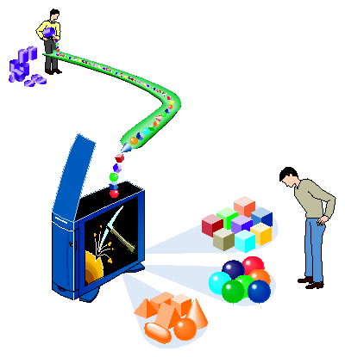
Center
for
Machine Learning
Data Mining
Jianlin Cheng, PhD
Computer Science Department, University of Missouri, Columbia

Slide 2
Importance of Machine Learning and Data Mining
Computer Science (AI, database, robotics, vision, image processing, bioinformatics, …)
Scientific Research (big data challenges, NSF, NIH)
Economy (data mining, analytics companies)
Society (social interaction, health care, policy making, politics)

Slide 3
Demand for the Center
Academia (research and teaching jobs)
Industry (Google, Microsoft, Amazon, Facebook, IBM, …)
University of Missouri (science, humanities, engineering)
Computer Science Department

Slide 4
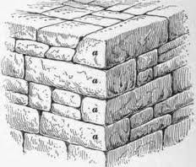
Foundation of the Center
Faculty research and education
Students interests
Collaboration opportunities
Funding opportunities

Slide 5
Research Objectives
Research Collaborations (CS, ECE, Natural Science, Social Science, Humanities, Statistics)
Theoretical Research in Machine Learning and Data Mining
Applications (biomedical, web, social network, e-commerce, finance, humanities)

Slide 6
Funding Opportunities
NSF IGERT Training Grant
DoE GAANN Training Grant
NSF Information and Intelligent Systems
NSF Big Data Challenge
NSF Advance in Bioinformatics (ABI)
NIH Big Data Program (upcoming)
Industry Partnership
Foundations

Slide 7
Education Objectives
Develop seminar
Participate in national and international conferences
Enrich machine learning and data mining curriculum
Train graduate students in research
Prepare undergraduate students

Slide 8
Management
Committee & Director
Research Grants (RIF distribution)
Academic & Industrial Relationship
Seminar and Journal Club
Other (travel funding, external speakers, student scholarship, faculty fellowship)

Slide 9
Thank you! Questions / Suggestions?
Acknowledgements: images.google.com

