Slide 1

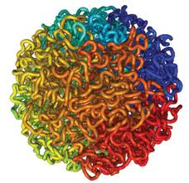

Reconstruction of 3D Human Genome Structure
Jianlin Jack Cheng
Associate Professor
Computer Science Department
University of Missouri, Columbia
GLBIO, 2014

Slide 2

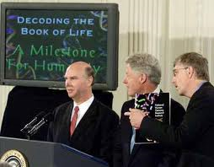
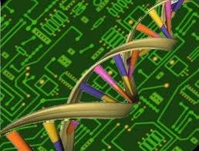

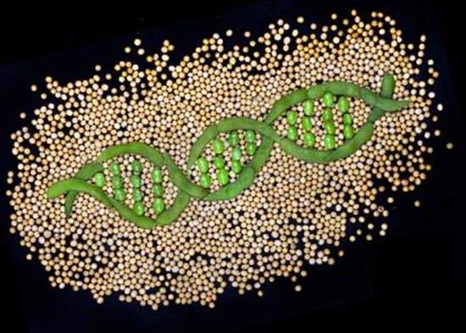

The Genomic Era
Collins, Venter, Human Genome, 2000
images.google.com

Slide 3
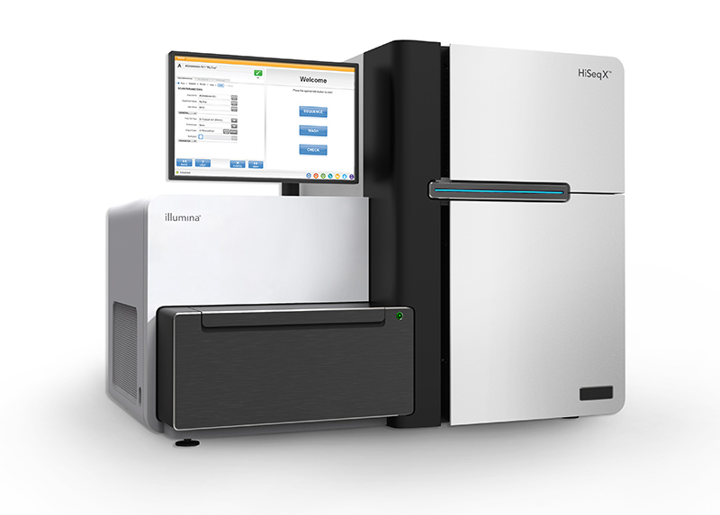
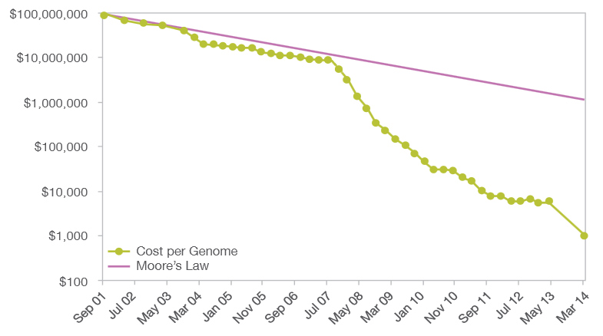

$1000 Personal Genome!
http://www.futuretimeline.net/blog/2014/01/16.htm#.U3Vg-FhdWzs

Slide 4
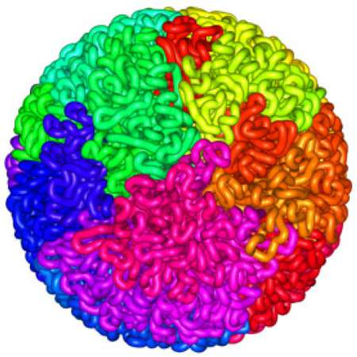
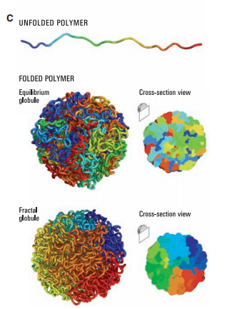
3D
Shape
Liberman-Aiden et al., 2009

Slide 5
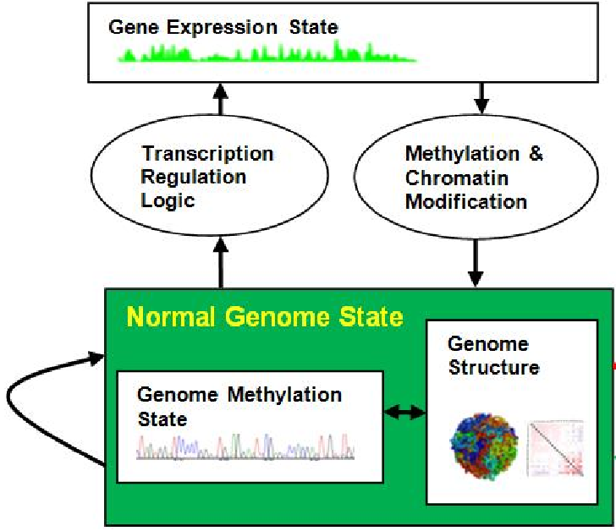
3D Genome Structure is Important
Cheng et al., unpublished.

Slide 6
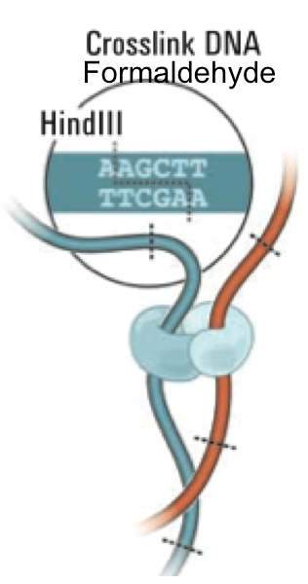
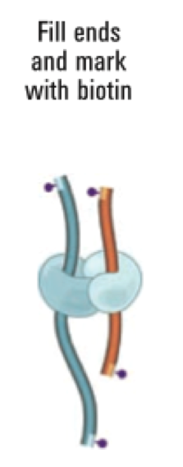
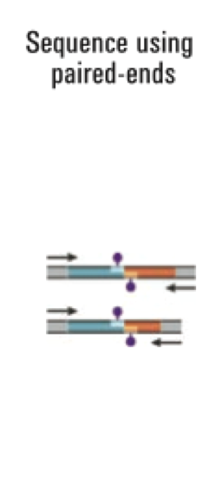
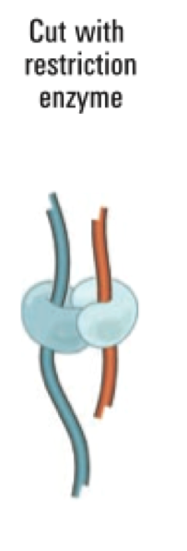
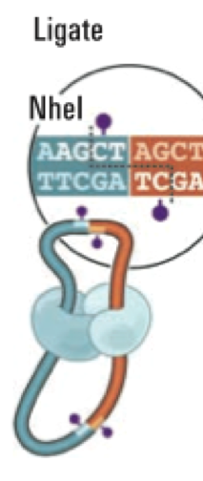
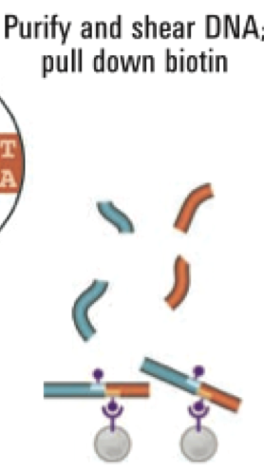
Chromosome Conformation Capturing (Hi-C)
Liberman-Aiden et al., 2009

Slide 7

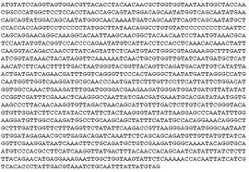
Genomic Spatial Interaction (Contact) Data
i
Map reads to the human
genome sequence
j
1 2 …… n
1
2
.
.
.
n
40 |  |  |  | 1
 | 3 |  | 8
 |  | 10
 | 8 |  | 15
1
C[i,j] = # contacts
Intra- / inter-chromosome contact map
Wang et al., 2013

Slide 8
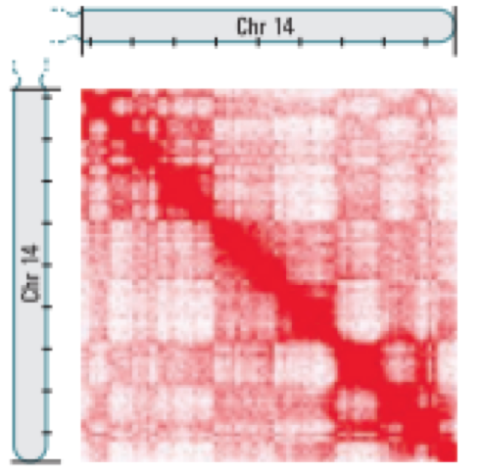
Intra-Chromosomal Contact Map
Chr. 14
Chr. 11
Intra-Chromosome
1M Resolution
Leukemia B-Cell
Inter-Chromosome
1M Resolution
Normal B-Cell
Wang et al., 2013

Slide 9
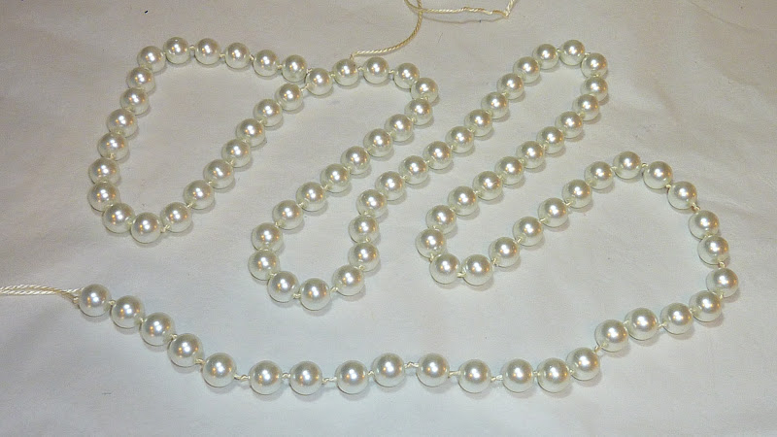
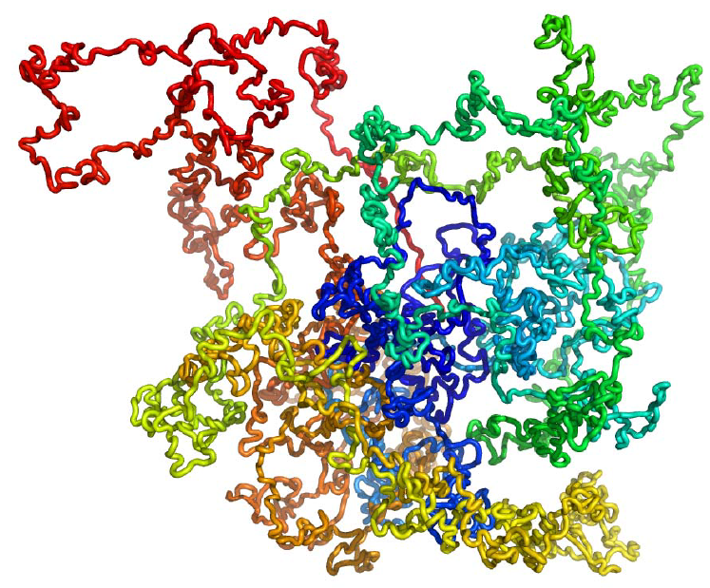
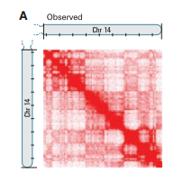
3D Genome Structure Modeling
Trieu, Cheng, 2014
Notes:
We consider each region of genome as a bead and the entire genome is a string of beads. Then we place those beads in 3D such that the distances between beads are consistent with the 2D contact map.

Slide 10
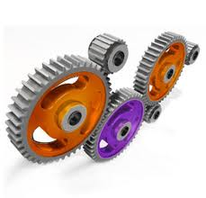
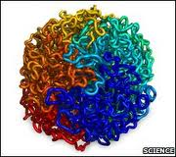
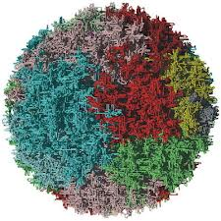
Contact Driven Structure Modeling
Initial Structural Representation of Units
Observed Contacts Between Units
Permutation & Optimization
Trieu, Cheng, 2014

Slide 11
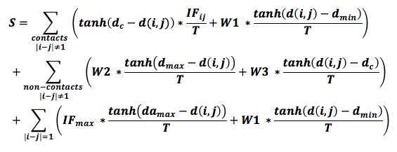
Scoring Function for Optimization
2
2
2
2
2
2
2
2
2
2
2
2
tanh: hyperbolic tangent function
IF_{ij}: interaction frequency between units i and j
T: total interaction frequencies
d_{c}: contact distance threshold (1.73-2.24um)
d_{min}: minimum distance between two units (0.2 um)
d_{max}: maximum distance between two units (2.45 um – 3.32 um)
da_{max}: maximum distance between two adjacent units (1.8 um)
W1, W2, W3, W4: weight parameters in order to maximize % satisfied contacts + % satisfied non-contacts
Trieu, Cheng, 2014

Slide 12
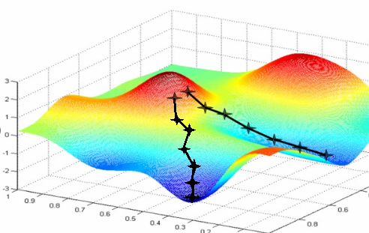
Gradient Ascent
images.google.com

Slide 13
Gradient Ascent
Random Initialization: (x₁⁰ y₁⁰, z₁⁰), (x₂⁰ y₂⁰, z₂⁰),…, (x_{N}⁰ y_{N}⁰, z_{N}⁰) in [-0.5, 0.5]
Update:
X₁^{t+1} = X₁^{t} + η*ΔX
Y₁^{t+1} = Y₁^{t} + η*ΔY
Z₁^{t+1} = Z₁^{t} + η*ΔZ
X₂^{t+1} = X₂^{t} + η*ΔX
Y₂^{t+1} = Y₂^{t} + η*ΔY
Z₂^{t+1} = Z₂^{t} + η*ΔZ
.
.
.
X_{N}^{t+1} = X₁^{t} + η*ΔX
Y_{N}^{t+1} = Y₁^{t} + η*ΔY
Z_{N}^{t+1} = Z₁^{t} + η*ΔZ
Trieu, Cheng, 2014

Slide 14
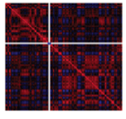
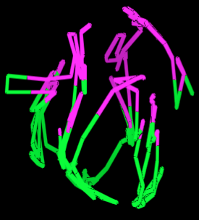

Two-Compartment (Euchromatin & Heterochromatin) Validation
Chromosome 7 of the normal B-cell
Trieu, Cheng, 2014

Slide 15
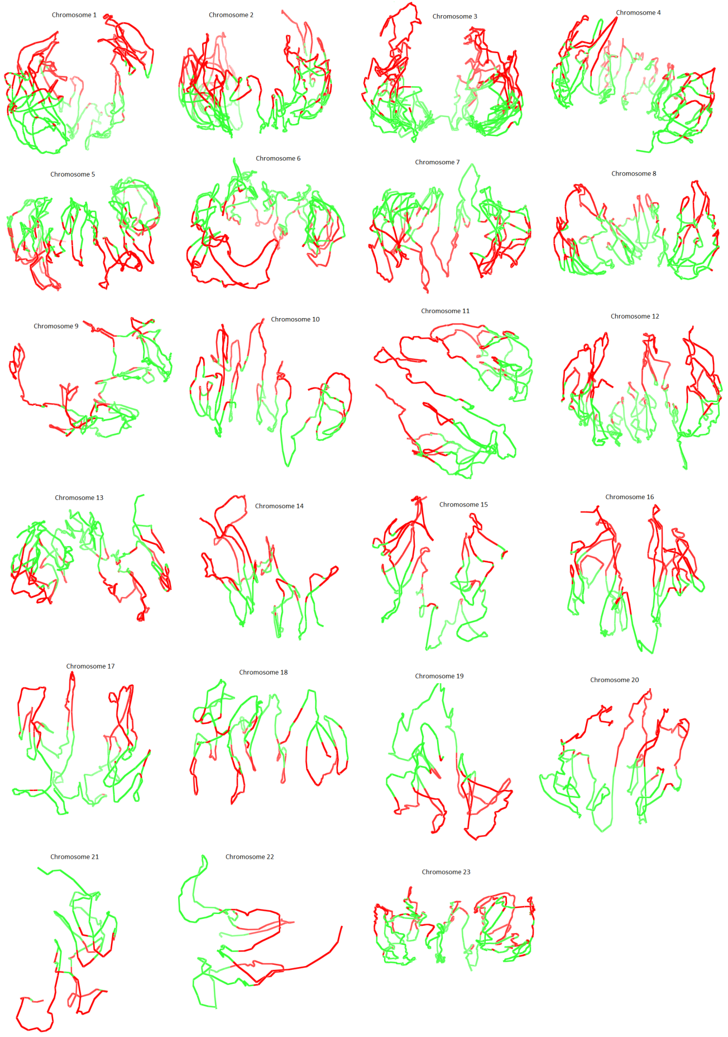
3D Models of 23 Pairs of Chromosomes of Normal B-Cell
Trieu, Cheng, 2014

Slide 16
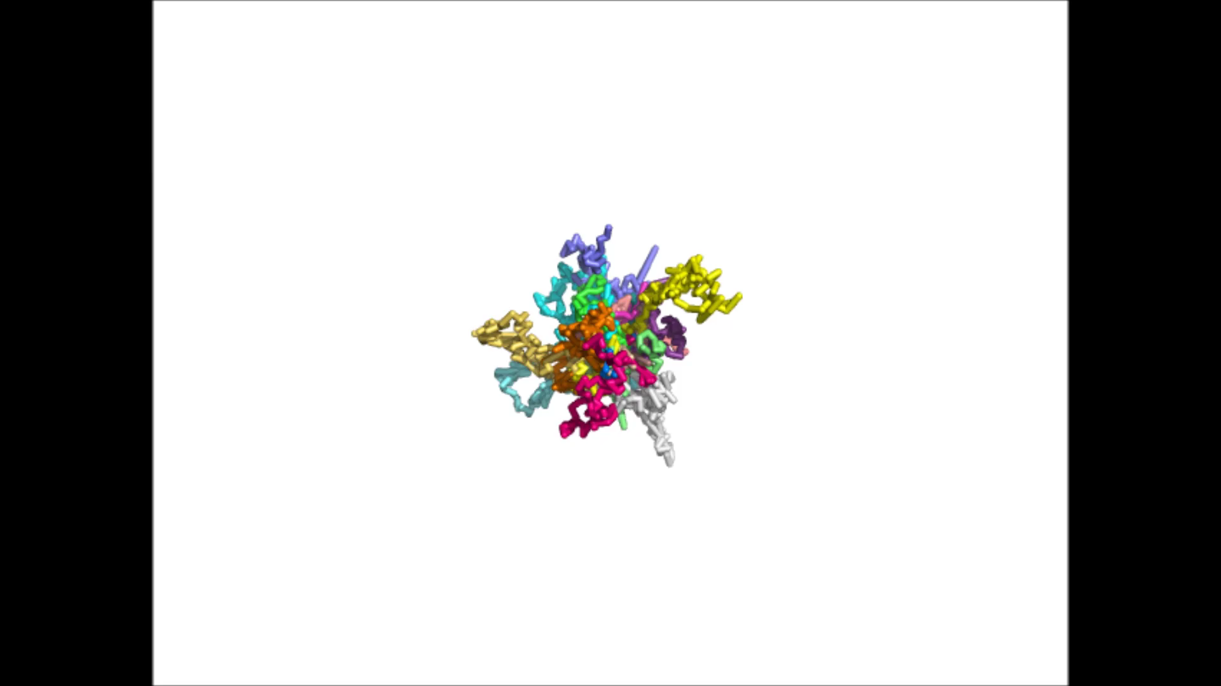
3D Genome Modeling Movie

Slide 17
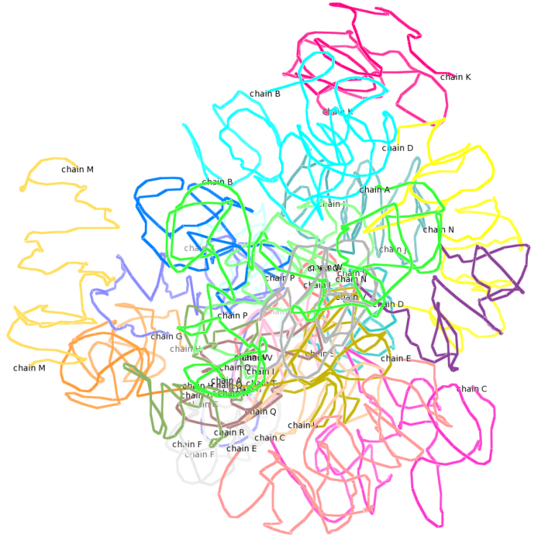
3D Model of the Human Genome
Small chromosomes in center and larger ones in periphery

Slide 18

Acknowledgements
Tuan Trieu, Renzhi Cao, Zheng Wang
Charles Caldwell, Kristen Taylor, Aaron Briley
Project’s website: http://people.cs.missouri.edu/~chengji/nsf_career.html

