Slide 1
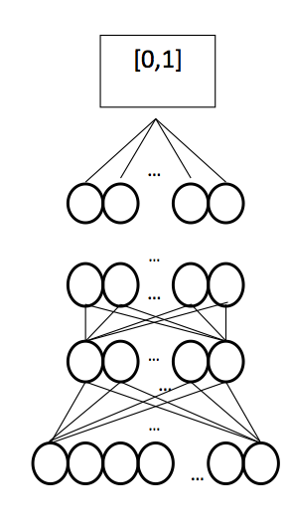
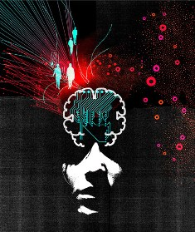
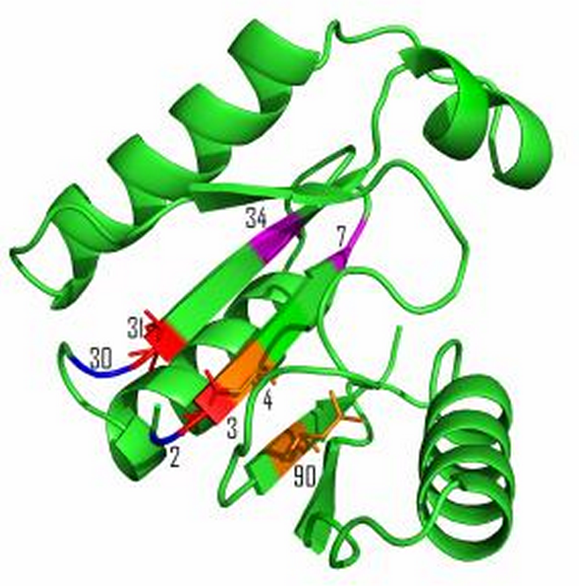
Deep Learning and its Application to Protein Structure Prediction
Jianlin Jack Cheng
University of Missouri, Columbia, USA
2014 ACLS Summer School

Slide 2


Deep Learning Buzz
2012: Is Deep Learning
a revolution in artificial
intelligence?
Accomplishments
Apple’s Siri virtual personal assistant
Google’s Street View
Google/Facebook/Tweeter/Yahoo Deep
Learning Acquisition
Hinton’s identification of drug molecule
Hinton’s hand writing recognition
Swiss AI Lab’s recognition of German
traffic sign images beats human experts
CASP10 protein contact map prediction
Rashid’s speech was translated into Chinese by deep learning tools.

Slide 3
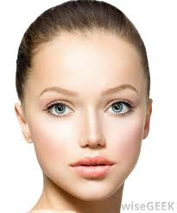
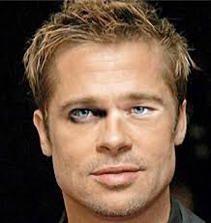
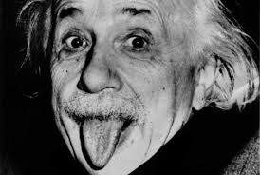
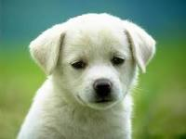
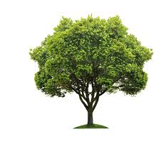

Machine Learning
Data
Learning
Prediction
Vectors:
<6.9 in, 170 lb, 25 y, 1,200 p>
...
Knowledge:
Learning
Algorithm
Classification
Images:
Clustering
Text:
I am attending the summer school.
….
Model /
Function
(f)
Speech:
Regression
…
Sequence:
MKVQYCDSLVIGGGLAGLRAAVATQQ
…
A data point is represented by an input feature
vector x = <x₁, x₂, …, x_{d}>.
Output
y = f(x)

Slide 4
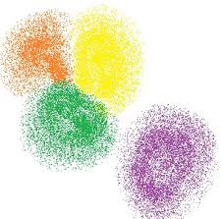
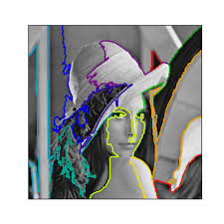
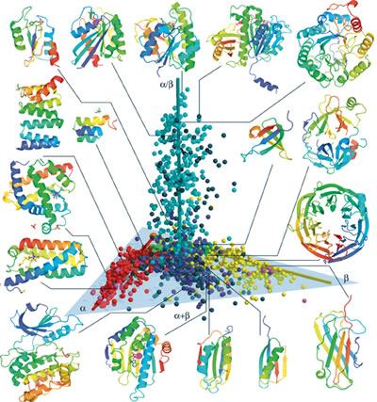
Unsupervised Learning
Learning from input data without using label / output information.
K-Means
Hierarchical Clustering

Slide 5
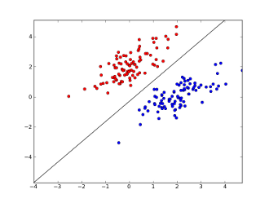
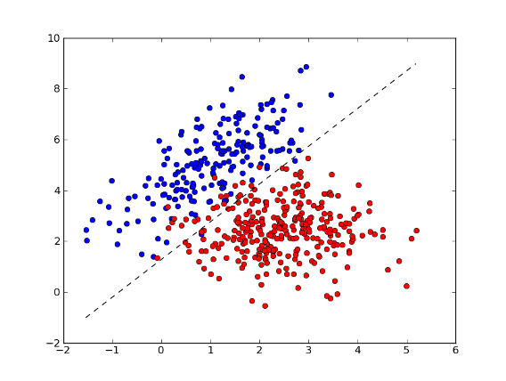
Supervised Learning
Learning to map input to output / label and is guided by output.
Training
f(x) = w₀ + w₁x₁ + w₂x₂ + …, w_{d}x_{d}
f(x) > 0: positive (1)
f(x) < 0: negative (-1)
Error: (f(x)-y)²
+
f(x) = σ(Σ(x))
-
1
x₁
x₂
……
x_{d}
Learning is to adjust w to minimize the squared
difference between f(x) and true y, i.e. Error.
Easy and automated:
Testing
Label information
Perceptron – 1950s

Slide 6
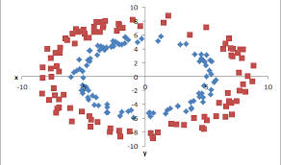
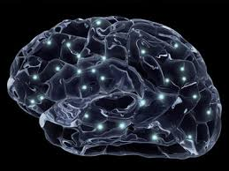
Neural Network
Backward
Propagation
Forward
Propagation
Error: (o-y)²
o
f(Σ)
Hidden layer
f(Σ)
f(Σ)
…
f(Σ)
1
x₁
x₂
……
x_{d}
1980s – Neural Network Revolution

Slide 7
o
f(Σ)
f(Σ)
f(Σ)
…
f(Σ)
……
Vanish
Gradient
f(Σ)
f(Σ)
…
f(Σ)
f(Σ)
f(Σ)
…
f(Σ)
1
x1
x2
……
xd

Slide 8
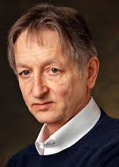
How to Construct Deep Networks?
G. Hinton

Slide 9
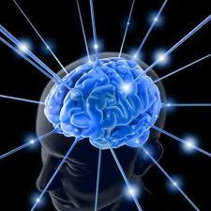
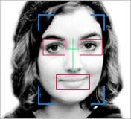
Why Deep Learning? – A Face Recognition Analogy
Face or not ?
……
Lines, circles, squares
Brain Learning
Image pixels

Slide 10
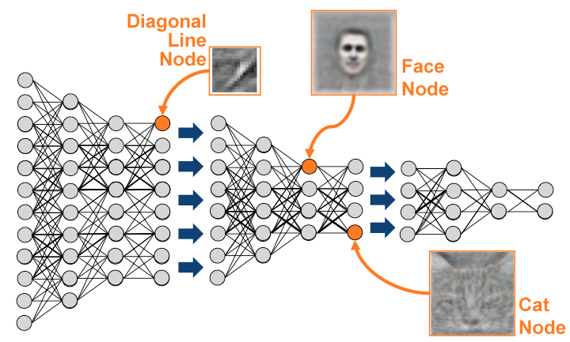
Learning Representation First
http://theanalyticsstore.com/deep-learning/

Slide 11
Training a Deep Network
Weights are learned layer by layer via unsupervised learning.
Final layer is learned as a supervised neural network.
All weights are fine-tuned using supervised back propagation.
[0,1]
…
…
…
…
…
…
…
Hinton and Salakhutdinov, Science, 2006

Slide 12

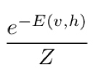


Unsupervised Restricted Boltzmann Machine (RBM)
hidden layer
c_{j}
A model for a distribution over two layers of binary nodes
Probability is defined via an “energy”
h
w_{ij}
v
b_{i}
visible layer
p(v,h) =

Slide 13
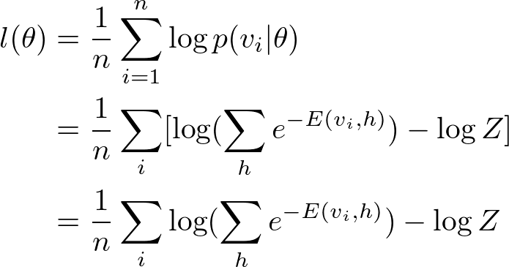
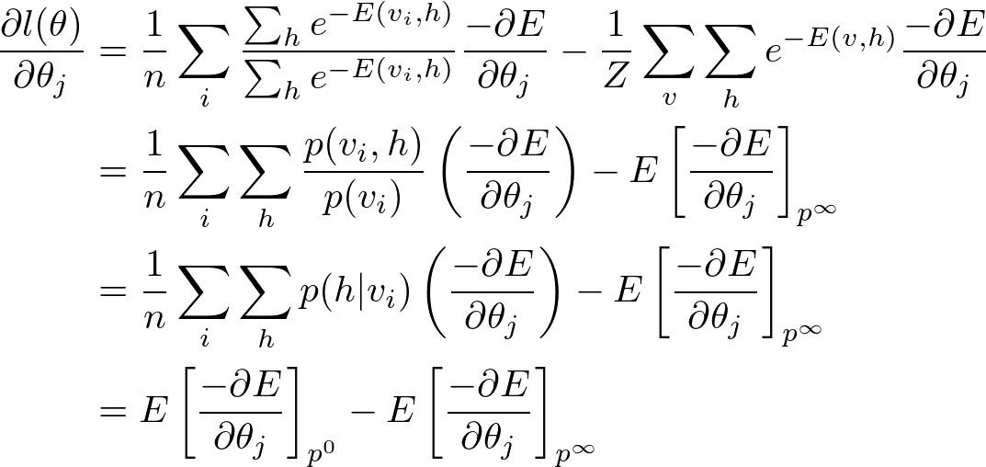
Training a RBM – ML approach
Expectation over all v and h

Slide 14
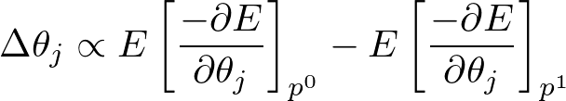
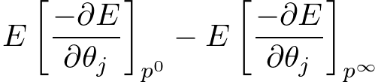
Training a RBM - Contrastive Divergence based on Gibbs Sampling
Instead of attempting to sample from joint distribution p(v,h) (i.e. p∞), sample from p¹(v,h).
Faster and lower variance in sample.
Hinton, Neural Computation(2002)

Slide 15
Training a RBM – A Maximum Likelihood Approach
Objective of Unsupervised Learning:
Find w_{i,j} to maximize the likelihood p(v) of visible data
Iterative Gibbs
Sampling:
Adjust w_{i,j} to increase the likelihood according to gradient

Slide 16





Training a RBM via Contrastive Divergence
Gradient of the likelihood with respect to w_{ij} ≈ the difference between interaction of v_{i} and h_{j} at time 0 and at time 1.
Hidden
Layer
j
j
Visible
Layer
i
i
t = 0 t = 1
Hinton, Neural Computation(2002)

Slide 17
Training a RBM via Contrastive Divergence
Gradient of the likelihood with respect to w_{ij} ≈ the difference between interaction of v_{i} and h_{j} at time 0 and at time 1.
Hidden
Layer
j
j
Visible
Layer
i
i
t = 0 t = 1
Hinton, Neural Computation(2002)

Slide 18
Training a RBM via Contrastive Divergence
Gradient of the likelihood with respect to w_{ij} ≈ the difference between interaction of v_{i} and h_{j} at time 0 and at time 1.
Hidden
Layer
j
j
Visible
Layer
i
i
t = 0 t = 1
σ: sigmoid function
Δw_{i,j} = <v_{i} p_{j}⁰> - <p_{i}¹p_{j}¹>
Hinton, Neural Computation(2002)

Slide 19
Training a Deep Network
Weights are learned layer by layer via unsupervised learning.
Final layer is learned as a supervised neural network.
All weights are fine-tuned using supervised back propagation.
[0,1]
…
…
…
…
…
…
…
Hinton and Salakhutdinov, Science, 2006

Slide 20
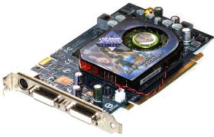
GPU Implementation
Calculations need for training and classification made use of CUDAMat and GPUs
Train DNs with over 1M parameters in about an hour
LSDEKIINVDF
KPSEERVREII
…
…
…
…
…
…
…
[0,1]
Eickholt and Cheng, Bioinformatics (2012)

Slide 21
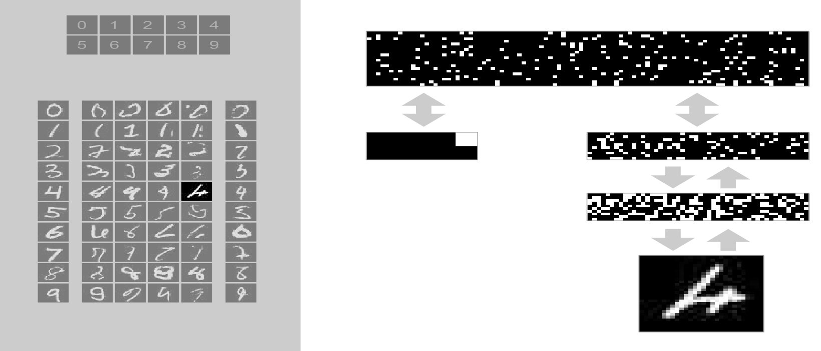
Demo – Handwriting Recognition

Slide 22
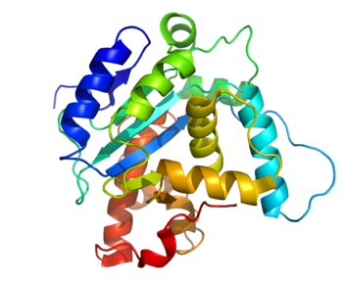
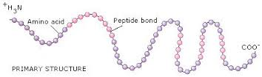
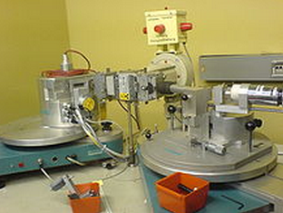
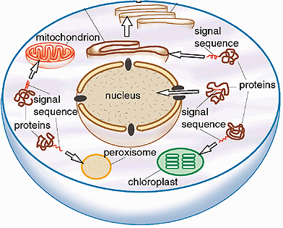
Sequence, Structure and Function
MKVQYCDSLVIGGGLAGLRAA…
Cell
<0.1% of proteins have known structures.

Slide 23
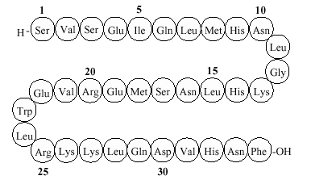
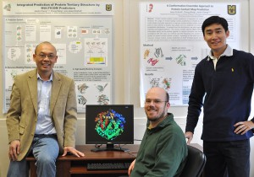
Computational Protein Structure Prediction
Zheng Wang
Jesse Eickholt

Slide 24
Residue-Residue Contact Prediction
1D Sequence
SDDEVYQYIVSQVKQYGIEPAELLSRKYGDKAKYHLSQRW
Objective:
Predict if two residues (i, j) are in
contact (spatially close), i.e.
Distance(i, j) < 8 Angstrom
3D Structure
Cheng, Baldi, 2007; Eickholt and Cheng, Bioinformatics (2012)

Slide 25
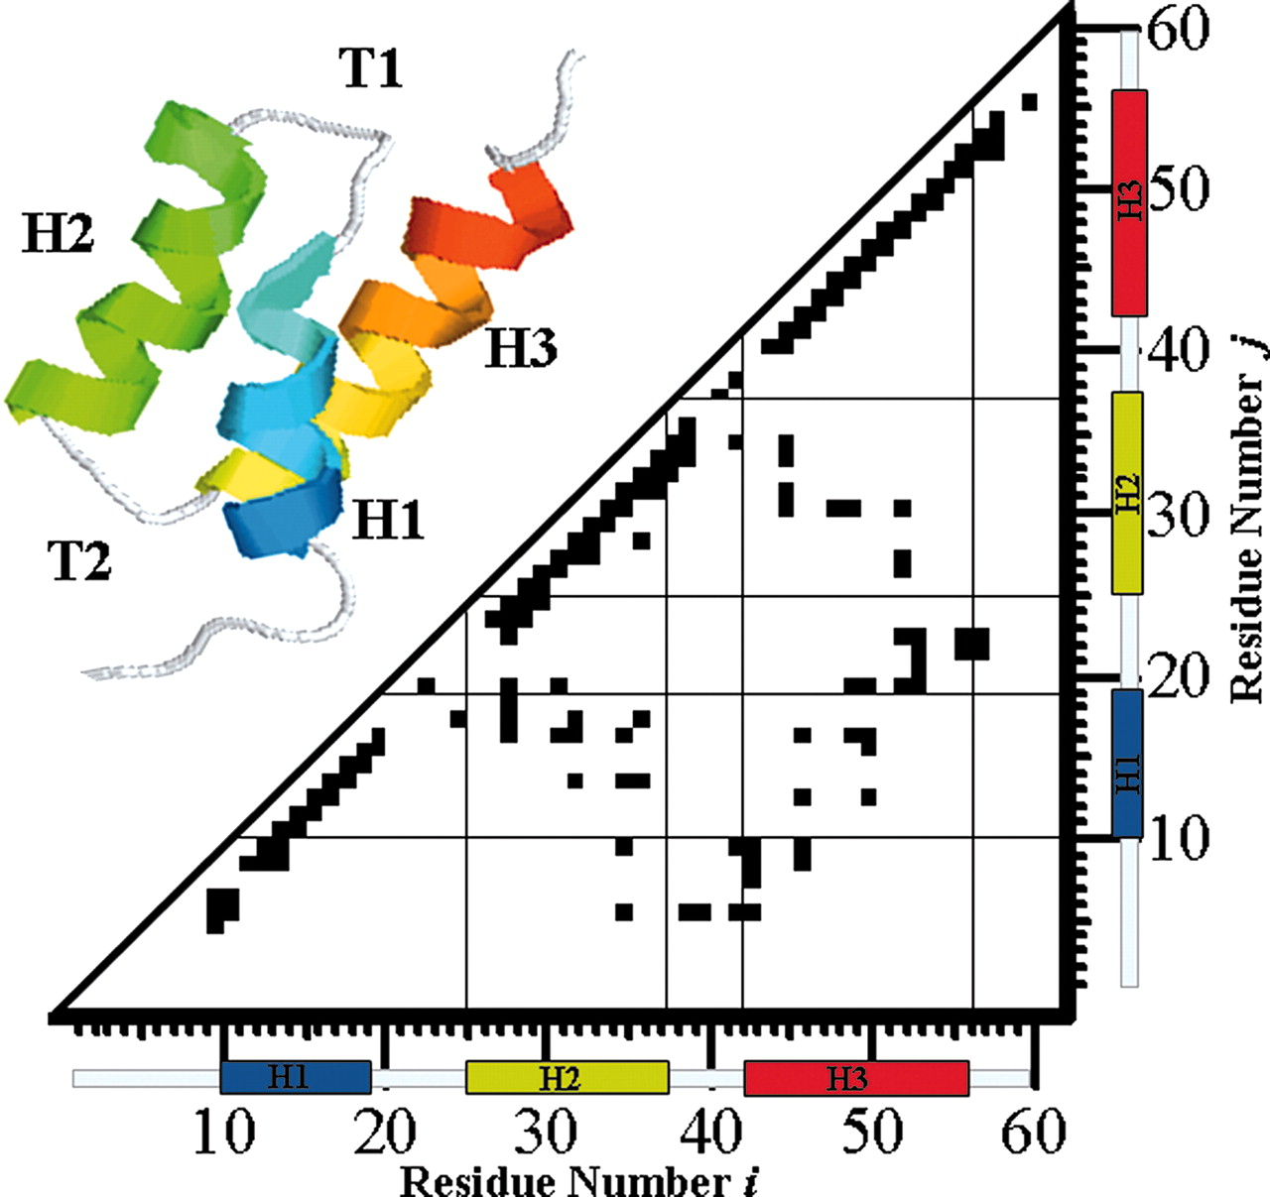
Visualization of Contact Map
Itoh, Sasao, 2006

Slide 26
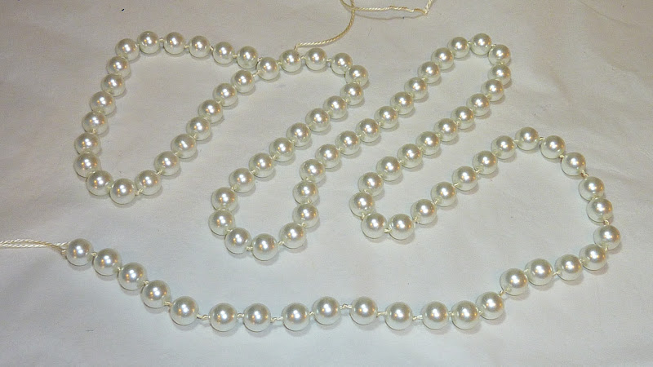
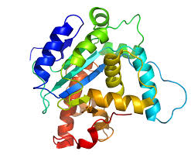

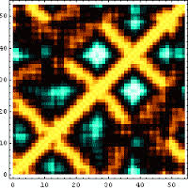
Contact-Based Structure Prediction
Notes:
We consider each region of genome as a bead and the entire genome is a string of beads. Then we place those beads in 3D such that the distances between beads are consistent with the 2D contact map.

Slide 27
A Binary Classification Problem
i
j
SDDEVYQYIVSQVKQYGIEPCSAELLSRKYGDKAKYHLSQRW
Residue identity, secondary structure, solvent accessibility, …
A Vector of ~400 Features (numbers between 0 and 1)
Probability that V and Y are in contact?
Eickholt and Cheng, Bioinformatics (2012)
Cheng & Baldi, 2007; Tegge et al., 2009

Slide 28
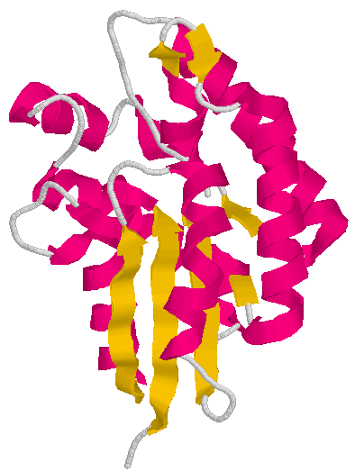
Input Features
i
j
SDDEVYQYIVSQVKQYGIEPCSAELLSRKYGDKAKYHLSQRW
20 binary numbers
3 numbers
2 numbers
Exposed
A 10000000000000000000
C 01000000000000000000
D 00100000000000000000
.
.
.
.
.
.
.
Y 00000000000000000001
Helix
Coil
Buried
Strand
Helix 100
Strand 010
Coil 001
Exposed 10
Buried 01
25 * 18 = 400 features for a pair (i, j)

Slide 29
Deep
Learning
Network
Architecture
~350 nodes
~500 nodes
~500 nodes
w_{i,j}
~400 input nodes
A Vector of ~400 Features (numbers between 0 and 1)
Eickholt and Cheng, Bioinformatics (2012)

Slide 30

Training a Deep Network
[0,1]
1239 Proteins for Training
Residue Pairs (|i-j| >= 6)
…
…
…
…
…
…
…
Eickholt and Cheng, Bioinformatics (2012)

Slide 31
Boosted Ensembles for Contact Prediction
…
…
…
…
…
…
…
…
…
…
…
……
…
…
…
…
…
…
…
…
…
…
[0,1]
[0,1]
[0,1]
[0,1]
Final output of ensemble is a performance weighted sum of individual DN outputs.
Eickholt and Cheng, Bioinformatics (2012)

Slide 32
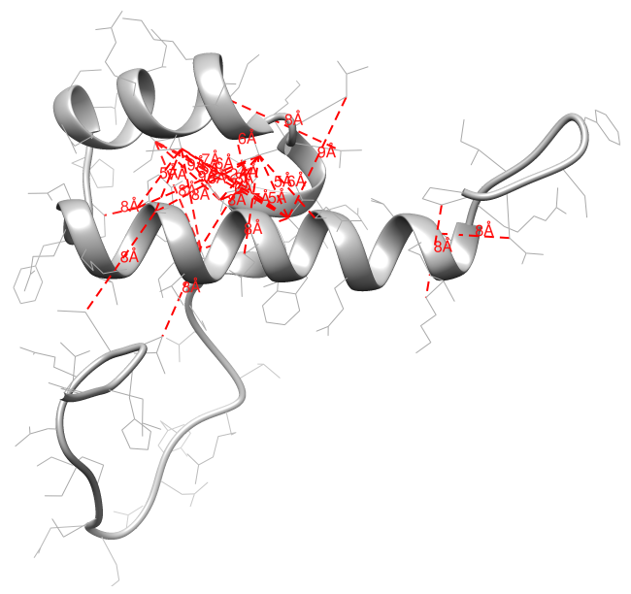
Results on Test Data Set (196 Proteins)
Metric | Acc. L/5 | Acc. L/5 (one shift)
Short Range (6 <= |i-j| <12) | 0.51 | 0.79
Medium Range (12 <= |i-j| <24) | 0.38 | 0.65
Long Range (|i-j| >= 24) | 0.34 | 0.55
An Example:

Slide 33
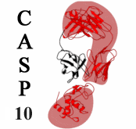
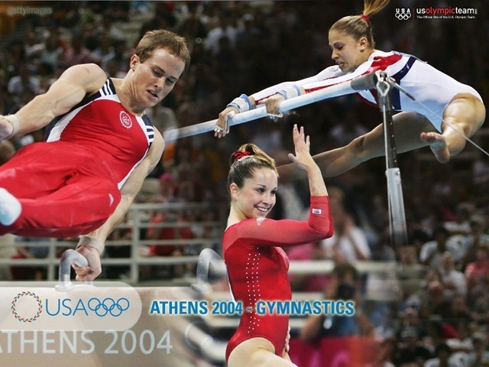
Blind Test on CASP10 Targets
Exact match (96 proteins, long-range contacts)
Method | Acc. L/5
DNcon | 0.30
SVMcon | 0.19
9-fold better than random
Inexact match with minor shifts
Method | δ | Acc. L/5
DNcon | 1 | 0.53
SVMcon | 1 | 0.37
DNcon | 2 | 0.62
SVMcon | 2 | 0.45

Slide 34

Movie: Contact-Guided Fragment Assembly of Target T0716

Slide 35
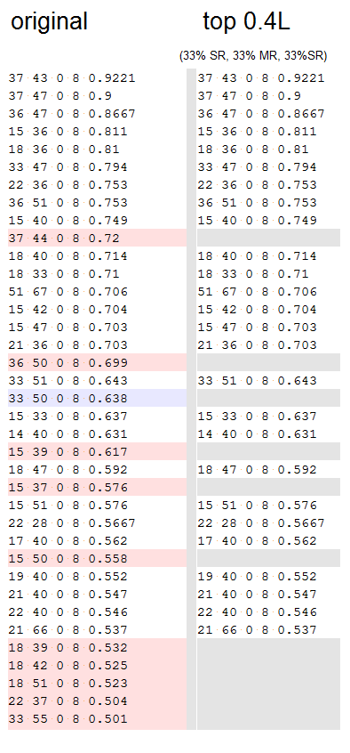
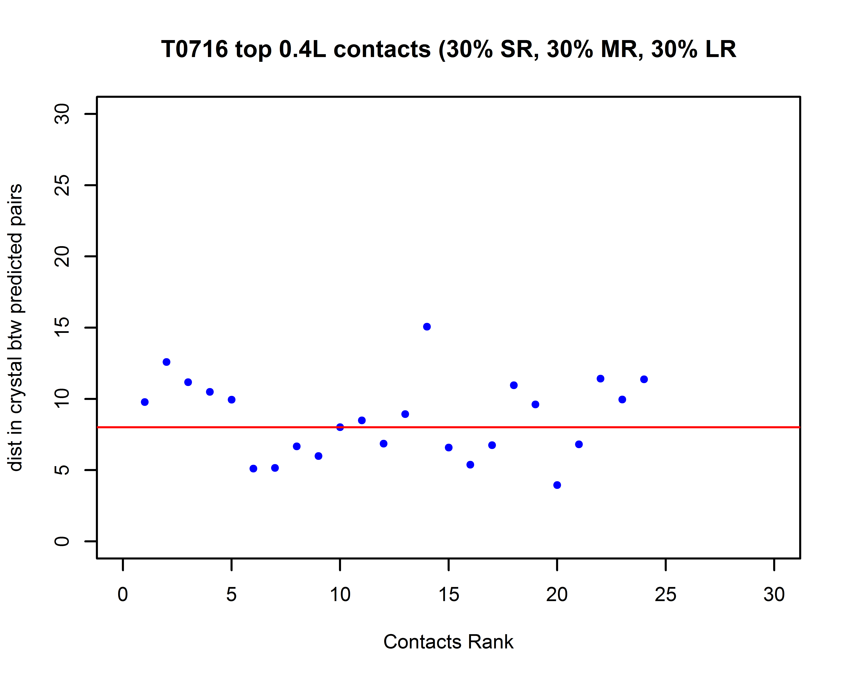
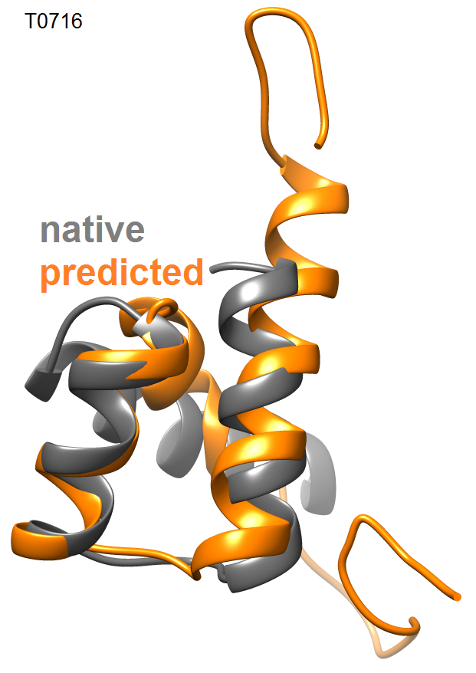
3D Reconstruction from Predicted Contacts (CASP Target T0716)
Target : T0716 (CASP10)
Length : 71
RMSD : 4.3A
GDT-TS : 0.58
Contacts : DNcon (filtered and selected 0.4L)
Selection: Best Structure
Contact selection
and
filtering
Notes:
Contact Filtering: Contact filtering was applied to predicted DNcon contacts. Contacts were divided into Long Range (LR), Short Range (SR), and Medium Range (MR). From each of these groups top contacts were selected to make the top 0.4L contacts.
The grey structure with red lines shows the predicted structure and the contacts used to fold the structure.

Slide 36
Summary
Learn representation of data at first
Combine unsupervised learning and supervised learning
Utilize big unlabeled data
Win protein residue-residue contact prediction
Contact prediction guides tertiary structure prediction

Slide 37
Thank you! Question?
Brain Thinking
Deep Learning
Protein Contact Prediction

