Slide 1

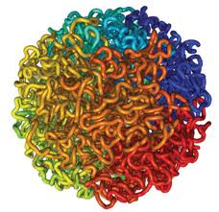

Modeling 3D Human Genome Structure
Jianlin Jack Cheng
Associate Professor
Computer Science Department
University of Missouri, Columbia
ISMB, Boston, 2014

Slide 2

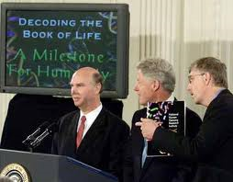
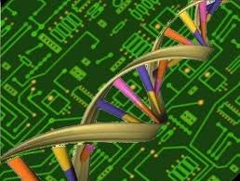

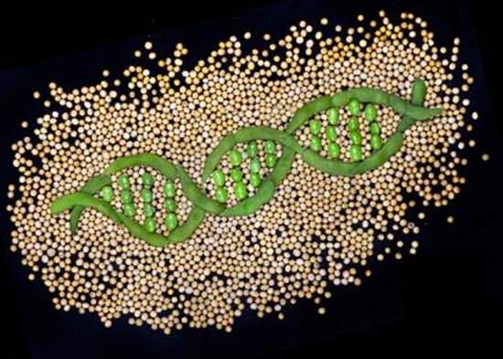
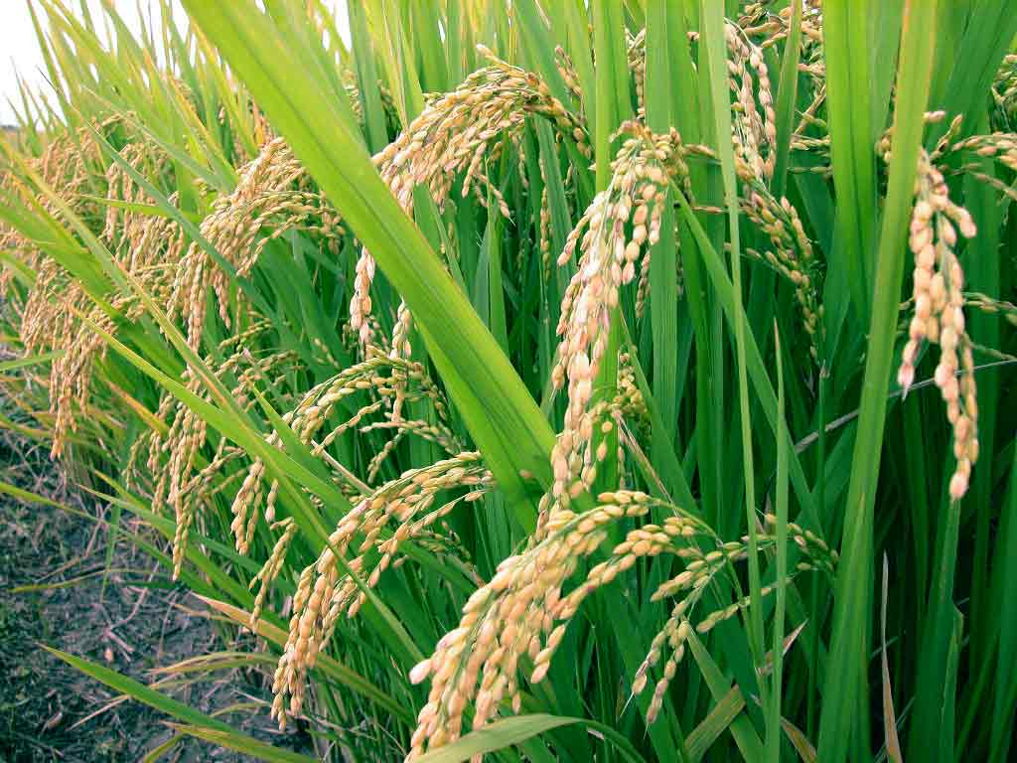
The Genomic Era
Collins, Venter, Human Genome, 2000
images.google.com

Slide 3
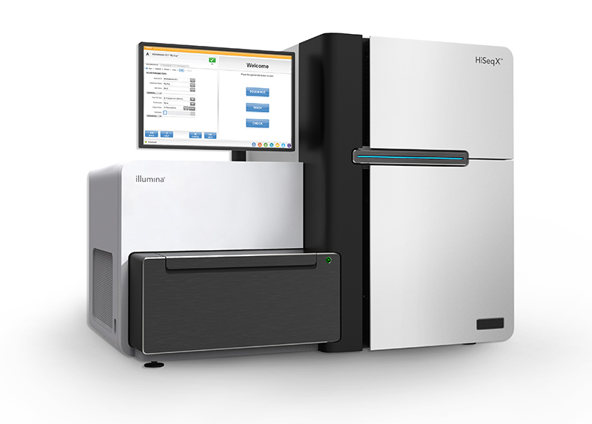
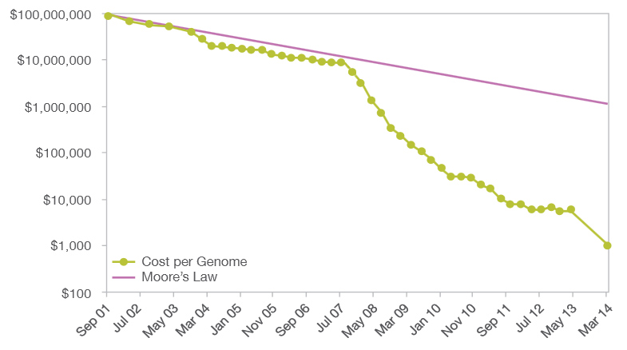
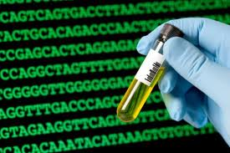
$1000 Personal Genome!
http://www.futuretimeline.net/blog/2014/01/16.htm#.U3Vg-FhdWzs

Slide 4
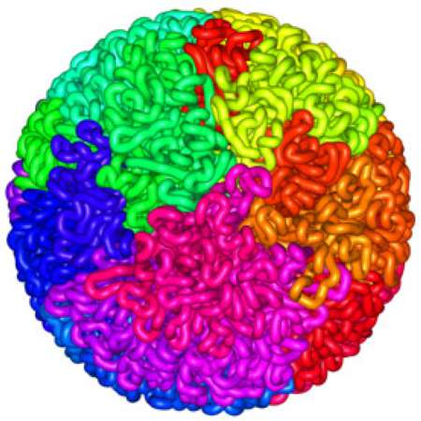
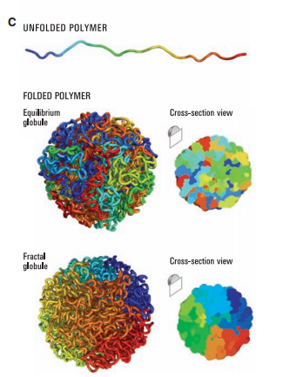
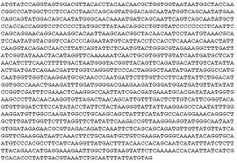
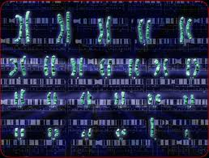
3D
Shape
Liberman-Aiden et al., 2009

Slide 5
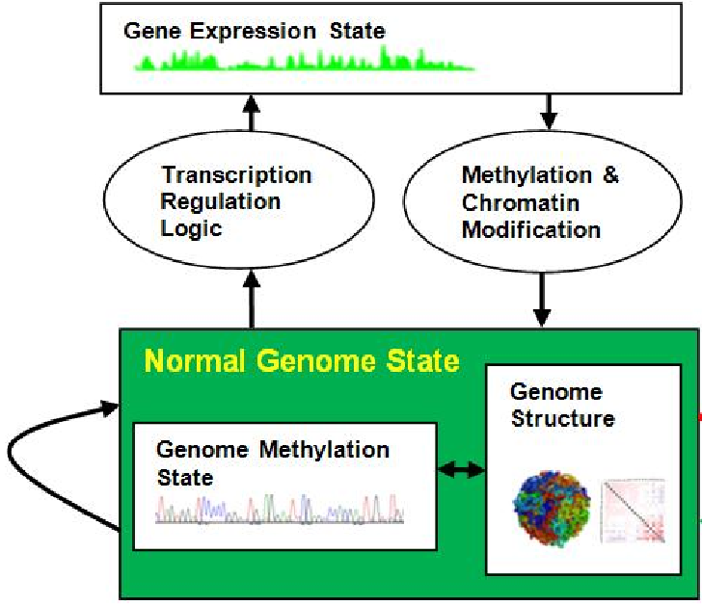
3D Genome Structure is Important
Cheng et al., unpublished.

Slide 6
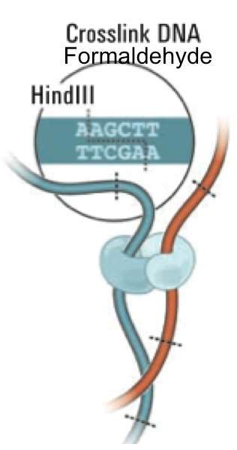
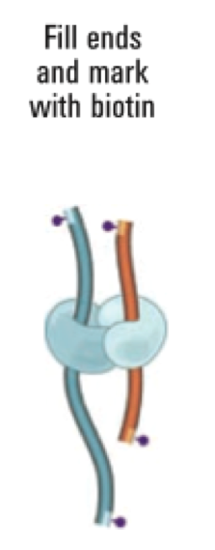
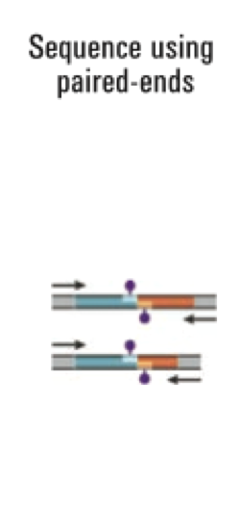
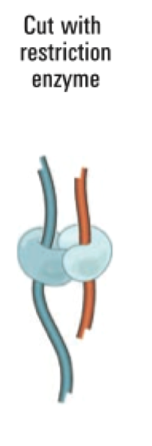
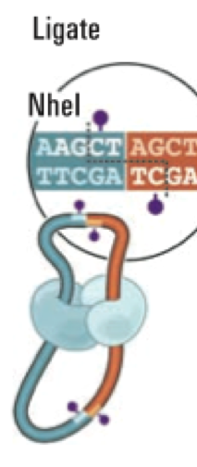
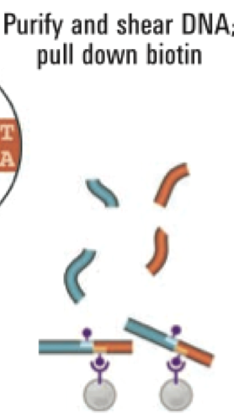
Chromosome Conformation Capturing (Hi-C)
Liberman-Aiden et al., 2009

Slide 7

Genomic Spatial Interaction (Contact) Data
i
Map reads to the human
genome sequence
j
1 2 …… n
1
2
.
.
.
n
40 |  |  |  | 1
 | 3 |  | 8
 |  | 10
 | 8 |  | 15
1
C[i,j] = # contacts
Intra- / inter-chromosome contact map
Wang et al., 2013

Slide 8
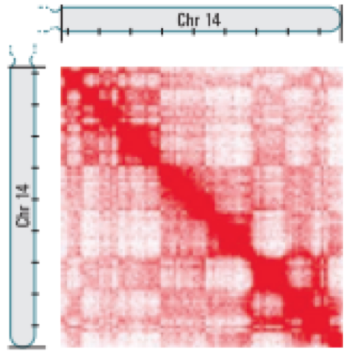
Intra-Chromosomal Contact Map
Chr. 14
Chr. 11
Intra-Chromosome
1M Resolution
Leukemia B-Cell
Inter-Chromosome
1M Resolution
Normal B-Cell
Wang et al., 2013

Slide 9
Four Hi-C Data Sets
Human acute lymphoblastic leukemia B-cell of a patient (ALL B-Cell)
The MHH-CALL-4 B-ALL cell line (CALL4)
The follicular lymphoma cell-line (RL)
Normal B-Cell (Liberman Aiden, 2009)
Sequenced by Illumina HiSeq 2000
Cells | Num. of Reads | Read Length | Coverage
ALL B-Cell | 77,888,742 | 120 | ~1.49
CALL4 B Cell Line | 133,542,778 | 100 | ~2.36
RL B Cell Line | 125,256,746 | 100 | ~1.15
Normal B-Cell | 12,887,282 | 76 | ~0.17
Wang et al., 2013

Slide 10
Intra-chromosomal heat maps for primary ALL B-Cell
Wang et al., 2013

Slide 11
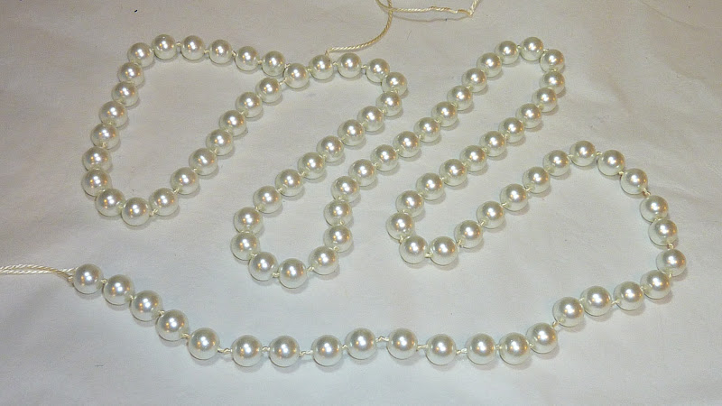
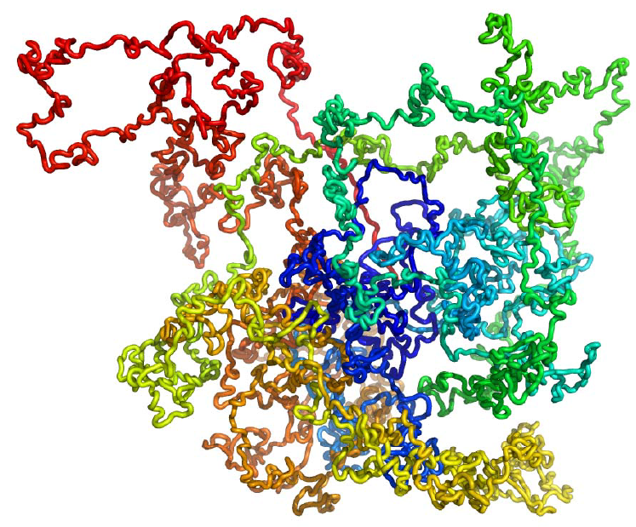
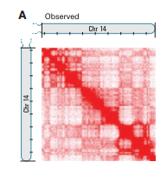
3D Genome Structure Modeling
Trieu, Cheng, 2014
Notes:
We consider each region of genome as a bead and the entire genome is a string of beads. Then we place those beads in 3D such that the distances between beads are consistent with the 2D contact map.

Slide 12
Review of Pioneering Works
Small scale (10 – 50 Mb)
Rough approximation (convert contacts to distances)
Coarse structure
Duan et al., 2010. Rousseau et al., 2011. Bau et al., 2011.

Slide 13
Spatial Representation of a Genome Region at a Scale
……
Divided into N equal / variable size (e.g. 1MB) consecutive units sequentially
The center of a unit is denoted by a point and its coordinate (x, y, z)
Trieu, Cheng, 2014

Slide 14
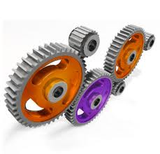
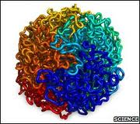
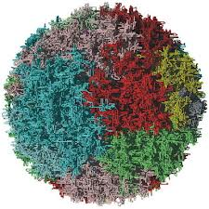
Contact Driven Structure Modeling
Initial Structural Representation of Units
Observed Contacts Between Units
Permutation & Optimization
Trieu, Cheng, 2014

Slide 15
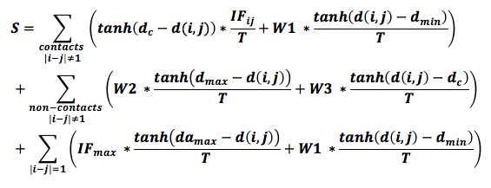
Scoring Function for Optimization
2
2
2
2
2
2
2
2
2
2
2
2
tanh: hyperbolic tangent function
IF_{ij}: interaction frequency between units i and j
T: total interaction frequencies
d_{c}: contact distance threshold (1.73-2.24um)
d_{min}: minimum distance between two units (0.2 um)
d_{max}: maximum distance between two units (2.45 um – 3.32 um)
da_{max}: maximum distance between two adjacent units (1.8 um)
W1, W2, W3, W4: weight parameters in order to maximize % satisfied contacts + % satisfied non-contacts
Trieu, Cheng, 2014

Slide 16
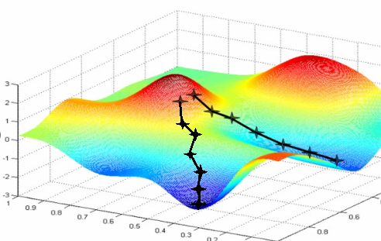
Gradient Ascent
images.google.com

Slide 17
Gradient Ascent
Random Initialization: (x₁⁰ y₁⁰, z₁⁰), (x₂⁰ y₂⁰, z₂⁰),…, (x_{N}⁰ y_{N}⁰, z_{N}⁰) in [-0.5, 0.5]
Update:
X₁^{t+1} = X₁^{t} + η*ΔX
Y₁^{t+1} = Y₁^{t} + η*ΔY
Z₁^{t+1} = Z₁^{t} + η*ΔZ
X₂^{t+1} = X₂^{t} + η*ΔX
Y₂^{t+1} = Y₂^{t} + η*ΔY
Z₂^{t+1} = Z₂^{t} + η*ΔZ
.
.
.
X_{N}^{t+1} = X₁^{t} + η*ΔX
Y_{N}^{t+1} = Y₁^{t} + η*ΔY
Z_{N}^{t+1} = Z₁^{t} + η*ΔZ
Trieu, Cheng, 2014

Slide 18
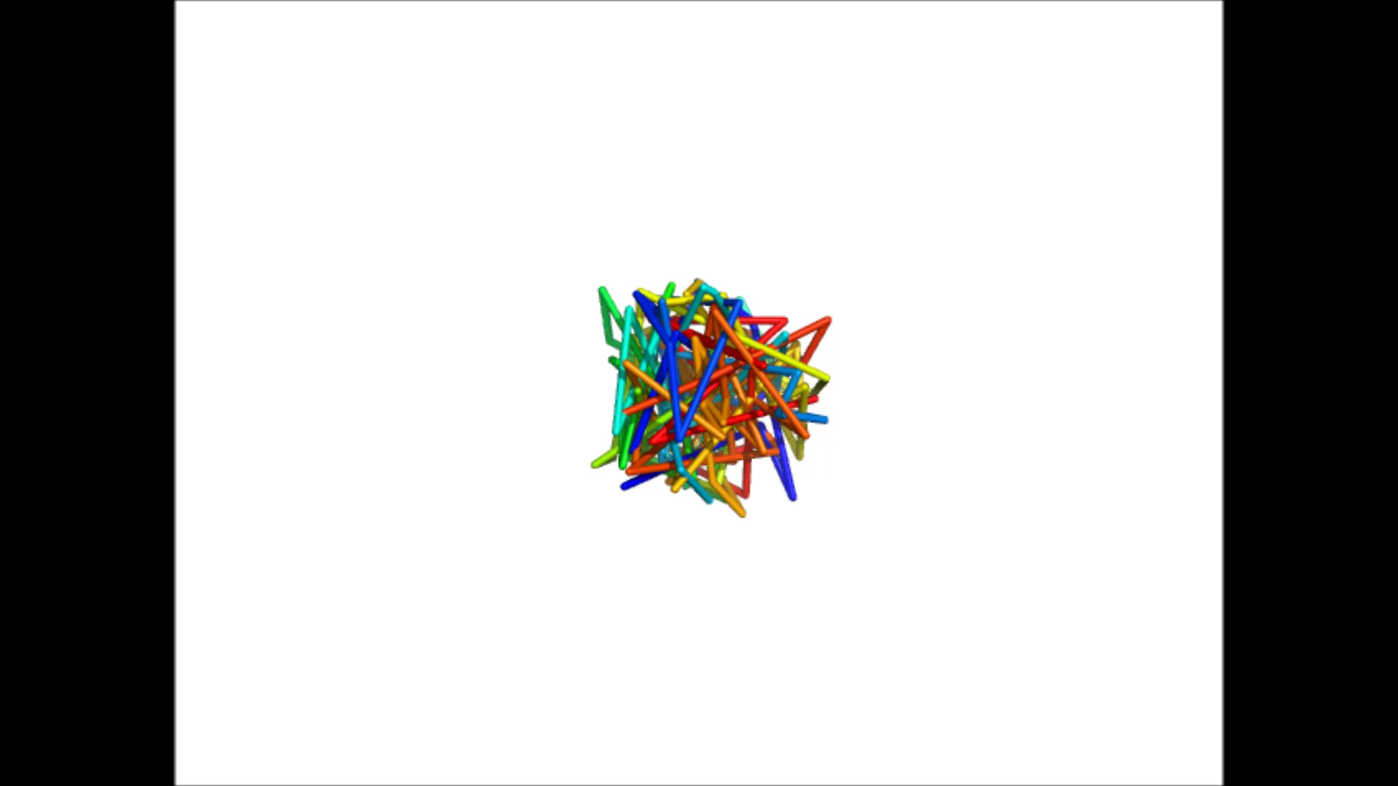
3D Structure Modeling of Chr. 11

Slide 19
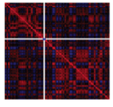
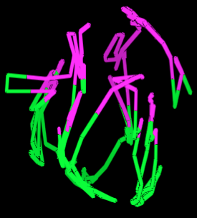

Two-Compartment (Euchromatin & Heterochromatin) Validation
Chromosome 7 of the normal B-cell
Trieu, Cheng, 2014

Slide 20
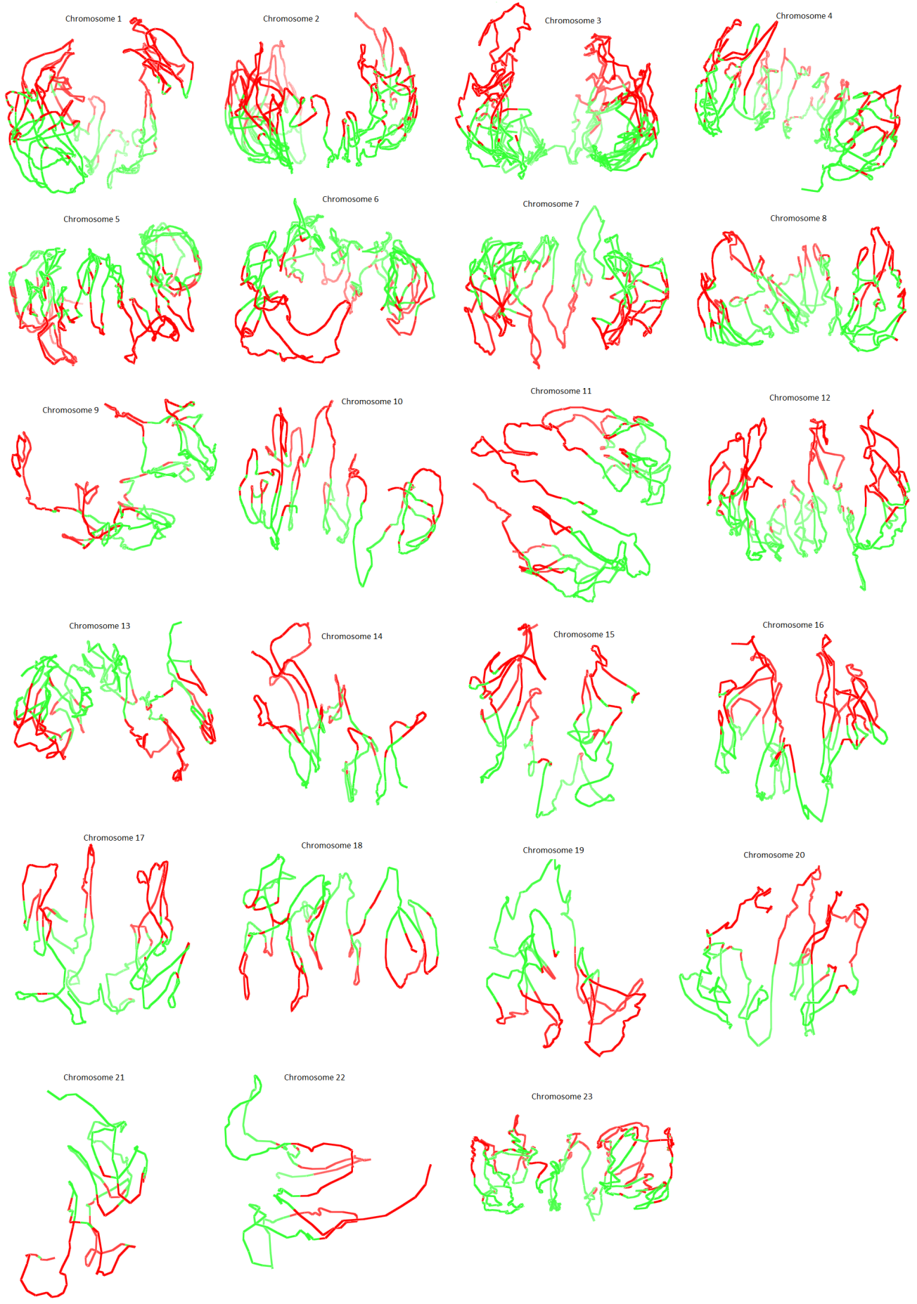
3D Models of 23 Pairs of Chromosomes of Normal B-Cell
Trieu, Cheng, 2014

Slide 21
The contact and non-contact scores of the chromosomal models of the ALL B-cell
Trieu, Cheng, 2014

Slide 22
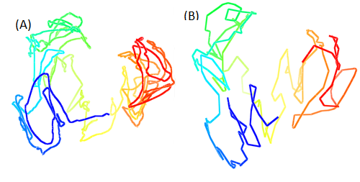
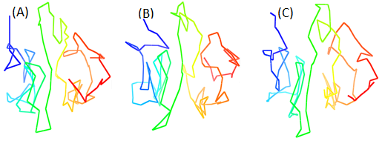
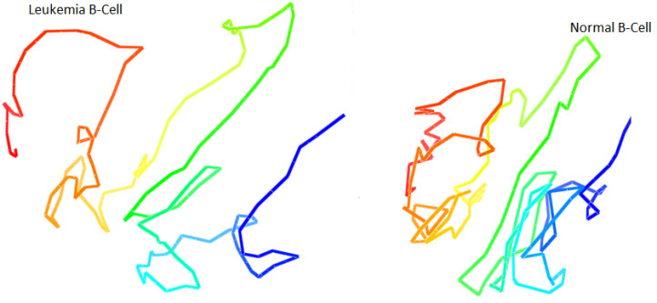
Robustness Test and Comparison
Models of Chr. 11 at d_{c}² threshold of 6, 7, 8 um.
Models of Chr. 1 at resolution of 200K and of 1M.
The percentage of recovered contacts in all chromosomes
Models of Chr. 11 in the leukaemia B-Cell and the normal B-Cell.

Slide 23
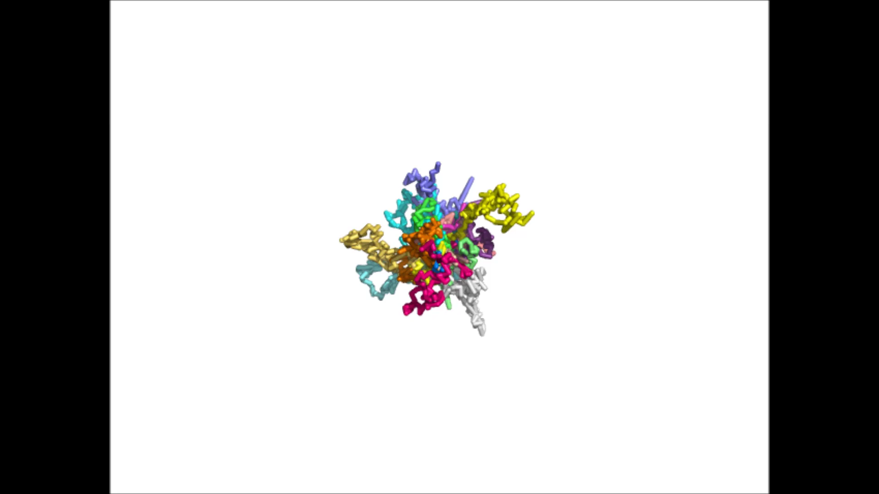
Modeling of 3D Genome

Slide 24
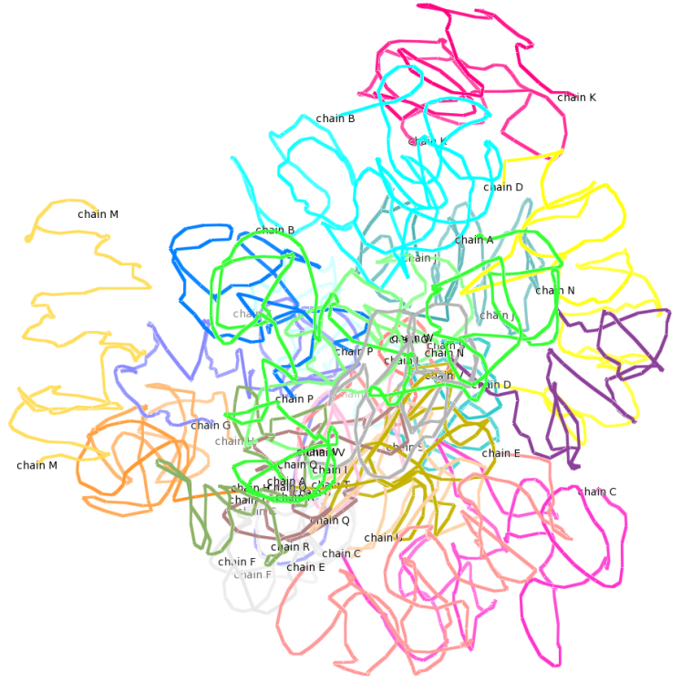
3D Model of the Human Genome
Chromosome territory – fractal model
Small chromosomes in center and larger ones in periphery

Slide 25
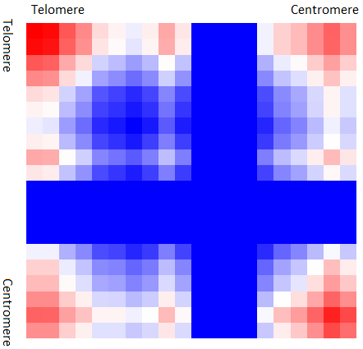
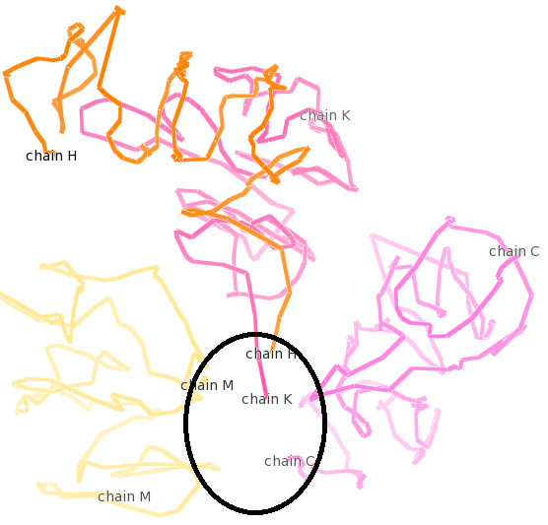
Telomere and Centromere Interactions

Slide 26
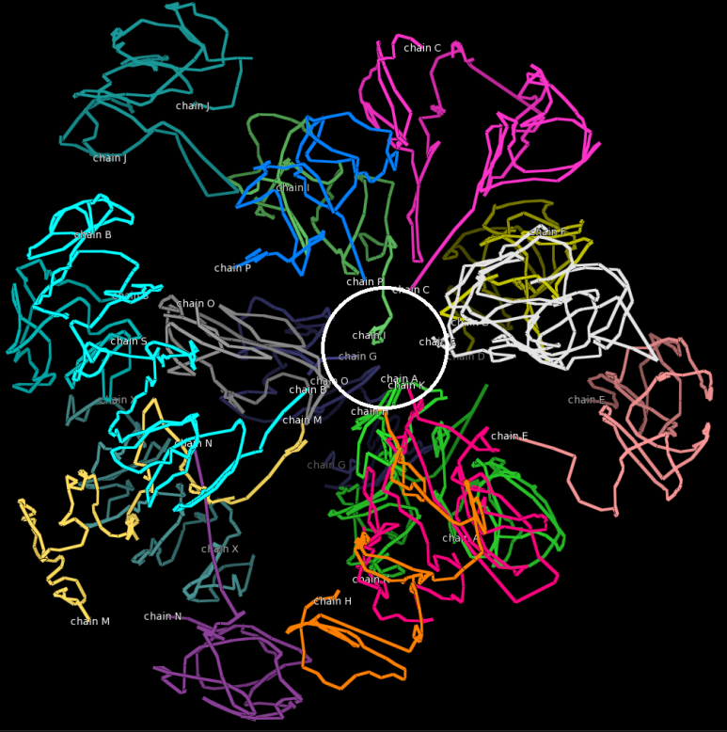
Telomeres and/or centromeres of large chromosomes extend towards the nucleus center

Slide 27

Acknowledgements
Tuan Trieu, Renzhi Cao, Zheng Wang
Charles Caldwell, Kristen Taylor, Aaron Briley
Project’s website: http://people.cs.missouri.edu/~chengji/nsf_career.html

