Slide 1
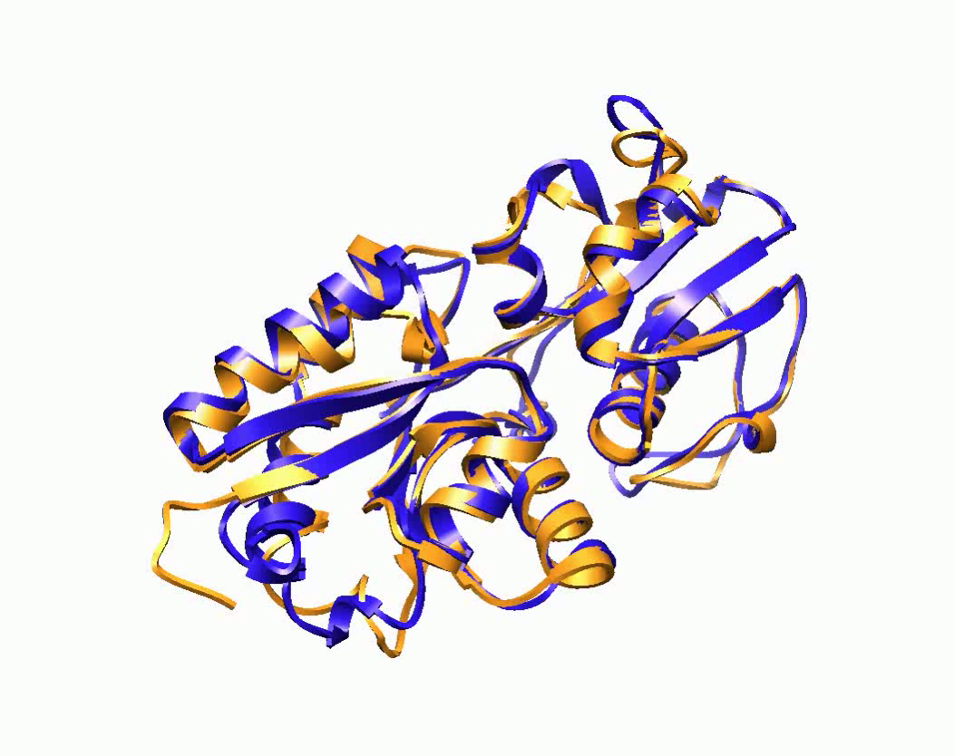


MULTICOM - Large-Scale Sampling and Mining of Template Based Models
Jianlin Jack Cheng
Computer Science Department
University of Missouri, Columbia, USA
Mexico, 2014

Slide 2
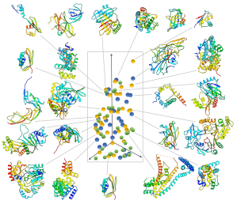
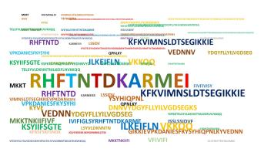
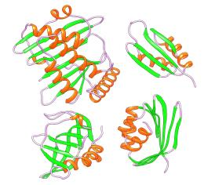
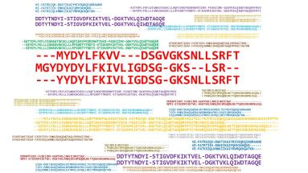
Large-Scale Model Sampling
Targeted
Sampling
Sequence Space
Fold Space
Template & Alignment
Combination
Model
Generation
Model Pool
Alignment Space

Slide 3

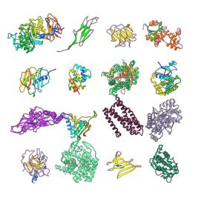
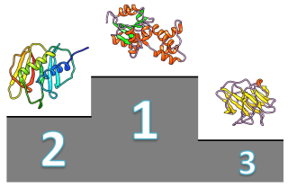
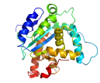
Large-Scale Model Mining
Model Ranking
Massive Assessment
Internal or CASP
Model Pool
Combination
Refinement
Side Chain Tuning

Slide 4
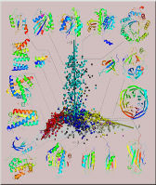
Large-Scale Sampling of Templates, Alignments, and Models
Samplers
BLAST
CSBLAST
CSIBLAST
PSIBLAST
SAM
HMMer
HHSearch
HHblits
HHsuite
MULTICOM
PRC
FFAS
Compass
MUSTER
RaptorX
Template Library
Alignment Combination
125,000 templates
(in-house)
1. Alignment Combination Based on E-Values
Model
Generation
Fold
Sampling
2. Alignment Combination Based on Structures
39,000
(in-house)
Modeller MTMG FUSION
3. Multiple Sequence Alignment + Structural Features
Third-party (local)
150 – 200
Models

Slide 5
Contributions of Samplers on TBM Targets
MULTICOM (Server)
MULTICOM (Human)
Samplers | Best (targets)
BLAST | 1
CSBLAST
CSIBLAST
PSIBLAST
SAM | 1
HMMer | 1
HHSearch | 22
HHblits | 6
HHsuite | 6
MULTICOM | 20
PRC | 1
FFAS
COMPASS | 3
MUSTER | 6
RaptorX | 9
Servers (partial list) | Best (domains)
nns | 10
BAKER-ROSETTASERVER | 8
IntFOLD3 | 7
Zhang-Server | 4
TASSER-VMT | 3
MULTICOM Server | 2
QUARK | 2
RBO_Aleph | 2
HHPred-A | 2
FFAS-3D | 2
myprotein-me | 2
PhyreX | 1
SAM-T08-server | 1
ZHOU-SPARKS-X | 1
HHPred-X | 1

Slide 6
Large-Scale Model Quality Assessment
Methods (blue: in-house) | Type | Features
MULTICOM-NOVEL | Single | Structural, physical, chemical features
OPUS-PSP | S | Ca atom contact potentials
Proq2 | S | Structural features
RWplus | S | Side-chain orientation dependent potential
ModelEva1 | S | Structural features, contacts
ModelEva2 | S | Structural features, contacts, disorder, conservation
RS_CB_SRS | S | Distance dependent statistical potential
SELECTpro | S | Energy-based (h-bond, angle, electrostatics, vdw)
Dope | S | Statistical potential
DFire2 | S | Energy-based potential
Modfoldcluster2 | Cluster | Pairwise model similarity (geometry)
APOLLO | C | Pairwise model similarity
Pcons | C | Pairwise model similarity
QApro | C + S | Weighted pairwise model similarity
MULTICOM (human) | Consensus | Average ranking

Slide 7
Large-Scale Model Quality Assessment
Methods (blue: in-house) | Type | Average GDT-TS | # Better | # Best
MULTICOM-NOVEL | Single | 0.38 | 6 | 2
OPUS-PSP | S | 0.37 | 6 | 3
Proq2 | S | 0.39 | 7 | 2
RWplus | S | 0.37 | 6 | 2
ModelEva1 | S | 0.38 | 7 | 2
ModelEva2 | S | 0.35 | 3 | 2
RS_CB_SRS | S | 0.34 | 3
SELECTpro | S | 0.41 | 1
Dope | S | 0.38 | 7 | 3
DFire2 | S | 0.37 | 6 | 2
Modfoldcluster2 | Cluster | 0.40 | 3
APOLLO | C | 0.40 | 4 | 1
Pcons | C | 0.40 | 2
QApro | C + S | 0.37 | 8 | 2
MULTICOM (human) | Consensus | 0.43 | 11 | 2

Slide 8

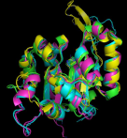

Tactics
Diversity
Stratification
Combine similar models
Combination
or fragments
3DRefine (energy, bond, angle) + FUSION
to refold unaligned loops and tails
+ SCRWL for side chain packing (server)
Tuning
Exception
Handling
Automated detection and replacement of bad models (worked in all 13 server exception cases)

Slide 9
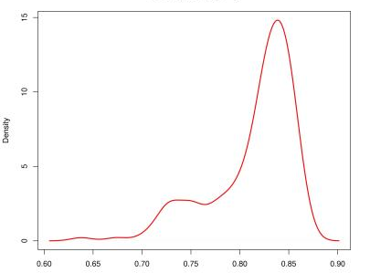



Good Case 1: T0762-D1, MULTICOM Server
GDT: 0.84
GDT: 0.73
GDT: 0.87
Blue: structure
Gold: model
GDT-TS score: 0.86
0.6 0.65 0.7 0.75 0.80 0.85 0.9
Templates: 4IB2, 4EF1, 4OTE, 4K3F, 3UP9, 3GXA, 4GOT
The best server model designated
as the first model
Distribution of GDT-TS Scores of MULTICOM Server Models

Slide 10
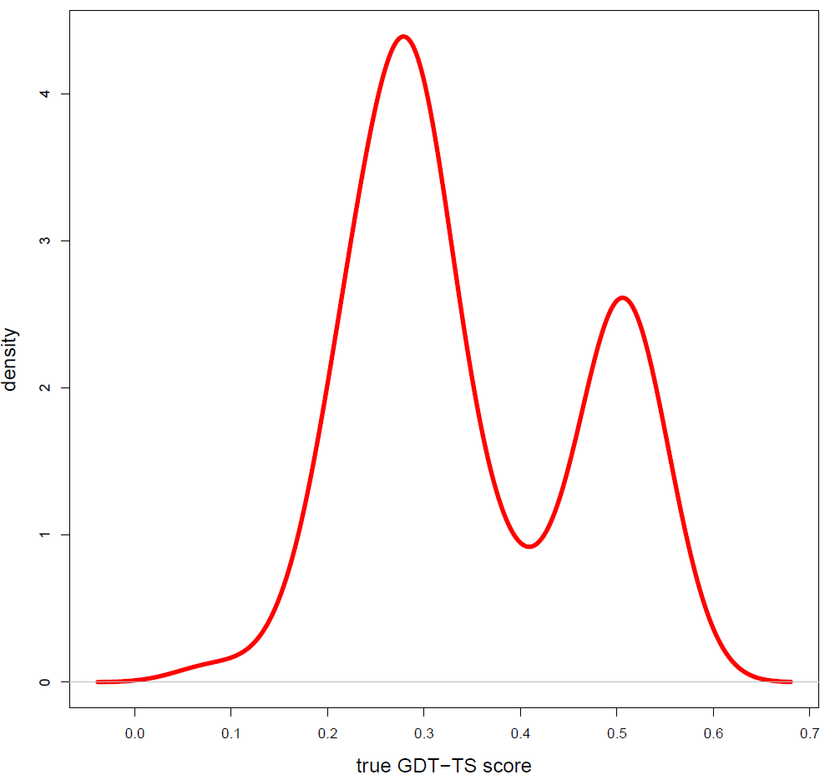
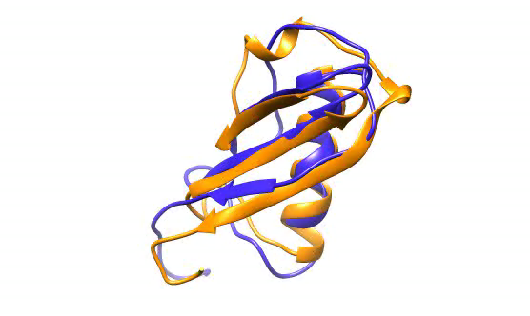
Good Case 2: T0853-D1, MULTICOM Human
0.0 0.1 0.2 0.3 0.4 0.5 0.6 0.7
Blue: structure
Gold: model
GDT-TS score: 0.59
Distribution of GDT-TS Scores of CASP Server Models
Server models:
Zhang-Server_TS1
BAKER-ROSETTASERVER_TS4
myprotein-me_TS1
Human model is better than
Zhang-Server_TS1

Slide 11
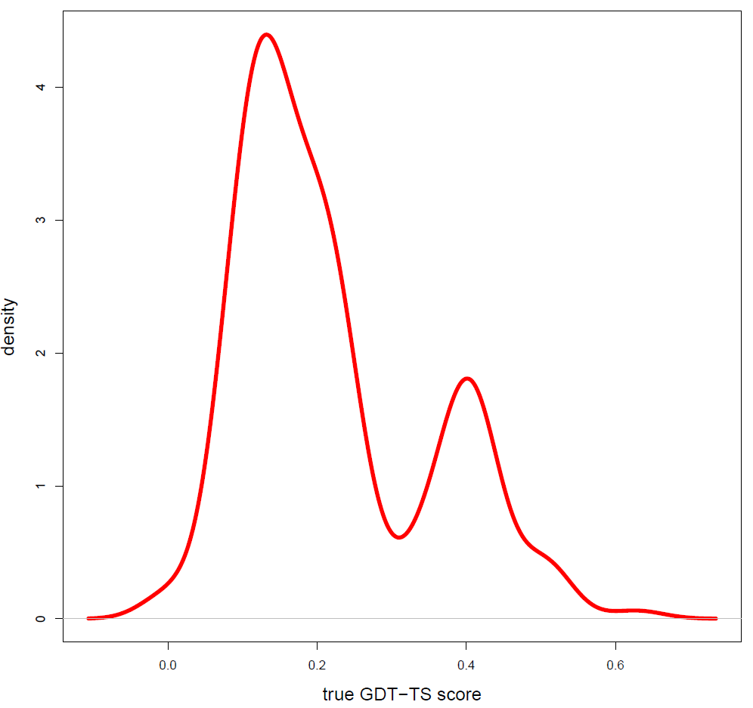
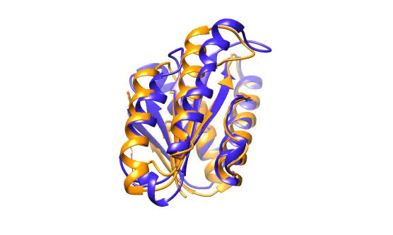
Good Case 3: T0783-D2, MULTICOM Human
Blue: structure
Gold: model
GDT-TS score: 0.63
0.0 0.2 0.4 0.6
Distribution of GDT-TS Scores of CASP Server Models
Server models:
nns_TS1
nns_TS3
nns_TS2
FFAS-3D_TS1
Human model:
The same GDT-TS score
Better side-chain quality

Slide 12
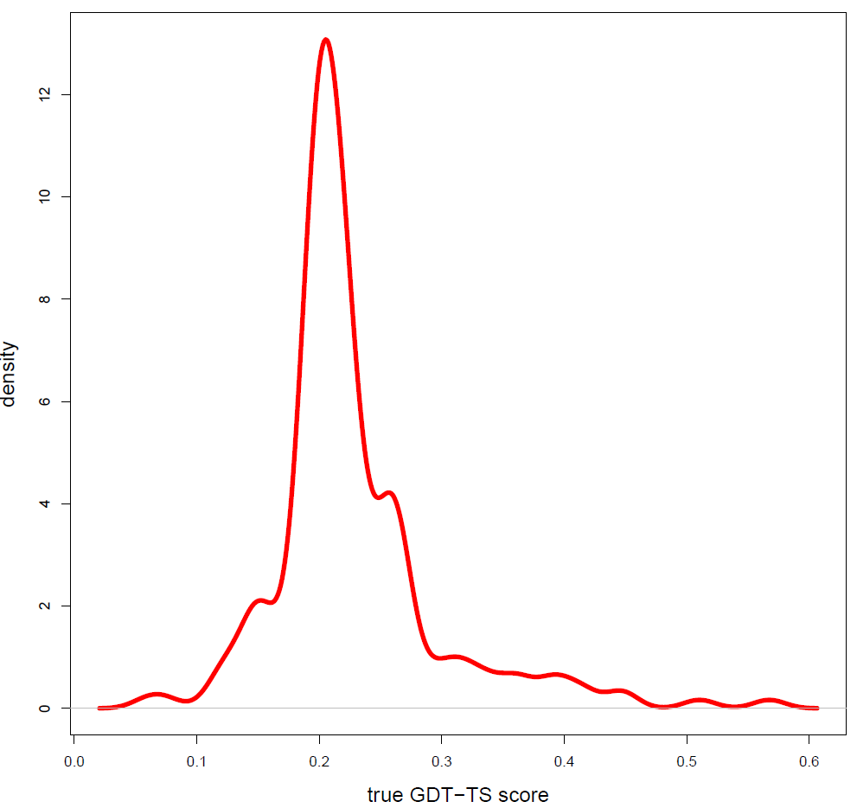
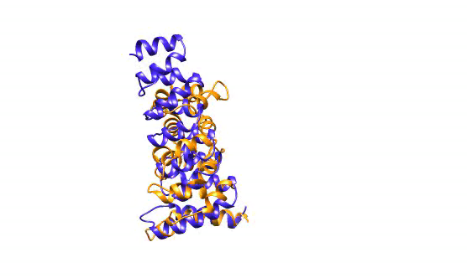
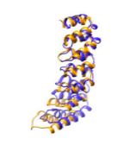
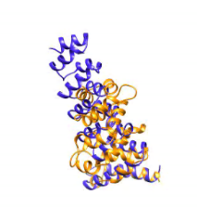
Bad Case: T0827-D1, MULTICOM Human
0.0 0.1 0.2 0.3 0.4 0.5 0.6
Distribution of GDT-TS Scores of CASP Server Models
Blue: structure
Gold: model
GDT-TS score: ~0.22
Selected and combined models
of low (average) quality

Slide 13

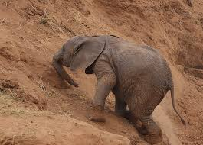
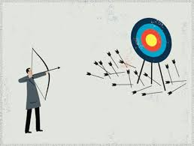
Success, Struggle and Failure
Large-scale independent sampling
Large-scale quality assessment
Exception handling
Model combination
Model refinement
Model refolding
Template recognition in thin, remote profile
Alignment in thin, remote profile
Quality assessment with few good models

Slide 14

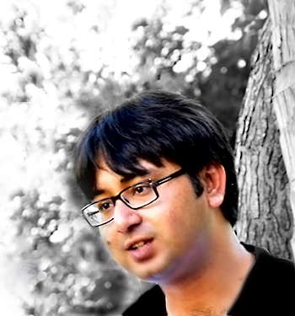

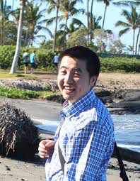


Acknowledgements
Group Members
Badri Adhikari
Deb Bhattacharya
Renzhi Cao
Jilong Li
CASP Assessors
Dr. Roland Dunbrack
CASP Organizers
CASP Server Predictors

