Slide 1
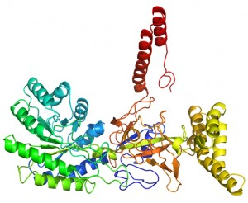
A Conformation Ensemble Approach to Protein Structure Prediction
Jianlin Jack Cheng
Computer Science Department
University of Missouri, Columbia
CSBW, ACM-BCB 2014

Slide 2
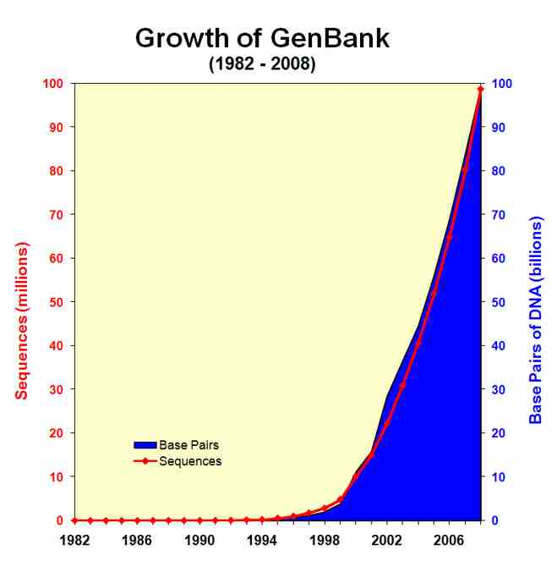
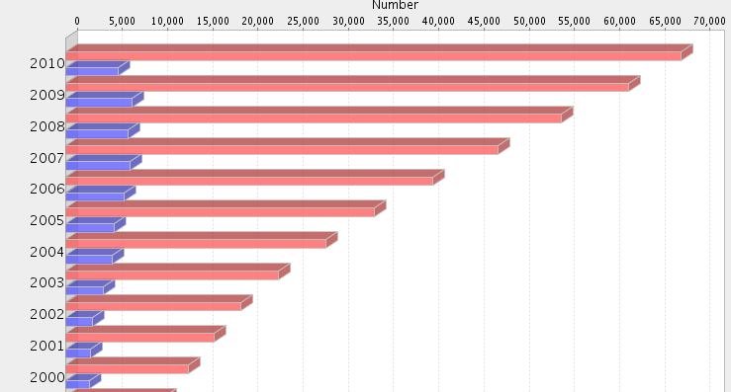
Protein Sequence - Structure Gap
Sequence
Structure Growth of PDB

Slide 3
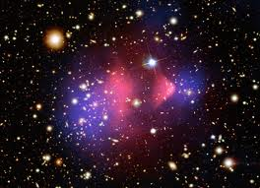
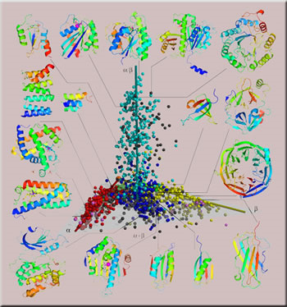
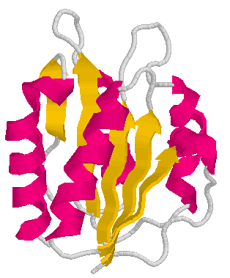
Template-Based Approach
Protein sequence space
is astronomical!
Protein structure space is limited!
Chothia, Nature,1992
Fold
MWLKKFGINKH…
Recognition
Alignment
Target protein
Protein Data Bank
Template

Slide 4
Model Generation (e.g., Modeller)
Fisher, 2005

Slide 5
Major Challenges in Template Based Modeling
Select best templates?
Generate best alignments?
Generate best models?
Select best models?
Wang et al., 2010; Cheng et al., 2012

Slide 6
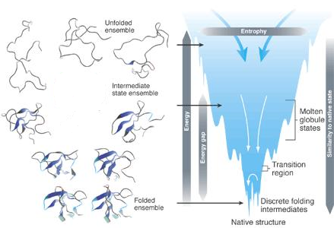
A Probabilistic Conformation Ensemble Approach
Brooks et al., 2001
P(conformation) P(-energy)
Conformation distribution
Maximum likelihood & maximum a posterior

Slide 7
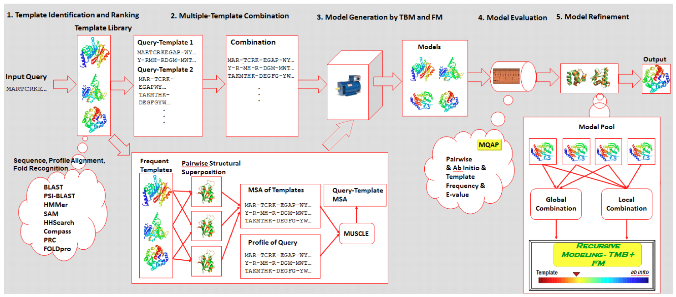
A Multi-Level Combination Protocol
Template Identification | 2. Template Combination | 3. Model Generation | 4. Model Combination | 5. Model Refinement
Sampling
Condensation

Slide 8
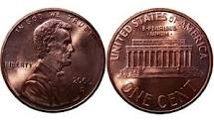
Conformation Sampling and Condensation are Two Sides of the Same Coin
Conformation Sampling
Conformation Condensation

Slide 9
Targeted Sampling in Fold Space
BLAST (sequence-sequence)
PSI-BLAST (sequence – profile)
SAM (sequence – HMM)
HMMer (sequence – HMM)
Compass (profile – profile)
HHSearch (HMM - HMM)
PRC (HMM-HMM)
FOLDpro (Support Vector Machine)
Cheng, Baldi, Bioinformatics, 2006
Li et al., BMC Structural Biology, 2011
Li et al., BMC Structural Biology, 2013

Slide 10
Multi-Template Averaging in Template and Alignment Space
Target VR-RNNMGMPLIESSSYHDALFTLGYAGDRISQMLGMRYANNLHDLFLAEGYYEASQRKR
Temp1 IAHIYANNLHDLFLAEGYYEASQRLFEIEL FGLMGN LSSWVGA
(10⁻⁸⁰)
Temp2 LLAQ-GRLSEMAGADALDVNIYIDSNG
(10⁻⁷⁰)
Temp3 QGTARDRAWQLEVERHRAQGTSASFL
(10⁻¹⁰)
Temp4 AANQLDAMRALGYAQERYFEMDLMRRAPAGELSELFGAKAVDLK
(10⁻⁵)
Cheng, BMC Structure Biology, 2008

Slide 11
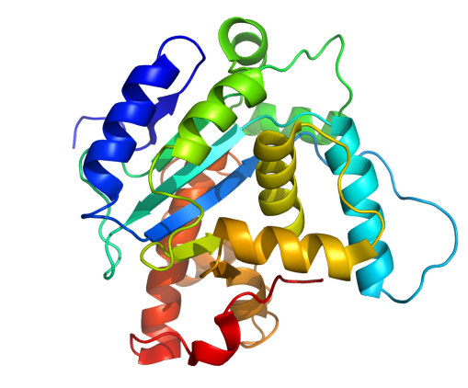
Multi-Template Averaging in Template and Alignment Space
Target VR-RNNMGMPLIESSSYHDALFTLGYAGDRISQMLGMRYANNLHDLFLAEGYYEASQRKR
Temp1 IAHIYANNLHDLFLAEGYYEASQRLFEIEL------FGLMGN------LSSWVGA-----
(10⁻⁸⁰)
Temp2 LLAQ-GRLSEMAGADALDVNIYIDSNG---------------------------------
(10⁻⁷⁰)
Temp3 ---------------------------ARDRAWQLEVERHRAQGTSASFL----------
(10⁻¹⁰)
Temp4 ----------------------------------------------------GAKAVDLK
(10⁻⁵)
+ Template Structures
2006 2008 2010 2012 2014
Improve over single-templates!
Cheng, 2008; Li et al., 2013

Slide 12
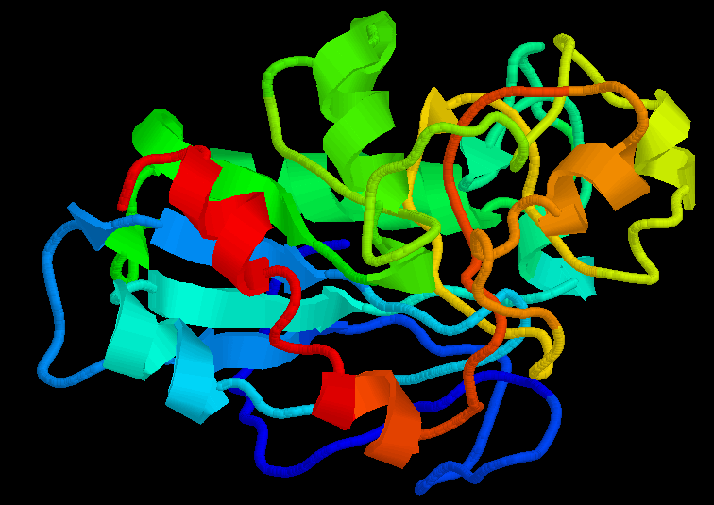
A Problem – Atom Clashes in CASP8
Inconsistent
Consistent
Combine 49 templates – Target T0413

Slide 13
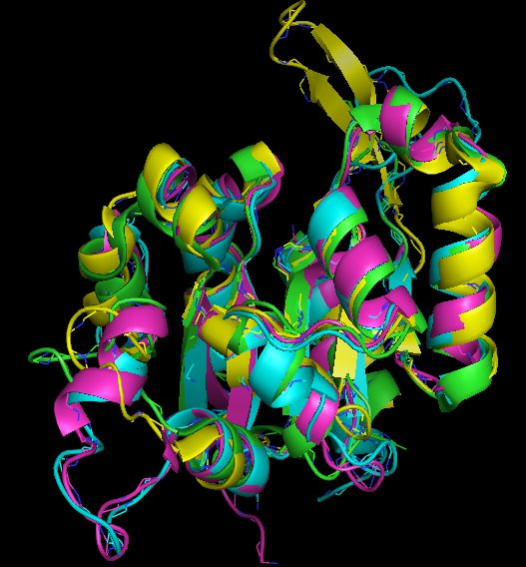
Structure Comparison-Guided Model Combination (CASP9 & 10)
Combine structurally consistent
target-template alignments
Cheng et al., 2010; Li et al., 2013

Slide 14
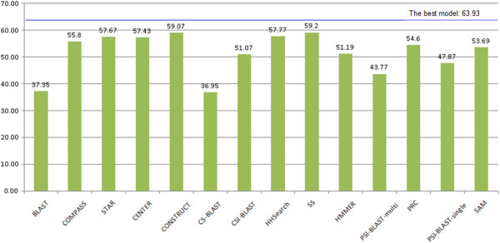
Combining Fold and Alignment Samplers Improves Quality
Total GDT-TS Score of 107 CASP9 Targets
Li et al., 2013

Slide 15
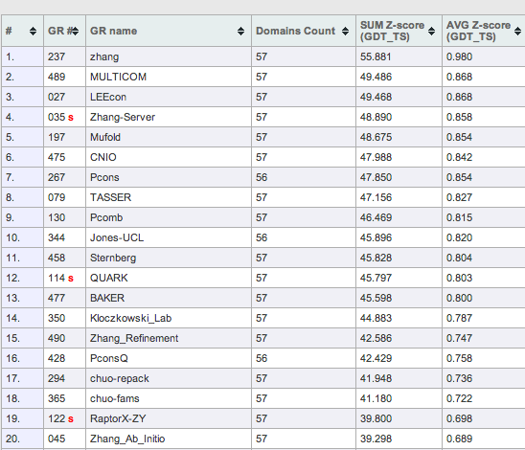
CASP10 TBM Results in 2012
Top 20 / 150
Predictors

Slide 16
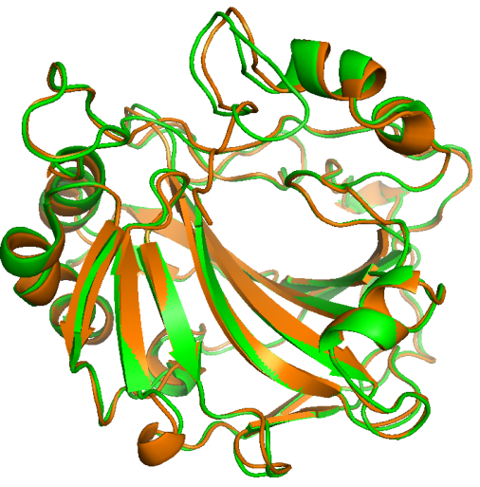
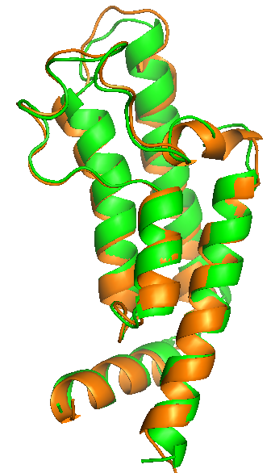
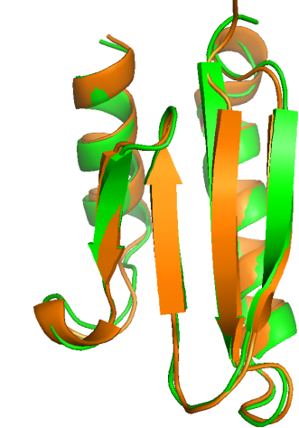
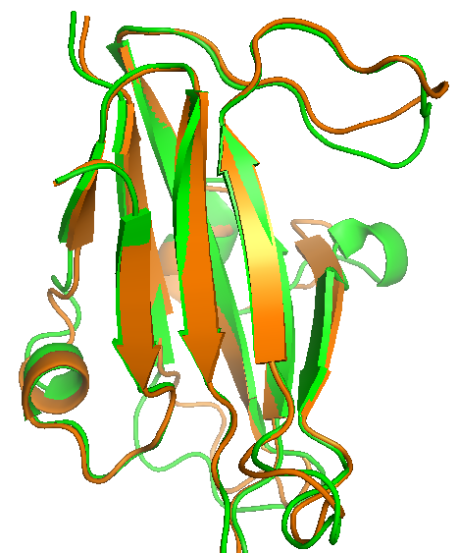
Some High-Quality CASP Predictions
T0390
GDT=0.90
T0426
GDT=0.97
T0432
GDT=0.92
T0458
GDT=0.97
Orange: structure; Green: model
Structures of ~40% of targets were predicted with in high-accuracy, RMSD < 2 Å,
~30% with correct topology but low resolution, ~30% with incorrect topology.

Slide 17
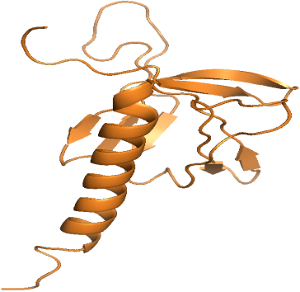
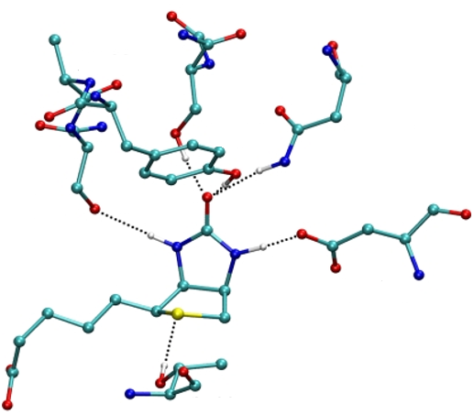
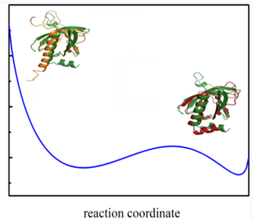
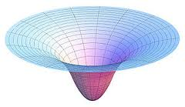
A Two-Step Refinement Process
1. Optimize Hydrogen-Bonding Network
Local geometry restraints
Conformational search
Initial Structure
Optimized HB Network
Initial Model
Refined Model
Native Structure
2. Calculate the
Potential Energy
Composite Physics and Knowledge Based Force Field
Energy Minimization
Using L-BFGS
Coordinate
Bhattacharya, Cheng, 2012;
Bhattacharya, Cheng, 2013

Slide 18
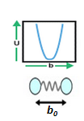
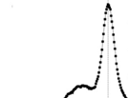
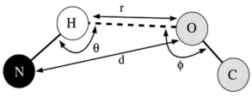
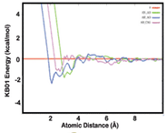
A Powerful Composite Force Field
A. Physics Based
B. Knowledge Based
E (Bond Length)
E (Hydrogen Bonding Potential)
N-H-O
H-O=C
E (Bond Angle)
Zhang et.al. 2011
E (Knowledge Based Contact Potential)
E (Torsion Angle )
Summa et.al. 2007
Composite Physics and Knowledge Based Force Field
E (Tether Cα and Cβ)
Bhattacharya, Cheng, 2012;
Bhattacharya, Cheng, 2013

Slide 19
Energy Function and Optimization
Energy function
Limited-memory Broyden-Fletcher-Goldfarb-Shanno (BFGS) Optimization method – a quasi-Newton method that can be applied to a large number of variables (MESHI, Keasar, 2005 )

Slide 20
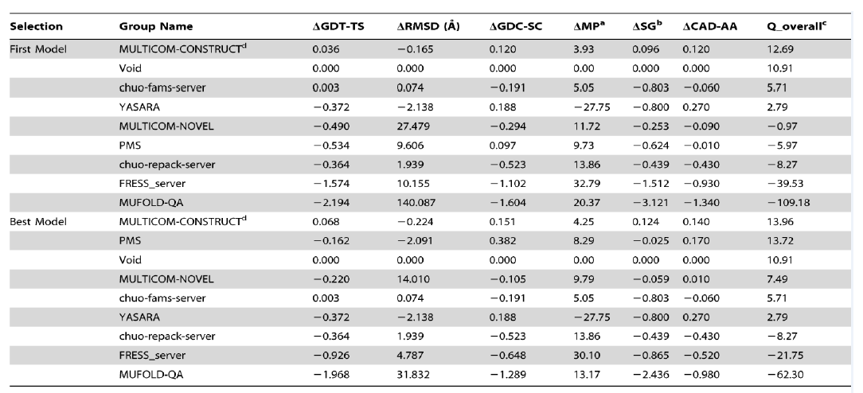
Comparison with Other Top Servers in CASP10
3DRefine was the only server consistently improved the quality of models on average. Global quality improvement: ~1%, Local quality improvement: +10%.

Slide 21
Protein Refinement Movie (TR705)

Slide 22
The MULTICOM Toolbox
http://sysbio.rnet.missouri.edu/multicom_toolbox/

Slide 23
Acknowledgements
Group Members
Badri Adhikari
Debswapna Bhattacharya
Renzhi Cao
Xin Deng
Jesse Eickholt
Jilong Li
Matt Spencer
Zheng Wang

Slide 24
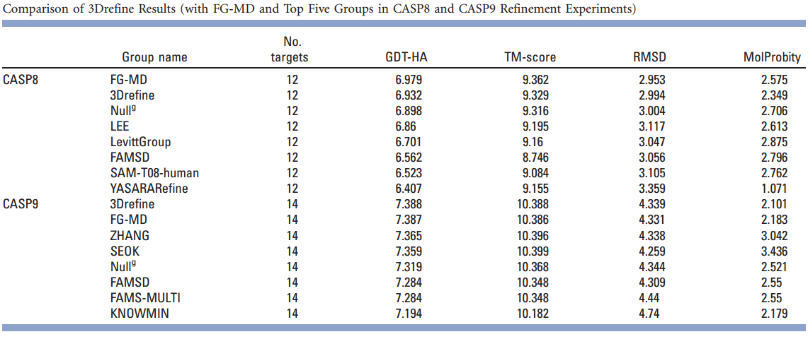
Evaluation on CASP8 and CASP9 Refinement
(3DRefine) – Consistent Improvement
Global Quality: ~1%, Local Quality: +10%
Bhattacharya, Cheng, 2012

Slide 25
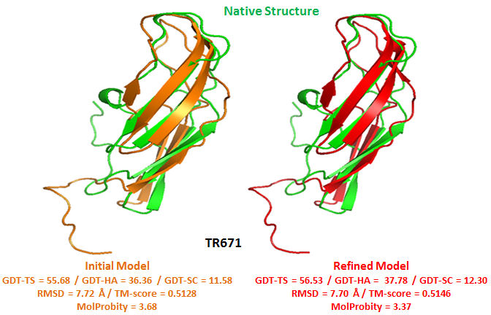
A CASP10 Refinement Example

