Slide 1
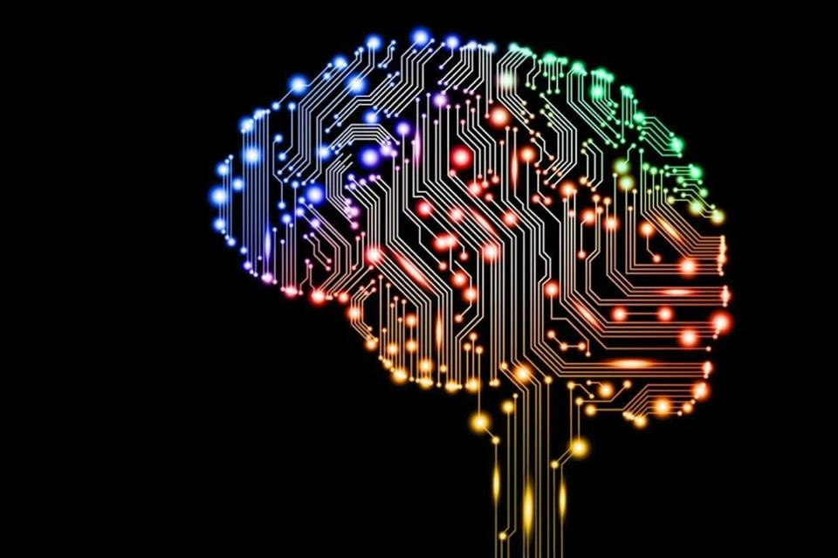
Deep Learning
Jianlin Cheng
Department of EECS
University of Missouri – Columbia
2019

Slide 2
Acknowledgements
Some content of this teaching presentation was drawn from many sources created by great scientists in the field of deep learning (Hinton, LeCun, Bengio, Ng, et al.).

Slide 3
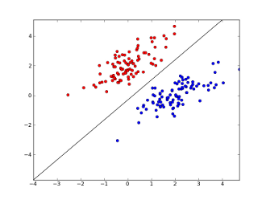
Simplest Neural Network for Classification – Logistic Regression
Loss/cross-entropy:
-(ylog(o) + (1-y)log(1- o))
Binary Classification
O: output f(x)
y: target (0 or 1)
+
g(a)
g: sigmoid
function
a: activation
-
w₀
w₁
w₂
w_{d}
1
x₁
x₂
……
x_{d}
activation = w₀ + w₁x₁ + w₂x₂ + …, w_{d}x_{d}
P(y = 1) = f(x) =

Slide 4
Simplest Neural Network for Classification – Logistic Regression
Multi Classification
Loss/cross-entropy:
O: output f(x)
y: target (0 or 1)
1
m
g: softmax
a: activation
w_{m0}
w₁₀
w₁₁
w₁₂
w_{md}
w_{1d}
1
x₁
x₂
……
x_{d}
activation = w₀ + w₁x₁ + w₂x₂ + …, w_{d}x_{d}
P(y_{i} = 1) = f(x) =

Slide 5
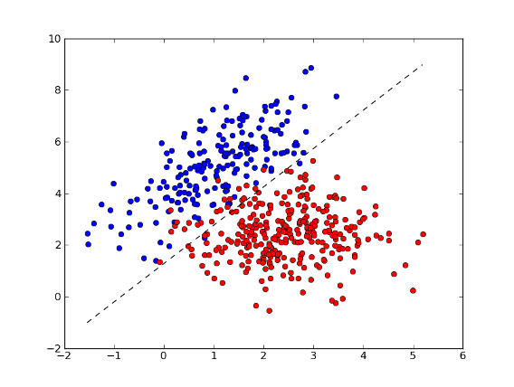
Perceptron
Learning to map input to output (label) and is guided by output.
Training
f(x) = w₀ + w₁x₁ + w₂x₂ + …, w_{d}x_{d}
f(x) > 0: positive class (1)
f(x) < 0: negative class (0)
Error: (o - y)²
+
f(x) = σ(Σ(x))
Activation function:
Delta function
w₀
w₁
w_{d}
-
1
x₁
x₂
……
x_{d}
Learning is to adjust w to minimize the squared
error between f(x) and true y.
Testing
Label information
Perceptron – 1960s

Slide 6
Simplest Neural Network for Regression – Linear Regression
Error: (o-y)²
Y: target
O: output
I(a)
Activation function: identity
function
a: activation
w₀
w₁
w₂
w_{d}
1
x₁
x₂
……
x_{d}
Output = w₀ + w₁x₁ + w₂x₂ + …, w_{d}x_{d}

Slide 7
TensorFlow Demo of One-Node Network
Data Sets: MNIST digit recognition data or Iris flower classification data
Google’s TensorFlow installation: https://www.tensorflow.org/
Install it on mac: https://www.tensorflow.org/install/install_mac
Activate tensorflow: $source ~/tensorflow/bin/activate

Slide 8
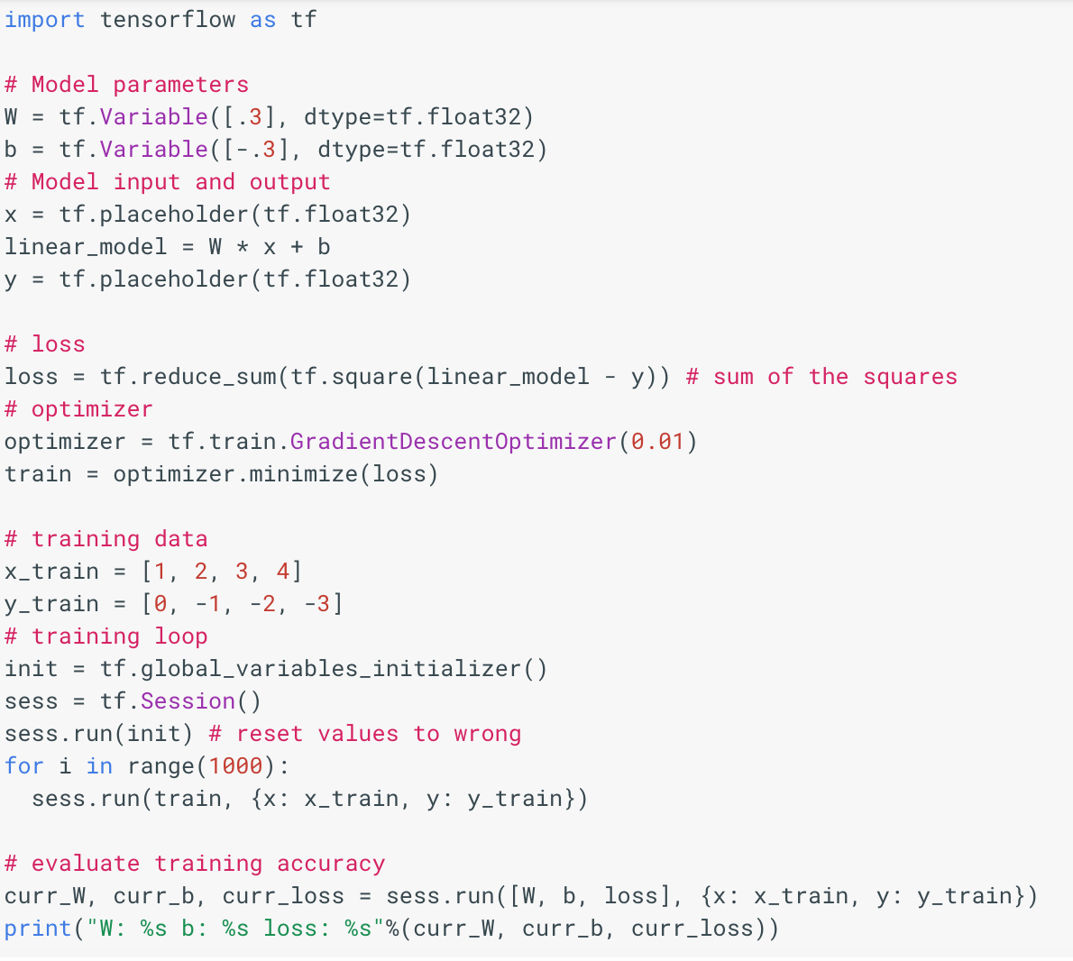
TensorFlow Model for Linear Regression I

Slide 9
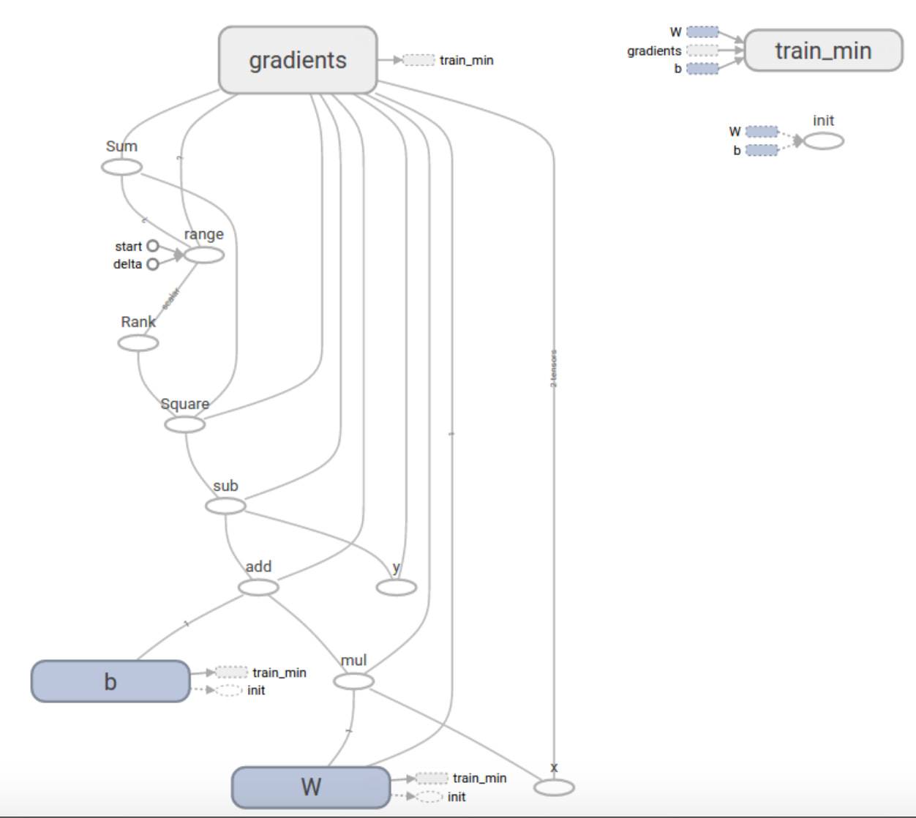

Slide 10
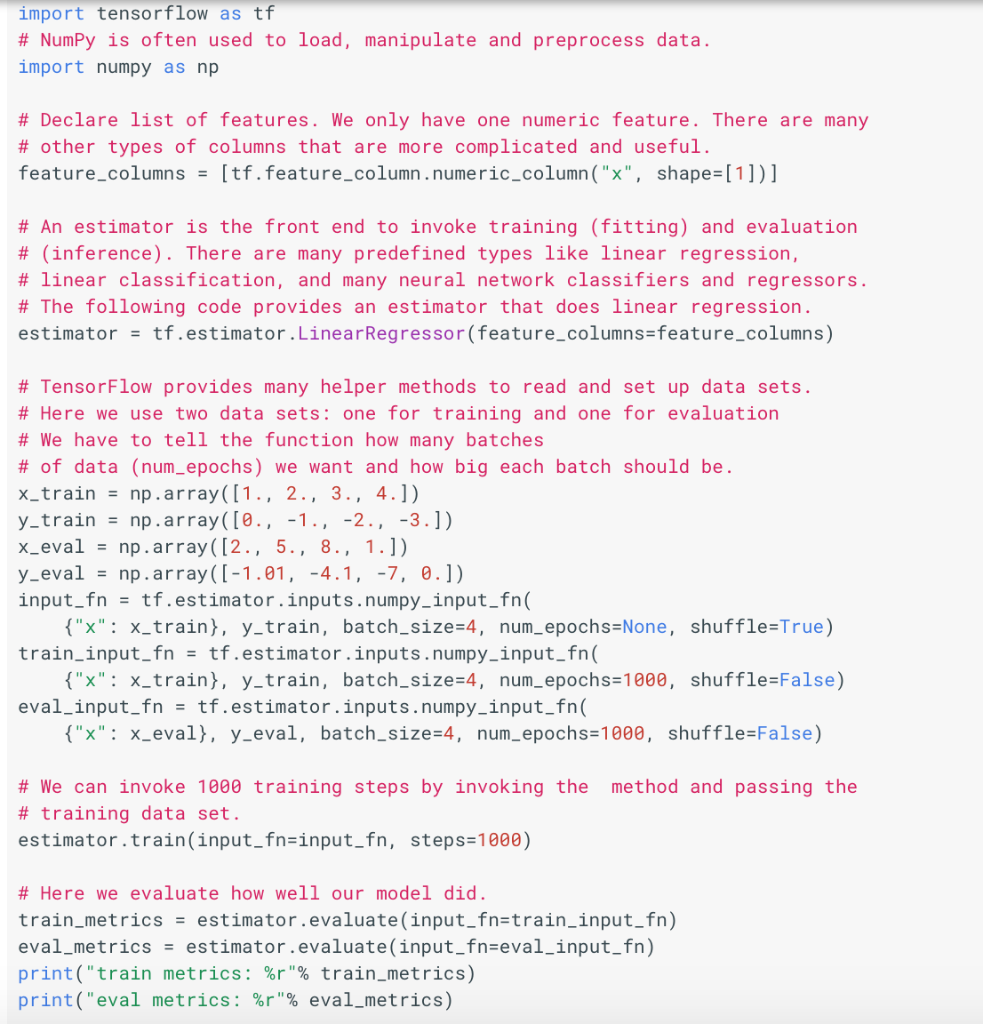
Tensor Flow Linear Model II

Slide 11
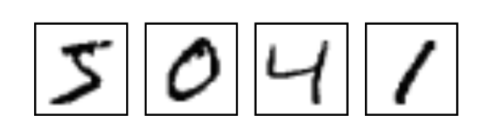
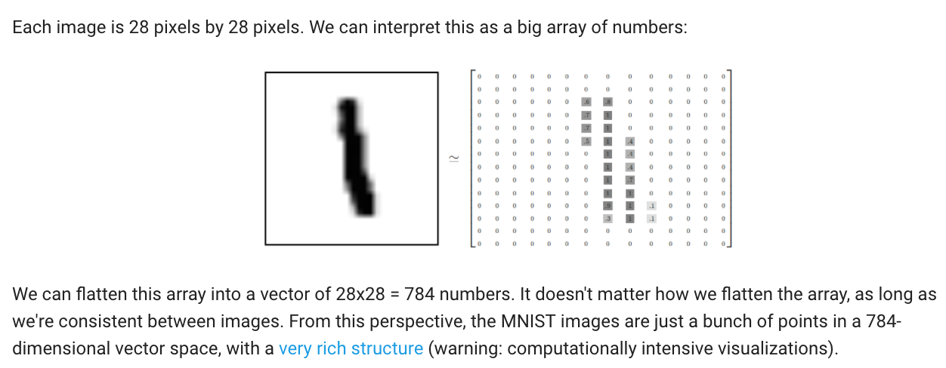
Logistic Regression for Hand Writing Classification

Slide 12
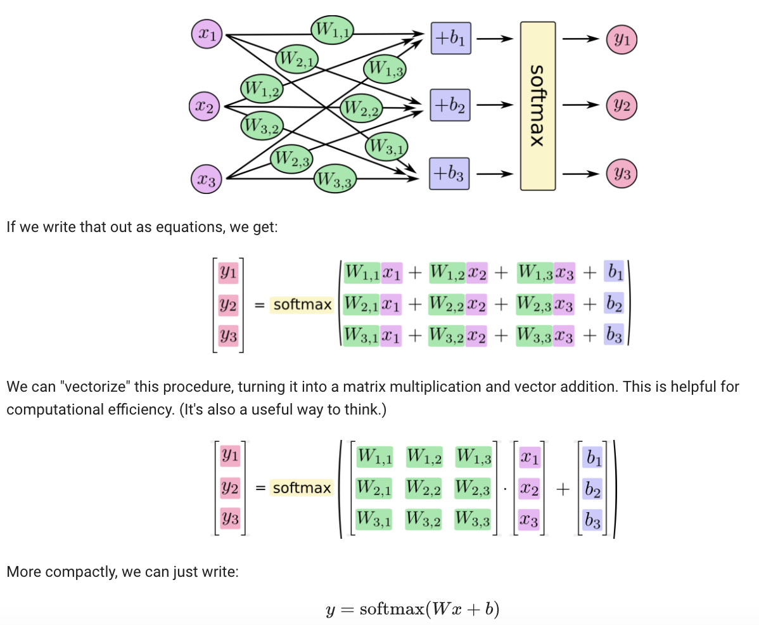

Slide 13
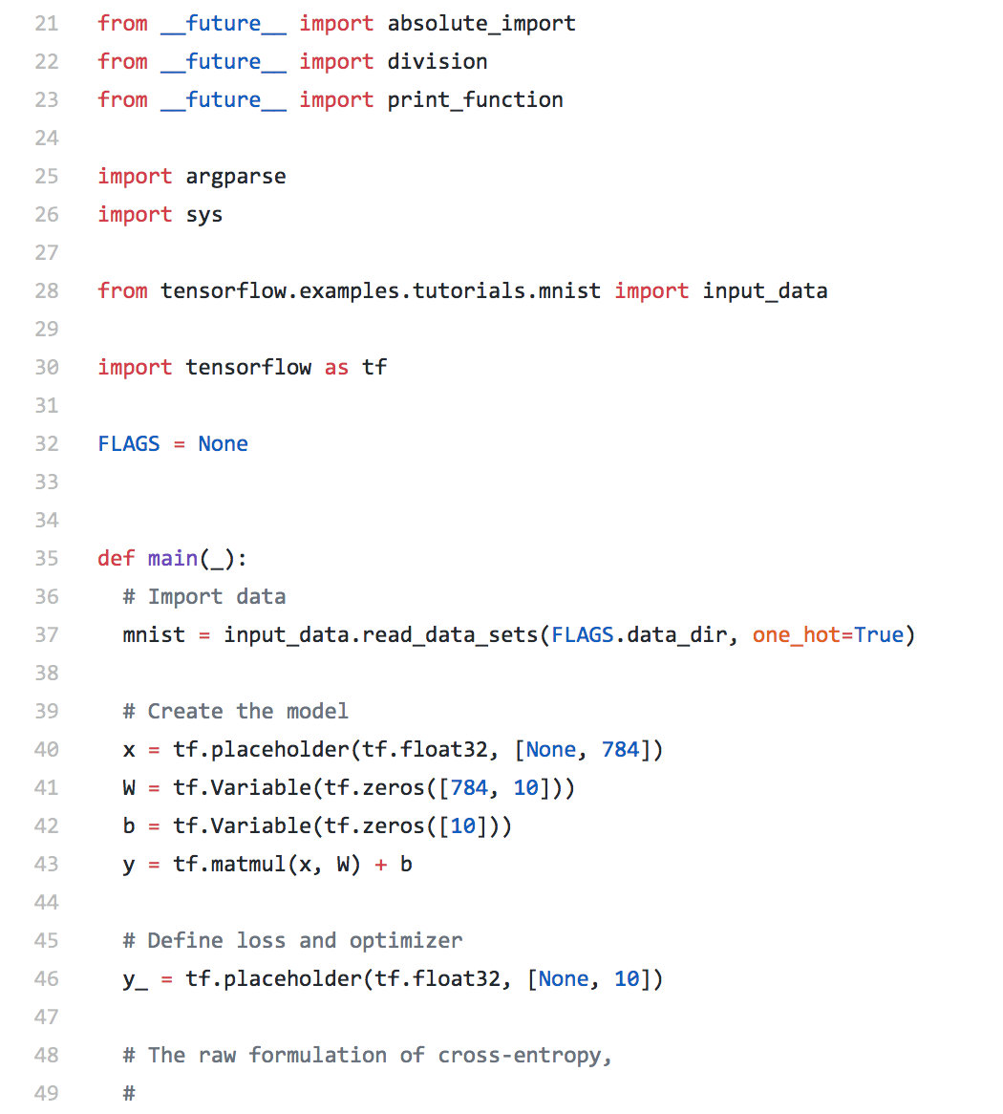

Slide 14
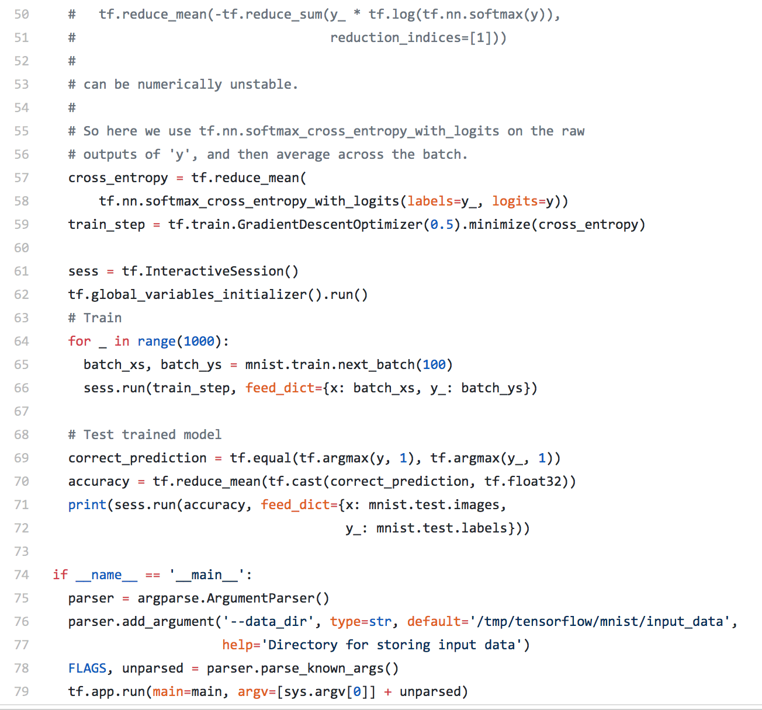

Slide 15
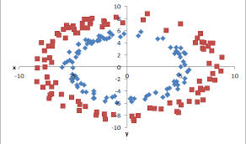
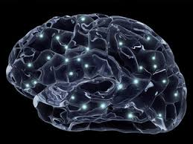
Neural Network
Backward
Propagation
Forward
Propagation
Error: (o-y)²
o
f(Σ)
Hidden layer
f(Σ)
f(Σ)
…
f(Σ)
1
x₁
x₂
……
x_{d}
1980s – Neural Network Revolution

Slide 16
Two-Layer Neural Network
y₁
y_{k}
y_{c}
Output
…
Activation function: f (linear,sigmoid, softmax)
Activation of unit a_{k}:
w_{kj}
z₁
z_{M}
z_{j}
Z₀=1
…
Activation function: g (linear, tanh, sigmoid)
Activation of unit a_{j}:
w₁₁
w_{1i}
w_{ji}
1
…
x₀
x₁
x_{i}
x_{d}

Slide 17
Adjust Weights by Training
How to adjust weights?
Adjust weights using known examples (training data) (x₁,x₂,x₃,…,x_{d},t).
Try to adjust weights so that the difference between the output of the neural network y and t (target) becomes smaller and smaller.
Goal is to minimize Error (difference) as we did for one layer neural network

Slide 18
Adjust Weights using Gradient Descent
Known:
Minima
Error
Data: (x₁,x₂,x₃,…,x_{n}) target t.
Unknown weights w:
w₁₁, w₁₂,…..
Randomly initialize weights
Repeat
for each example, compute output y calculate error E = (y-t)²
compute the derivative of E over w: dw=
w_{new} = w_{prev} – η * dw
W
Until error doesn’t decrease or max num of iterations (epochs)
Note: η is learning rate or step size.

Slide 19
Stochastic Gradient Descent
Known:
Minima
Error
Data: (x₁,x₂,x₃,…,x_{n}) target t.
Unknown weights w:
w₁₁, w₁₂,…..
Randomly initialize weights
Repeat
Randomize the order of examples, divide into batches
for each example in a batch, compute output y and error E = (y-t)²
compute the derivative of E over w: dw=
Add the derivatives of a batch together
w_{new} = w_{prev} – η * dw
W
Until error doesn’t decrease or max num of iterations (epochs)
Note: η is learning rate or step size.

Slide 20
Neural Network Learning: Two Processes
Forward propagation: present an example (data) into neural network. Compute activation into units and output from units.
Backward propagation: propagate error back from output layer to the input layer and compute derivatives (or gradients).

Slide 21
Forward Propagation
Output
y_{k}
y₁
y_{k}
y_{c}
Activation function: f (linear,sigmoid, softmax)
…
Activation of unit a_{k}:
w_{kj}
z₁
z_{j}
z_{M}
z_{j}
…
Activation function: g (linear, tanh, sigmoid)
Activation of unit a_{j}:
w₁₁
w_{1i}
w_{ji}
…
x₁
x_{i}
x_{d}
Time complexity?

Slide 22
Forward Propagation
Output
y_{k}
y₁
y_{k}
y_{c}
Activation function: f (linear,sigmoid, softmax)
…
Activation of unit a_{k}:
w_{kj}
z₁
z_{j}
z_{M}
z_{j}
…
Activation function: g (linear, tanh, sigmoid)
Activation of unit a_{j}:
w₁₁
w_{1i}
w_{ji}
…
x₁
x_{i}
x_{d}
Time complexity?
O(dM + MC) = O(W)

Slide 23
Backward Propagation
y₁
y_{k}
y_{c}
f
…
a_{k}:
w_{kj}
z₁
z_{j}
z_{M}
…
g
w_{ji}
a_{j}:
w₁₁
w_{1i}
…
x₁
x_{i}
x_{d}
Time complexity?

Slide 24
Backward Propagation
y₁
y_{k}
y_{c}
f
…
a_{k}:
w_{kj}
z₁
z_{j}
z_{M}
…
g
w_{ji}
a_{j}:
w₁₁
w_{1i}
…
x₁
x_{i}
x_{d}
Time complexity?
O(CM+Md) = O(W)
If no back-propagation, time
complexity is: (MdC+CM)

Slide 25
Example
y
f linear function
a_{k}:
w_{j}
z₁
z_{j}
z_{M}
g is sigmoid:
…
a_{j}:
w₁₁
w_{1i}
w_{ji}
…
x₁
x_{i}
x_{d}

Slide 26
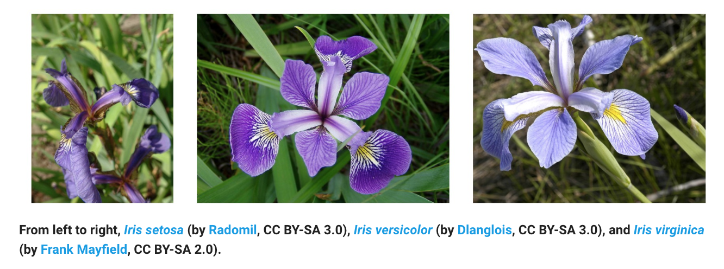
TensorFlow Demo of Simple Neural Networks
Data Sets: Iris flower classification data
Google’s TensorFlow installation: https://www.tensorflow.org/

Slide 27
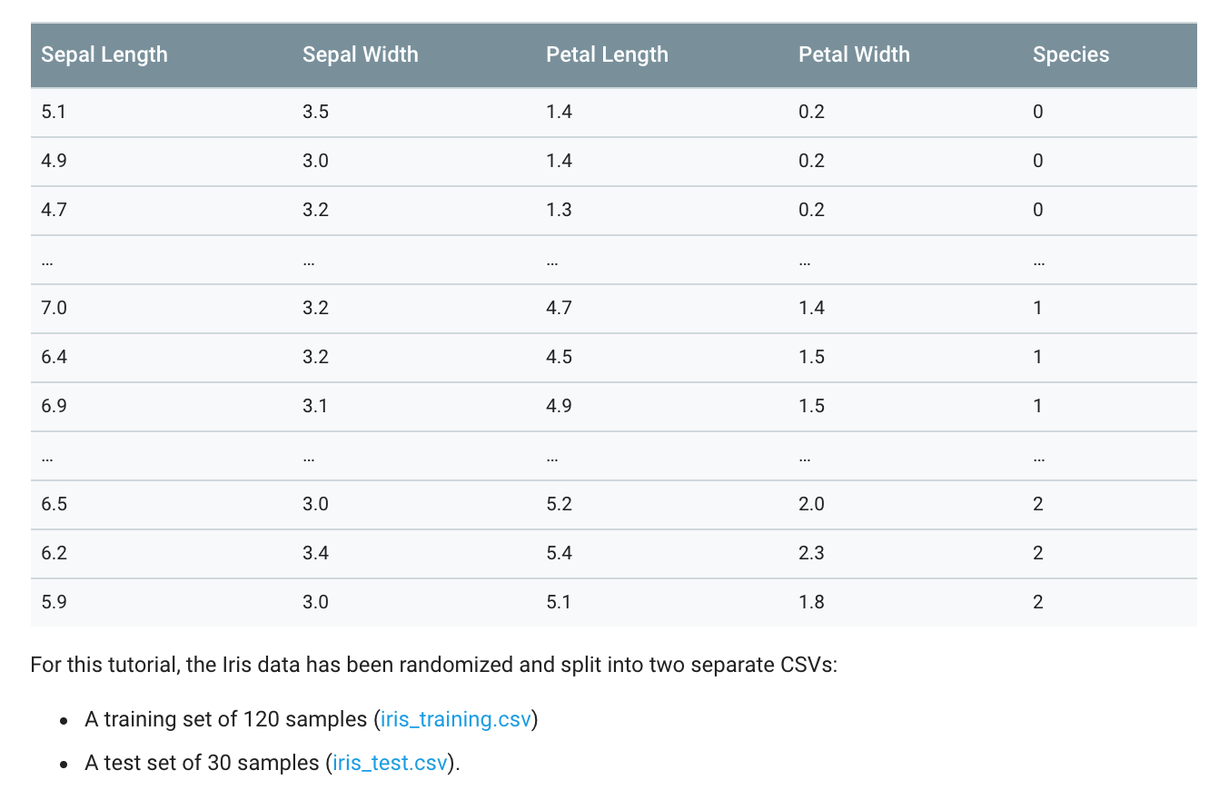

Slide 28
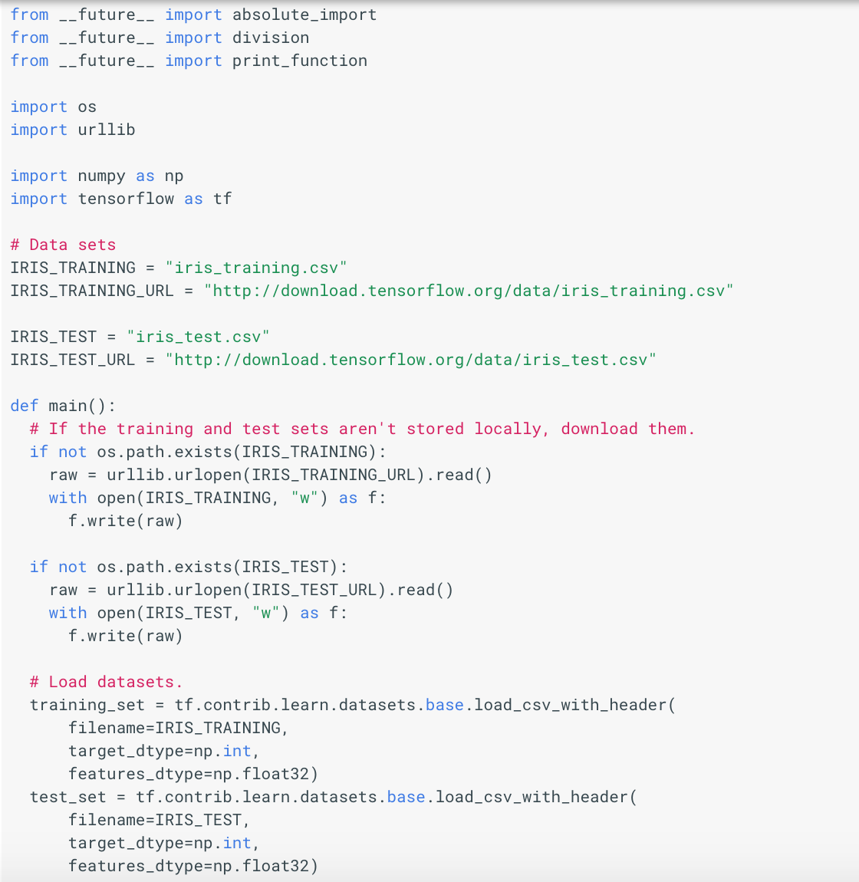

Slide 29
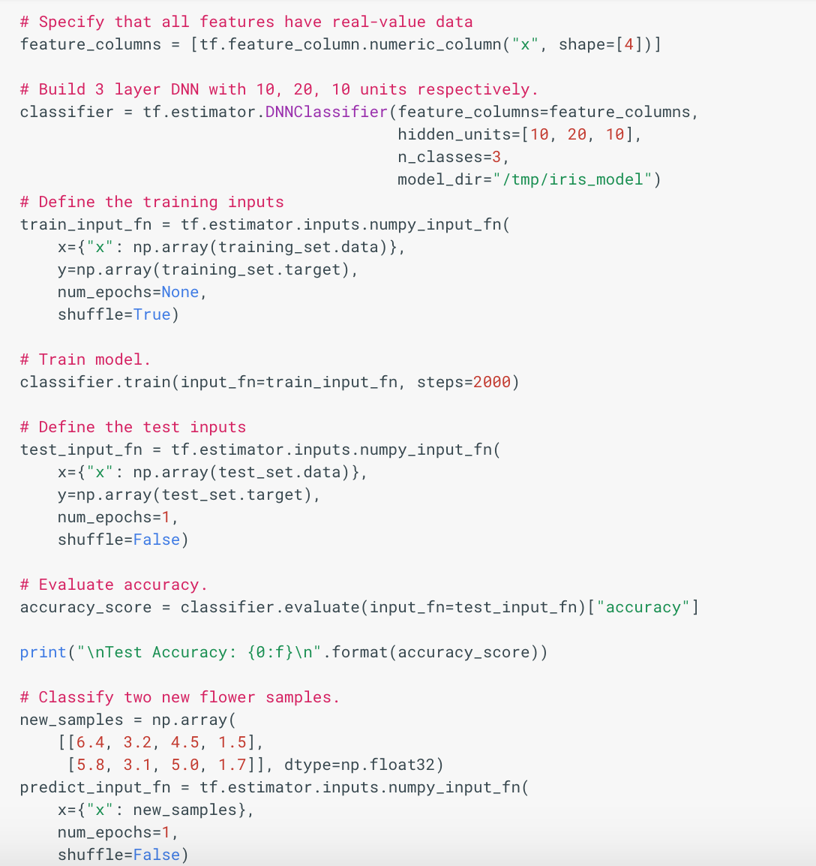

Slide 30
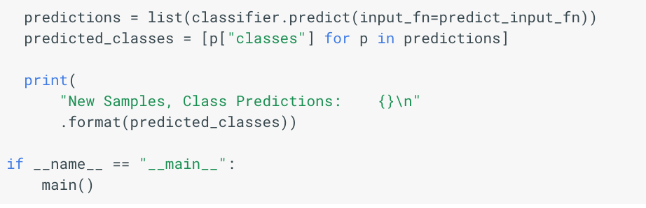

Slide 31
Keras
Keras is an open-source neural-network library written in Python. It is capable of running on top of TensorFlow, Microsoft Cognitive Toolkit, Theano, or PlaidML.^{[1][2]} Designed to enable fast experimentation with deep neural networks, it focuses on being user-friendly, modular, and extensible. It was developed as part of the research effort of project ONEIROS (Open-ended Neuro-Electronic Intelligent Robot Operating System),^{[3]} and its primary author and maintainer is François Chollet, a Google engineer. Chollet also is the author of the XCeption deep neural network model^{[4]}.
In 2017, Google's TensorFlow team decided to support Keras in TensorFlow's core library.^{[5]}Chollet explained that Keras was conceived to be an interface rather than a standalone machine learning framework. It offers a higher-level, more intuitive set of abstractions that make it easy to develop deep learning models regardless of the computational backend used.^{[6]} Microsoft added a CNTK backend to Keras as well, available as of CNTK v2.0.^{[7][8]}

Slide 32
An Example with TensorFlow in Keras for MNIST Classification
import tensorflow as tf
mnist = tf.keras.datasets.mnist
(x_train, y_train),(x_test, y_test) = mnist.load_data()
x_train, x_test = x_train / 255.0, x_test / 255.0
model = tf.keras.models.Sequential([
tf.keras.layers.Flatten(input_shape=(28, 28)),
tf.keras.layers.Dense(128, activation='relu'),
tf.keras.layers.Dropout(0.2),
tf.keras.layers.Dense(10, activation='softmax')
])
model.compile(optimizer='adam',
loss='sparse_categorical_crossentropy',
metrics=['accuracy'])
model.fit(x_train, y_train, epochs=5)
model.evaluate(x_test, y_test)
https://www.tensorflow.org/overview/

Slide 33
o
f(Σ)
f(Σ)
f(Σ)
…
f(Σ)
……
Vanishing
Gradient or
Explosion
f(Σ)
f(Σ)
…
f(Σ)
f(Σ)
f(Σ)
…
f(Σ)
1
x1
x2
……
xd

Slide 34
Neural Network’s Winter in 1990s
A standard three-layer neural network is a universal approximator
Hard to train multi-layer neural networks
Get different models from different training (local minimal)

Slide 35

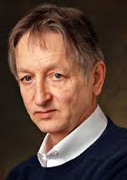
How to Construct Deep Networks?
G. Hinton
2000s

Slide 36
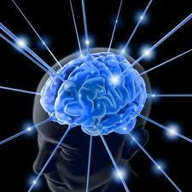
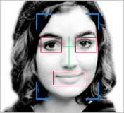
Learning by Composition? – A Face Recognition Analogy
Face or not ?
……
Lines, circles, squares
Brain Learning
Image pixels

Slide 37
Breakthrough
Deep Learning: machine learning algorithms based on learning multiple levels of representation / abstraction
Amazing improvements in error rate in object recognition, object
detection, speech recognition, and more recently, in natural language processing / understanding

Slide 38
Machine Learning for Artificial Intelligence
Four key ingredients for ML towards AI
Lots & lots of data
Very flexible models
Enough computing power
Technical improvement (ReLu function, ResNet, semi-supervised learning)
Powerful priors that can defeat the curse of dimensionality

Slide 39
Linear Activation Function

Slide 40
Sigmoid Function

Slide 41
Hyperbolic Tangent Function (TanH)

Slide 42
Rectified Linear Unit (ReLU)

Slide 43
Leaky ReLU

Slide 44
Bypassing the curse of dimensionality
We need to build compositionality into our ML models just as human languages exploit compositionality
Exploiting compositionality gives an exponential gain in representational power: (1) distributed representations/embeddings (feature learning); (2) deep architecture ( multi-levels of feature learning)
Additional prior: compositionality is useful to describe the world around us efficiently

Slide 45
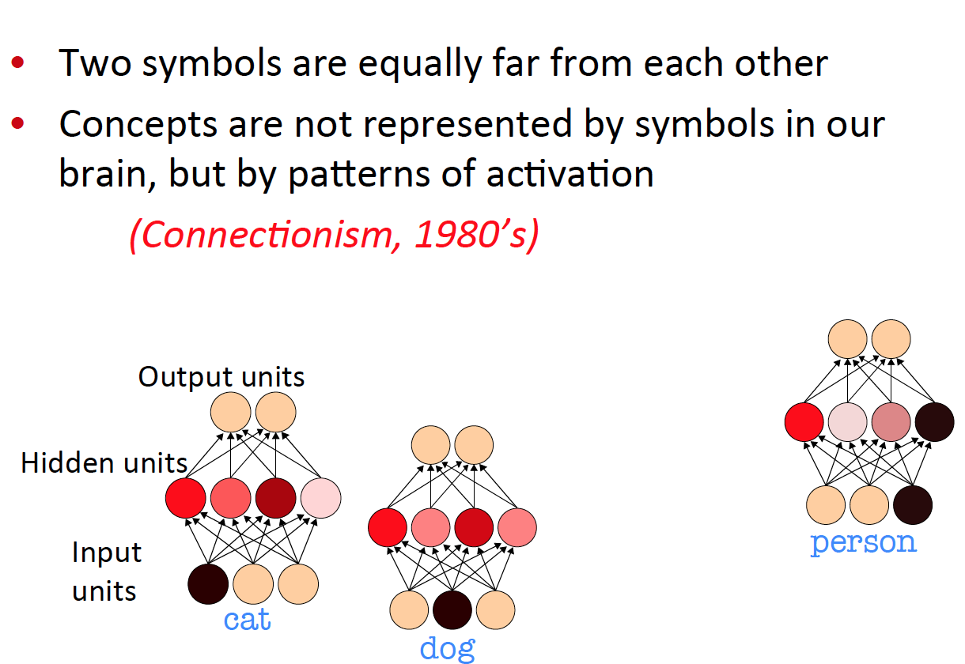
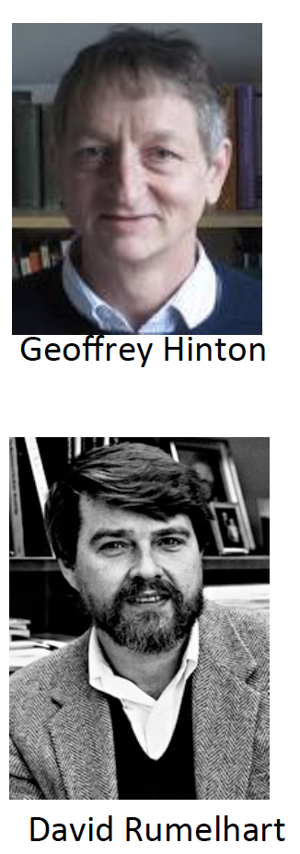
Classical Symbolic AI vs
Learning Distributed Representations

Slide 46
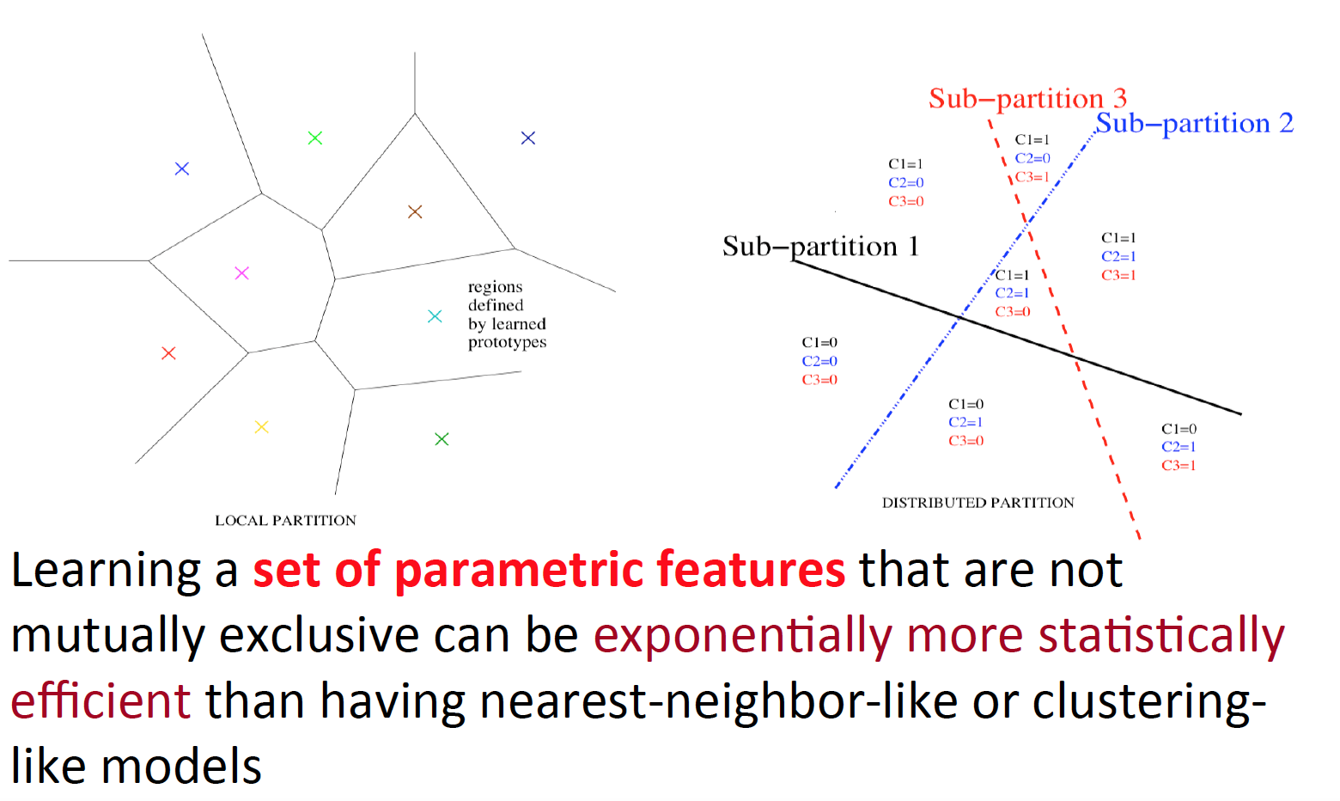
Exponential advantage of distributed representations

Slide 47
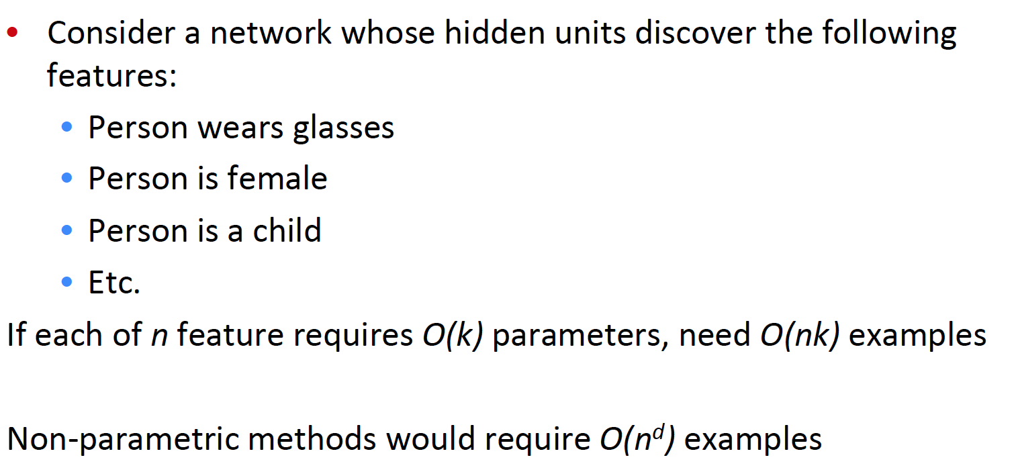
Each feature can be discovered without the need for seeing the exponentially large number of configurations of the other features

Slide 48
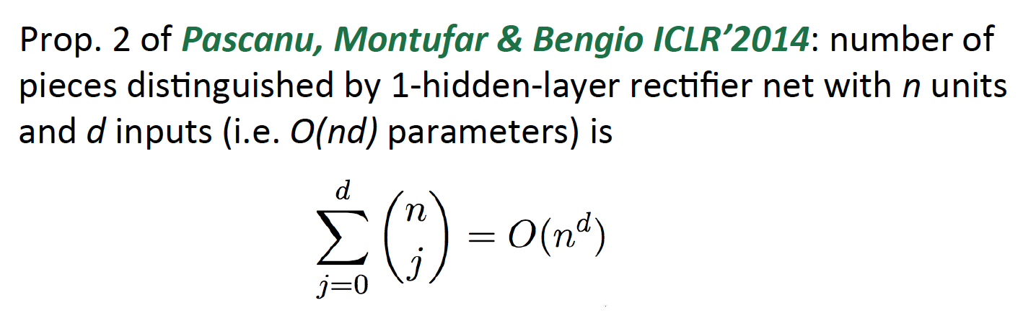
Exponential advantage of distributed representations

Slide 49
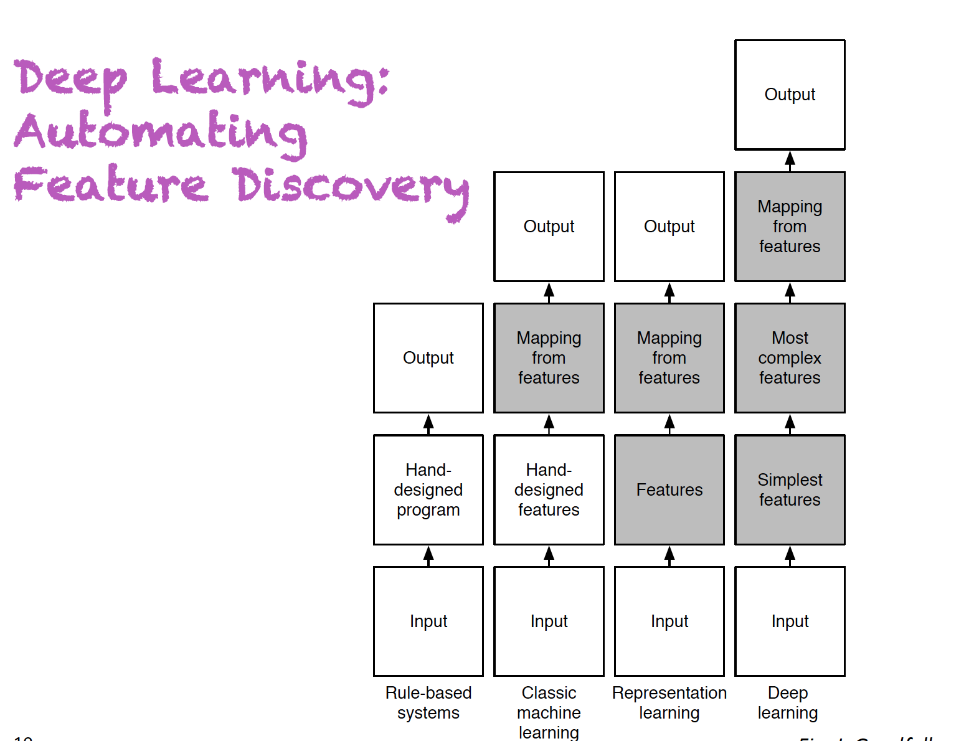

Slide 50
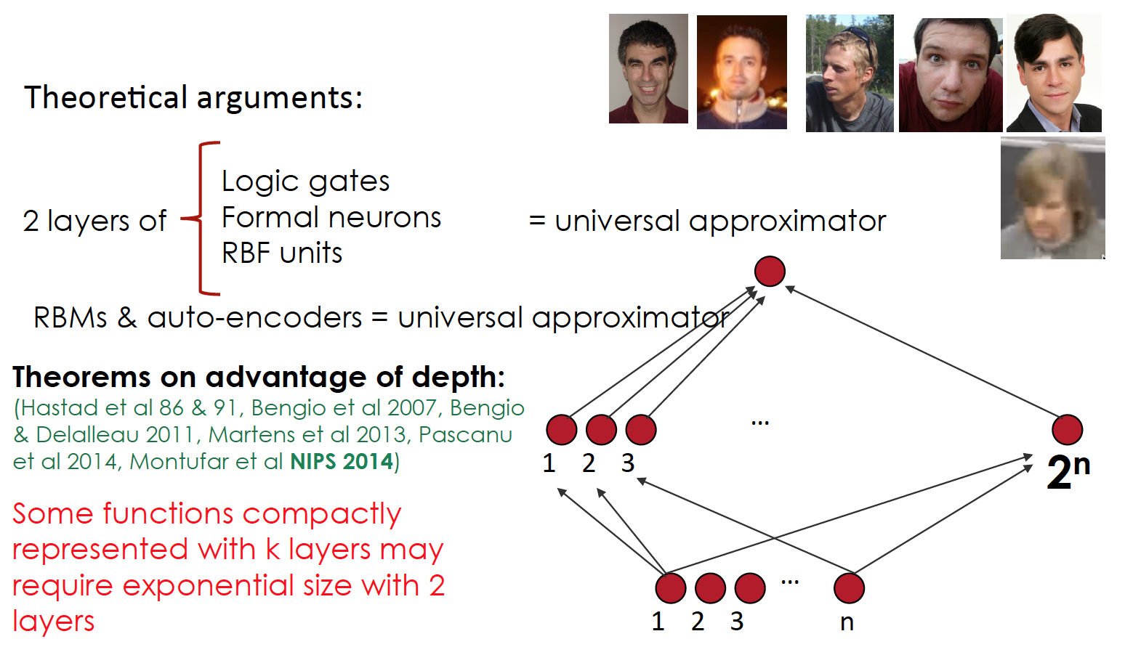
Exponential advantage of depth

Slide 51
Why does it work? No Free Lunch
It only works because we are making some assumptions about the data generating distribution
Worse-case distributions still require exponential data
But the world has structure and we can get an exponential gain by exploiting some of it

Slide 52
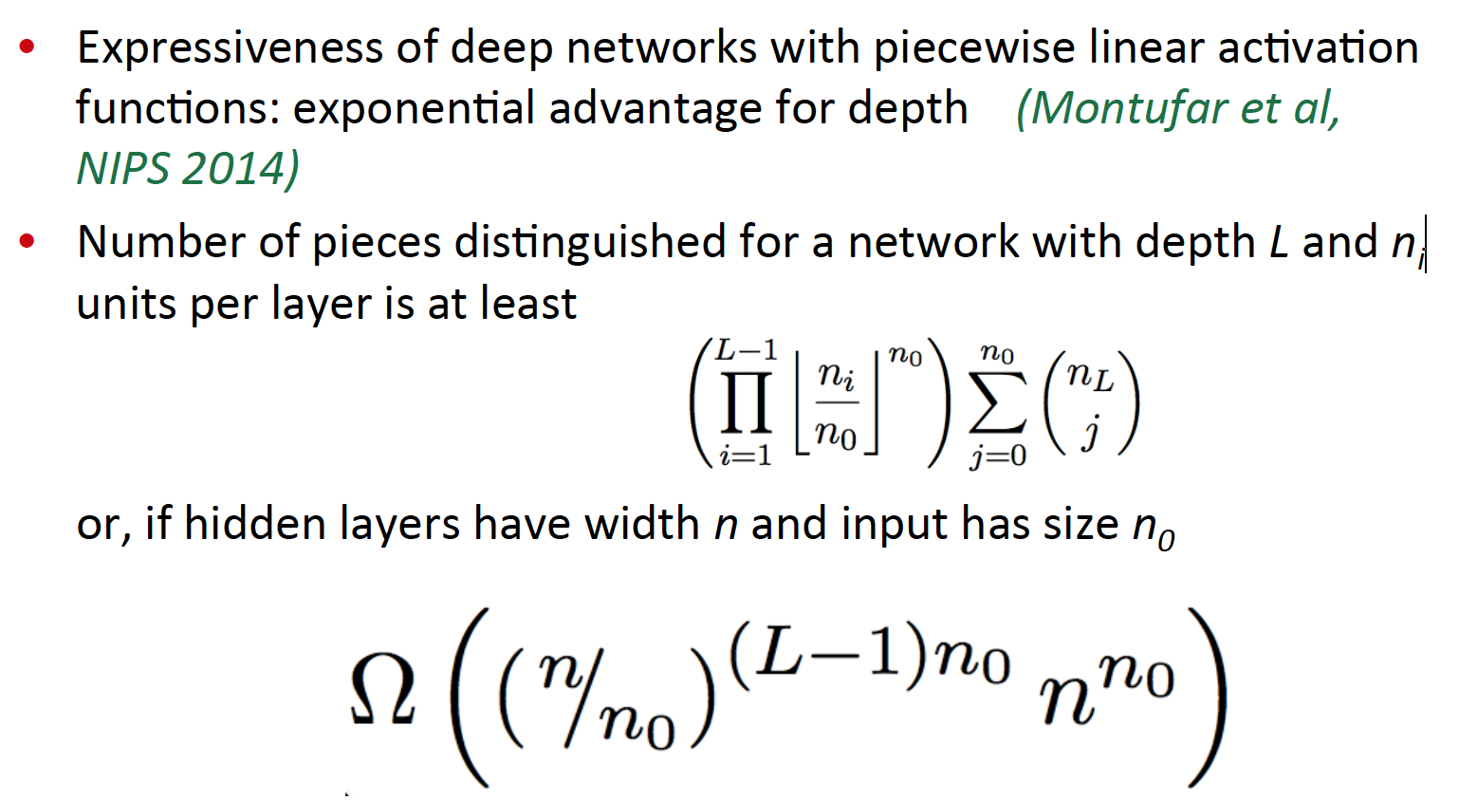
Exponential advantage of depth

Slide 53
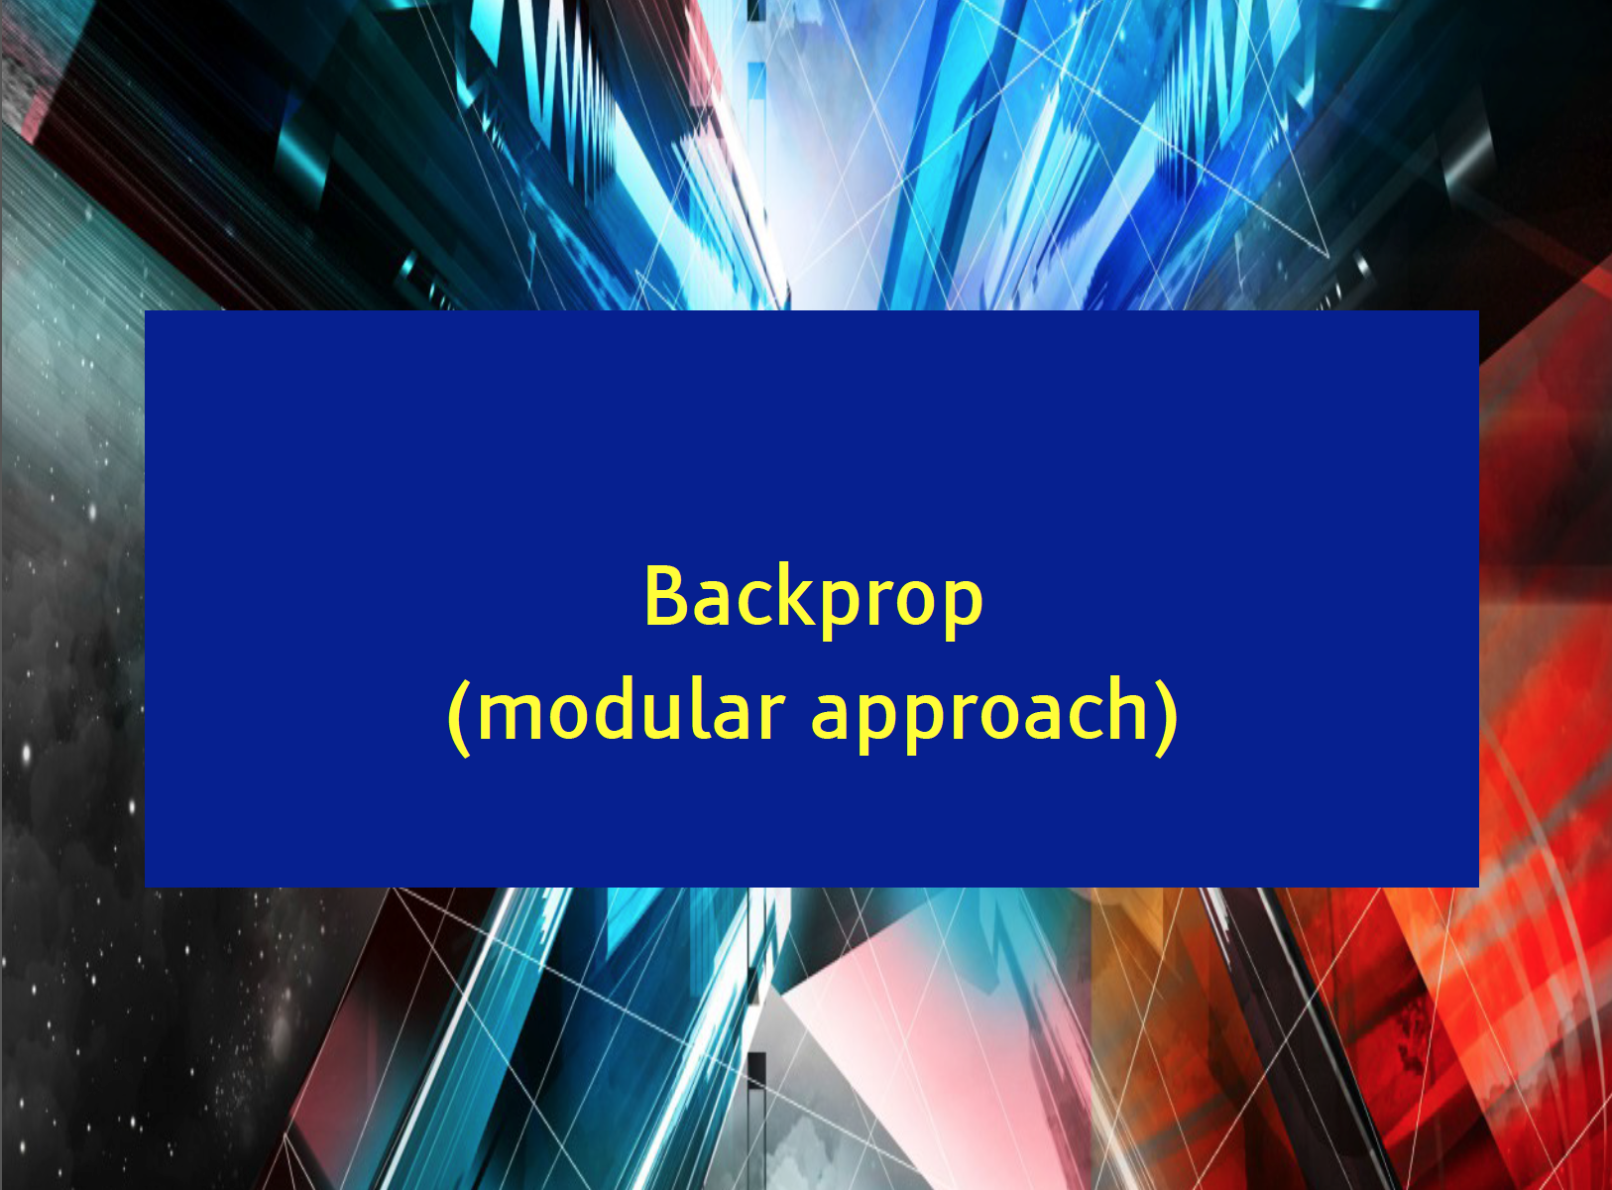
Construct Deep Networks

Slide 54
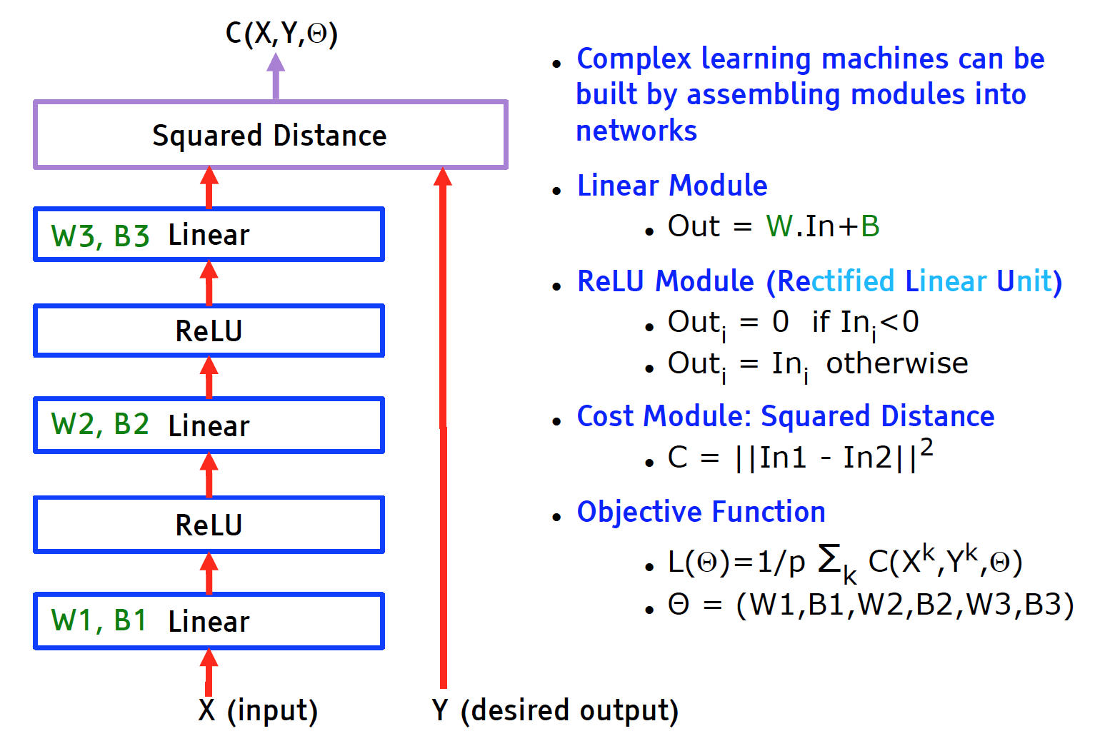
Typical Deep Multilayer Neural Net Architecture

Slide 55
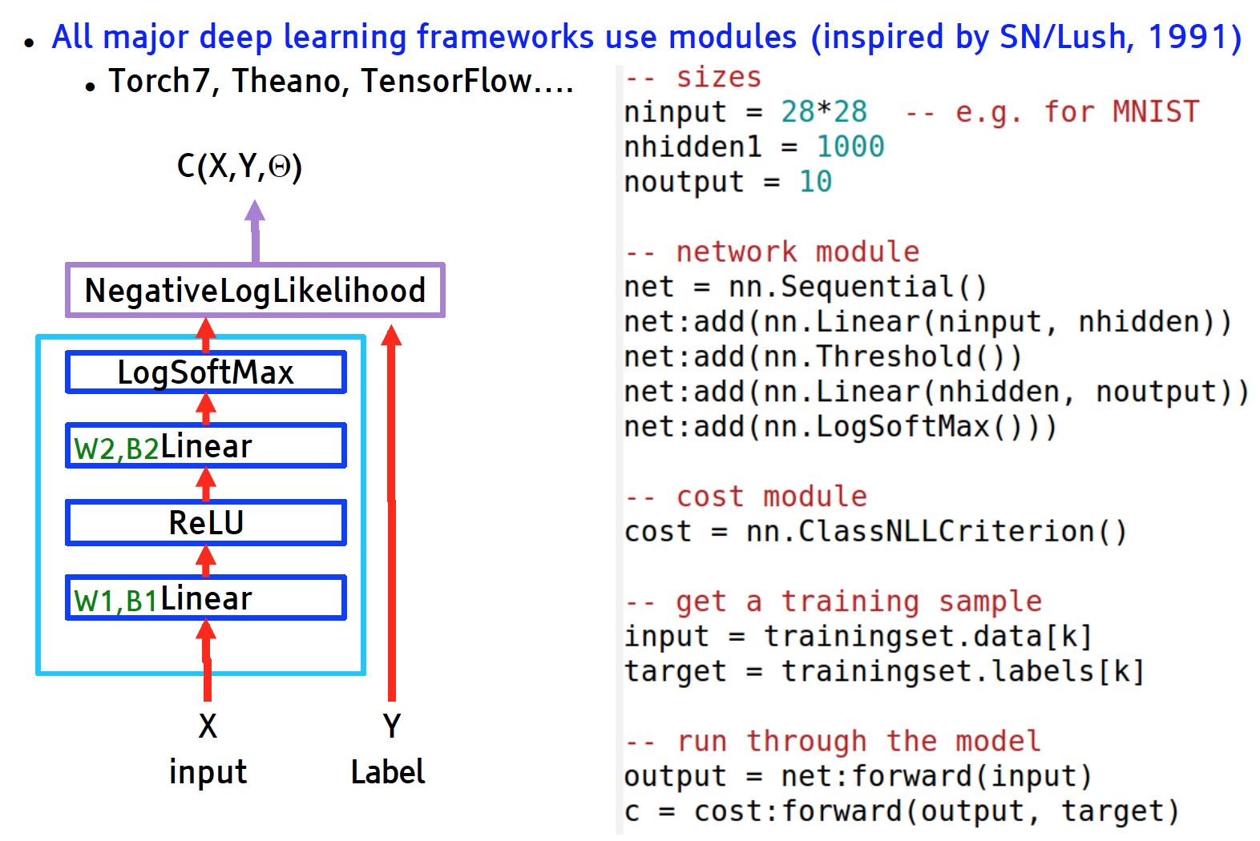

Slide 56
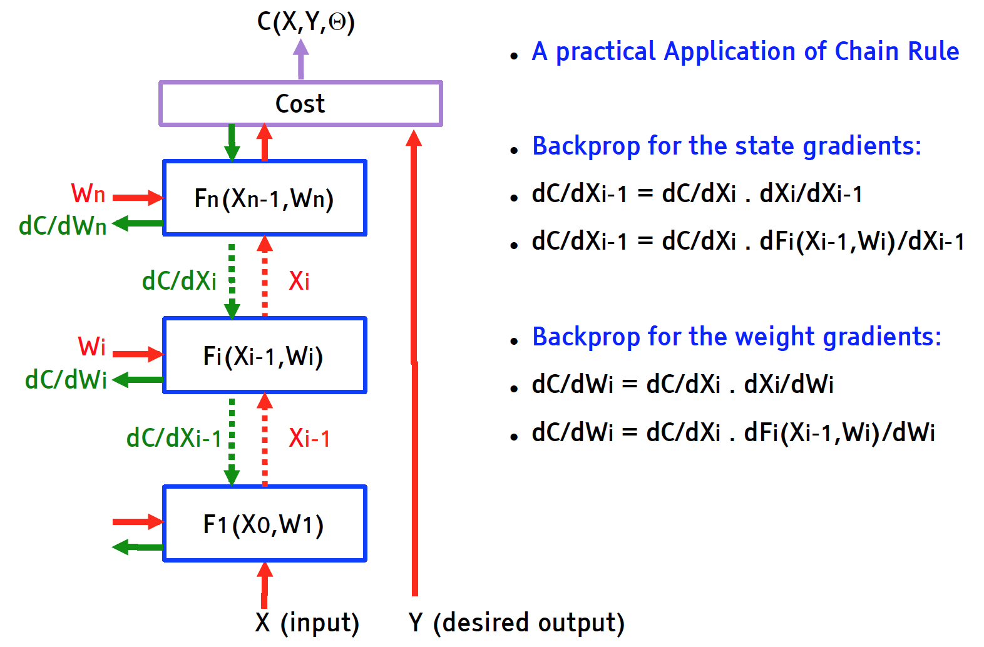
Computing Gradients by Back-Propagation

Slide 57
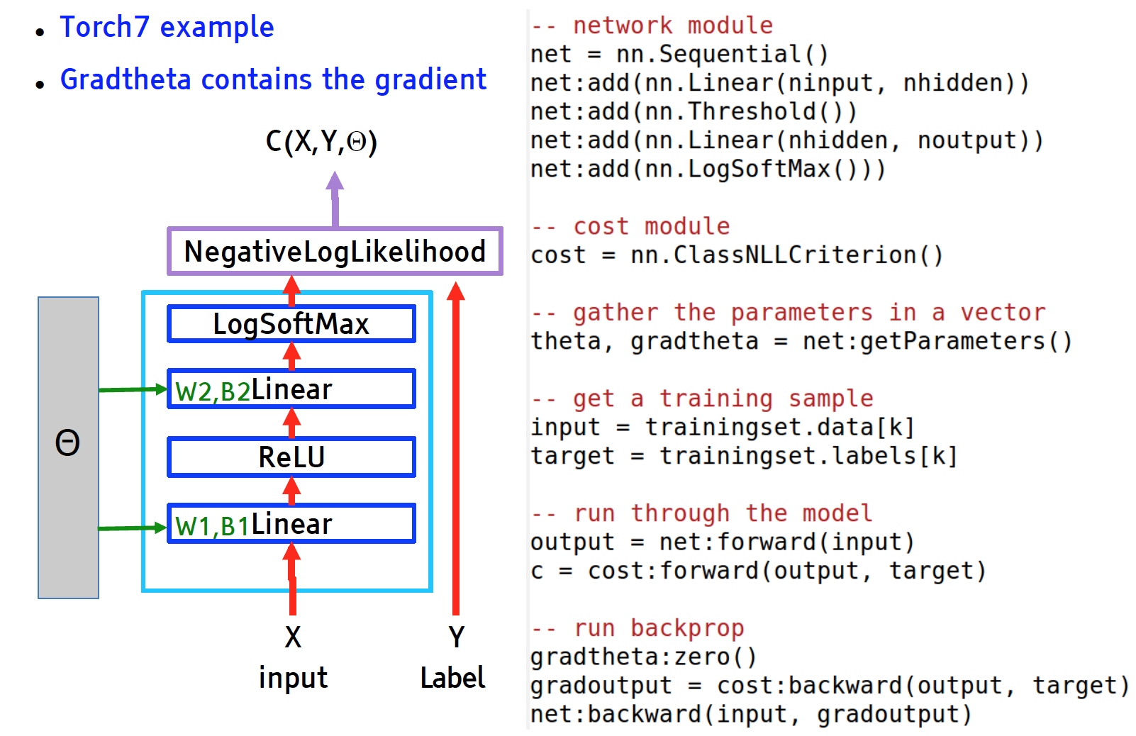
Running Backprop

Slide 58
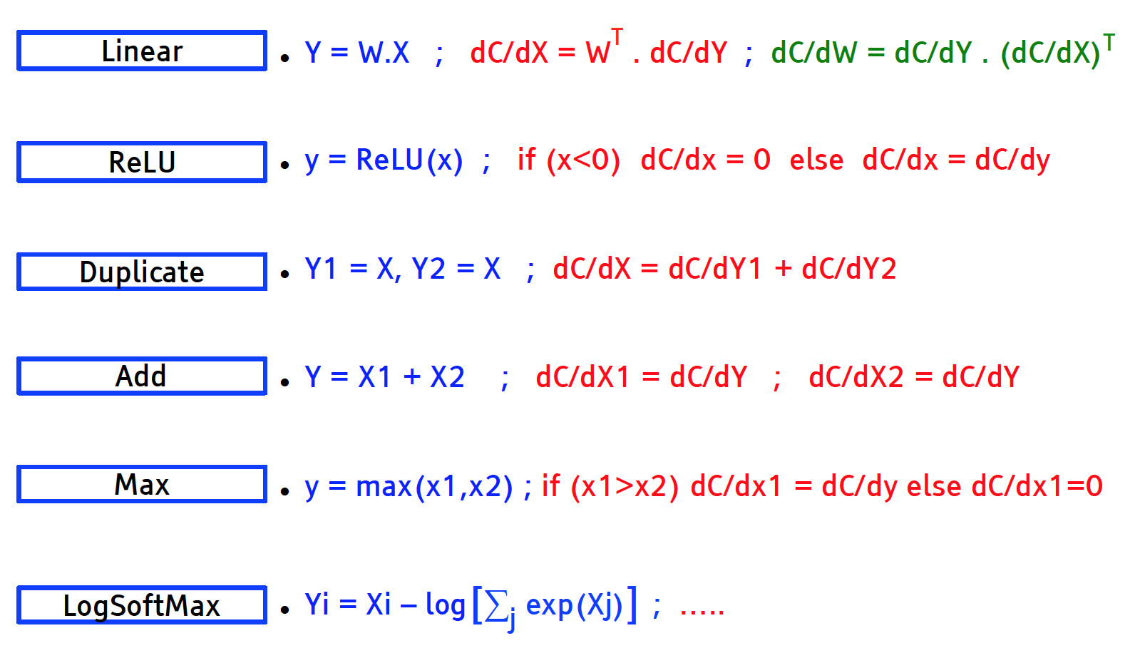
Modular Classes
dC/dW = dC/dY . dY/dx

Slide 59
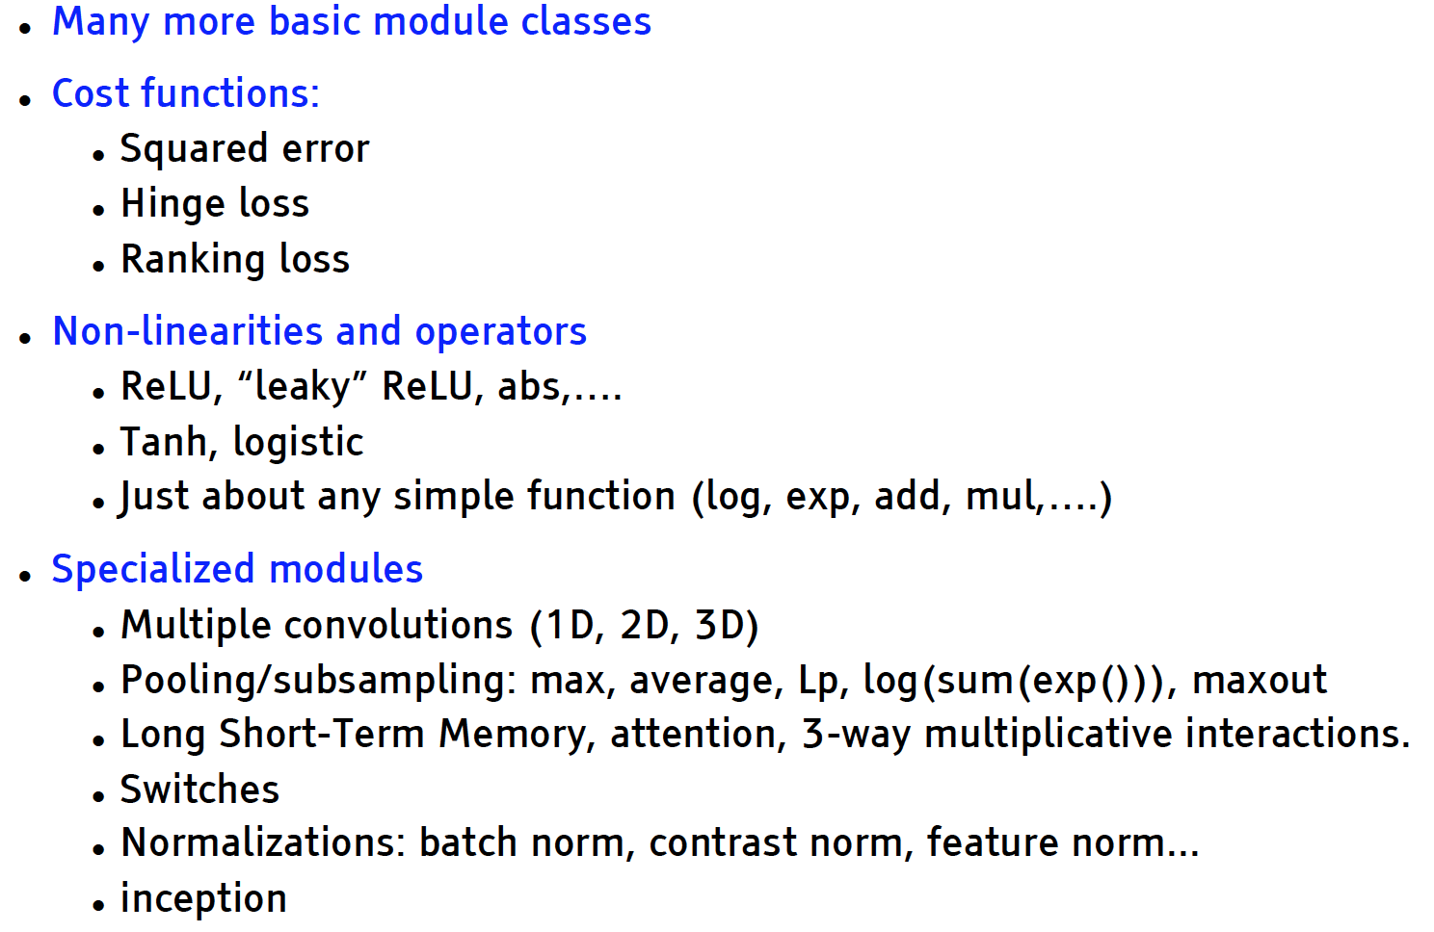
Modular Classes
(replace linear filter with non-linear filter in convolutional neural network)

Slide 60
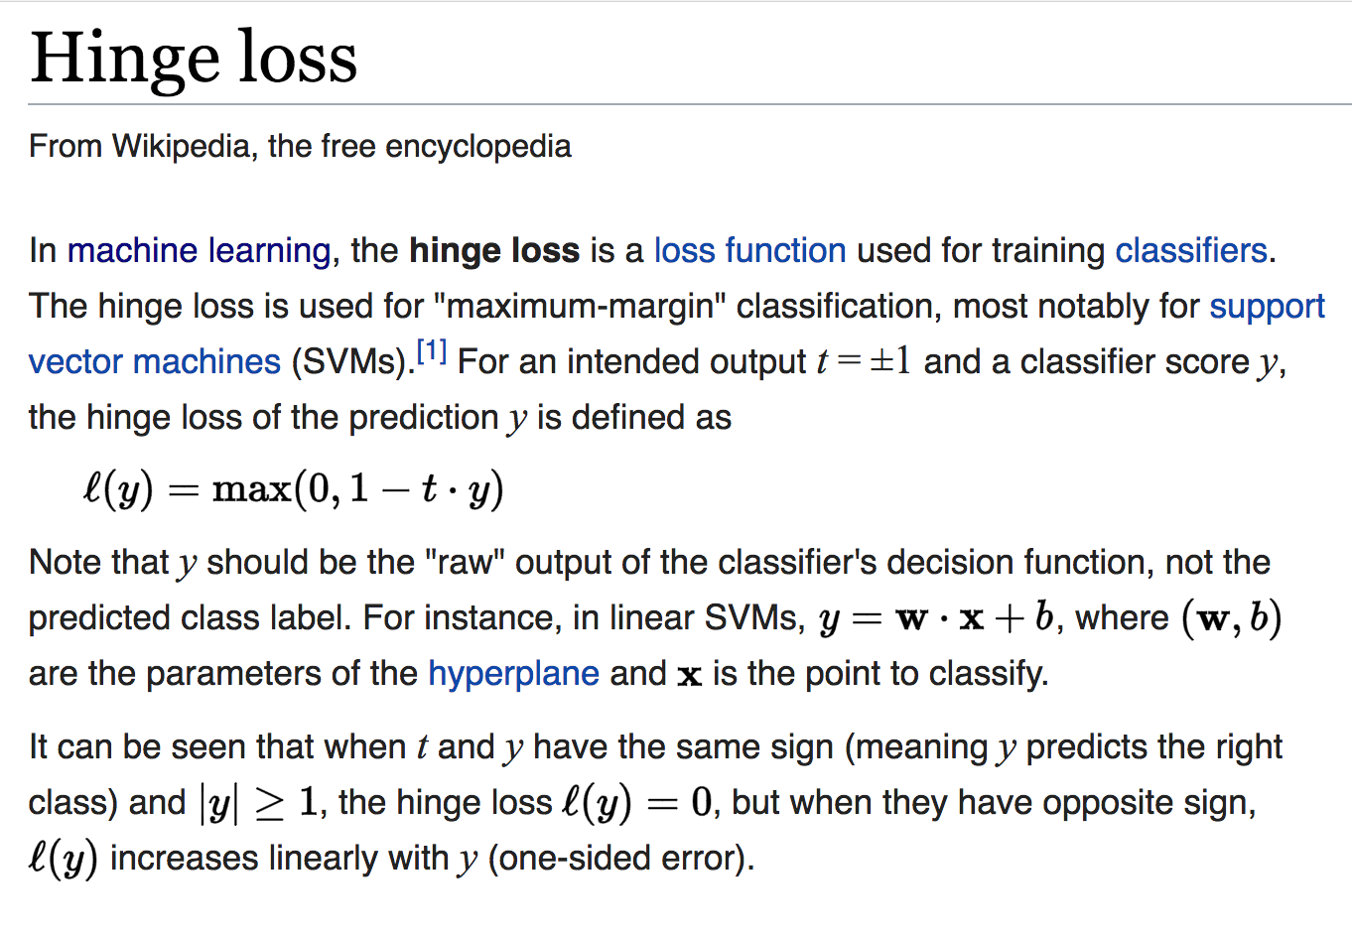

Slide 61
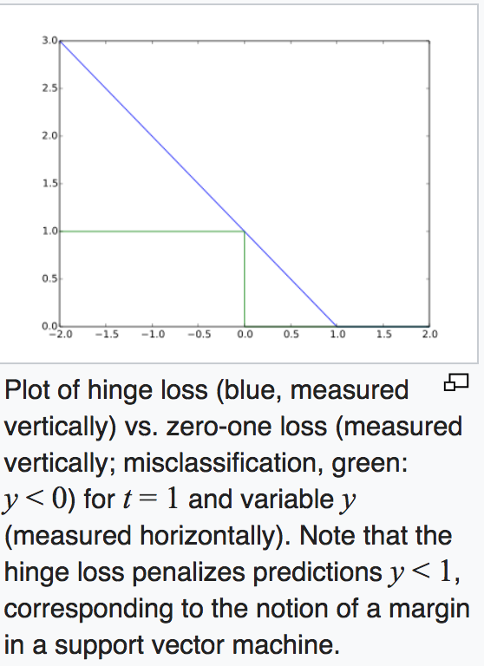

Slide 62
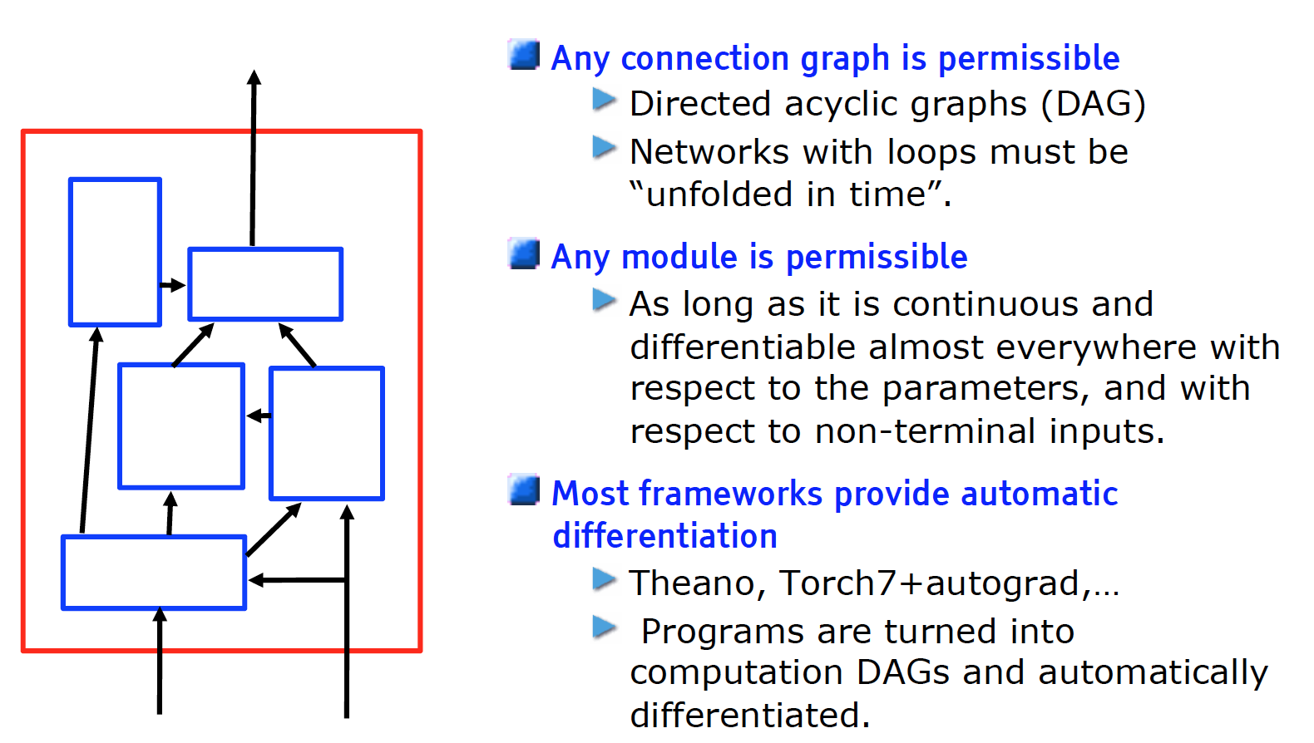
Any architecture works

Slide 63
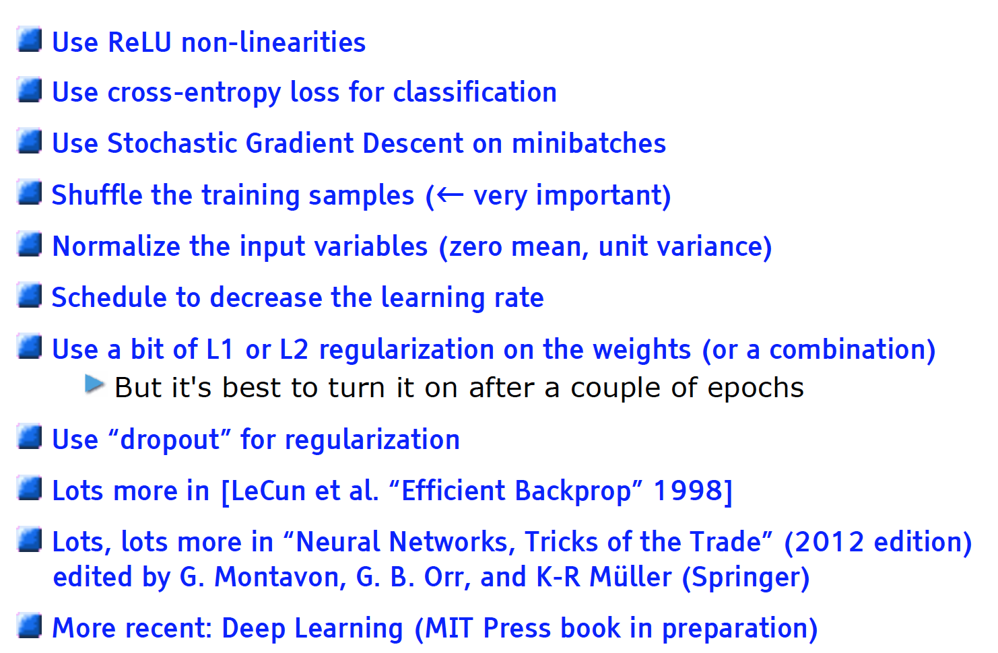
Backprop in Pratice

Slide 64
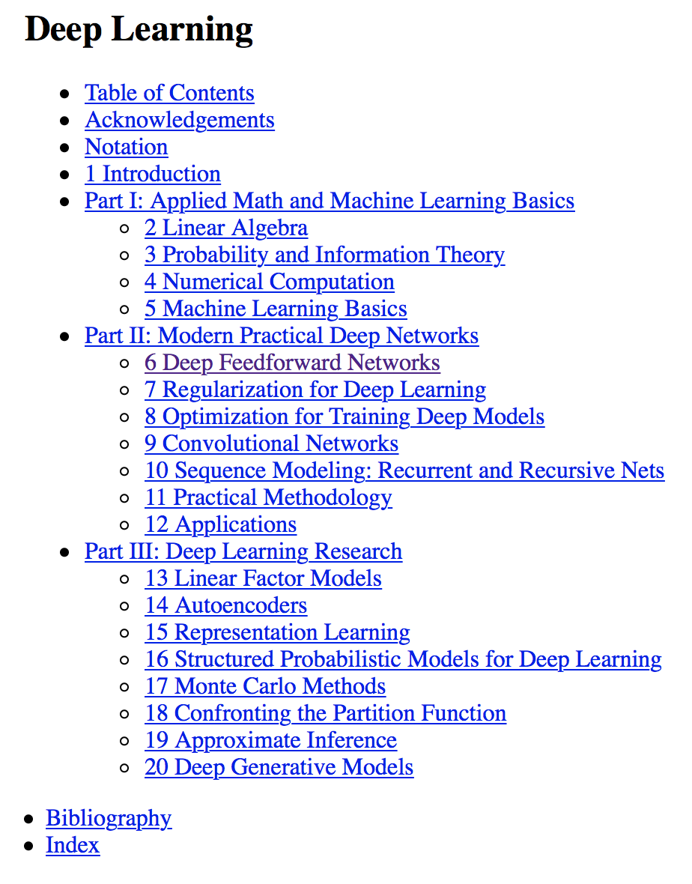
Free Deep
Learning Book
2016
Ian Goodfellow and Yoshua Bengio and Aaron Courville
URL: http://www.deeplearningbook.org

Slide 65


Slide 66
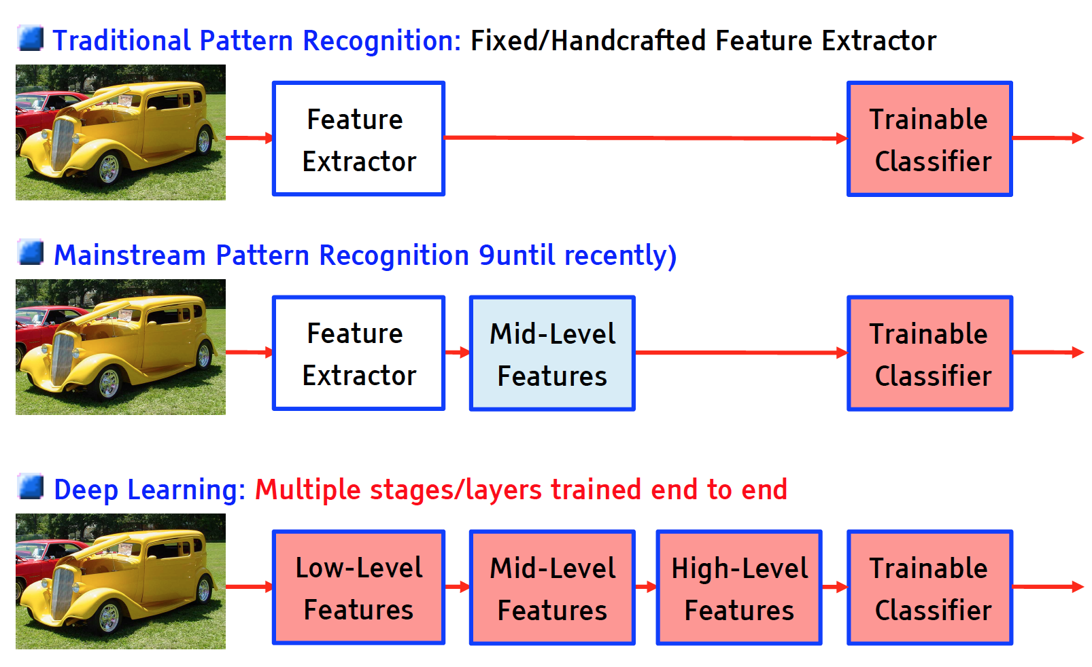
Deep Learning = Training Multistage Machines

Slide 67
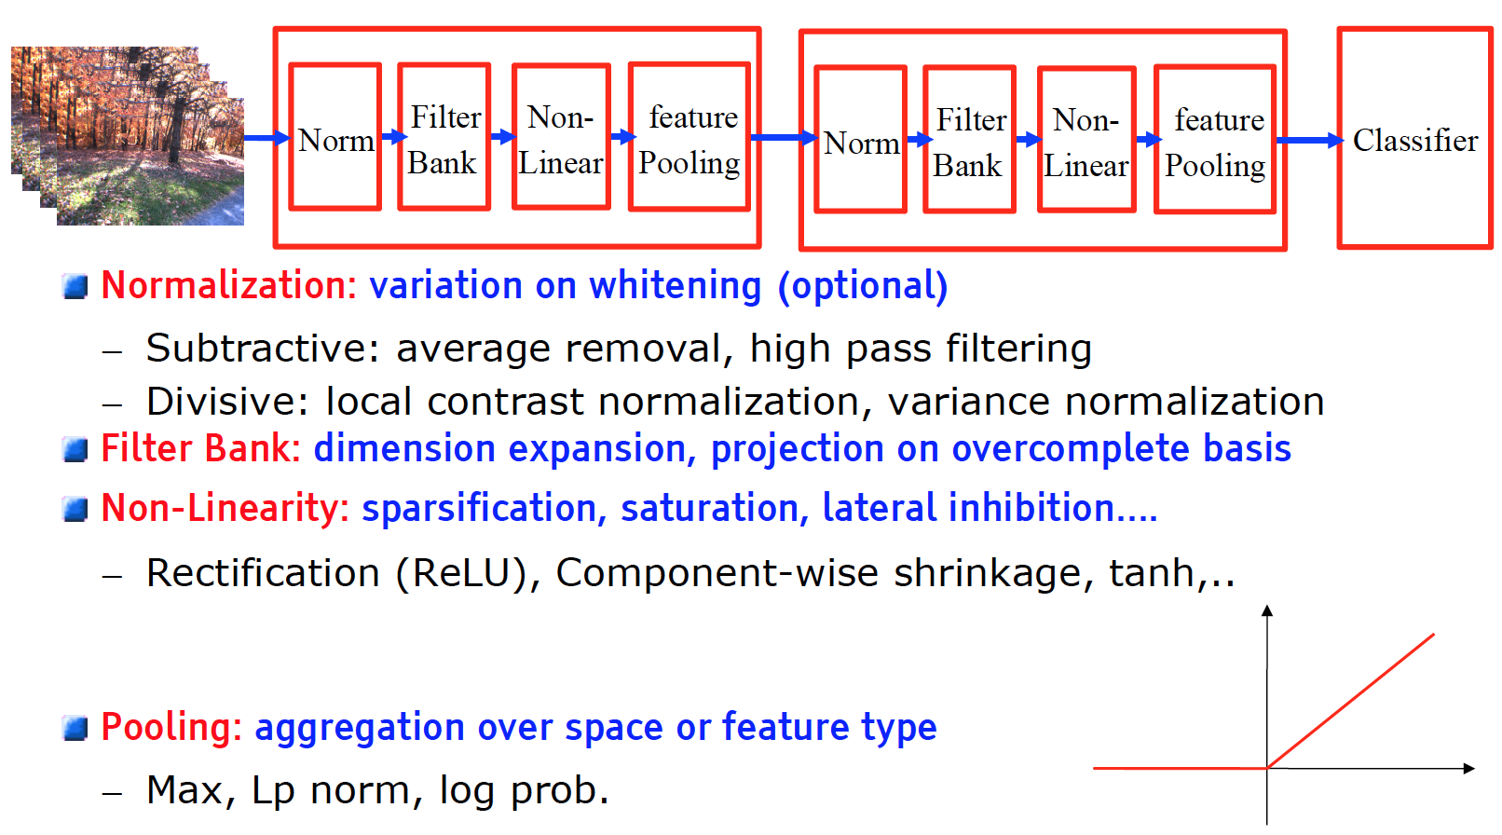
Overall Architecture: multiple stages of Normalization → Filter Bank → Non-Linearity → Pooling
tanh, ….
log prob.

Slide 68
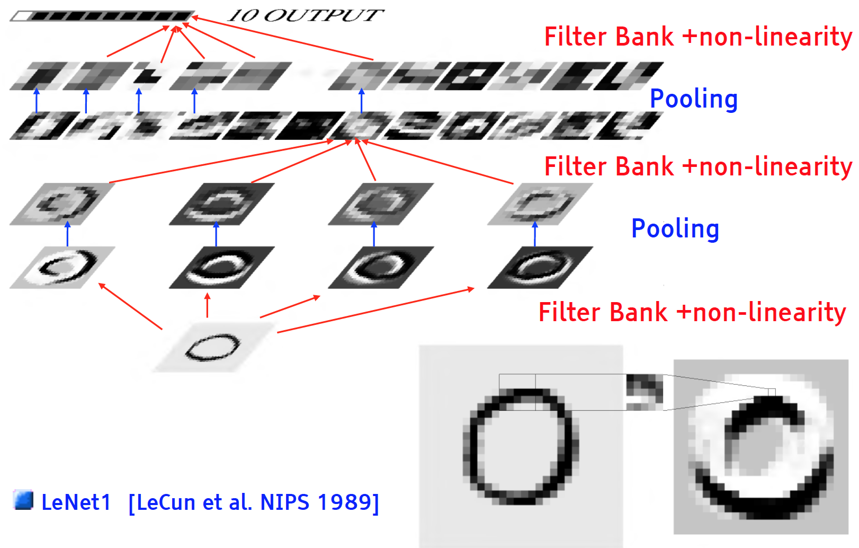
Convolutional Architecture

Slide 69
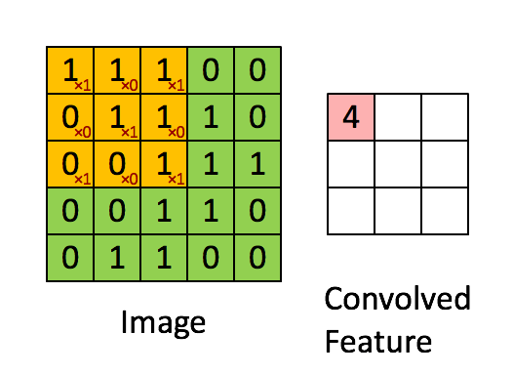
Convolution Example without Padding

Slide 70
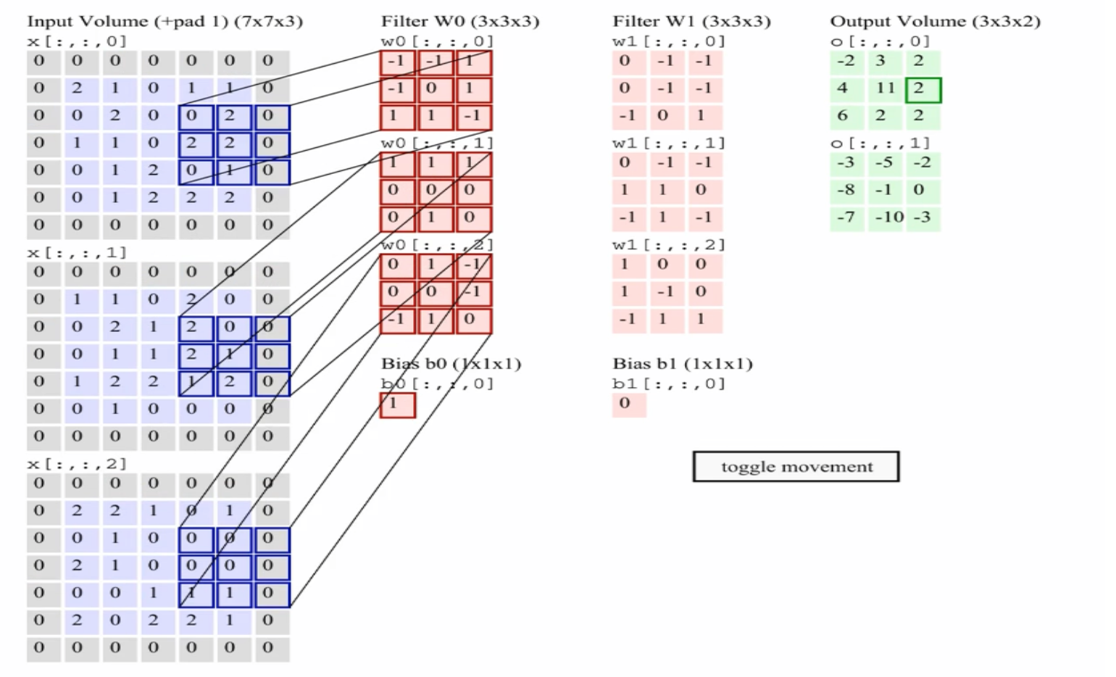
Multiple Convolutions
Animation: Andrej Karpathy http://cs231n.github.io/convolutional-networks/

Slide 71
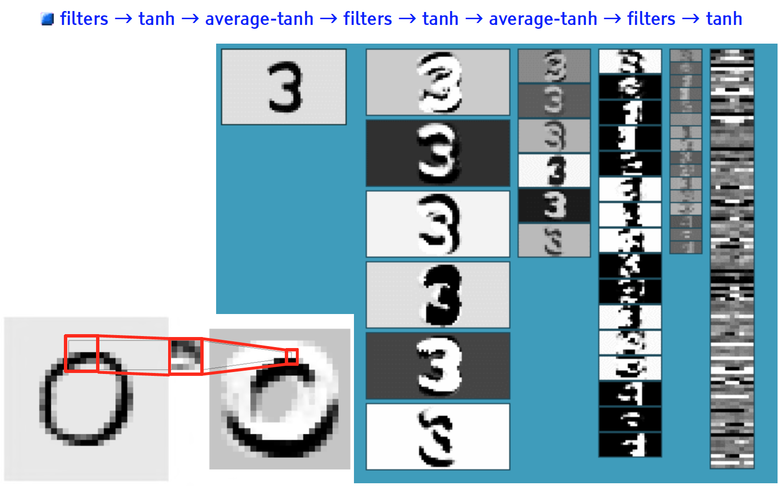
Convolutional Networks (vintage 1990)

Slide 72
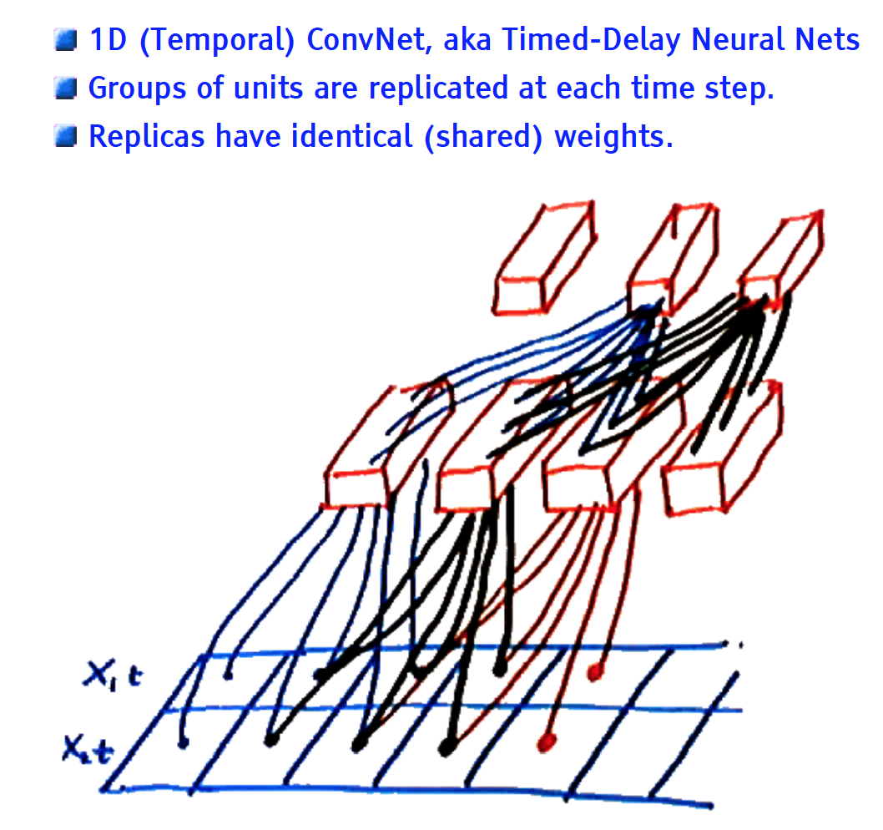
1D (Temporal) convolutional net

Slide 73
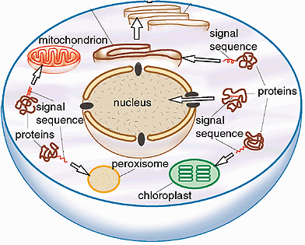
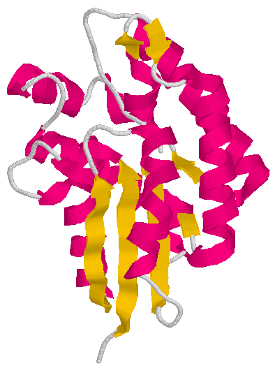

Protein Folding and Structure Prediction
AGCWY……
Cell
Importance of protein structure prediction
Disease mechanism
Drug design
Protein design
Protein engineering
Precision medicine

Slide 74


1D CNN for Protein Fold Classification

Slide 75

Deep 1D-Convoluation Neural Network
Rectified Linear Unit (ReLU): f(x) = max(0, x)
Output layer: 1,195 nodes with sigmoid function
Hou et al., 2017

Slide 76

Training Data
Distribution of sequence lengths of protein domains in SCOP 1.75 database
16,712 protein domains

Slide 77

Batch Training Using Binning and Padding according to Sequence Length
Hou et al., 2017

Slide 78

Demo of Training DCNN

Slide 79
Accuracy on Validation Datasets of SCOP1.75
Num of Predictions | Set 1 (Sim < 95%) | Set 2 (Sim < 70%) | Set 3 (Sim < 40%) | Set 4 (Sim < 25%) | Average
Top 1 | 80.4% | 78.2% | 75.8% | 67.0% | 75.3%
Top 5 | 93.7% | 92.4% | 90.0% | 87.6% | 91.0%
Accuracy on Independent Dataset of
SCOP 2.06 (4,418 proteins, Sim <= 40%)
Method | Top 1 | Top 5
DeepSF | 77% | 92%
MajorityAssignment | 4% | 16%

Slide 80

Simple ConvNet for MNIST [LeCun 1998]

Slide 81
Convolution Example without Padding

Slide 82

Sliding Window ConvNet + Weighted FSM (Fixed Post-Proc)

Slide 83

Why Multiple Layers? The World is Compositional

Slide 84

ConvNets are somewhat inspired by the Visual Cortex

Slide 85

What are ConvNets Good For

Slide 86


CNN – Translation Invariance
The 2-d planes of nodes (or their outputs) at subsequent layers in a CNN are called feature maps
To deal with translation invariance, each node in a feature map has the same weights (based on the feature it is looking for), and each node connects to a different overlapping receptive field of the previous layer
Thus each feature map searches the full previous layer to see if, where, and how often its feature occurs (precise position less critical)
  The output will be high at each node in the map corresponding to a receptive field where the feature occurs
  Later layers could concern themselves with higher order combinations of features and rough relative positions
  Each calculation of a node’s net value, Σxw+b in the feature map, is called a convolution, based on the similarity to standard convolutions
Notes:
Exact position of detected feature not important, but the relative positions can be and can be captured by later layers
5x5, 4x4 common
Convolution input, kernel (learned convolution of weights - tensor), and feature map output

Slide 87
CNN Structure
Each node (e.g. convolution) is calculated for each receptive field in the previous layer
  During training the corresponding weights are always tied to be the same (ala BPTT)
  Thus a relatively small number of unique weight parameters to learn, although they are replicated many times in the feature map
  Each node output in CNN is f(Σxw + b) (ReLU, tanh etc.)
  Multiple feature maps in each layer
  Each feature map should learn a different translation invariant feature
  Since after first layer, there are always multiple feature maps to connect to the next layer, it is a pre-made human decision as to which previous maps the current convolution map receives inputs from, could connect to all or a subset
Convolution layer causes total number of features to increase
Notes:
Note increase in first convolution layer from initial image
Some models let each node have a unique (rather than shared) bias weight
Total features increase, but not the volume of any given feature map stays same (zero-padded) or decreases (save)

Slide 88
Sub-Sampling (Pooling)
Convolution and sub-sampling layers are interleaved
Sub-sampling (Pooling) allows number of features to be diminished, and to pool information
  Pooling replaces the network output at a certain point with a summary statistic of nearby outputs
  Max-Pooling common (Just as long as the feature is there, take the max, as exact position is not that critical), also averaging, etc.
  Pooling smooths the data and reduces spatial resolution and thus naturally decreases importance of exactly where a feature was found, just keeping the rough location – translation invariance
  2x2 pooling would do 4:1 compression, 3x3 9:1, etc.
  Convolution usually increases number of feature maps, pooling keeps same number of reduced maps (one-to-one correspondence of convolution map to pooled map) as the previous layer
Notes:
L2 pooling – Square root of sum of the activation squares in the field – ~average magnitude
Max pooling – winner take all for receptive field
Small fields most common (2x2), also allows for deeper network
Note depth of network is basically decided by the sub sampling pool size, since once the feature maps are small (e.g. 5x5) there no more room for convoluting and need to just put then in the MLP
Can get some effects of Pooling and save computation by having convolutional layers less tightly overlapped (stride)

Slide 89

Pooling Example (Summing or averaging)
Notes:
Usually smaller receptive fields, can overlap some

Slide 90
Pooling (cont.)
  Common layers are convolution, non-linearity, then pool (repeat)
  Note that pooling always decreases map volumes (unless pool stride = 1, highly overlapped), making real deep nets more difficult. Pooling is sometimes used only after multiple convolved layers and sometimes not at all.
  At later layers pooling can make network invariant to more than just translation – learned invariances
Notes:
Create “Grandmother” cells corresponding do different variants of the concept

Slide 91
CNN Training
Trained with BP but with weight tying in each feature map
  Randomized initial weights through entire network
  Just average the weight updates over the tied weights in feature map layers
Convolution layer
  Each feature map has one weight matrix for each input and one bias
  Thus a feature map with a 5x5 receptive field (filter) would have a total of 26 weights, which are the same coming into each node of the feature map
  If a convolution layer had 10 feature maps, then only a total of 260 unique weights to be trained in that layer (much less than an arbitrary deep net layer without sharing)
Sub-Sampling (Pooling) Layer
  All elements of receptive field max’d, averaged, summed, etc. Result multiplied by one trainable weight and a bias added, then passed through non-linear function (detector, e.g. ReLU) for each pooling node
  If a layer had 10 pooling feature maps, then 20 unique weights to be trained
Notes:
Note that pooling (size and function) are hand-crafted by the network designer, though there is a trainable weight and bias to “tune” the pooling
Or BP variant
Can use Local response normalization or variants – effort to have feature maps learn different features, but not essential
But standard BP already deals with that since trying to minimize errors and if all hidden nodes learned the same function, then would get lousy accuracy, with easy problem could duplicate, but then that is all right.
Usually need more maps in layers (100s…)

Slide 92
CNN Hyperparameters
Structure itself, number of layers, size of filters, number of feature maps in convolution layers, connectivity between layers, activation functions, final supervised layers, Pooling parameters, etc.
Drop-out often used in final fully connected layers for overfit avoidance – less critical in convolution/pooling layers which already regularize due to weight sharing
Stride – if don’t have to test every location for the feature (i.e. stride = 1), could sample more coarsely
  Another option for down-sampling
As is, the feature map would always decrease in volume which is not always desirable - Zero-padding avoids this and lets us maintain up to the same volume
  Would shrink fast for large kernel/filter sizes and would limit the depth (number of layers) in the network
  Also allows the different filter sizes to fit arbitrary map widths
Notes:
Locally unique connections – Same map size but weights trained independently
Tiled convolution – neighbor node uses different kernel, but kernels repeat after some stride
Could have a stride value in each dimension

Slide 93

ILSVRC Image net Large Scale Vision Recognition Competition
RGB: 224 x 224 x 3 = 150,528 raw real valued features
Notes:
Top-5 error – Is target label one of your top 5 predictions ) Dog, dogtype, etc.
224x224x3 (RGB) input – 150,000 raw input features
Image net larger 15M and 22k classes

Slide 94

Example CNNs Structures ILSVRC winners
Note Pooling considered part of the layer
96 convolution kernels, then 256, then 384
Stride of 4 for first convolution kernel, 1 for the rest
Pooling layers with 3x3 receptive fields and stride of 2 throughout
Finishes with fully connected (fc) MLP with 2 hidden layers and 1000 output nodes for classes
Notes:
Alex Krizhevsky w/Hinton
Note Convolution and Pool often considered one convolutional layer (Layers are number of layers with convolution)
96 kernels/feature maps, then 256, etc.
/4 stride of 4 for convolution first layer, 1 for rest
/2 stride 2 overlapped pooling throughout – Alex net uses 3x3 pooling receptive field
Used local response normalization – Lateral inhibition approach with ReLUs which increase highest neurons while inhibiting local neighbors

Slide 95

Example CNNs Structures ILSVRC winners
Notes:
VGG – Very Deep CNNs – Visual Geometry Group (VGG) Oxford, England - small filters 3x3 (smallest possible to give Up down left right) with more depth (19 layers), zero pad to maintain volume
Stride 1 for convolution, stride 2 for pooling, pooling only every 4 layers

Slide 96

Increasing Depth
Notes:
2015 - Ensemble of Residual Networks
Reaching human levels of discrimination
2016 – down to 3.0% with ensemble, but not a new model (boring?) – No new major architectures, reaching Bayes limit, Interest waned and many main competitors had moved on

Slide 97


Go Deep with Residual Network
He et al., 2015

Slide 98


Slide 99
CNN Summary
High accuracy for image applications – Breaking all records and doing it using just using just raw pixel features!
Special purpose net – good for images or problems with strong grid-like or sequential local spatial/temporal correlation
Once trained on one problem (e.g. vision) could use same net (often tuned) for a new similar problem – general creator of vision features (Transfer learning)
Unlike traditional nets, handles variable sized inputs
  Same filters and weights, just convolve across different sized image and dynamically scale size of pooling regions (not # of nodes), to normalize
  Different sized images, different length speech segments, etc.
Lots of hand crafting and CV tuning to find the right recipe of receptive fields, layer interconnections, etc.
  Lots more Hyperparameters than standard nets, and even than other deep networks, since the structures of CNNs are more handcrafted
  CNNs getting wider and deeper with speed-up techniques (e.g. GPU, ReLU, etc.) and lots of current research, excitement, and success
Notes:
Dynamic size – Pooling region just sums/maxes over an area with one final weight so no hard changes when we adjust pool region size
Simard 2003, Simple consistent CNN structure 5x5 with 2x2 subsampling with number of features 5 in first C-layer, 50 in next, until too small.
Don’t actually used pool layer as instead just connect every other node which samples rather than max/average.
Each layer reduces feature size by (n-3)/2. Just two layers for mnist.
They also use elastic distortions which is a type of jitter to get increased data. 99.6% - best at the time, Distortions also help a lot with standard MLP
Thus an approach with less Hyperparameter fiddling
Ciresan and Schmidhuber 2012, Multi column DNN. CNN with depth 6-10 (deeper if initial input image is bigger), and wider on fields, 1-2 hidden layers in MLP, columns are CNNs (an ensemble with different parameters, features, etc.) where their output is averaged, jitter inputs, multi-day GPU training, annealed LR (.001 dropping to .00003) 99.76% mnist

Slide 100

Build a DCNN to classify digital images
on MNIST dataset

Slide 101


Key code

Slide 102


Slide 103


Slide 104


Slide 105

Train and Evaluate

Slide 106
Dilated Convolution

Slide 107
Deep Belief Network – Learning Representation of Data First

Slide 108
o
f(Σ)
f(Σ)
f(Σ)
…
f(Σ)
……
Vanishing
Gradient
f(Σ)
f(Σ)
…
f(Σ)
f(Σ)
f(Σ)
…
f(Σ)
1
x1
x2
……
xd

Slide 109
Why Deep Learning? – A Face Recognition Analogy
Face or not ?
……
Lines, circles, squares
Brain Learning
Image pixels

Slide 110

Learning Representation First
http://theanalyticsstore.com/deep-learning/

Slide 111

A Deep Learning Success

Slide 112


Energy Based Models
p(x) – probability of our data; data is represented by feature vector x.
and
Attach an energy function (ie, E(x)) to score a configuration (ie, each possible input x).
We want desirable data to have low energy. Thus, tweak the parameters of E(x) accordingly.
Restricted Boltzann Machines (RBM)

Slide 113



EBMs with Hidden Units
To increase power of EBMs, add hidden variables.
By using the notation,
We can rewrite p(x) in a form similar to the standard EBM,
Free energy
log(P(x)) = -F(x) – log(Z)
Restricted Boltzmann Machines (RBM)

Slide 114


Tweakin’ Parameters
Now we need to adjust the model so it reflects our data, do ML
Likelihood fn
Avg. Log-likelihood fn

Slide 115

Tweakin’ Parameters
Take the derivative
-
-
-
-
-
-
-

Slide 116
Tweakin’ Parameters
Take the derivative
This is an expectation over all possible configurations of input x.
Can think of as an expectation over dataset.
Restricted Boltzann Machines (RBM)

Slide 117



Transition to RBM
Looks like training a EBM is, in general, a tall task. But after much
Jump to an end result…
Restricted Boltzmann Machines (RBM)

Slide 118

RBMs
Represented by a bipartite graph, with symmetric, weighted connections
One layer has visible nodes and the other hidden (ie, latent) variables.
Notes are often binary , stochastic units (ie, assume 0 or 1 based on probability)

Slide 119




Unsupervised Restricted Boltzmann Machine (RBM)
hidden layer
c_{j}
A model for a distribution over two layers of binary nodes
Probability is defined via an “energy”
h
w_{ij}
v
b_{i}
visible layer
p(v,h) =

Slide 120


What’s gained by “Restricted”
1) Conditional probabilities factor nicely
2) Using binary units, we also can get
So we can get a sample of the visible or hidden nodes easily...
and
Restricted Boltzann Machines (RBM)

Slide 121


Training a RBM – Maximum Likelihood

Slide 122

Gibbs Sampling
Can sample from p(v,h) by repeatedly sampling from v and h using the eqns. for p(v|h) and p(h|v).
As t →∞, (v^{(t)} ,h^{(t)}) converge to samples of p(v,h).
But… hard to know when equilibrium has been reach, can be computationaly expensive
Restricted Boltzann Machines (RBM)

Slide 123


Training a RBM - Contrastive Divergence based on Gibbs Sampling
Instead of attempting to sample from joint distribution p(v,h) (i.e. p∞), sample from p¹(v,h).
Hinton, Neural Computation(2002)

Slide 124



Learning Rule
Recall energy function
Calculating derivatives…
So,

Slide 125
A quick way to learn an RBM
j
j
Start with a training vector on the visible units.
Update all the hidden units in parallel
Update the all the visible units in parallel to get a “reconstruction”.
Update the hidden units again.
i
i
t = 0 t = 1
data
reconstruction
This is not following the gradient of the log likelihood. But it works well. It is approximately following the gradient of another objective function (Carreira-Perpinan & Hinton, 2005).

Slide 126





Training a RBM via Contrastive Divergence
Gradient of the likelihood with respect to w_{ij} ≈ the difference between interaction of v_{i} and h_{j} at time 0 and at time 1.
Hidden
Layer
j
j
Visible
Layer
i
i
t = 0 t = 1
Hinton, Neural Computation(2002)

Slide 127
Training a RBM via Contrastive Divergence
Gradient of the likelihood with respect to w_{ij} ≈ the difference between interaction of v_{i} and h_{j} at time 0 and at time 1.
Hidden
Layer
j
j
Visible
Layer
i
i
t = 0 t = 1
Hinton, Neural Computation(2002)

Slide 128
Training a RBM via Contrastive Divergence
Gradient of the likelihood with respect to w_{ij} ≈ the difference between interaction of v_{i} and h_{j} at time 0 and at time 1.
Hidden
Layer
j
j
Visible
Layer
i
i
t = 0 t = 1
σ: sigmoid function
Δw_{i,j} = <v_{i} p_{j}⁰> - <p_{i}¹p_{j}¹>
Hinton, Neural Computation(2002)

Slide 129
Challenges with RBMs
A number of choices to be made
  Types of nodes, learning weight, initial values, batch sizes, etc.
  Care should be taken to avoid over-fitting
A RBM “manual” is available on line…
http://www.cs.utoronto.ca/~hinton/absps/guideTR.pdf
Software package: Pylearn2: http://deeplearning.net/software/pylearn2/
On both GPU and CPU

Slide 130


GPU Implementation
Calculations need for training and classification made use of CUDAMat and GPUs
Train with over one million parameters in about an hour

Slide 131

Why ???
Okay, we can model p(x).
But how to…
Find p(label|x). We want a classifier!
Improve the model for p(x).

Slide 132
Deep Belief Nets
RBMs are typically used in stack
  Train them up one layer at a time
  Hidden units become visible units to the next layer up
  If your goal is a discriminator, you train a classifier on the top level representation of your input.
data

Slide 133
Training a Deep Network
Weights are learned layer by layer via unsupervised learning.
Final layer is learned as a supervised neural network.
All weights are fine-tuned using supervised back propagation.
[0,1]
…
…
…
…
…
…
…
Hinton and Salakhutdinov, Science, 2006

Slide 134
Why stack them up? Why does this work?
This is a good question, with a long complicated answer.
Basically, doing so can improve a lower variation bound on the probability of training data under the model.
Hinton, Osindero, & The, 2006

Slide 135
How to generate from the model
To generate data:
  Get an equilibrium sample from the top-level RBM by performing alternating Gibbs sampling for a long time.
  Perform a top-down pass to get states for all the other layers.
  So the lower level bottom-up connections are not part of the generative model. They are just used for inference.
h3
Bonus when modeling p(x), we can see what the model believes in
h2
h1
data
Slide modified from Hinton, 2007

Slide 136
Deep Autoencoders
28x28
They always looked like a really nice way to do non-linear dimensionality reduction:
  But it is very difficult to optimize deep autoencoders using backpropagation.
We now have a much better way to optimize them:
  First train a stack of 4 RBM’s
  Then “unroll” them.
  Then fine-tune with backprop.
1000 neurons
500 neurons
250 neurons
30
linear units
250 neurons
500 neurons
1000 neurons
Hinton & Salakhutdinov, 2006; slide form Hinton UCL tutorial
28x28

Slide 137
Some Applications
We will look at two applications done by Hinton’s Lab
A model for digit recognition
Cluster/search documents

Slide 138

Applications: A model of digit recognition
Classify digits (0 – 9)
Input is a 28x28 image from MNIST (training 60k, test 10k examples)

Slide 139
Applications: A model of digit recognition
This is work from Hinton et al., 2006
2000 top-level neurons
The top two layers form an associative memory whose energy landscape models the low dimensional manifolds of the digits.
The energy valleys have names
10 label neurons
500 neurons
The model learns to generate combinations of labels and images.
To perform recognition we start with a neutral state of the label units and do an up-pass from the image followed by a few iterations of the top-level associative memory.
500 neurons
28 x 28 pixel image
Matlab/Octave code available at
http://www.cs.utoronto.ca/~hinton/
Slide modified from Hinton, 2007

Slide 140

Model in action
Hinton has provided an excellent way to view the model in action…
http://www.cs.toronto.edu/~hinton/digits.html

Slide 141

More Digits
Samples generated by letting the associative memory run with one label clamped. There are 1000 iterations of alternating Gibbs sampling between samples.
Slide from Hinton, 2007

Slide 142

Even More Digits
Examples of correctly recognized handwritten digits that the neural network had never seen before
Slide from Hinton, 2007

Slide 143
Extensions
Do classification.
One way (probably no the best), train generative model with labeled/unlabeled data
Then train a NN on higher dimensional representation.
NN or SVM
2000 top-level neurons
500 neurons
500 neurons
28 x 28 pixel image

Slide 144
Applications: Classifying text documents
A document can be characterized by the frequency of words that appear (ie, word counts for some dictionary become feature vector)
Goals…
  Group/cluster similar documents
  Find similar documents

Slide 145
How to compress the count vector
2000 reconstructed counts
Multi-layer auto-encoder
Train a model to reproduce its input vector as its output
This setup forces as much information as possible be compressed and passed thru the 10 numbers in the central bottleneck.
These 10 numbers are then a good way to compare documents.
500 neurons
250 neurons
10
250 neurons
500 neurons
2000 word counts
Slide modified from Hinton, 2007

Slide 146
How to compress the count vector
2000 reconstructed counts
Multi-layer auto-encoder
Train a model to reproduce its input vector as its output
This setup forces as much information as possible be compressed and passed thru the 10 2 numbers in the central bottleneck.
These 10 2 numbers are then a good way to compare documents.
500 neurons
250 neurons
Or ‘2’ for easy visualization
10 2
250 neurons
500 neurons
2000 word counts
Slide modified from Hinton, 2007

Slide 147

Residue-Residue Contact Prediction
1D Sequence
i
j
SDDEVYQYIVSQVKQYGIEPAELLSRKYGDKAKYHLSQRW
Objective:
Predict if two residues (i, j) are in
contact (spatially close), i.e.
distance(i, j) < 8 Angstrom
3D Structure
Eickholt & Cheng, 2012

Slide 148
A Binary Classification Problem
i
j
SDDEVYQYIVSQVKQYGIEPCSAELLSRKYGDKAKYHLSQRW
Residue info, secondary structure, solvent accessibility, …
A Vector of ~400 Features (numbers between 0 and 1)
Probability that V and Y are in contact?
Cheng & Baldi, 2007; Tegge et al., 2009; Eickholt & Cheng, 2012

Slide 149

Input Features
i
j
ALTLHYDRYTTSRRLDPIPQLKCVGGTAGCDSYTPKVIQRCQN
3 numbers
2 numbers
20 numbers for residue profile
Exposed
Helix
Coil
Buried
Strand
Helix 100
Strand 010
Coil 001
Exposed 10
Buried 01
25 * 18 = 400 features for a pair (i, j)

Slide 150

Deep
Belief
Network
Architecture
~350 nodes
~500 nodes
~500 nodes
w_{i,j}
~400 input nodes
A Vector of ~400 Features (numbers between 0 and 1)

Slide 151

Training a Deep Network
[0,1]
1239 Proteins for Training
Residue Pairs; Millions of Residue Pairs
…
…
…
…
…
…
…

Slide 152
GPU Implementation
Parallelize training of deep learning network with GPUs and CUDAMat
Train DNs with over 1M parameters in about an hour
LSDEKIINVDF
KPSEERVREII
…
…
…
…
…
…
…
[0,1]
Eickholt & Cheng, 2012

Slide 153

Boosted Ensembles for Contact Prediction
…
…
…
…
…
…
…
…
…
…
…
……
…
…
…
…
…
…
…
…
…
…
[0,1]
[0,1]
[0,1]
[0,1]
Final output of ensemble is the weighted sum of individual DN outputs.
Eickholt and Cheng, Bioinformatics (2012)

Slide 154




Results on Test Data Set (196 Proteins) and CASP
Metric | Acc. L/5 | Acc. L/5 (one shift)
Short Range (6 <= |i-j| <12) | 0.51 | 0.79
Medium Range (12 <= |i-j| <24) | 0.38 | 0.65
Long Range (|i-j| >= 24) | 0.34 | 0.55
2012
2014
2016
2017

Slide 155
Deep Recurrent Neural Network

Slide 156

Temporal and Spatial Series Problem

Slide 157

Recurrent Neural Network

Slide 158

Recurrent Neural Network

Slide 159

Increase the expressive power of RNN with more depth

Slide 160

Long-term dependencies

Slide 161
RNN Tricks
(Pascanu, Mikolov, Bengio, ICML 2013; Bengio, Boulanger & Pascanu, ICASSP 2013)
Clipping gradients (avoid exploding gradients)
Momentum
Initialization (start in right ballpark avoids exploding/vanishing)
LSTM self-loops (avoid vanishing gradient)

Slide 162
Long Short Term Memory (LSTM)
Hochreiter & Schmidhuber (1997) solved the problem of getting an RNN to remember things for a long time (like hundreds of time steps).
They designed a memory cell using logistic and linear units with multiplicative interactions.
Information gets into the cell whenever its “write” gate is on.
The information stays in the cell so long as its “keep” gate is on.
Information can be read from the cell by turning on its “read” gate.

Slide 163
Implementing a memory cell in a neural network
keep gate
To preserve information for a long time in the activities of an RNN, we use a circuit that implements an analog memory cell.
  A linear unit that has a self-link with a weight of 1 will maintain its state.
  Information is stored in the cell by activating its write gate.
  Information is retrieved by activating the read gate.
  We can backpropagate through this circuit because logistics are have nice derivatives.
1.73
write gate
read gate
input from rest of RNN
output to rest of RNN

Slide 164
Backpropagation through a memory cell
keep 0
keep 1
keep 1
keep 0
1.7
1.7
1.7
write 1
read
0
write 0
read
0
write 0
read
1
1.7
1.7
time →

Slide 165
A simple LSTM block with only input, output, and forget gates
https://ipfs.io/ipfs/QmXoypizjW3WknFiJnKLwHCnL72vedxjQkDDP1mXWo6uco/wiki/Long_short-term_memory.html

Slide 166

RNN Tricks

Slide 167
1D: Secondary Structure Prediction
MWLKKFGINLLIGQSVOR
Helix
Neural Networks
Coil
CCCCHHHHHCCCSSSSSS
Strand
Cheng, Randall, Sweredoski, Baldi. Nucleic Acid Research, 2005

Slide 168

Bidirectional Recurrent Neural Network for Protein Secondary Structure Prediction
Pollastri, Baldi, 2002
Cheng et al., 2006

Slide 169


Slide 170


Slide 171


Slide 172


Slide 173


Slide 174


Slide 175


Slide 176

Saddle Point

Slide 177


Slide 178


Slide 179

Piecewise Linear Nonlinearity

Slide 180

Stochastic Neurons as Regularizer:
Improving neural networks by prevenHng co-adaptaHon of feature detectors (Hinton et al 2012, arXiv)

Slide 181


Slide 182


Slide 183

Prediction Phase

Slide 184

Early Stopping

Slide 185


Slide 186


Slide 187
Deep AutoEncoder

Slide 190
Generative Adversarial Network (GAN)

Slide 193
Deep Reinforcement Learning

