Slide 1




Tutorial: Protein Intrinsic Disorder Jianhan Chen, Kansas State University Jianlin Cheng, University of Missouri A. Keith Dunker, Indiana University
Presented at:
Pacific Symposium on Biocomputing
January 3, 2012.
Notes:
1

Slide 2
Outline
Intrinsically Disordered Proteins (IDPs)
Definitions
Methods for detecting IDPs and IDP regions
Examples
Prediction of disorder from amino acid sequence
Visit www.disprot.org
Research Frontiers of IDPs – A Session Summary
Prediction methods for IDPs
Simulation of IDPs’ conformations
Analysis of IDPs’ function and evolution
Notes:
2

Slide 3
Part I: Intrinsically Disordered Proteins

Slide 4
Definitions: Intrinsically Disordered Proteins (IDPs) and IDP Regions
Whole proteins and regions of proteins are intrinsically disordered if:
they lack stable 3D structure under physiological conditions, and if:
they exist instead as dynamic, inter-converting configurational ensembles without particular equilibrium values for their coordinates or bond angles.
Notes:
4

Slide 5
Types of IDPs and IDP Regions
Flexible and dynamic random coils, which
are distinct from structured random coils.
Transient helices, turns, and sheets in
random coil regions
Stable helices, turns and sheets, but
unstable tertiary structure (e.g. molten
globules)
Notes:
5

Slide 6
Three of ~ Sixty Methods for Studying IDPs and IDP Regions (Book in Press)
X-ray Diffraction: requires regular spacing for diffraction to occur. Mobility of IDPs and IDP regions causes them to simply disappear. Gives residue-specific information.
NMR: various NMR methods can directly identify IDPs and IDP regions due to their faster movements as compared to the movements of globular domains. Gives residue-specific information.
Circular Dichroism: IDPs and IDP regions typically give “random-coil” type CD spectrum. Gives whole-protein information, not residue-specific information.
Notes:
6

Slide 7
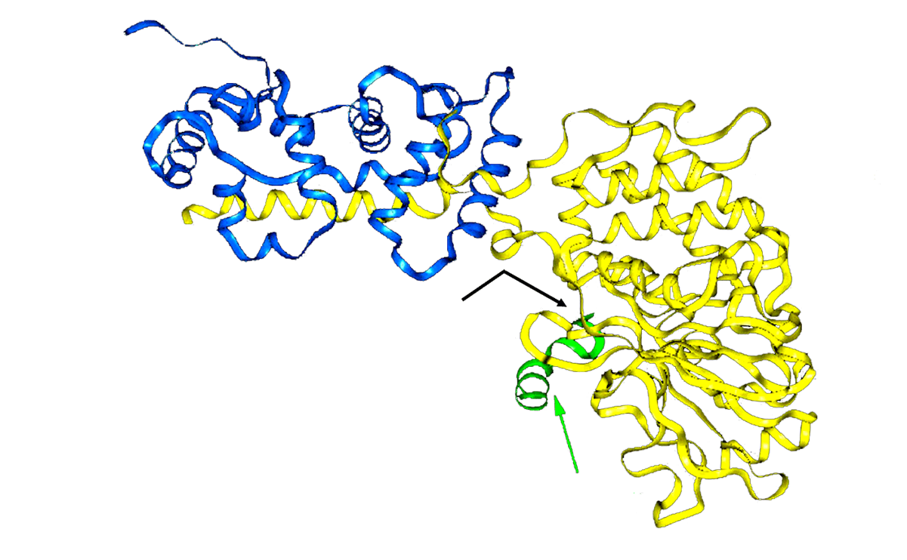
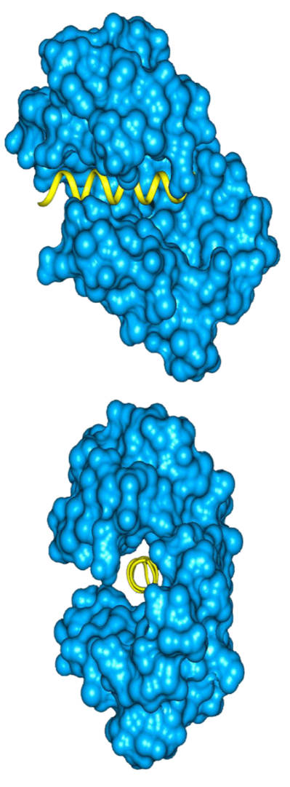
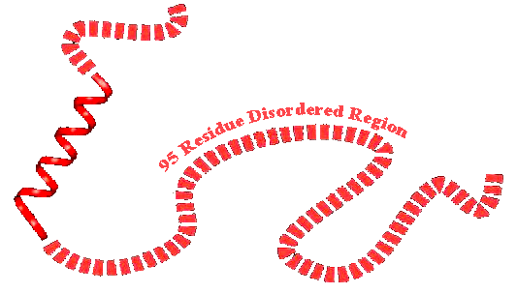
X-ray Determined Disorder: Calcineurin and Calmodulin
Meador W et al., Science
257: 1251-1255 (1992)
B-Subunit
A-Subunit
Active Site
Autoinhibitory
Peptide
Kissinger C et al., Nature 378:641-644 (1995)

Slide 8
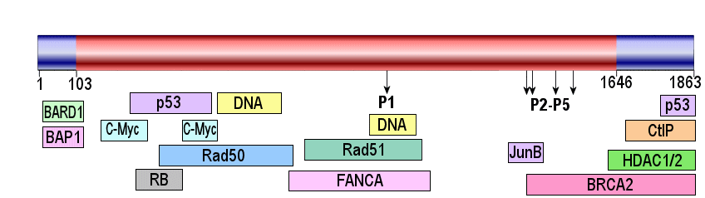
NMR Determined Disorder: Breast Cancer Protein 1 (BRCA1)
103 + 217 = 320
320 / 1,863 → 17% Structured
1,543 / 1,863 → 83% Unstructured (Disordered)
Many such “natively unfolded proteins” or “intrinsically disordered proteins” have been described.
Mark WY et al., J Mol Biol 345: 275-287 (2005)
Notes:
8

Slide 9
Intrinsic Disorder in the Protein Data Bank
Observed
Not Observed
Ambiguous
Uncharacterized
Total
Eukarya
647067
39077
24621
504312
1215077
(53.3%)
(3.2%)
(2.0%)
(41.5%)
(100%)
Bacteria
573676
19
126
17702
82479
692983
(82.8%)
(2.7%)
(2.6%)
(11.9%)
(100%)
Viruses
76019
4856
3797
127970
212642
(35.7%)
(2.3%)
(1.8%)
(60.2%)
(100%)
Achaea
60411
2055
2112
3029
67607
(89.4%)
(3.0%)
(3.1%)
(4.5
%)
(100%)
Total
1357173
65114
48232
717790
2188309
(62.0%)
(3.0%)
(2.2%)
(32.8%)
(100%)
LaGall et al., J. Biomol Struct Dyn 24: 325-342 (2007)

Slide 10
LaGall et al., J. Biomol Struct Dyn 24: 325-342 (2007)

Slide 11
Why are IDPs & IDP Regions unstructured?
IDPs & IDP Regions lack structure because:
They lack a cofactor, ligand or partner.
They were denatured during isolation.
Their folding requires conditions found inside cells.
Their lack of structure is encoded by their amino acid composition.
Notes:
11

Slide 12
Amino Acid Compositions
Surface
Buried

Slide 13
Why are IDPs & IDP Regions unstructured?
To a first approximation, amino acid composition determines whether a protein folds or remains intrinsically disordered.
Given a composition that favors folding, the sequence details determine which fold.
Given a composition that favors not folding, the sequence details provide motifs for biological function.
Notes:
13

Slide 14
Prediction of Intrinsic Disorder
Ordered / Disordered Sequence Data
Aromaticity,
Hydropathy,
Charge,
Complexity
Attribute Selection or Extraction
Separate Training and Testing Sets
Neural Networks,
SVMs, etc.
Predictor Training
Predictor Validation on Out-of-Sample Data
Prediction
Notes:
14

Slide 15
PONDR®VL-XT, PONDR®VSL2B
and PreDisorder
(+) Disordered
XPA
(–) Structured
Iakoucheva L et al., Protein Sci 3: 561-571 (2001)
Dunker AK et al., FEBS J 272: 5129-5148 (2005)
Deng X., et al., BMC Bioinformatics 10:436 (2009)
Notes:
15

Slide 16
Predicted Disorder vs. Proteome Size

Slide 17
Why So Much Disorder? Hypothesis: Disorder Used for Signaling
• Sequence → Structure → Function
– Catalysis,
– Membrane transport,
– Binding small molecules.
• Sequence → Disordered Ensemble → Function
– Signaling, Sites for PTMs, Partner Binding,
– Regulation, Dunker AK, et al., Biochemistry 41: 6573-6582 (2002)
– Recognition, Dunker AK, et al., Adv. Prot. Chem. 62: 25-49 (2002)
– Control. Xie H, et al., Proteome Res. 6: 1882-1932 (2007)
Notes:
17

Slide 18
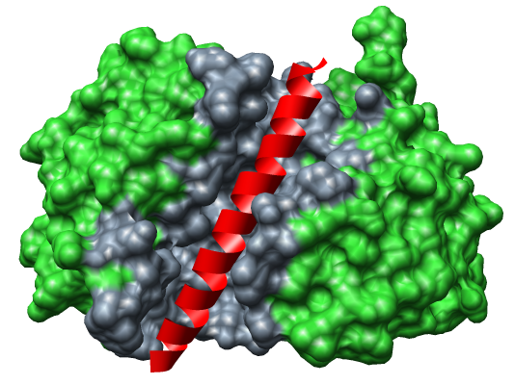
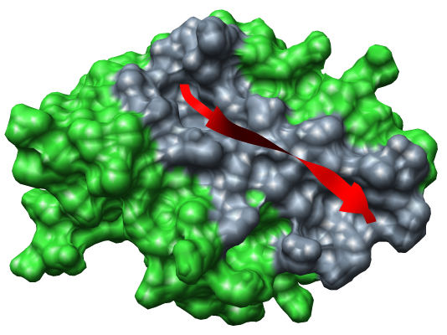
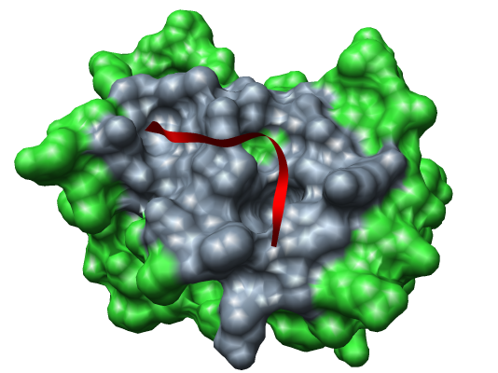
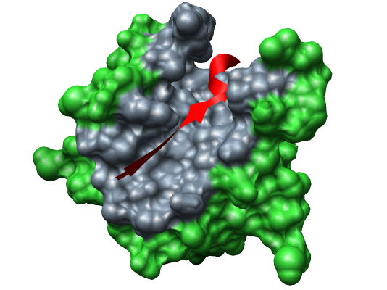
Molecular Recognition Features (MoRFs)
α-MoRF
β-MoRF
Proteinase A + Inhibitor IA3
viral protein pVIc + Adenovirus 2 Proteinase
ι-MoRF
complex-MoRF
Amphiphysin + α-adaptin C
β-amyloid protein + protein X11
Vacic V, et al. J Proteome Res. 6: 2351-2366 (2007)
Notes:
18

Slide 19






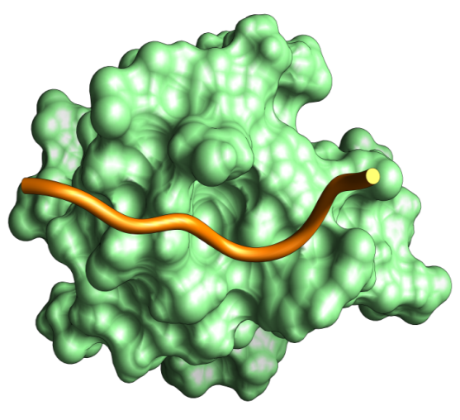









































Protein Interaction Domains: GYF Bound to CD2
http://www.mshri.on.ca/pawson/domains.html; GOOGLE: Tony Pawson
Notes:
19

Slide 20
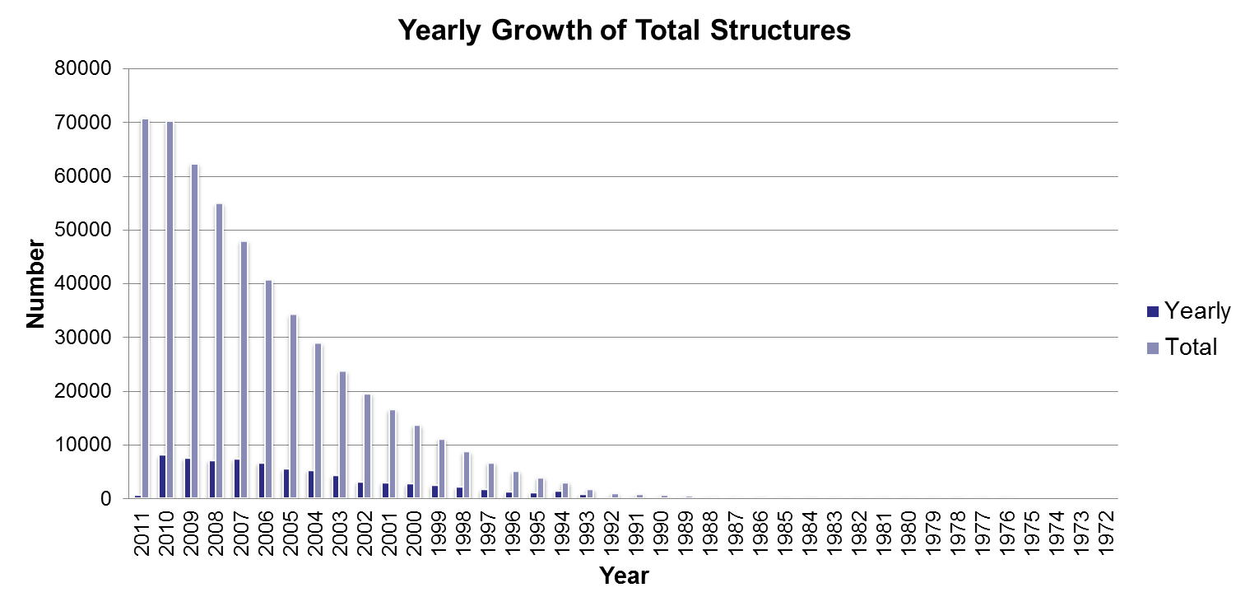
Short and Long MoRFs in PDB
As of 1/11/11, PDB contained 70,695 entries:
number of short* MoRFs = 7681
number of long** MoRFs = 8525
short MoRFs + long MoRFs = ~ 23% of PDB entries!
* Short = 5 – 30 aa
**Long = 31 – 70 aa
Notes:
20

Slide 21
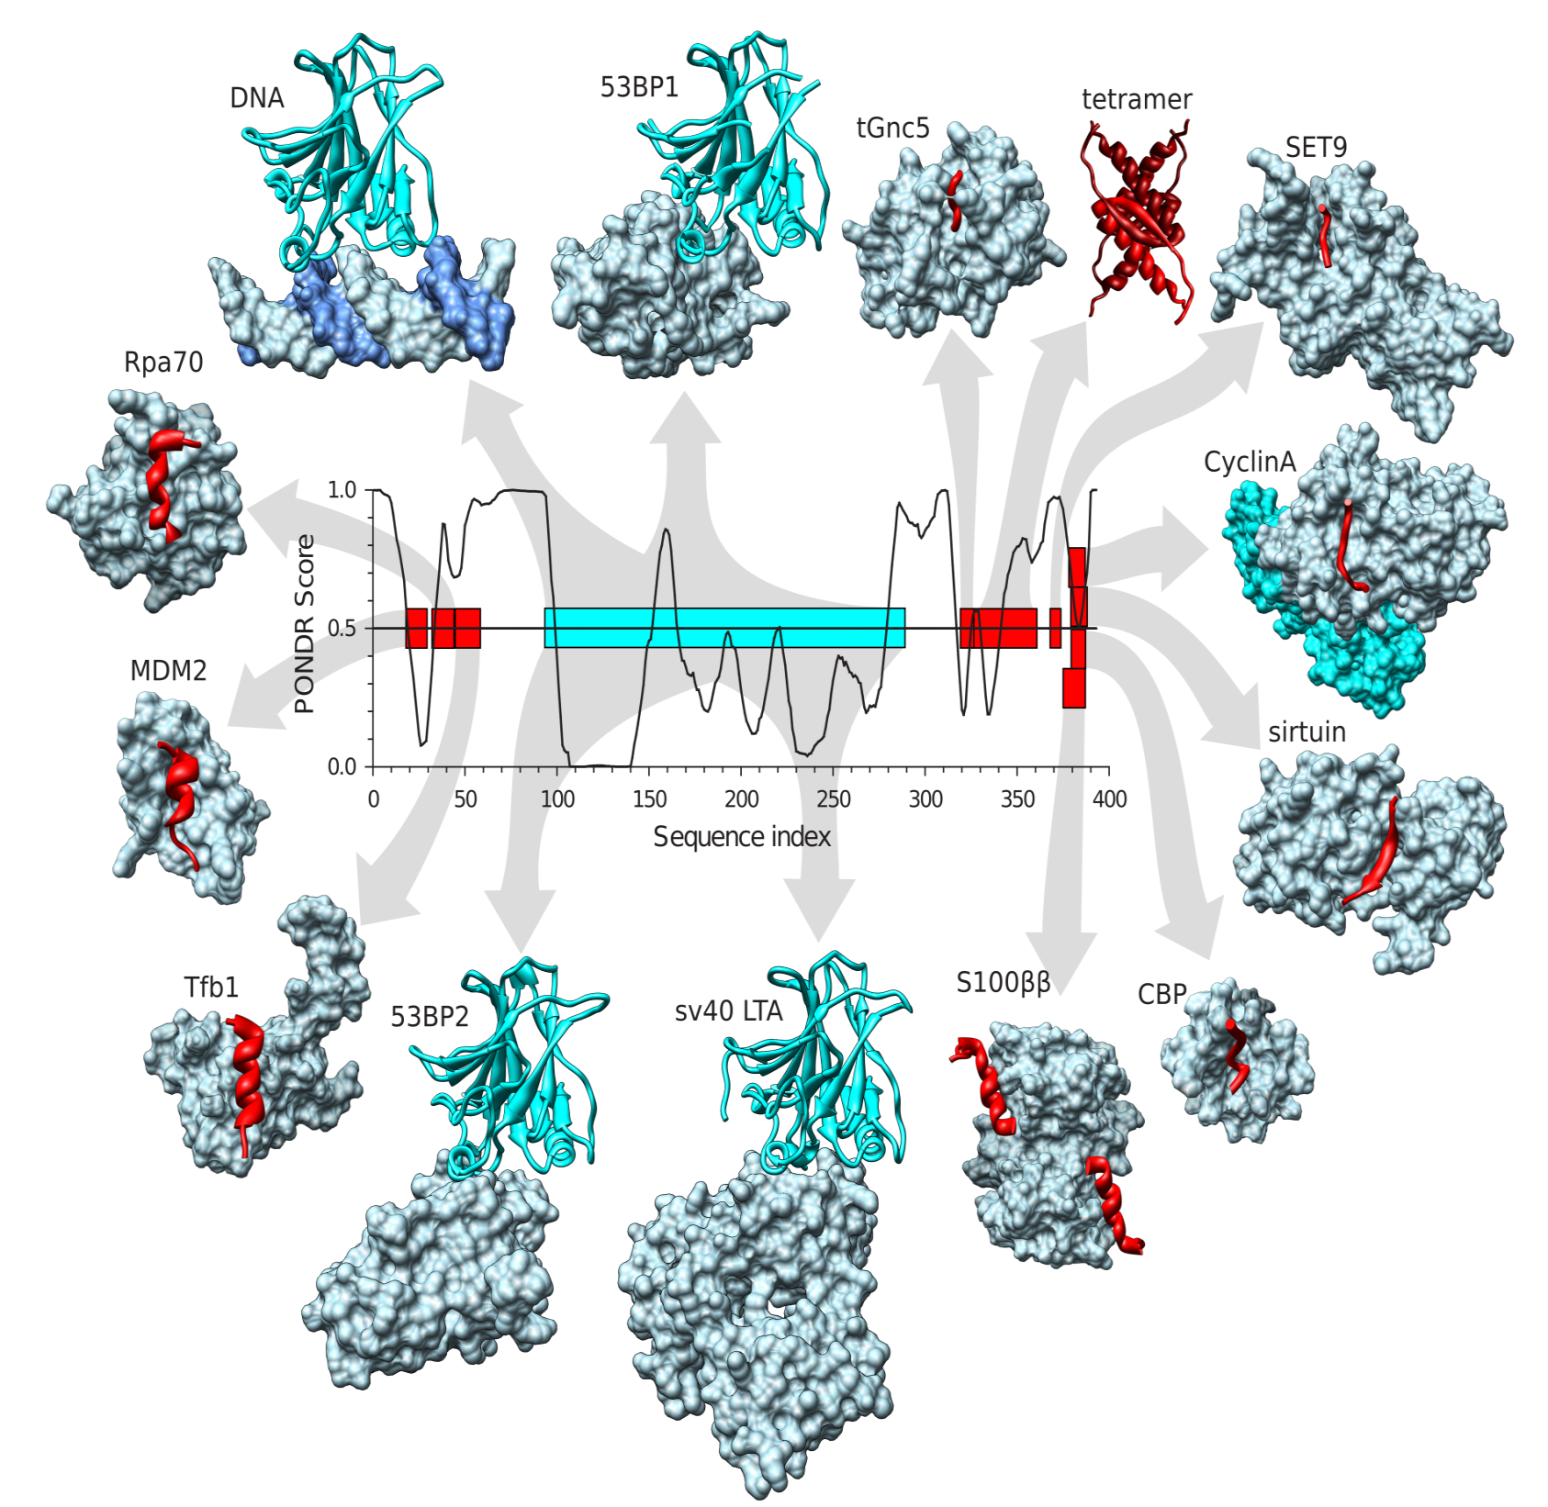
p53 MoRFs
Note use of
disordered
tails!
Uversky VN
& Dunker AK
BBA 1804:
1231-1264
(2010)

Slide 22
Part II: Research Frontiers of Intrinsically Disordered Proteins

Slide 23
Current Topics of Intrinsically Disordered Proteins
Prediction of Intrinsically Disordered Proteins (IDPs)
Simulation of IDPs’ conformation
Analysis of IDPs’ function and evolution
Chen, Cheng, Keith, PSB, 2012

Slide 24
IDP Prediction Methods
Identification of Disordered Region
Ab initio method
Template-based method
Clustering method
Meta method
Deng et al., Molecular Biosystems, 2011

Slide 25
Benchmark on 117 CASP9 Targets
Disorder Predictor | ACC Score | AUC Score | Weighed Score | Pos. Sens. | Pos. Spec. | Neg. Sens. | Neg. Spec. | F-meas.
Prdos2 | 0.752 | 0.852 | 7.153 | 0.608 | 0.375 | 0.897 | 0.957 | 0.464
PreDisorder | 0.748 | 0.819 | 7.187 | 0.650 | 0.300 | 0.846 | 0.960 | 0.410
biomine_DR_pdb | 0.739 | 0.818 | 6.763 | 0.597 | 0.338 | 0.881 | 0.956 | 0.432
GSmetaDisorderMD | 0.736 | 0.813 | 6.906 | 0.657 | 0.266 | 0.816 | 0.959 | 0.378
mason | 0.730 | 0.740 | 6.297 | 0.537 | 0.416 | 0.923 | 0.952 | 0.469
ZHOU-SPINE-D | 0.729 | 0.829 | 6.411 | 0.579 | 0.326 | 0.878 | 0.954 | 0.417
GSmetaserver | 0.713 | 0.811 | 5.982 | 0.577 | 0.279 | 0.849 | 0.952 | 0.376
ZHOU-SPINE-DM | 0.705 | 0.789 | 5.621 | 0.535 | 0.303 | 0.875 | 0.949 | 0.387
Distill-Punch1 | 0.701 | 0.797 | 5.392 | 0.505 | 0.338 | 0.897 | 0.946 | 0.405
GSmetaDisorder | 0.694 | 0.793 | 5.268 | 0.519 | 0.287 | 0.869 | 0.947 | 0.370
OnD-CRF | 0.694 | 0.733 | 5.513 | 0.586 | 0.231 | 0.802 | 0.950 | 0.332
CBRC_POODLE | 0.693 | 0.828 | 4.958 | 0.447 | 0.425 | 0.939 | 0.944 | 0.435
MULTICOM | 0.687 | 0.852 | 4.723 | 0.419 | 0.481 | 0.955 | 0.942 | 0.448
IntFOLD-DR | 0.683 | 0.794 | 4.831 | 0.481 | 0.299 | 0.885 | 0.944 | 0.369
Biomine_DR_mixed | 0.683 | 0.769 | 4.901 | 0.501 | 0.274 | 0.865 | 0.945 | 0.354
Spritz3 | 0.683 | 0.751 | 4.732 | 0.457 | 0.336 | 0.909 | 0.943 | 0.387
DISOPRED3C | 0.669 | 0.851 | 3.975 | 0.349 | 0.775 | 0.990 | 0.937 | 0.481
GSmetaDisorder3D | 0.669 | 0.781 | 4.142 | 0.398 | 0.399 | 0.939 | 0.939 | 0.399
biomine_DR | 0.659 | 0.815 | 3.647 | 0.333 | 0.696 | 0.985 | 0.936 | 0.451
OnD-CRF-pruned | 0.659 | 0.707 | 4.358 | 0.526 | 0.205 | 0.792 | 0.943 | 0.295
Distill | 0.654 | 0.693 | 4.152 | 0.510 | 0.204 | 0.798 | 0.941 | 0.291
ULg-GIGA | 0.589 | 0.718 | 1.302 | 0.191 | 0.608 | 0.988 | 0.924 | 0.290
Biomine_DR_mixed | 0.572 | 0.769 | 0.644 | 0.152 | 0.647 | 0.992 | 0.920 | 0.247
Deng et al., Molecular Biosystems, 2011

Slide 26
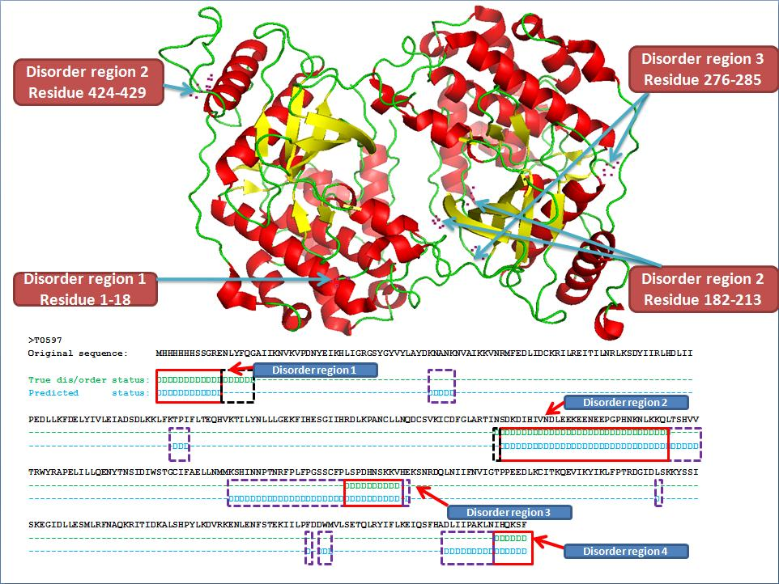
A Prediction Example by PreDisorder
Deng et al., Molecular Biosystems, 2011

Slide 27
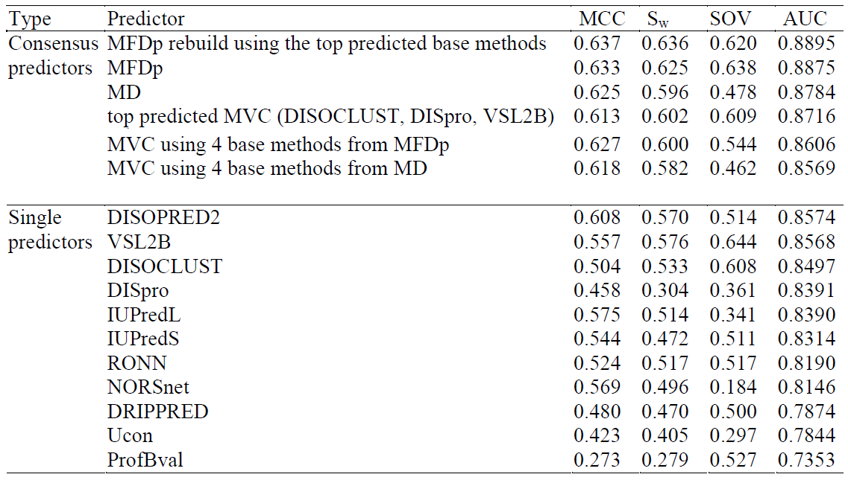
Improve Disorder Prediction by Regression-Based Consensus
Peng and Kurgan, PSB, 2012

Slide 28
Current Topics of Intrinsically Disordered Proteins
Prediction of Intrinsically Disordered Proteins (IDPs)
Simulation of IDPs’ conformation
Analysis of IDPs’ function and evolution
Chen, Cheng, Keith, PSB, 2012

Slide 29
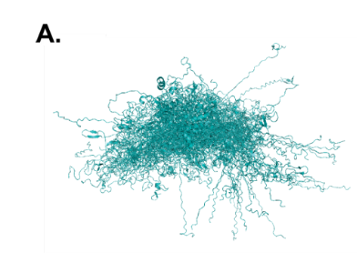
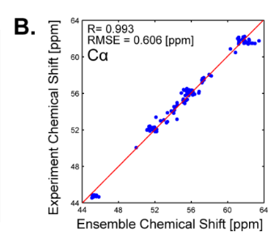
Construct IDP Ensembles Using Variational Bayesian Weighting with Structure Selection
Construct a minimal number of conformations
Estimate uncertainty in properties
Validated against reference ensembles of a-synuclein
Alignment of weighted structures
Fisher et al., PSB, 2012

Slide 30
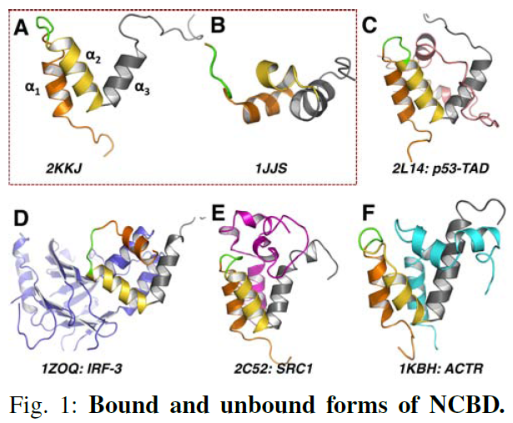
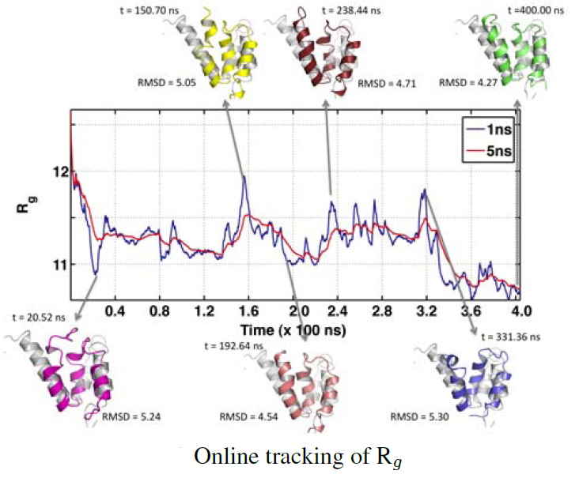
Discover Intermediate States in IDP Ensemble by Quasi-Aharmonic Analysis
Bound and unbound forms of Nuclear
Co-Activator Binding Domain (NCBD)
Burger et al., PSB, 2012

Slide 31
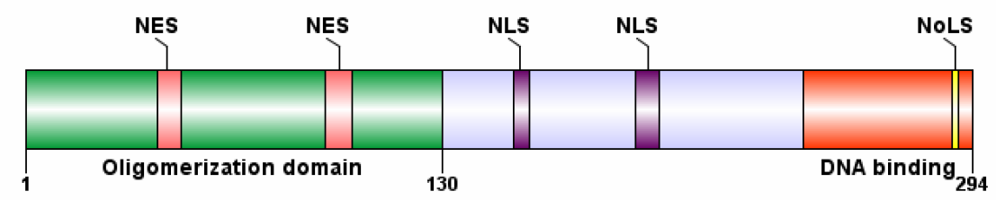
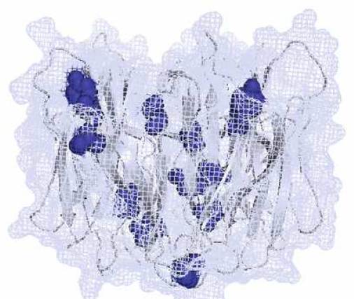
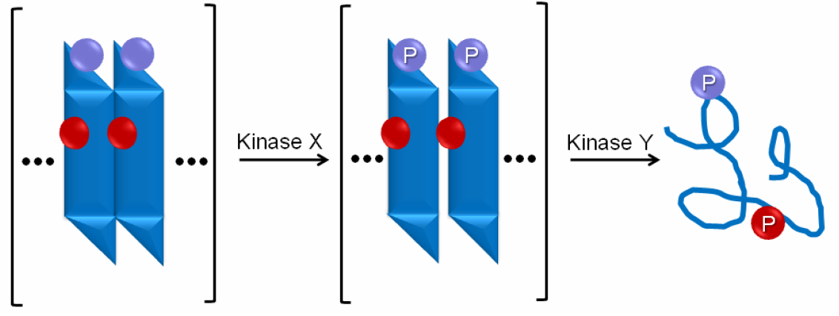
Order-Disorder Transformation by Sequential Phosphorylations?
Domains organization of human nucleophosmin (Npm)
Order – Disorder Transition Triggered by Phosphorylation
Phosphorylation Sites (blue)
Mitrea and Kriwacki, PSB, 2012

Slide 32
Current Topics of Intrinsically Disordered Proteins
Prediction of Intrinsically Disordered Proteins (IDPs)
Simulation of IDPs’ conformation
Analysis of IDPs’ function and evolution
Chen, Cheng, Keith, PSB, 2012

Slide 33
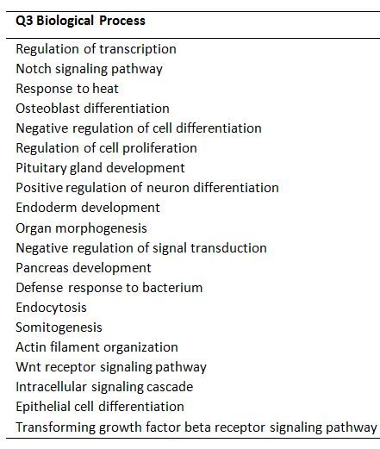
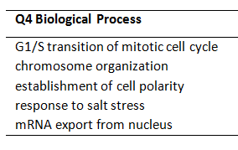
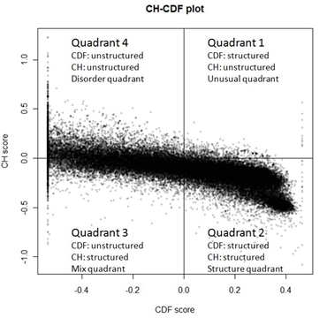
Classify Disordered Proteins by CH-CDF Plot
Charge-hydropathy , cumulative distribution function
Four classes: structured, mixed, disordered, rare
Huang et al., PSB, 2012

Slide 34
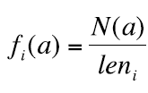
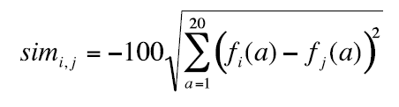
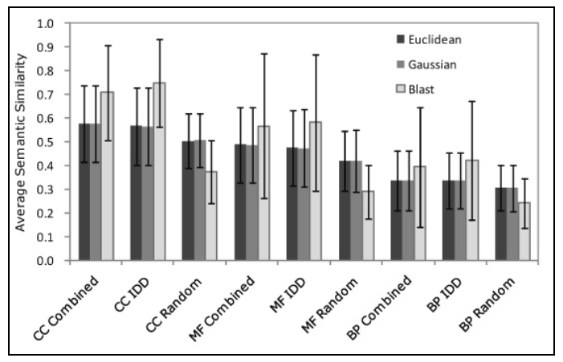
Function Annotation of IDP Domains by Amino Acid Content
Frequency of an amino acid in sequence i
Similarity between disordered proteins
Achieve similar function prediction
precision, but much higher coverage
in comparison with Blast
CC: cellular component
MF: molecular function
BP: biological process
Patil et al., PSB, 2012

Slide 35
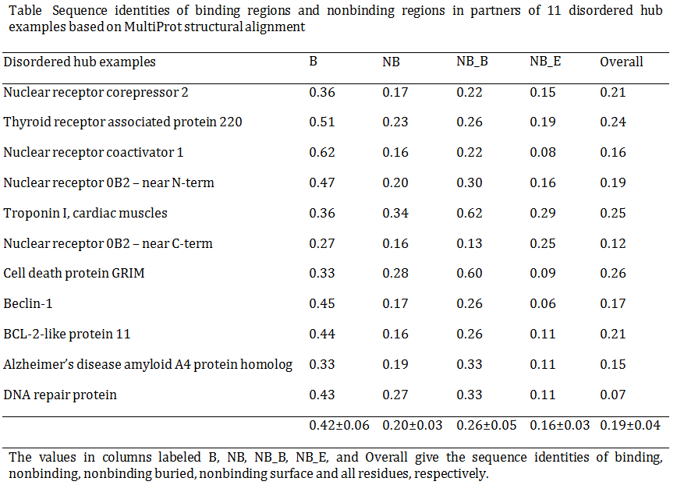
High Conservation in Flexible Disordered Binding Sites
Hsu et al., PSB, 2012

Slide 36
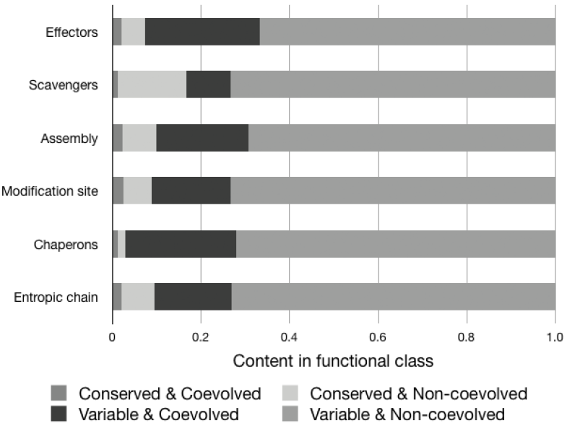
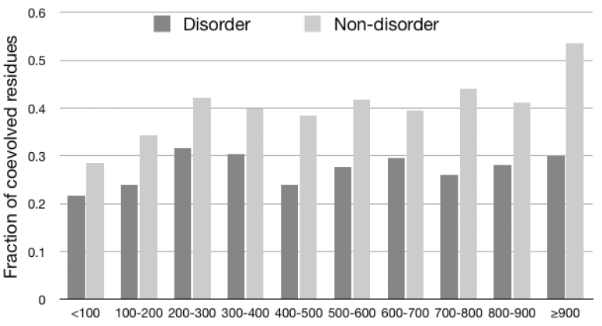
Sequence Conservation & Co-Evolution in IDPs and their Function Implication
Jeong and Kim, PSB, 2012

Slide 37
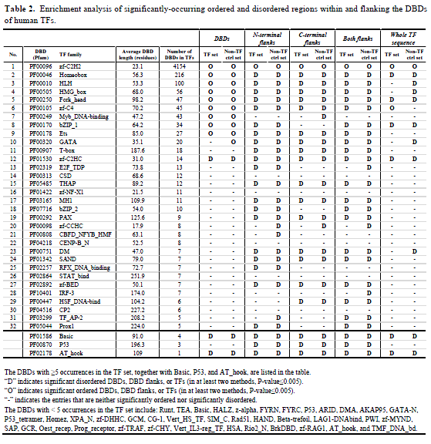
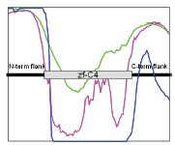
Intrinsic Disorder Flanking DNA-Binding Domains of Human TFs
Guo et al., PSB, 2012

Slide 38
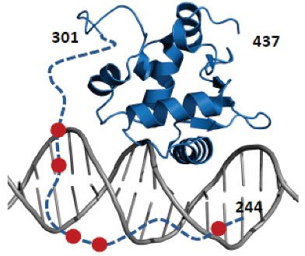
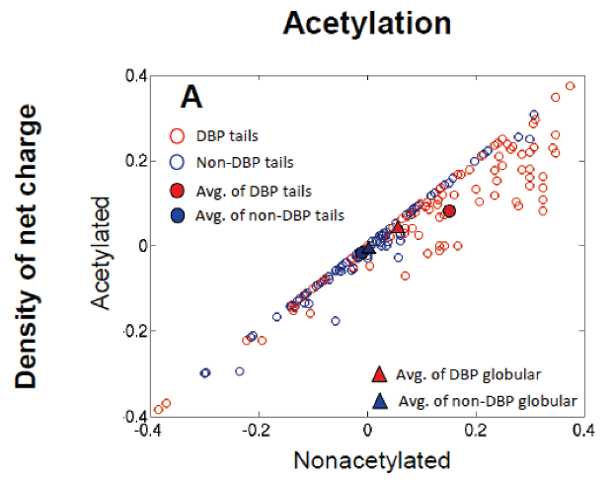
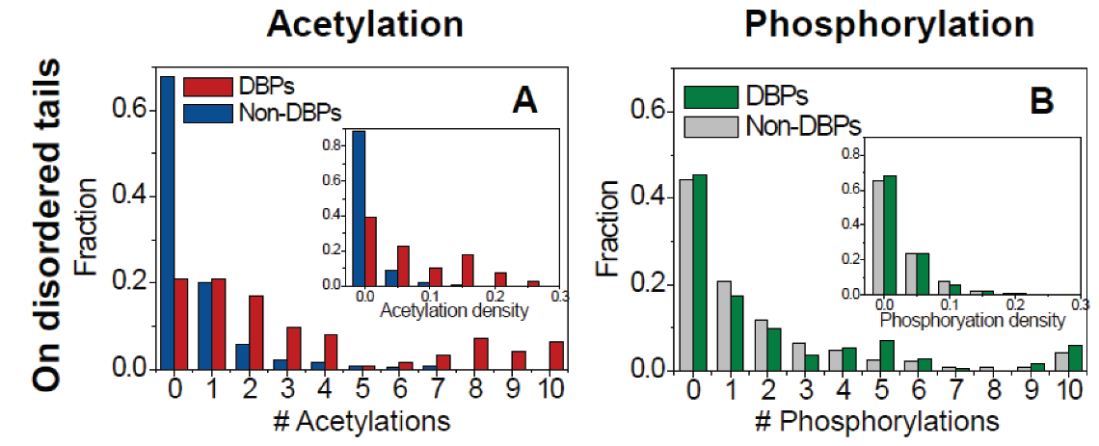
Modulate Protein-DNA Binding by Post-Translational Modifications at Disordered Regions
Vuzman et al.,
PSB, 2012

Slide 39
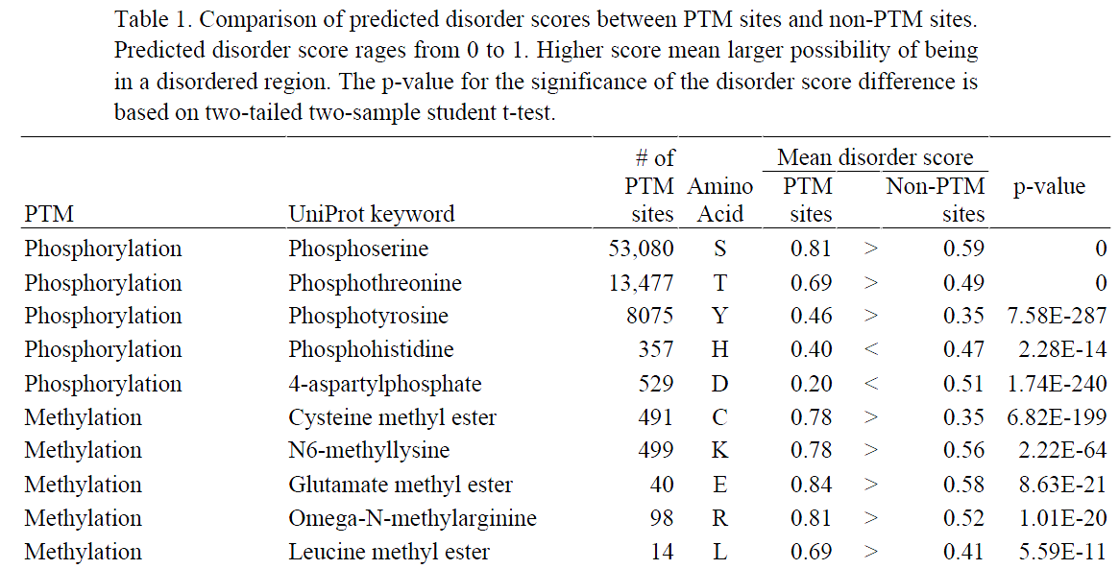
High Correlation between Disorder and Post-Translational Modification
Disorder-order transitions might be introduced by modifications of phospho-serine-threonine, mono-di-tri-methyllysine, sulfotyrosine, 4-carboxyglutamate
Gao and Xu, PSB, 2012

Slide 40
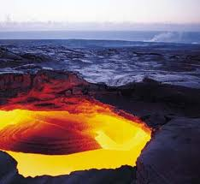
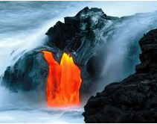
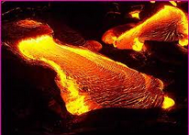
Acknowledgements
Authors and reviewers of PSB IDP session
IDP community
PSB organizers
Thank You ! ! !
Images.google.com

