Slide 1
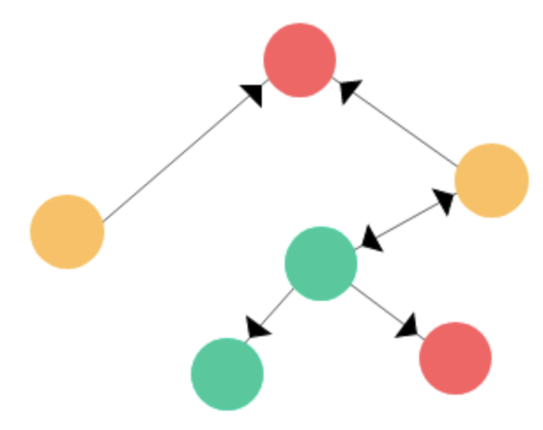
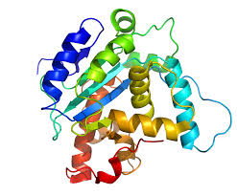
Improving AlphaFold-based Prediction of Protein Structure and Interaction
Jianlin (Jack) Cheng
Department of Electrical Engineering and Computer Science
University of Missouri - Columbia, USA
Pittcon 2024, San Diego, California

Slide 2
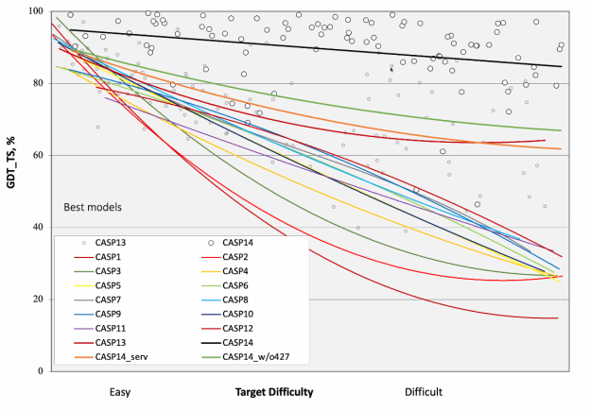
The Biggest AI Breakthrough in Protein Structure Prediction and Bioinformatics
AlphaFold by Google DeepMind
Community effort and progress over ~30 years
Critical Assessments of Techniques for Protein Structure Prediction (CASP1, CASP2, …, CASP15 from 1994 to 2022)
CASP14, AlphaFold2, 2020
CASP14, all others, 2020
CASP13, 2018
CASP10, 2012
CASP6, 2004
CASP1, 1994
Provided by CASP organizers
2022 Breakthrough Prize, 2023 Lasker Award

Slide 3
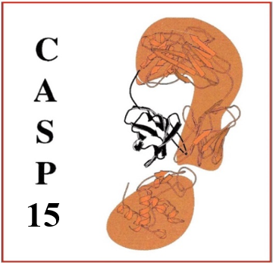
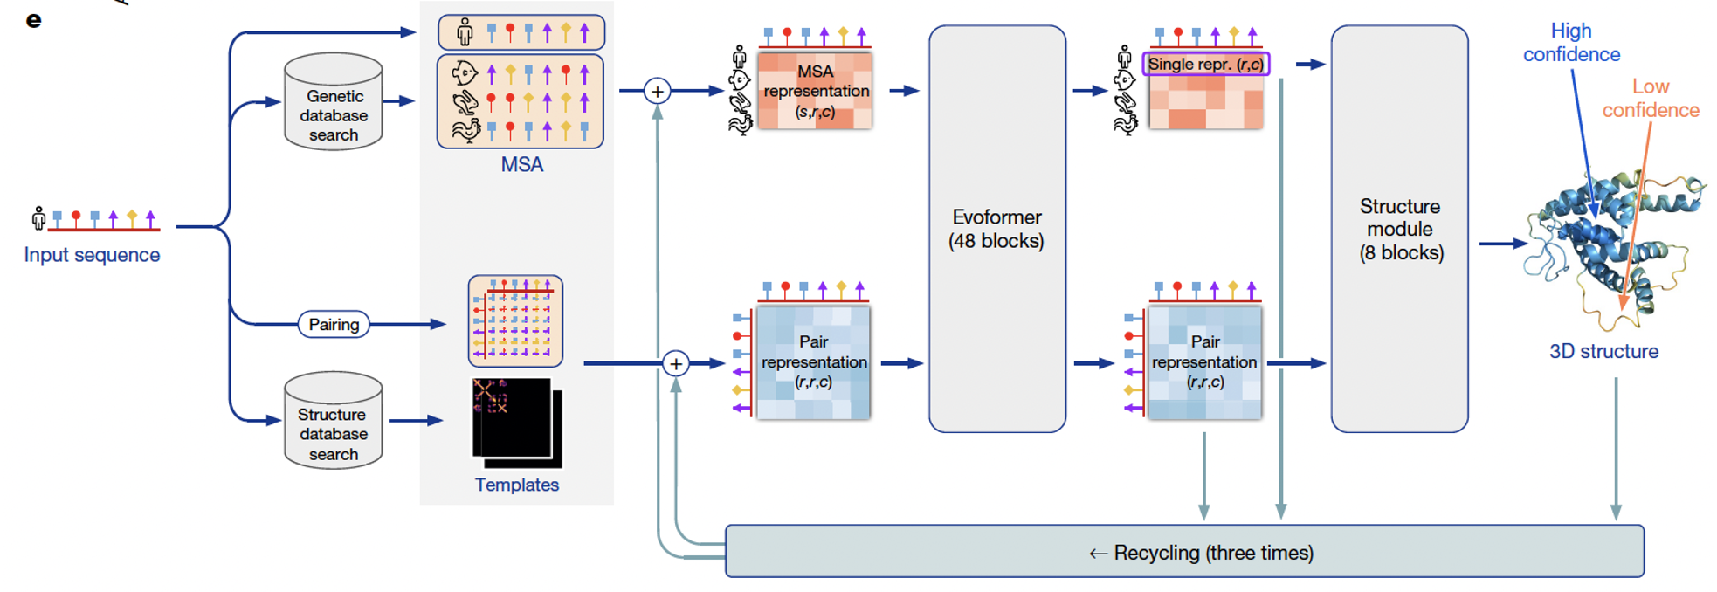
How to further improve AlphaFold?
AlphaFold2
Jumper et al., 2021
Input
Deep Learning Model
(Evoformer & 3D module)
Output
Sampling MSA and templates
Ranking and refinement

Slide 4
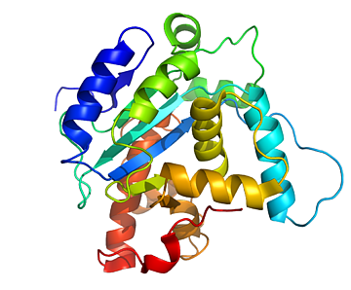
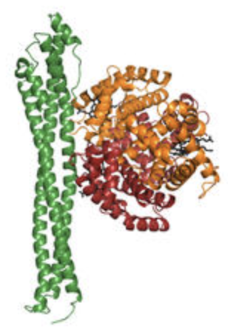
The Strategy for Improving AlphaFold2 in MULTICOM
Monomer Multiple Sequence Alignment (MSA) Sampling
Parameters
Tertiary Structure (TS) Prediction
Tertiary Structures
AlphaFold2
Model Sampling
Model Ranking
Model Refinement
Monomer
Monomer Template Sampling
Structure Search on PDB
& AlphaFoldDB
Extracted
Structures of Chains
Multimer MSA Sampling
Quaternary Structure (QS)
Prediction
Quaternary Structures
AlphaFold-multimer
Model
Sampling
Model Ranking
Model Refinement
Multimer (complex)
Multimer Template Sampling
Parameters

Slide 5
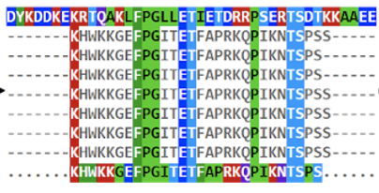
MSA Sampling
Sequence Databases:
UniRef30, UniRef90, BFD, MGnify clusters, UniProt, ColabFold DB, and IMG
Monomer MSAs
HHblits, jackhammer,
MMseq2, DeepMSA
TS
Prediction
Monomer
TS structure
FoldSeek
AlphaFoldDB & PDB
Each
Chain
MSAs of Chain 1
MSAs of Chain n
……
Multimer
MSAs
Multimer (complex / assembly)
Merged by species, protein-protein interaction, complexes in PDB
QS
Prediction

Slide 6
Template Sampling
AlphaFold default search
PDB70 or PDB90
Monomer Structure Templates
TS Prediction
Monomer
HHsearch with
monomer MSA
Tertiary
Structure
FoldSeek
PDB
Templates for Chain 1
Templates for Chain n
Each
Chain
……
Multimer
Multimer Structure Templates
QS
Prediction
Merge

Slide 7
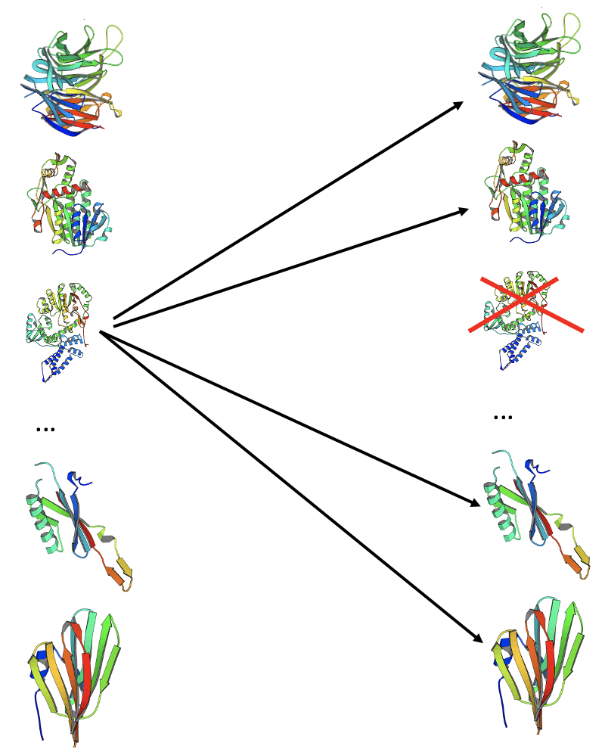
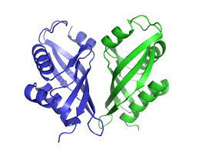
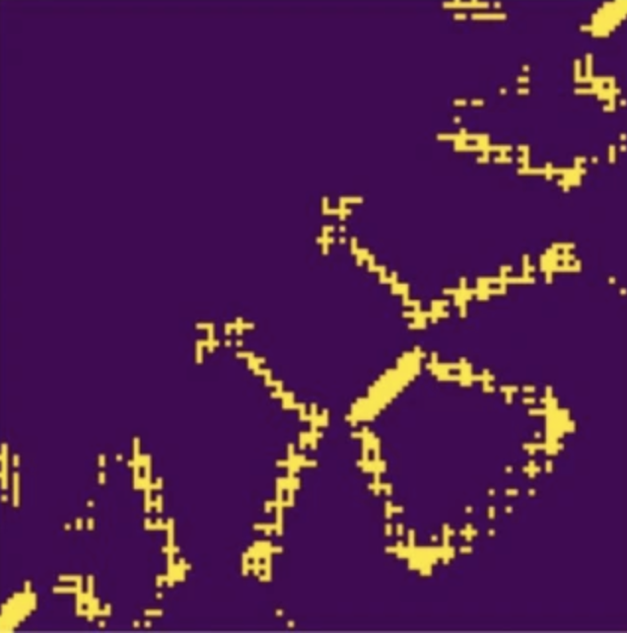
Model Ranking (Scoring)
AlphaFold2 ‘s internal score
Average Pairwise Structural Similarity (PSS) between a model and other models
Interface Contact Probability Score (ICPS) of multimer by deep learning (CDPred)
Average of PSS and ICPS
PSS
ICPS
Inter-chain contacts in
an interface of a multimer
Inter-chain contact probability
map predicted by CDPred

Slide 8
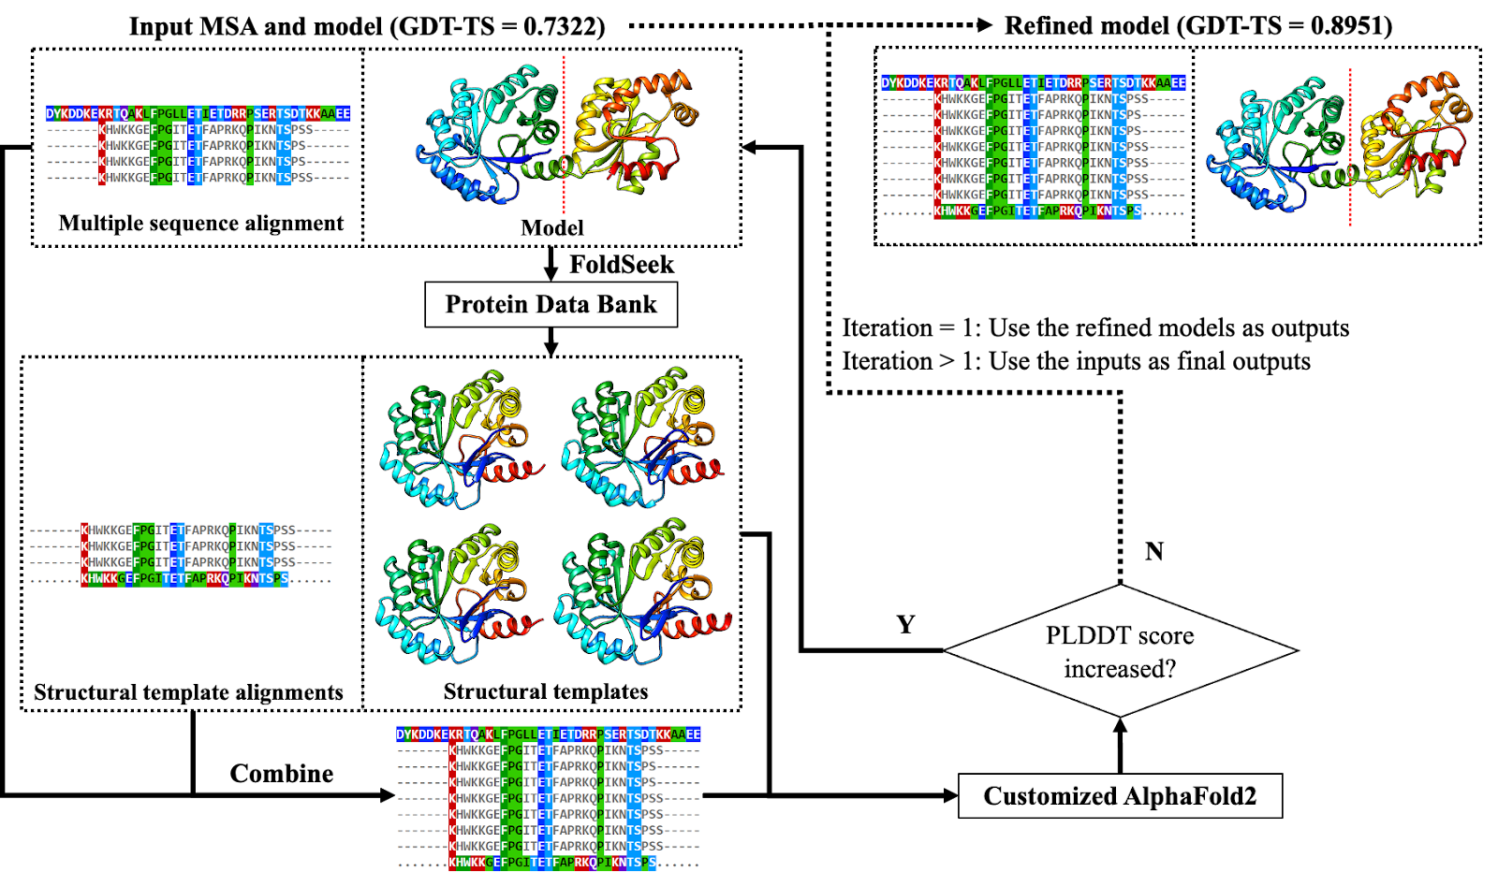
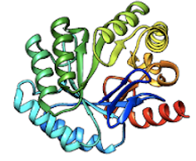
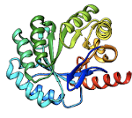
Iterative Structure Alignment-Based TS and QS Model Refinement
Input model and MSA Refined model with highest score
N
Model Generation
The similar approach to QS model refinement

Slide 9
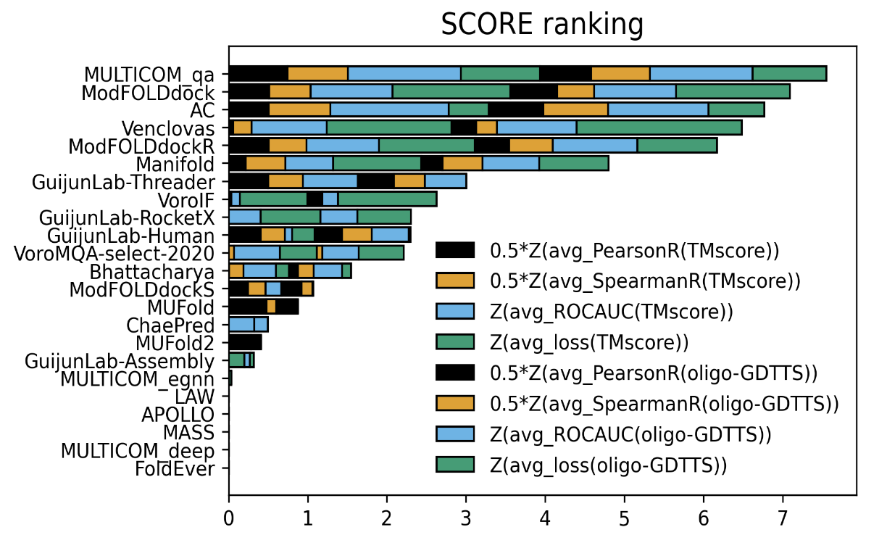
Top Predictors in Estimating Multimer Global Model Accuracy (EMA) in CASP15
MULTICOM_qa = (PSS + ICPS) / 2
https://predictioncenter.org/casp15/zscores_EMA.cgi
CASP15 Talk: https://www.youtube.com/watch?v=RHlxUWFDNvk

Slide 10
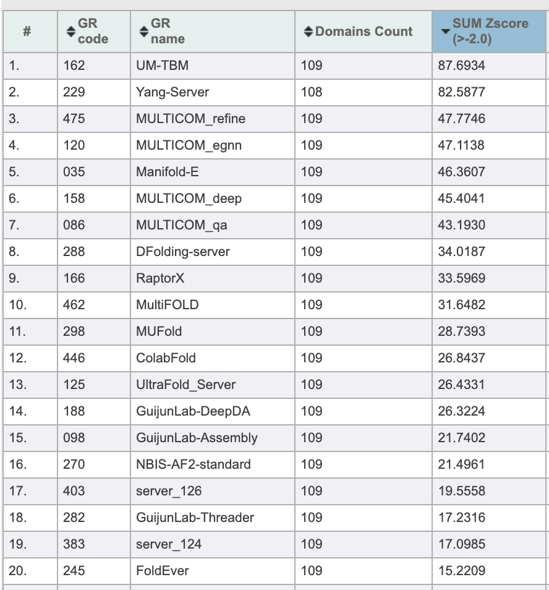
Top 20 of 47 Tertiary Structure Prediction Servers in CASP15
Univ. of Michigan
MULTICOM
Standard AlphaFold2
by Elofsson Group
On 94 domains

Slide 11
Top 15 of 26 Quaternary Structure (Multimer) Prediction Servers in CASP15
Shandong Univ.
No. | Server predictors | Sum of Z-scores | Avg TM-score on 41 multimers
1 | Yang-Multimer | 25.0147 | 0.7138
2 | Manifold-E | 19.864 | 0.7665
3 | MULTICOM_qa | 19.6209 | 0.7565
4 | MULTICOM_deep | 17.5549 | 0.7416
5 | DFolding-server | 17.4518 | 0.5978
6 | Kiharalab_Server | 16.5675 | 0.6703
7 | UltraFold_Server | 15.7925 | 0.6961
8 | MultiFOLD | 15.353 | 0.6643
9 | MUFold | 14.0905 | 0.7195
10 | ColabFold | 13.1542 | 0.6339
11 | NBIS-AF2-multimer | 12.2984 | 0.7186
12 | RaptorX-Multimer | 12.076 | 0.6744
13 | GuijunLab-Assembly | 10.4977 | 0.6701
14 | Yang-Server | 10.495 | 0.3578
15 | DFolding-refine | 9.7678 | 0.6584
MULTICOM
Standard
AlphaFold-multimer
On 41 multimers

Slide 12
Analysis of Tertiary Structure Prediction Results and Key Findings

Slide 13
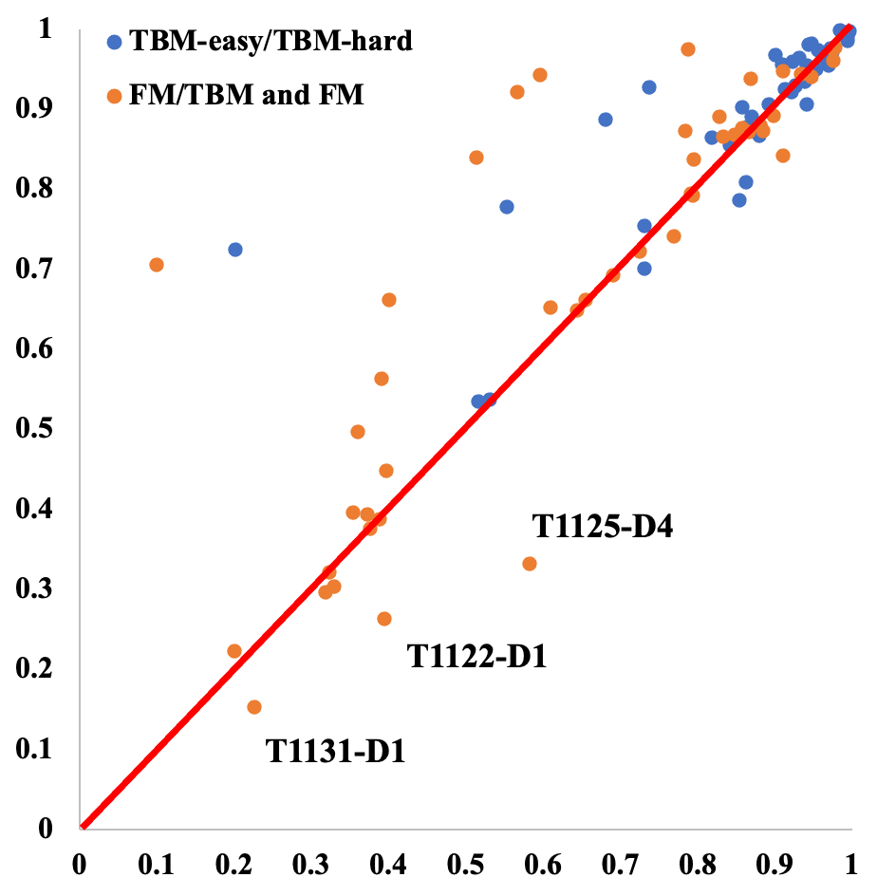
MULTCOM Improves Prediction Accuracy over Standard AlphaFold2
GDT-TS
of MULTICOM_refine
Ave. GDT-TS of Model 1
0.79 vs 0.75
p-value = 0.00067
Improvement = 5.3%
GDT-TS of standard AlphaFold2 (NIBS-AF2-Standard) on 91 common domains

Slide 14
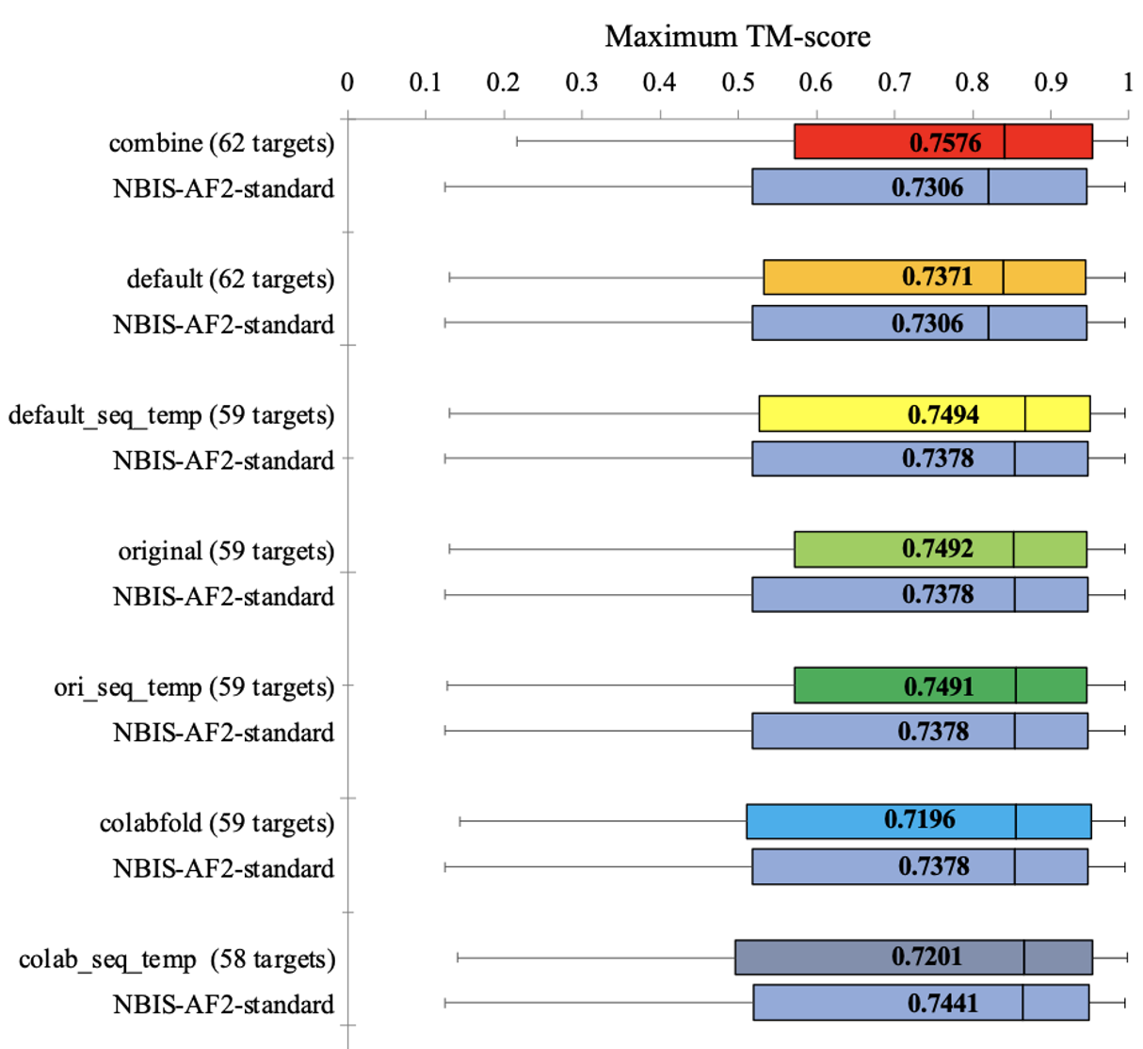
Importance of Sampling Diverse MSAs and Templates
3.7% improvement
p-value = 7.5e-08
different parameters
p-value = 0.10
p-value = 0.013
p-value = 0.022
p-value = 0.028

Slide 15
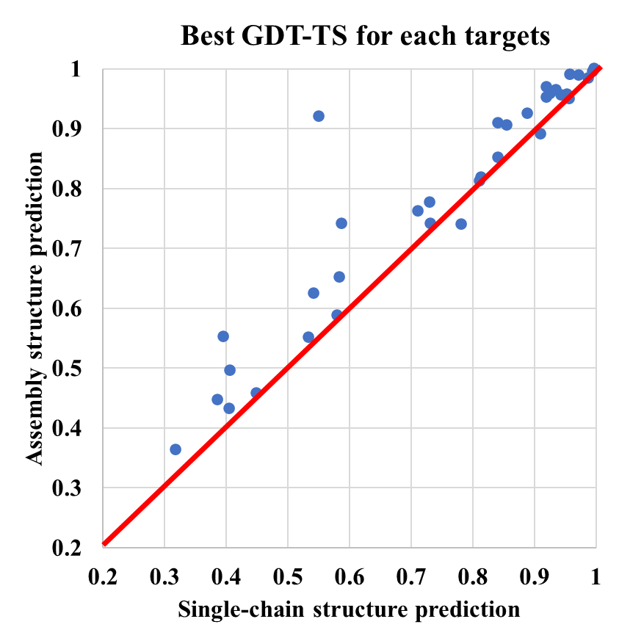
Importance of Considering Protein-Protein Interaction (PPI) in TS prediction
Plot of GDT-TS score of the best model for each target predicted by two methods
Unfortunately, most CASP15 predictors did not consider PPI!
Improvement on 33 out of 35 full-length targets that are subunits of assemblies

Slide 16
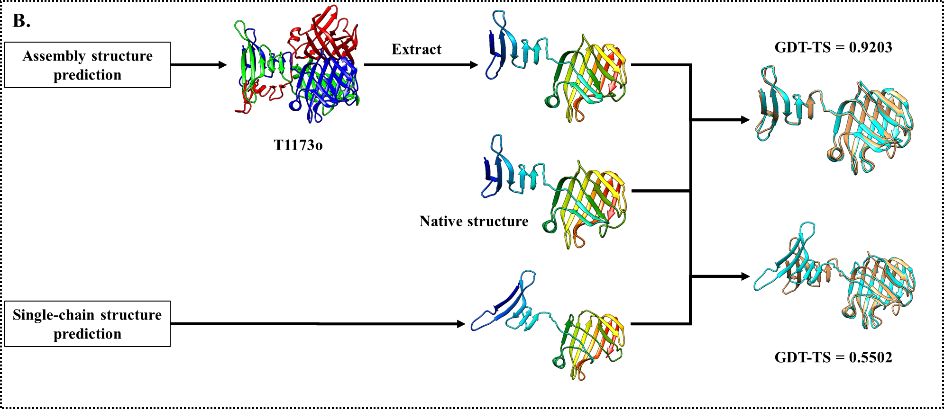
An Example of Considering PPI for TS Prediction: T1173

Slide 17
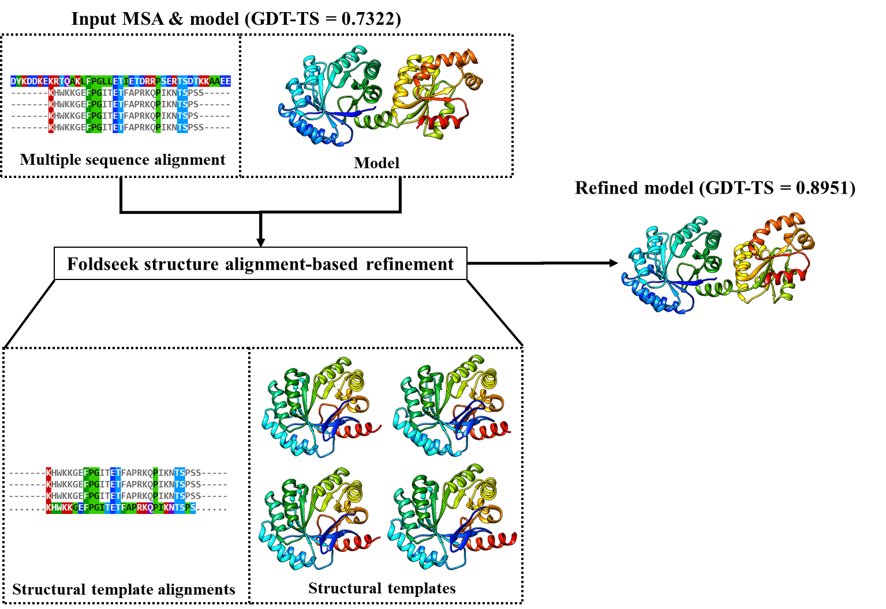
Effect of FoldSeek Structure Alignment-Based Refinement
On average: 0.7516 of refined models versus 0.7512 of initial models
T1180
The best model among all CASP15 models predicted by 132 server and human predictors

Slide 18
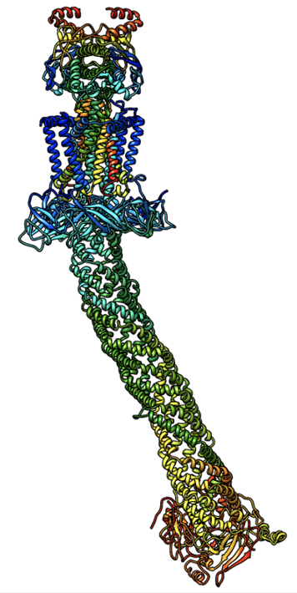
Analysis of Quaternary Structure Prediction Results and Key Findings

Slide 19
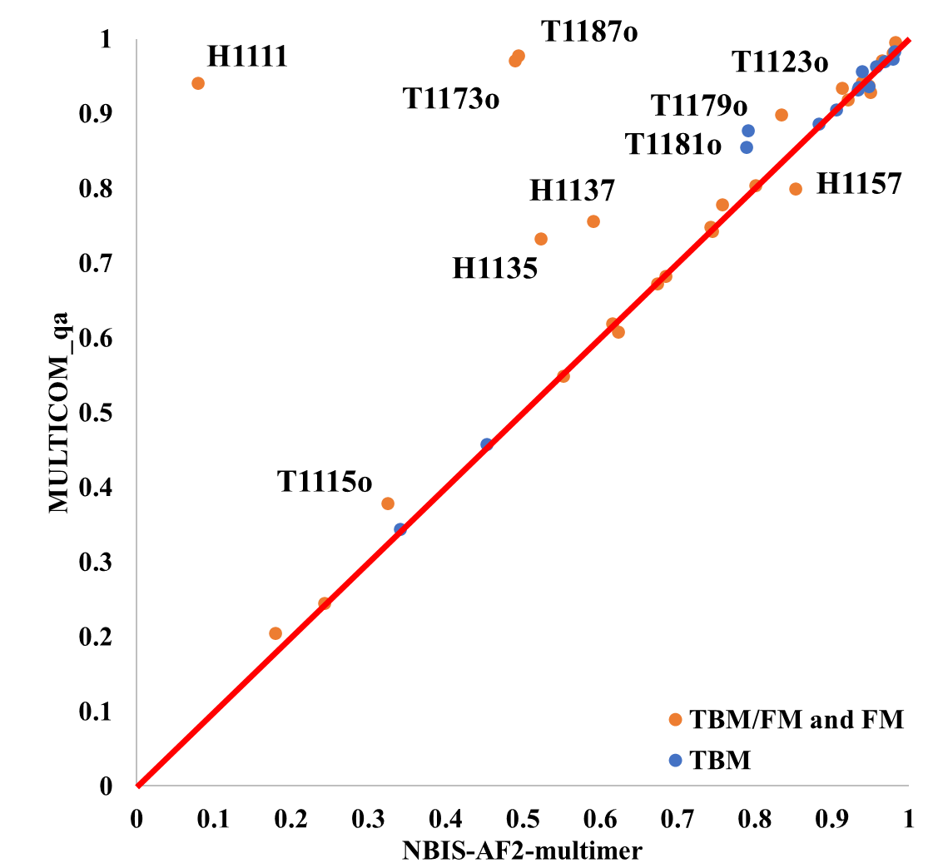
MULTICOM Significantly Outperforms Standard AlphaFold-multimer
Ave. TM-score of best of five
MULTICOM_qa = 0.796
NBIS-AF2-multimer = 0.738
P-value = 0.026
Improvement = 7.8%

Slide 20
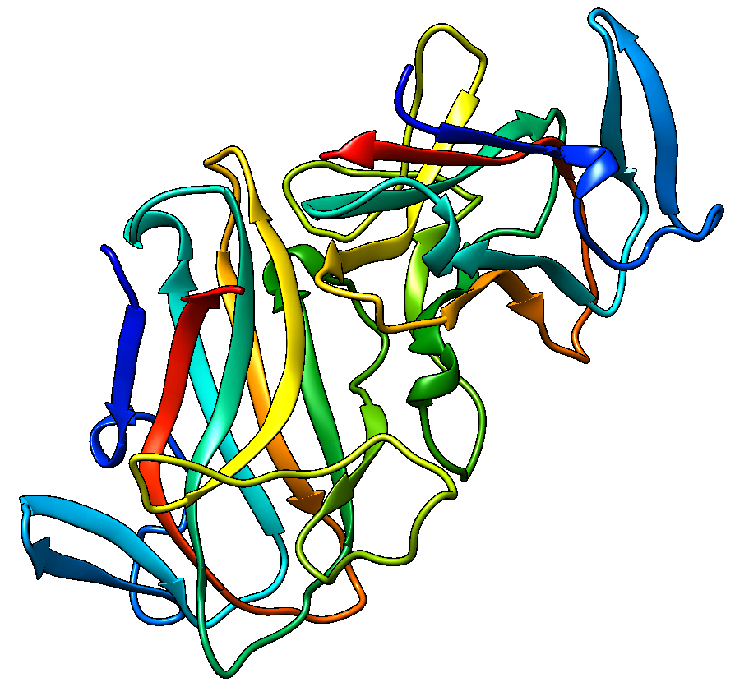
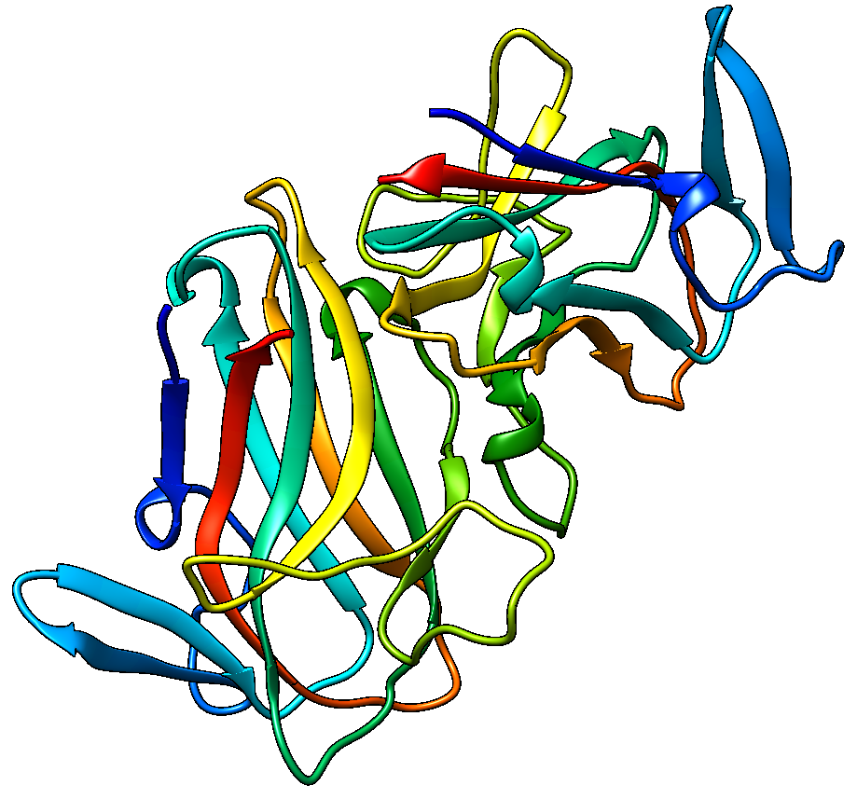
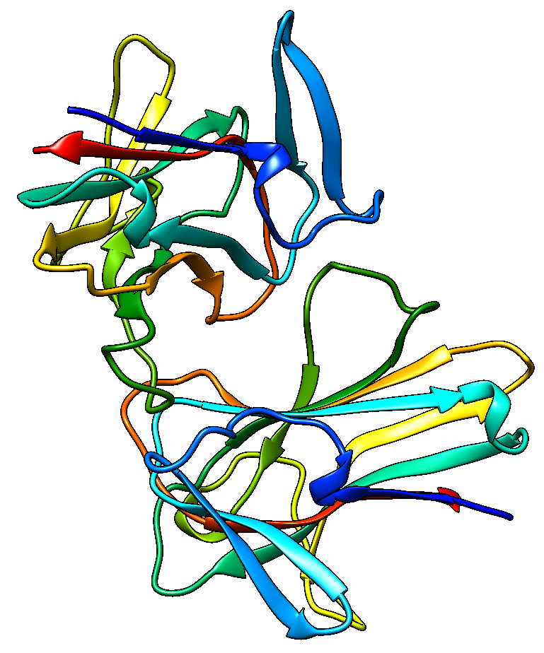
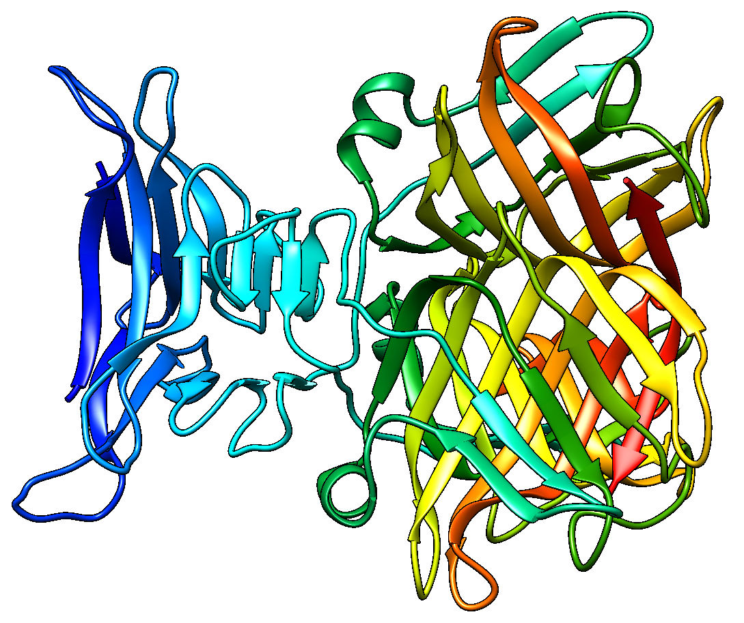
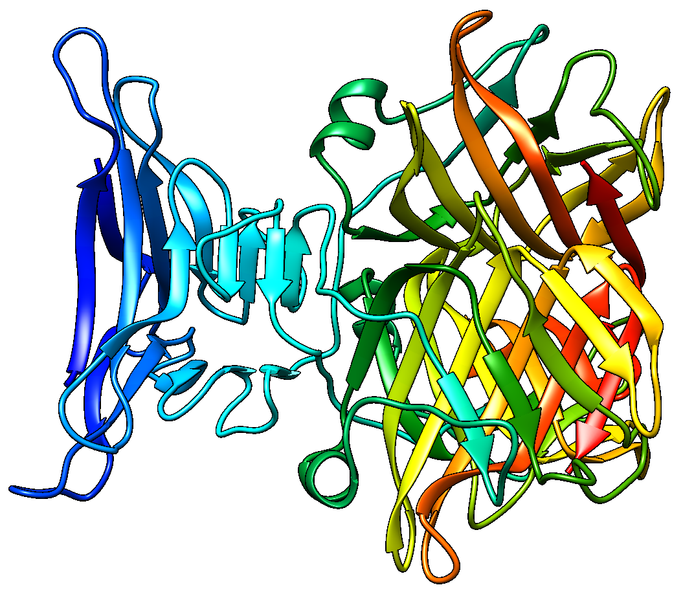
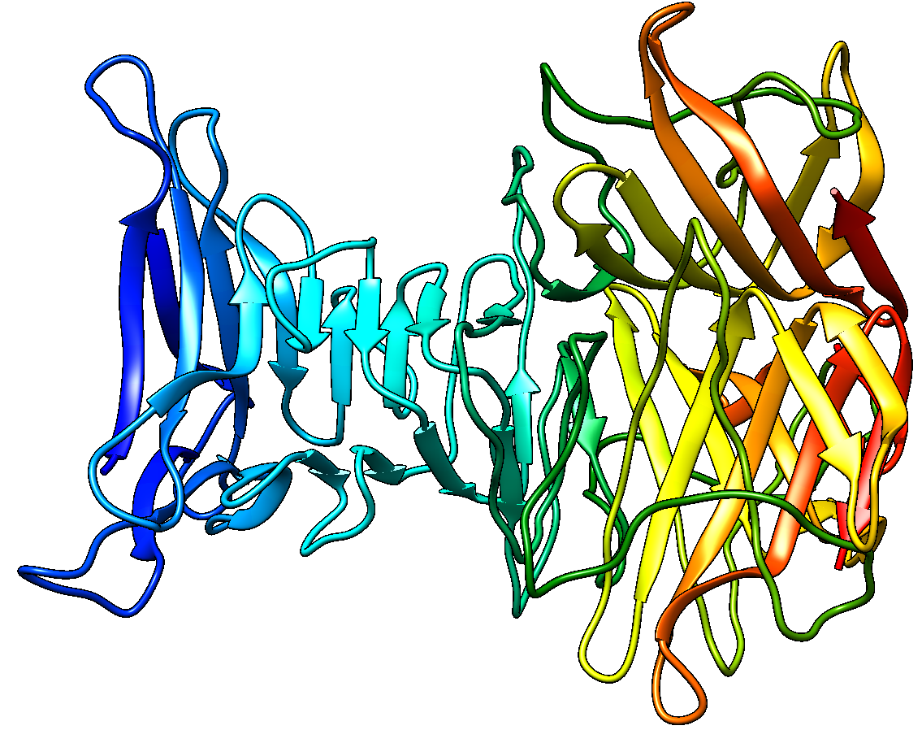
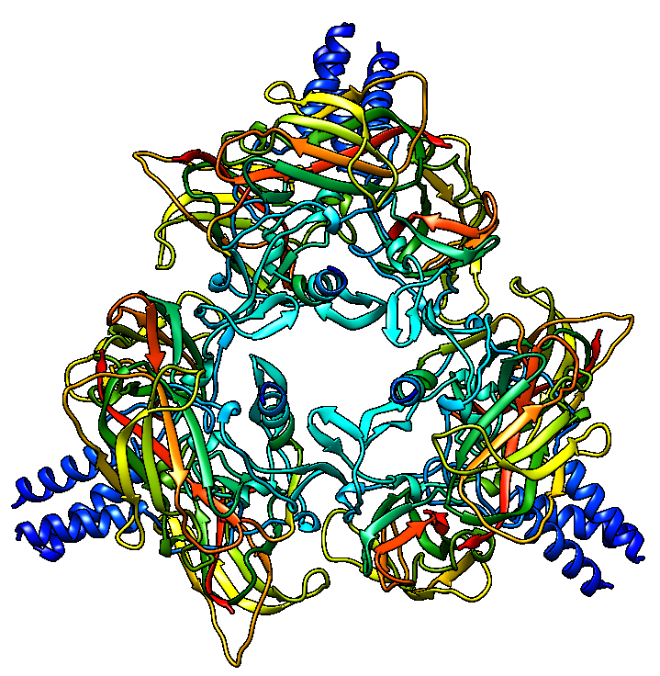
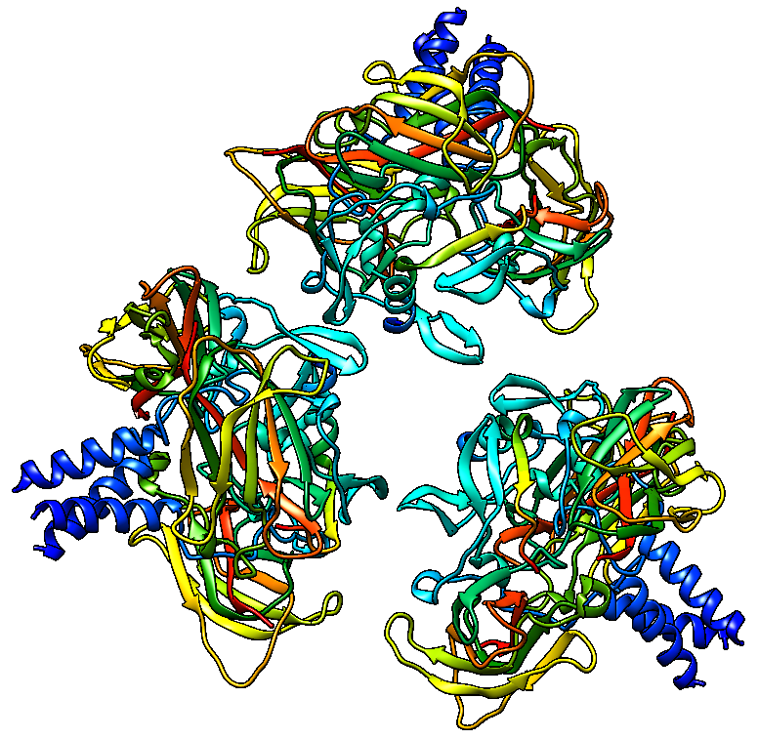
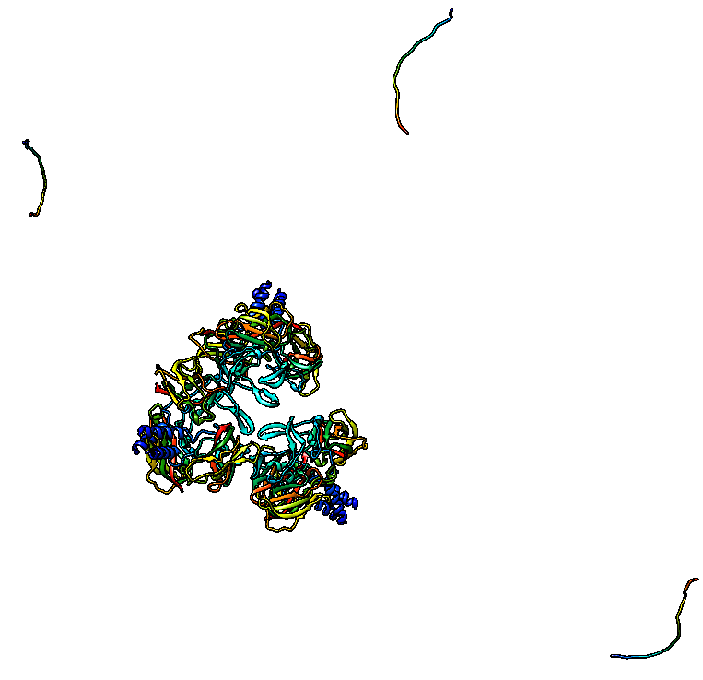
T1187o (A2)
Native structure
MULTICOM_qa
TM-score = 0.98
NBIS-AF2-mutlimer
TM-score = 0.50
T1173o (A3)
Native structure
MULTICOM_qa
TM-score = 0.97
NBIS-AF2-mutlimer
TM-score = 0.49
H1135 (A9B3)
Native structure
MULTICOM_qa
TM-score = 0.73
NBIS-AF2-mutlimer
TM-score = 0.52

Slide 21
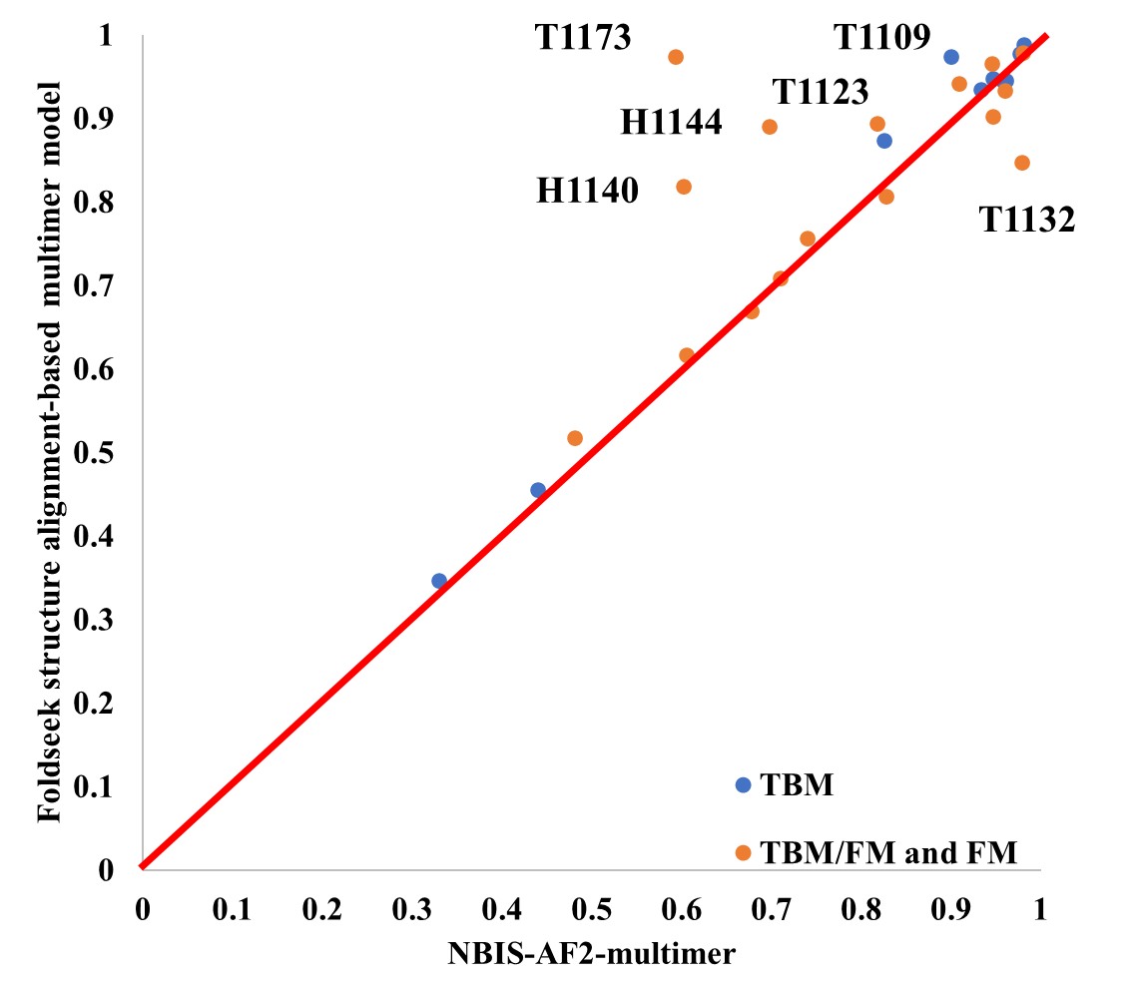
FoldSeek Structure Alignment-based Model Generation Outperforms Standard AlphaFold-multimer
TM-score of the best of top five models: 0.830 versus 0.798

Slide 22
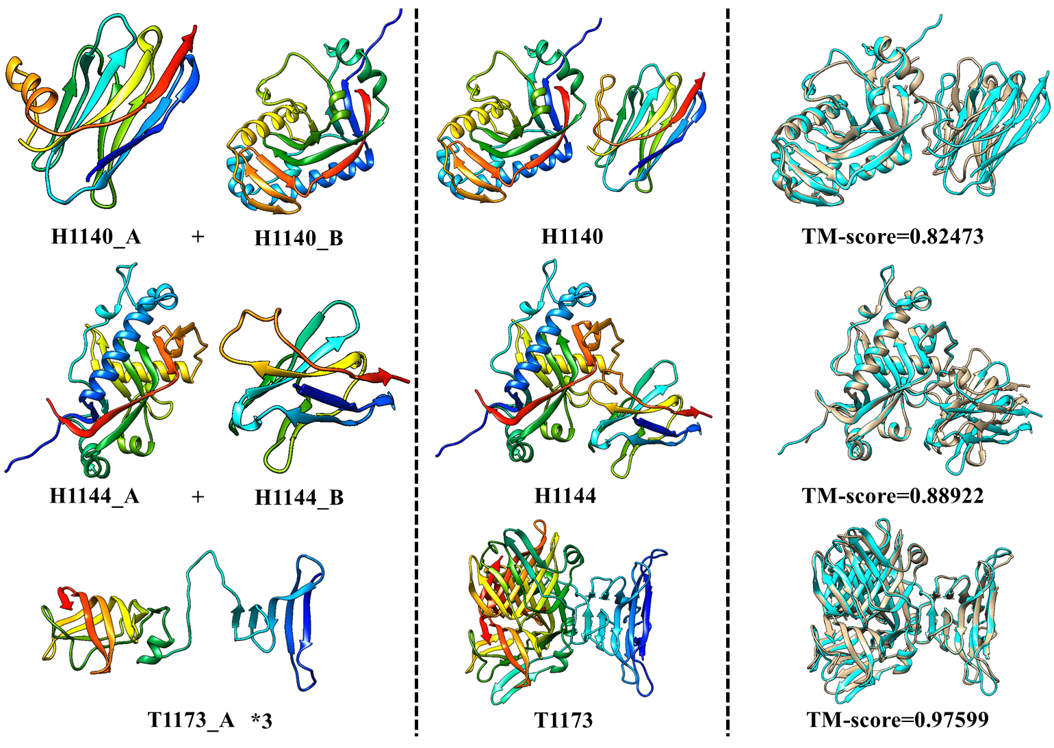
Good Examples of FoldSeek Structure Alignment-based Model Generation

Slide 23
Conclusions
Sampling a diverse set of MSAs and templates
Considering protein-protein interaction for TS prediction
FoldSeek structure alignment-based QS model generation
FoldSeek structure alignment-based model refinement
Pairwise model similarity score in complementarity with AlphaFold model quality score
MULTICOM3: https://github.com/BioinfoMachineLearning/MULTICOM3

Slide 24
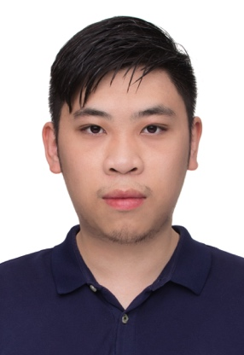
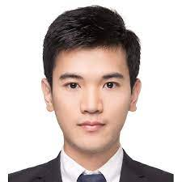
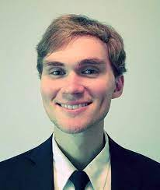
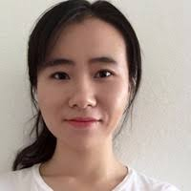
Acknowledgements
Current / Former PhD students:
Zhiye Guo
Farhan Quadir
Xiao Chen
Raj Roy
Jian Liu
Alex Morehead
Nabin Giri
Ashwin Dhakal
Tianqi Wu (Vanderbilt)
Chen Chen
(Amazon)

Slide 25
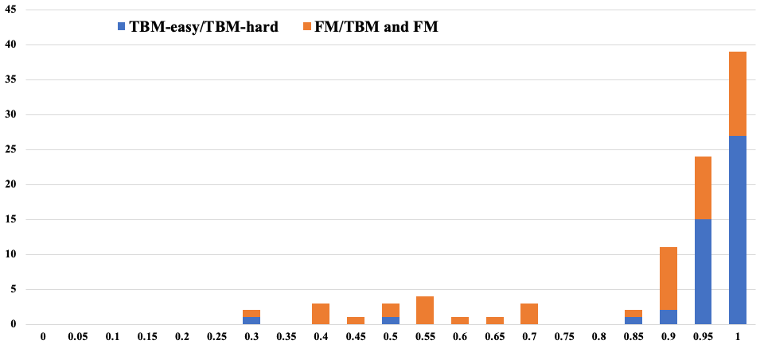
Overall Performance of MULTICOM Server in Tertiary Structure Prediction
The histogram of the TM-scores of the best of five models for 94 domains
high quality
(47 domains)
(47 domains)
Frequency
failure
correct fold
TM-score
Single sequence
Very shallow MSA
Alternative Conformation (outliers)
Average TM-score of top 1 model = ~0.92

Slide 26
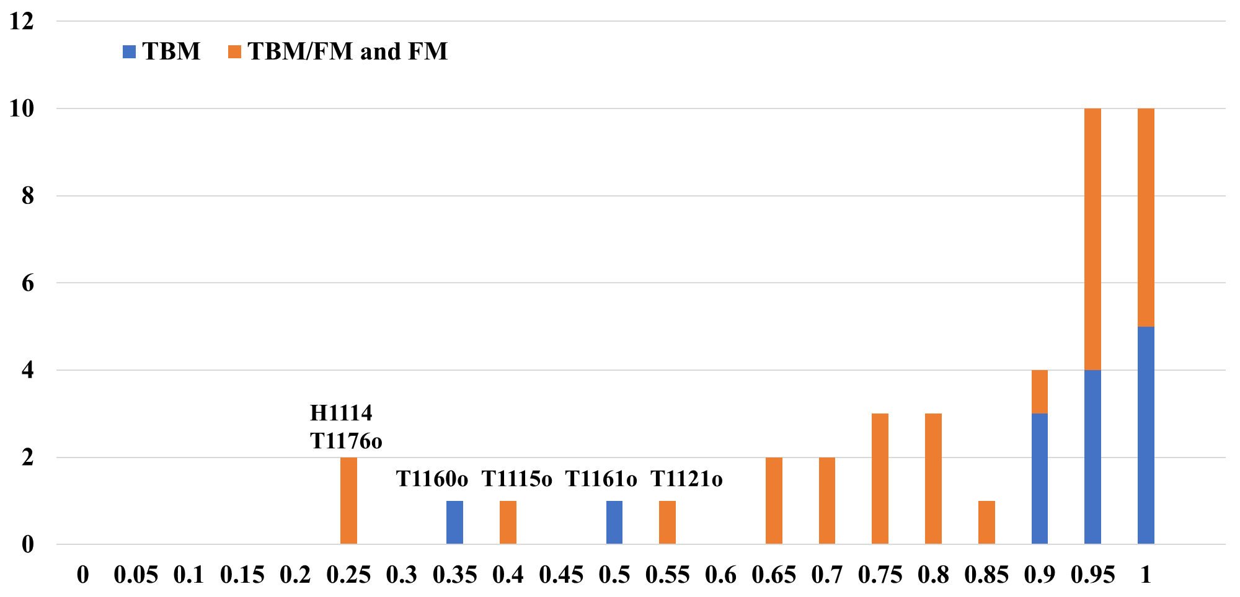
Overall Performance on 41 Multimers
The histogram for the TM-score of best of 5 models submitted by MULTICOM_qa
(27)
(14)
Frequency
TM-score
75%
Large multimer (H1114, T1176o, T1115o)
Alternative conformation (T1160o, T1161o)
Bad MSA (T1121o)
59%

