Slide 1
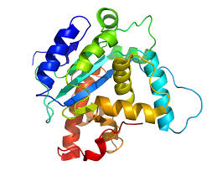
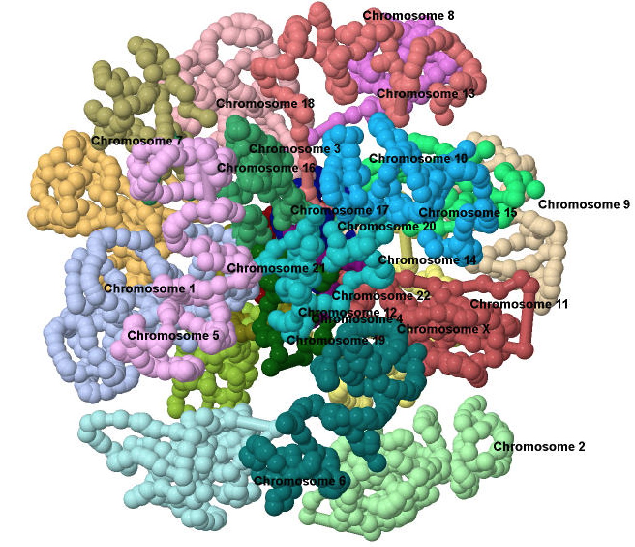
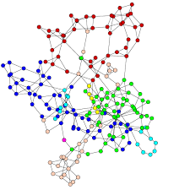

Bioinformatics, Data Mining and Machine Learning Laboratory (BDM)
Computer Science Department
University of Missouri – Columbia
2015

Slide 2

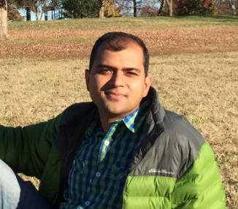
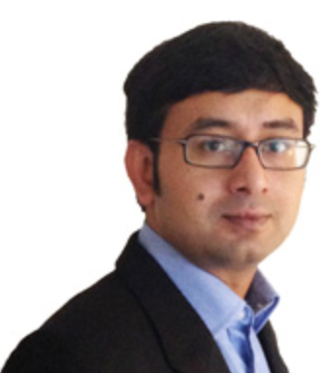
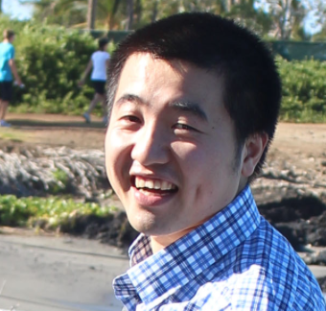

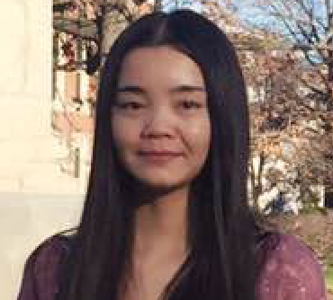

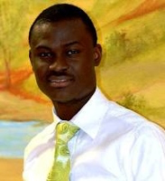
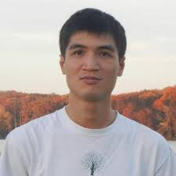
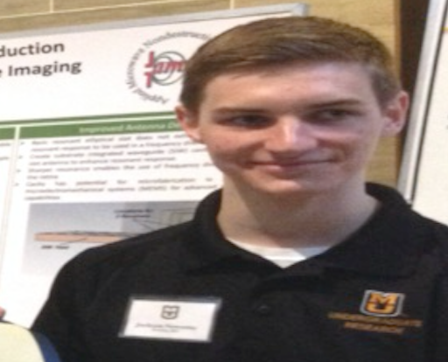
The People in the BDM Lab
PI: Dr. Jianlin Cheng
PhD Students (8)
Badri Adhikari
Deb Bhattacharya
Renzhi Cao
Jie Hou
Haiou Li (visiting)
Jilong Li
Oluwatosin Oluwadare
Tuan Trieu
Master’s Students (8):
Tyler Banks, Puneet Gaddam,
Pei Hu, Yuhao Tang,
Avery wells, Rui Xie,
Yuxiang Zhang, Xiao Zhou
Undergraduate Students (1):
Alumni (24):
Students/Postdocs
Jackson Nowotny

Slide 3
Research Theme and Focus
Theme: develop computational (e.g. data mining and machine learning) methods to analyze big biological data to solve big biomedical problems.
Focus:
Protein structure and function prediction
3D genome structure modeling
Biological network modeling on omics data

Slide 4
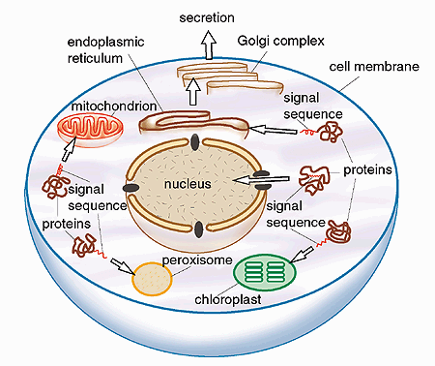
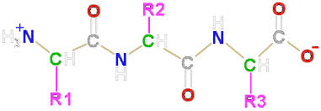
Focus I: Protein Structure and Function Prediction
Sequence
Structure
Function
Predicting protein structure & function from protein sequence is one of the most challenging and important problems in bioinformatics and computational biology.

Slide 5

Accomplishments
Methods/Tools: MULTICOM toolbox (dozens of bioinformatics tools)
Journal Papers: 61
CASP Competition: a top method from CASP7 to CASP11 (2006 – 2015)
CAFA Competition: a top method in CAFA1 (2012)
Funding: two NIH R01 grants (~$2.5 million, PI. PI: Dr. Cheng) from 2010 to 2019

Slide 6
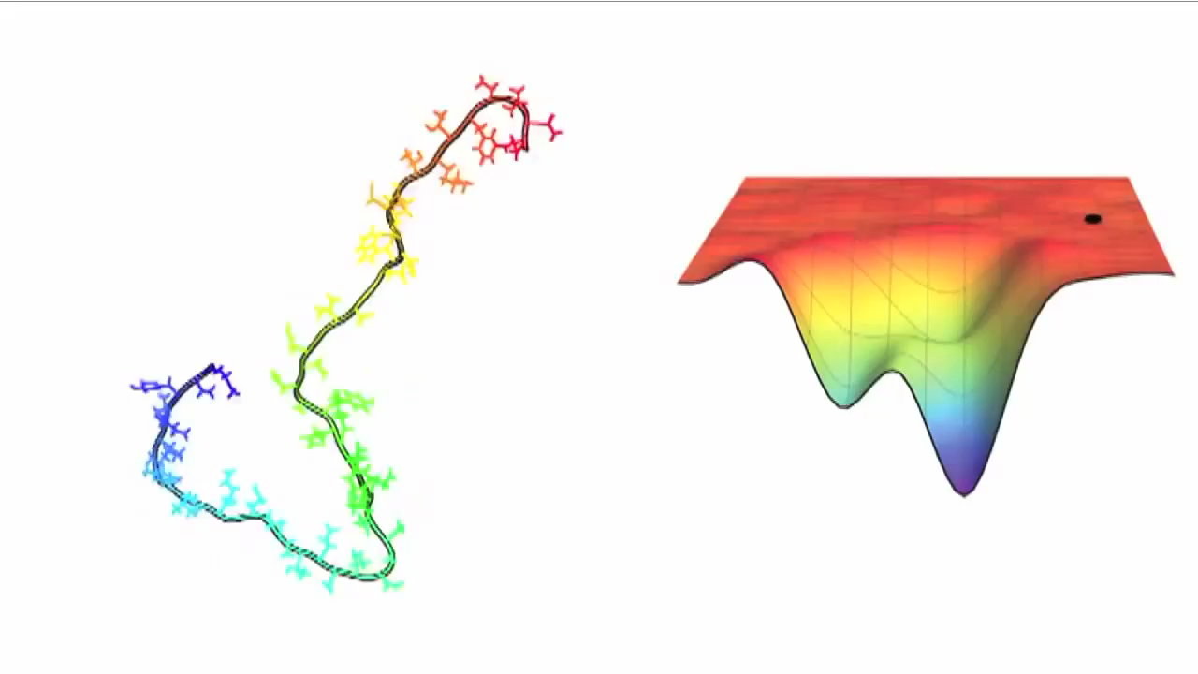
Demo of Our Protein Structure Prediction Software (FUSION)
-logP(d)
Funnel-shaped landscape

Slide 7
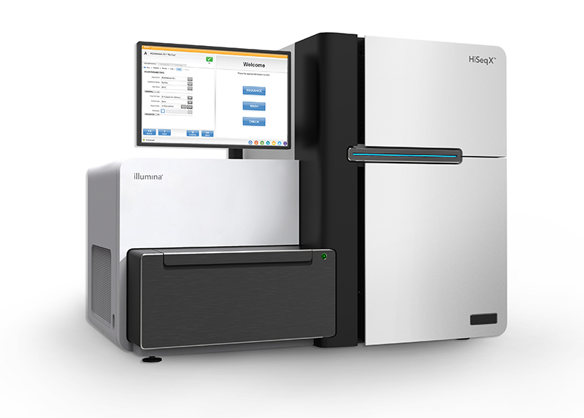
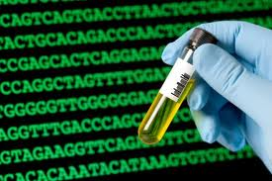
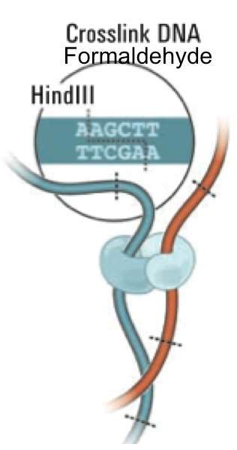
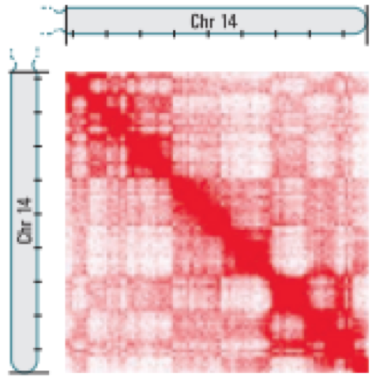
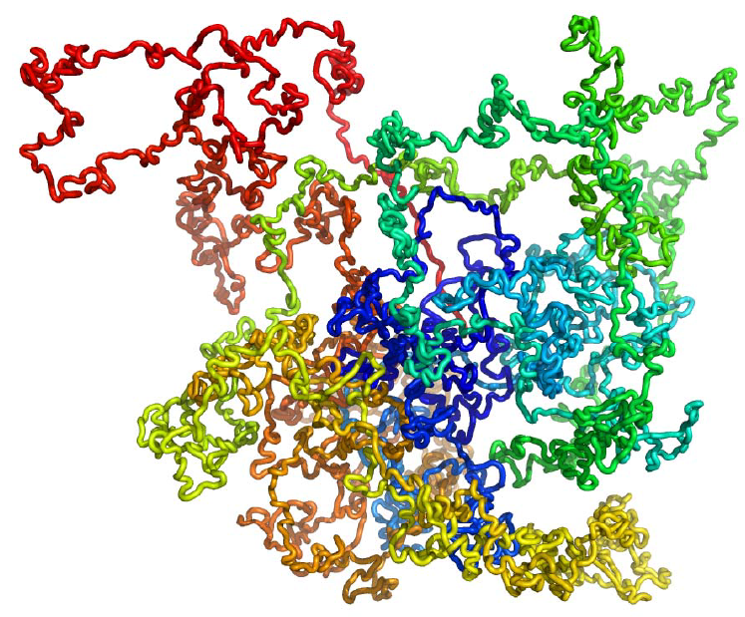
Focus II: 3D Genome Structure Modeling
Genome sequencing
Chromosomal contacts (Hi-C)
From contacts to 3D structure
Application: gene function and regulation

Slide 8

Accomplishments
Methods/Tools: MOGEN, Gen3D, Chromosome3D, GMOL, SMISS
Journal Papers: 11
Funding: NSF CAREER Award (PI: Dr. Cheng), $680,000 from 2012 to 2017

Slide 9
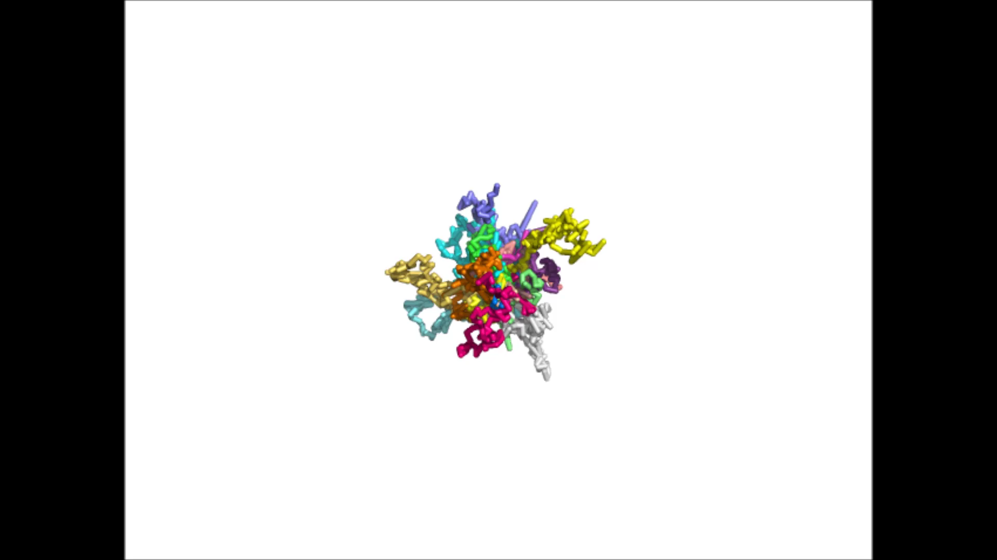
Demo of Our 3D Genome Structure Modeling Software (MOGEN)

Slide 10
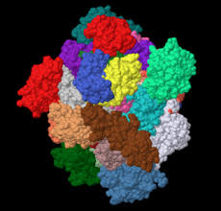
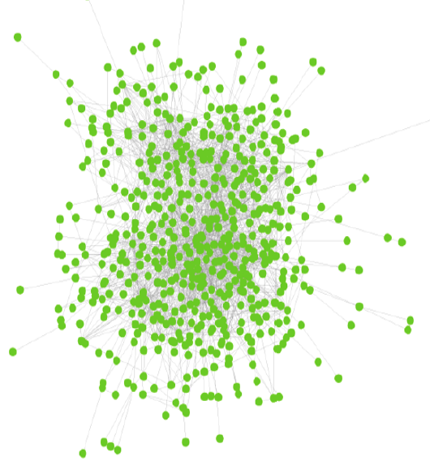
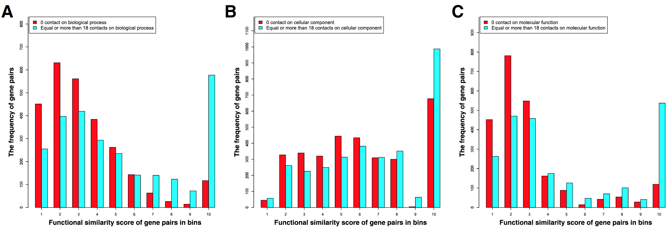
Application of 3D Genome to Gene Function Prediction
Gene A
Gene Interaction Network
Gene B

Slide 11
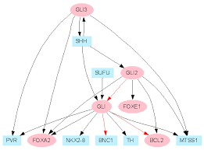
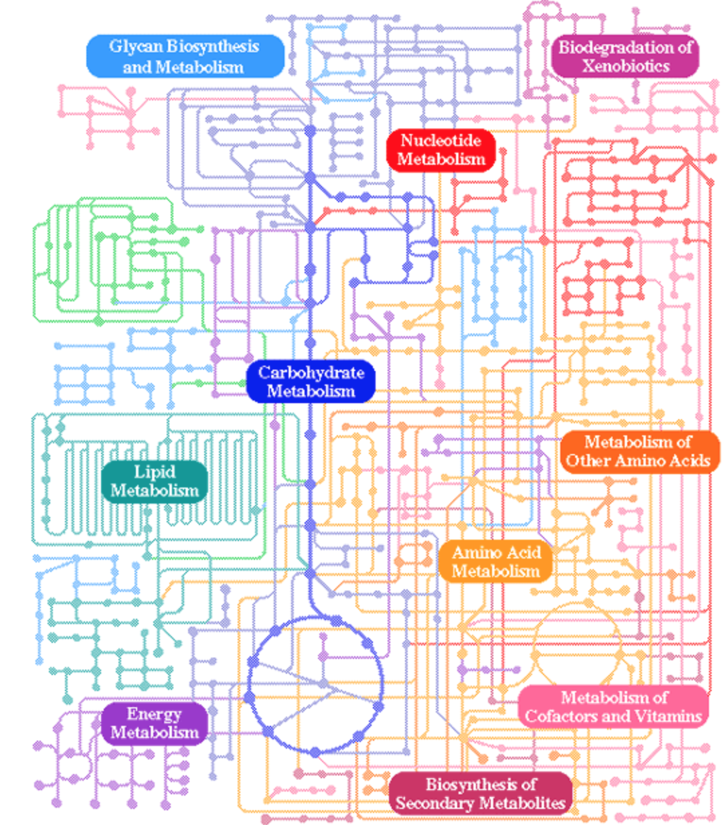
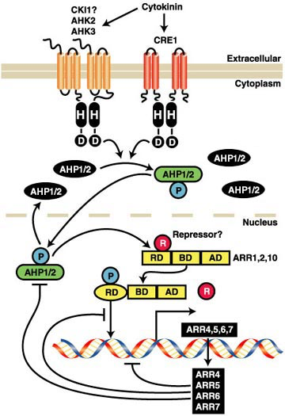
Focus III: Biological Network Modeling
Big Omics Data (genomics, transcriptomics, proteomics, metabolomics, etc)
Biological Networks
gene regulation networks metabolic networks signaling networks

Slide 12
Accomplishments
Tools: MENET, GNET, RNAMiner
Papers: 15
Collaborative Funding: (1) NSF systems biology grant (PI: Stacey, Co-PI: Cheng & Xu, 2010 - 2015), (2) DOE systems biology grant (PI: Stacey, Co-PI: Cheng & Xu, 2010 - 2014), (3) NIH Botanical Center grant (PI: Lubahn, Co-I: Cheng, 2010 – 2015), ~$10 million in total
Collaboration with dozens of groups at MU (plant sci., animal sci., medical sci., chemistry, biochemistry, physics, stats, engineering, CS)

Slide 13
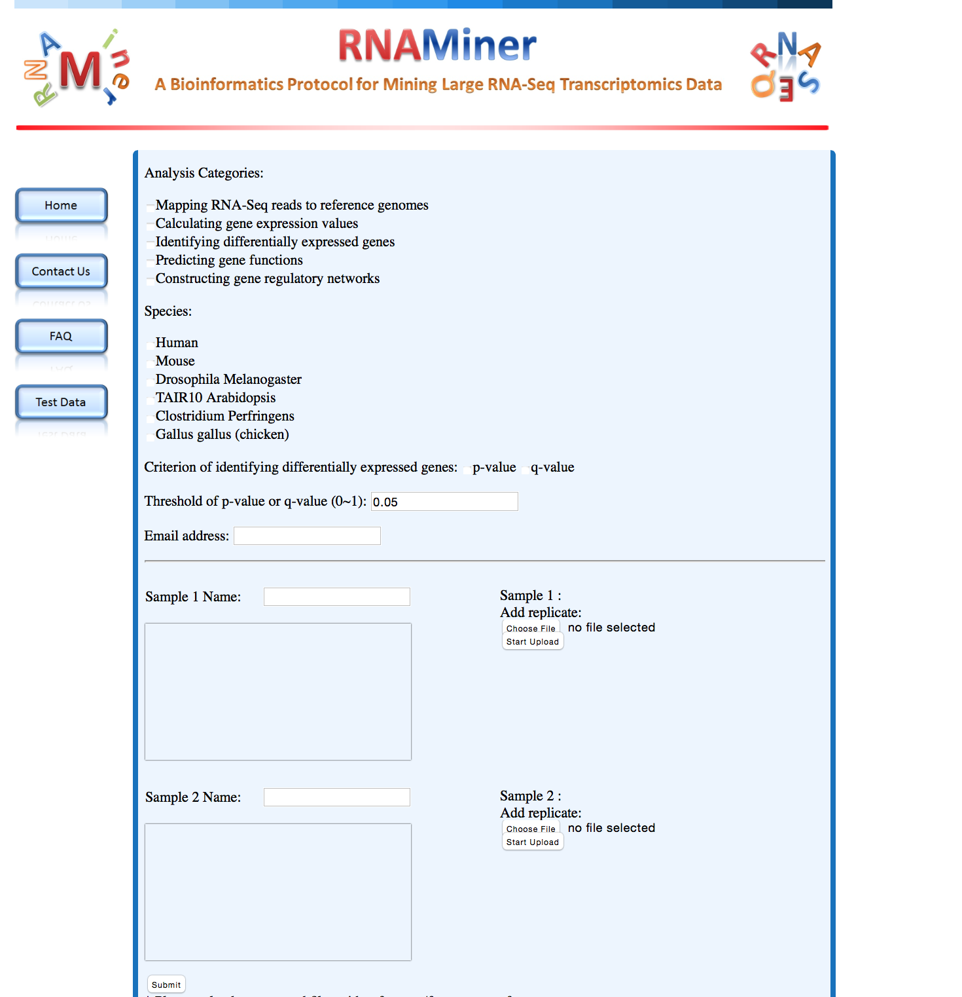
RNAMiner of Analyzing Big Transciptomics Data

Slide 14
Thank you! Questions?
Protein
3D Genome
Biological Network
Bioinformatics, Machine Learning, Data Mining

